Slide 1
CLASS 16
MOTIVES EMOTIONS AND INTERGROUP RELATIONS

Slide 2
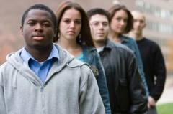
Stereotype Threat
Aronson & McGlone, 2009
NOTE: Quiz 2 on March 24

Slide 3
Stereotype Threat Defined
Psychological discomfort people experience when:
a. Harsh stereotypes applied to their group (e.g., ethnicity, gender, sexual orientation)
b. Stereotypes relate to task that person is attempts to master (e.g. math test, writing)
c. Stereotypes made salient in context of task
Stereotype Threats can be self-fulfilling
a. Threat can disrupt performance, thus confirming stereotype
b. Threat can make performance domain aversive, leading to dis-identification

Slide 4
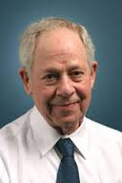
How Stereotype Threat Operates
Person is member of group with stereotyped reputation
Group: Women Stereotype: Women bad at math
Person in situation where stereotype applies
(math exam)
Person can confirm stereotype (do poorly on math test)
Threat of confirming stereotype undermines performance
Stereotype is confirmed
Stereotype threat is related to “Self Fulfilling Prophesy” e.g., “Pygmalion in the Classroom”
Robt. Rosenthal

Slide 5
Demonstrations of Stereotype Threat
Steele & Aronson, 1995
Prediction: Stereotype loses potency if task is not stereotype-diagnostic
Method: Black and White undergrads complete GRE-level verbal items
[Stereotype: Blacks less verbally competent]
Diagnostic condition: Test is IQ type test, truly diagnostic about verbal skills
Non-diagnostic cond: Test is not diagnostic, unrelated to intelligence
 | Diagnostic | Non-Diagnostic
White | No threat | No threat
Black | Threat | No threat

Slide 6
Performance as a Function of Subject Race
and Test Diagnosticity
Result is number of test items correctly solved

Slide 7
Demonstrations of Stereotype Threat
Steele & Aronson, 1995
Prediction: Stereotype loses potency if own race not made salient.
Method: Black and White undergrads complete GRE-level verbal items
[Stereotype: Blacks less verbally competent]
No threat prime: Subjects NOT asked to report their ethnicity before test
Threat prime: Subjects ARE asked to report their ethnicity before test
 | No-Threat Prime | Threat Prime
White | No threat | No threat
Black | No threat | Threat

Slide 8
Performance as a Function of Subject Race
and Threat Prime
Result is # items correctly solved

Slide 9
Stereotype Threat Applies to
ANY Group Subject to Threatening Stereotypes
Women in math and science
Latinos
Native Americans
Low-income Whites
Elderly (memory tasks)
High achieving White males
When compared to Asians on math

Slide 10
Stereotype Threat of Being a Strereotyper: Whites’ Feedback to Minorities (Harber, 1998)

Slide 11
Individual Differences in Vulnerability to Stereotype Threat
Vulnerability
High
Low
Sensitivity to prejudice, history of prejudice
X
Highly identified with performance domain (e.g., women science majors, Black lit majors)
X
Low expectation of prejudice
X

Slide 12
Anxiety Mediates Stereotype Threat
Self report data on anxiety and ST:
Mixed results, not conclusive
Blacovich et al., psychophysiological measures:
BP rises for Blacks in ST condition
Yerkes-Dotson Law
Perform.
Arousal
Stereotype Threat → improved / worsened performance on simple tasks.
Stereotype Threat → improved / worsened performance on complex tasks.

Slide 13
Cognitive Impairments and Stereotype Threat
ST related to Wegner’s research on suppression (e.g. don’t think of a white bear) studies. How so?
Under ST, people try to suppress thoughts about stereotype, and about confirming stereotype.
Mental work of suppression → reduced attention for task at hand
Reduced attention → weakened performance
Weakened performance → increased efforts to suppress
Spillover Effect
ST → increased cog load → worse performance on ST domain (women/math) →
increased cog load → worse performance on ST irrelevant domain (women/verbal; women/Stroop; resisting food, hand-grip).

Slide 14
How to Combat Stereotype Threat
Forewarning: Telling ST targets about ST (Aronson & Williams, 2006)
1. Black students get pamphlet describing: ST, test anxiety, unrelated topic
2. Complete classic ST experiment
Result: ST pamphlet and test anxiety pamphlet Ss show no ST effect; unrelated pamphlet Ss do show ST effect
Reframing Ability: Tell students abilities are malleable rather than fixed
* Aronson, Fried, & Good (2002): Black students do better on GRE verbal test if told test measures malleable ability rather than fixed ability. Also report
less anxiety.
* Good, Aronson, & Inzlicht (2003): Stereotype-vulnerable students told that:
1) Intelligence is malleable; 2) School difficulties are normal; 2) No info. Control group
Results: Latino students in conds 1 & 2 do better on statewide reading test
Female students in conds 1 & 2 = boys in math, but control < boys

Slide 15
How to Combat Stereotype Threat (continued)
Role Models: Counter-stereotypical exemplars weaken stereotype → less ST
* Marx & Roman (2002): Female experimenter, introduced as math expert, →
improved math performance by female students.
Self-Affirmation: Affirming self-concept bolsters resistance to ST
MORE ON THIS IN “SELF AFFIRMATION” CLASS

Slide 16
Terror Management Theory
Greenberg, Landau, Kosloff, & Solomon

Slide 17
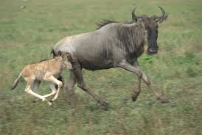
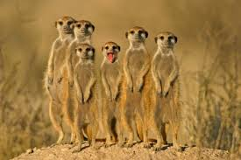
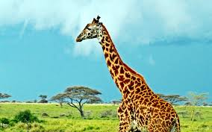
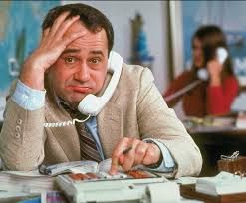
Human’s Existential Dilemma
Humans are like other animals
a. Mortal b. Compelled to flee from mortal danger
Humans are unlike other animals
a. Aware of mortality b. Aware cannot flee mortal danger of mortality
Animal compulsion to flee + awareness of inescapable mortality → Existential Terror

Slide 18
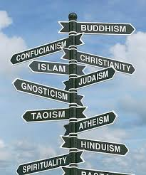
Terror Management Theory (TMT)
To cope with mortality angst, humans seek death transcendence
World view, supplied by culture, provides routes to death transcendence

Slide 19
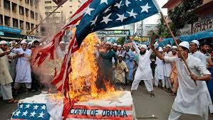
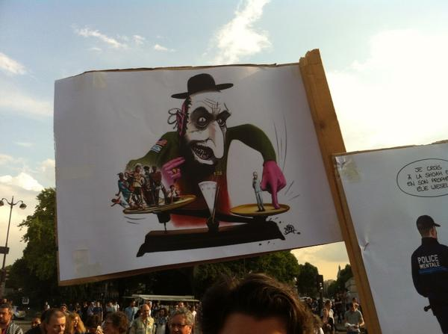
People Who Challenge World Views Represent Existential Threats
When mortality is made salient (MS), people need to hold on to beliefs
Those who challenge beliefs undermine our psychological shelter
Those who challenge beliefs are therefore attacked, but mainly when mortality is salient
Those who boost our beliefs are embraced, but mainly when mortality is salient

Slide 20
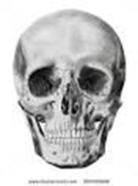
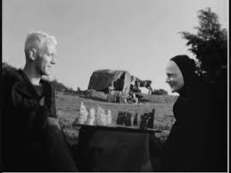
Mortality Salience Hypothesis:
Connecting Existential Threat, Cultural Buffers, and Intergroup/Interpersonal Conflict
Awareness of own mortality
Existential terror
Seek death transcendence
Embrace cultural Institutions
People who threaten our cultural buffers weaken our world views
Animosity, hostility to world view attackers
Efforts to defend/restore defenses
Affection, loyalty to world view advocates

Slide 21
Terror Management Research Design
Mortality Salience (MS) induction
Write about what will happen to you as you physically die.
Write about the emotions aroused in you by the thought of your own death.
Control Condition
Write about going to the dentist for painful dental work.
Write about the emotions aroused in you by the thought of this dental exam.
Outcome Measure
Attitudes toward group that challenges own world-view, or other means of
death transcendence (e.g., career).

Slide 22
Mortality Salience (MS) Induces Hostility Towards:
Other religions: Jews, Moslems
Those who evoke reminders of animal nature: Women (for men), elderly (for young)
Other nationalities: Germans (for Italians), Americans (for Iranians), Middle Easterners (for USA)
Own in-groups: For those whose ancestry deviates for majority-culture
MS also induces attraction towards:
Leaders, others who:
a. Support world view
b. Provide definite, clear, uncomplicated world view

Slide 23
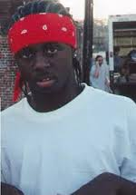
TMT and Stereotyping
Following MS, which image of African Americans will Whites prefer?
(Schimel et al., 1999)
Control condition (No MS)
MS condition
Why does MS → favoring stereotypic minority?
MS → reliance on traditional world view. Stereotypes part of world view.
Stereotype consistent minority supports world view, buffers threat.
Stereotype inconsistent minority challenges world view, amplifies threat.

Slide 24
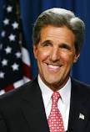
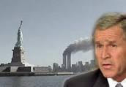
TMT and Support for Demagogues
Demagogue: A political leader who seeks support by appealing to popular desires and prejudices rather than by using rational argument
MS → support for politician who promised to lead the people to greatness (Cohen et al, 2004)
2004 Presidential campaign, Bush vs. Kerry
Control condition: Prefer Kerry
TM condition/Terrorism condition: Prefer Bush

Slide 25
TMT and Support for Violence
Mortality Threat
Iranian College Students
How much support student who advocates peaceful resolution Mid-East?
How much support student who advocates lethal martyrdom against US?
US College Students
OK to use extreme violence against terrorists,
even if thousands of innocents killed?
Liberals
Conservatives
Low
High
More
More
Less
Less
Less
More

Slide 26
TMT and Response to Stereotyped In-Group
MS will cause members of stereotyped groups to like or dislike
members of their group?
MS →Women anticipating difficult math test to dis-identify with other women.
MS + reading about Hispanic drug dealer → Hispanics to criticize paintings attributed to
Hispanic artist but not White artist.
MS may induce Stereotype Threat: MS → women to underperform on easy academic test
Diego Rivera

Slide 27
Moderators of, Challenges to, TMT
Individual Differences in susceptibility to MS
1. Intolerance for ambiguity / greater need for certainty
2. Depression
3. Low Self Esteem
4. Poorly attached
Challenge to TMT theory
1. Mortality threat or self-esteem threat?
2. Loss of life or loss of self?
Remedies to MS
1. Relativistic world view
2. Boost resources: Self-esteem, self worth, attachment

