Slide 1
Remainder of Semester
Diary Study: Due today, hand in end of class.
Final: May 7, 11:45- 1:15
Instructor Evaluation: https://sirs.rutgers.edu/blue

Slide 2
Review Question 1
Mirthful laughter promotes heart health by generating what chemical into the bloodstream?
A____ Oxygen
B ____ Carbon Dioxide
C____ Nitric Oxide
D____ Helium
E____ Nitrous Oxide
X

Slide 3
Review Question 2
ER medical staff often use humor. Doing so has what benefit?
A____ Work satisfaction
B____ Feelings of accomplishment
C____ Boost morale
D____ Improves professional objectivity
E____ All the above

Slide 4
Review Question 3
Being on a 1-month fast food diet most dramatically affected what part of Morgan Spurlock’s (the actor/producer) body?
A____ Kidneys
B____ Liver
C____ Occipital lobe
D____ Teeth
E____ None of the above

Slide 5
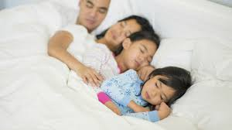
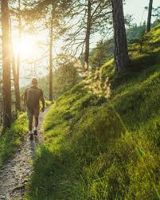
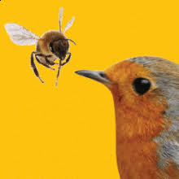
Class 27: Lifestyle and Health
Sleep
Being in Nature
Sex

Slide 6
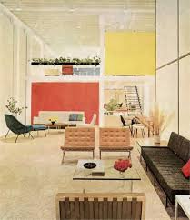
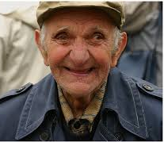
Environmental Cues and Health: Ellen Langer’s Odd Study
Subjects: 8 men in 70s.
Procedure: Live in monastery converted to look like 1950’s apartment:
Music, TV, books, magazines from 1950s—BUT NO MIRRORS
Men told to live like they had 20 years earlier; be as active, self-reliant
told to talk about 1950s events as if they were current events
Outcome: Relative to 8 men in control condition (stayed in “normal” monastery)
Better manual dexterity; sat taller; looked younger to “blind” judges
AND Better Eye-sight!
BBC Video: The Young Ones https://www.bbc.co.uk/programmes/p00b1n57 https://www.bbc.co.uk/programmes/p00b4yb3

Slide 7
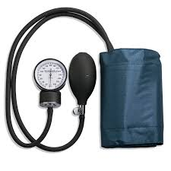
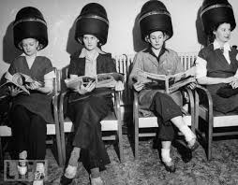
You Feel as Good as You Look?
Hair and Blood Pressure
Subjects: Women at salon for hair styling or hair coloring.
Procedure: BP recorded, hair styled, complete “satisfaction” survey, BP recorded
Outcome: Women who reported looking younger after hair style had lower BP
Looked younger to judges who see photos, hair-style omitted from pics.

Slide 8
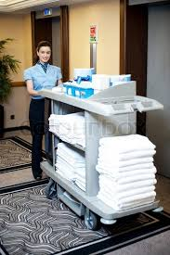
Attitude About Activity Affects Benefits of Activity
Crum & Langer, 2007
Work is exercise mindset
“Exercise is good for you”, and:
“Changing linens = 40 calories”
“Vacuuming = 50 calories”
Daily required work mindset
“Exercise is good for you” but no info relating work tasks to exercise.
Subjects: Maids at hotels told to regard work as exercise—more than Surgeon General recommends. Or not given this mindset
Outcome: “Work is Exercise” maids lost weight, better Body Mass Index (BMI)
better Hip to Waist ratio. Even though actual behavior did not change!

Slide 9
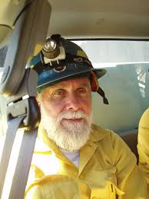
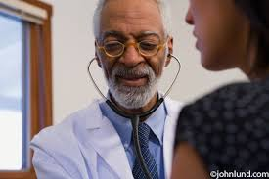
Uniforms and Health
Hsu, Chung, &Langer, 2010
Question: Does wearing a uniform improve health?
If income low, uniform is related to worse health
If income middle-range or higher, uniform → greater longevity
Why?
Clothing implies social status, and ability. Professional garb is an equalizer;
Look the same at 70 as at 30, in terms of clothing.
“Clothing makes the man (or woman)”

Slide 10
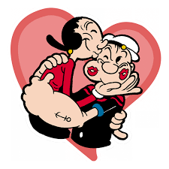
Benefits of Sex
Sexual activity boosts immune system
Increases antibody production
Fewer sick days
Boosts libido: Improves gonadal response.
Improves women’s bladder control
Lowers blood pressure
Sex is exercise
Cardiovascular health: Maintains hormonal balances; estrogen, testosterone
Pain management: Reduce pain sensation, increase pain threshold
Reduce risk of prostate cancer.
Improved sleep, reduce stress, improved cognition.
Longer life!

Slide 11
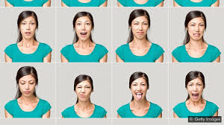
Benefits of Sleep
Cognitive performance
Visual attention, form memories
Learn new information
Ability to read facial expressions. Poor sleep → seeing neutral face as hostile.
(Interpersonal implications?)
React better to problems. Less cranky
Body health: Weight, diabetes, heart, colds
How much sleep? 8 hours is gold standard. Don’t be sleep shamed! Maintain regular sleep schedule
NIH Sleep Health Guide: https://www.nhlbi.nih.gov/health-topics/education-and-awareness/sleep-health

Slide 12
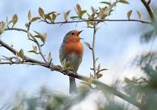
Benefits of Nature
Spending time in nature promotes physical health, especially in lush forests. Leads to:
Decreased stress
Lower blood pressure
Improved heart rate variability
Lower cortisol
Improved mood
Trees emit “phytoncides”, reduce stress. Bird sounds also reduce stress.
MDs prescribe “Nature Baths”
Science is iffy, however. Results don’t replicate strongly.

Slide 13
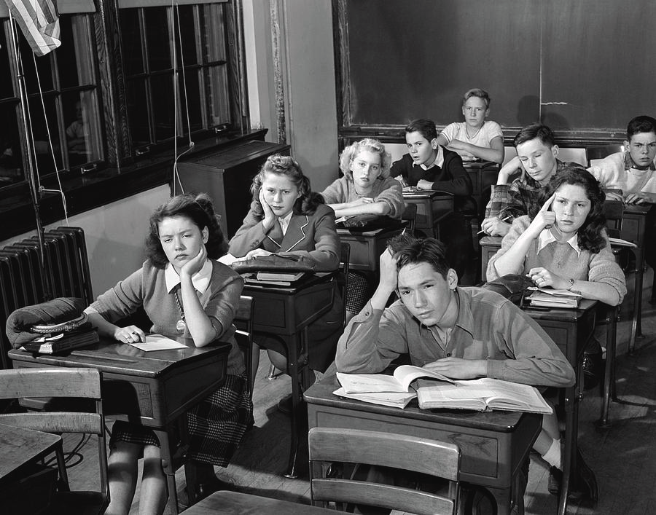
Thanks for Being in This Class, And Have a Great Summer

