Slide 1
ANNOUNCEMENTS
1. Diary Study
You should complete Dairy 6 today
Diary Write Up will be explained on Tuesday April 16
Final Exam: May 7, 11:45 to 1:15
Everything from Midterm to final lecture.
50 multiple choice + 4 Extra Credit questions
3. Quiz 2 Results: Class did well. Average 81% correct. Grades on Canvas

Slide 2
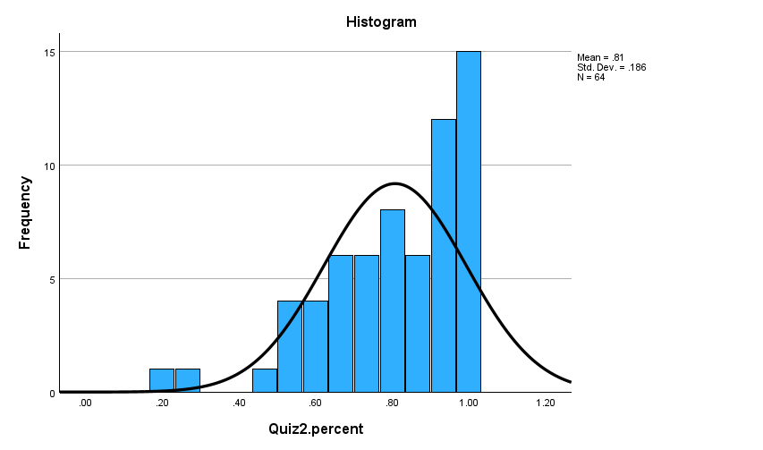
Quiz 2 Performance
Ave. Score = 81%

Slide 3
Review Question 1
For patients, hospital garb has what negative effect?
____ An added expense most can’t afford
____ There is little choice in color or design, offending personal style
____ Imposes childish, infirmed, low-status identity
____ Rarely allowed to take garb home, as souvenir of important event
____ None of the above
X

Slide 4
Review Question 2
Why do patients often fall into “good patient” role?
____ Hospitals place them in role of dependent child, who seeks to please.
____ Hospitals have legitimate needs for them to cooperate
____ Patients try to win the favor of staff to get better attention
____ Patients’ superstitious belief that MDs have god-like healing powers
____ All the above
X

Slide 5
Class 22
Being a Patient (finish)
Patient / Provider Communication (start)

Slide 6
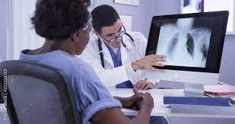
Should MDs Inform Patients?
If So, How Much?
What are problems with informing patients?
What are problems with not informing patients?
What about uncertain diagnoses? “You have a 40% chance of X illness”.

Slide 7
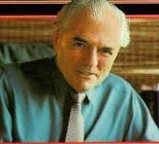
The Informed Patient
Irving Janis “ideal anxiety” approach (1958)
Hospital hires Janis (social psychologist) to reduce patient stress
Janis redefines situation: Some anxiety is good. Why?
1918-1990
No anxiety – person not prepared for difficult outcomes. Too much anxiety – person is flooded, can’t take in information. Recommends providing pats. with enough info to emotionally prepare.
Egbert study (1964): Works with pats. undergoing abdominal surgery
Patients either told / not told what to expect post-surgery (pain, recovery, severity, etc.)
Result: Informed pats need less narcotics, leave hospital sooner. Highly replicated finding.

Slide 8
Social Support and Surgical Recovery
You are about to undergo surgery. Would you prefer:
____ Private room (no roommate) ____ Roommate who is about to undergo same/diff surgery ____ Roommate who is in recovery from same/diff surgery
Kulik & Mahler study (1996)
Patients pared with roommate who is:
* Undergoing same / different surgery * Pre-operative / post-operative What matters in terms of patients’ recovery?

Slide 9
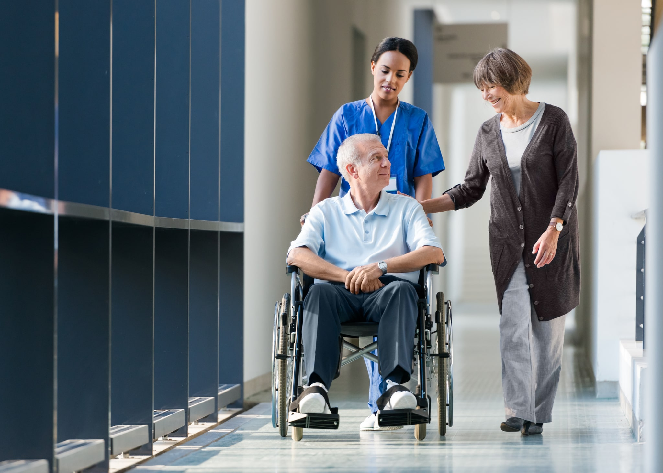
Social Support and Surgical Recovery: Roommate Same or Different Condition Kulik, Mahler, and Moore (1996)
Yards Walked
Walking Post-Surgery
Days in Hospital Post Surgery
Paired with post-op: Less anxious

Slide 10
Responsibility and Care-Giving on Patient Outcomes Rodin & Langer, 1977
Subjects are nursing home elderly.
Cond. 1: Reminded of their own responsibilities, and given a plant to care for.
Cond. 2: Reminded of staff responsibilities to them, and given a plant that staff cares for.
18 months later: Staff ratings, mortality. Who does better?
1
Cond ___ : * More positive staff ratings (happier, more sociable) * Lower mortality (more likely still alive)
Key Points Slides 6-9: Pats. do better when autonomy, efficacy restored.
1. Informed about condition: Diagnoses, discomfort
2. Roommate who can help interpret treatment, foresee outcomes.
3. Given responsibility, meaningful tasks.

Slide 11
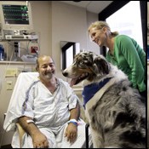
Animal Assisted Therapy
Animal Assisted Therapy (AAT):
Specially trained animals plus handlers visit hospitalized patients.
Dog lies on patient's bed, is petted.
Cute, but does it work?
Experiment by Kathie Cole, RN, UCLA Medical Center
77 heart-failure patients (ave. age = 57) receive 12 minute visit from either:
a. Dog
b. Human volunteer
c. No visit

Slide 12
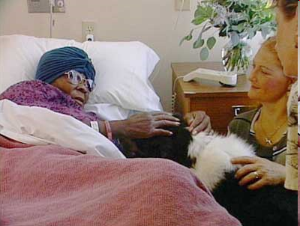
Results of AAT Study: The Paws that Refreshes
Anxiety:
Dog: Down 24 pts
Human: Down 10 pts
Epinephrine
Dog: Down 17%
Human: Down 02%
Control: Up 07%
Blood pressure
Dog: Down 10%
Human: Up 03%
Control: Up 05%
Why are dogs better than humans?

Slide 13
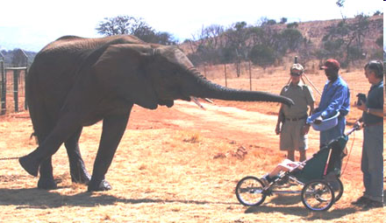
Elephant-Assisted Therapy: South Africa
Dolphin-Assisted Therapy: Israel, Florida, Ukraine

Slide 14
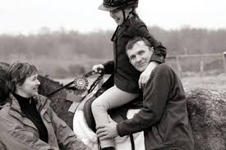
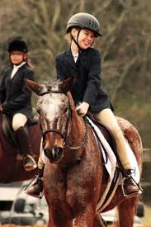
Therapeutic Riding and Cerebral Palsy
Veronic Skoczek and MacGuyver:
Skoczek suffers from cerebral palsy, affects walking and other motion.
After years of “therapeutic riding” walks unassisted.
Rhythm of horse’s gait mimics pelvic movement during walking.
Improves alignment, muscle symmetry, postural control
https://www.nsarco.com
Emotional Support Animal Registry
https://www.esaregistration.org/therapy-dog-and-animal-info/

Slide 15
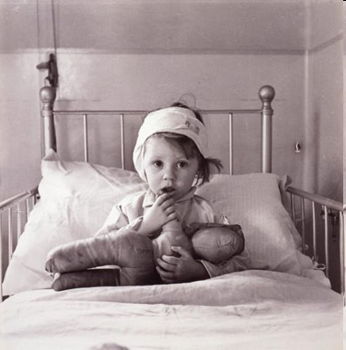
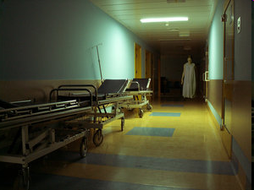
Children in Hospitals
Hospitals are frightening to children.
a. Place associated with pain
b. Sad/Scary looking patients
d. Parents are not in control
Emotional reactions
a. Fear, anxiety
b. Anger, rebellion
c. Shame (esp. at adolescence)
Being left overnight in hospital esp. upsetting.
a. "Setting" anxiety
b. Age 3-6: fear rejection c. Age 4-6 develop new fears (e.g., darkness)
d. Age 6-10 free-floating anxiety
e. Separation anxiety: deserted? punished?

Slide 16
Social-Psychological Tx for Hospitalized Children
Social Support
a. Parental visits study (Branstetter, 1969)
Cond 1. Mom at visiting hours only
Cond 2. Mom for extended periods
Cond 3. Surrogate mom
b. Kids in Cond 2 & 3 do better than Cond 1
c. Hospitals now let parents stay with kid all times
d. Story telling
Psychological Control
a. “Kid in Hospital” movie --> less anxiety
b. In gen., informed kids show less anxiety
c. Encourage kids to ask questions
d. Provide kids with coping skills * Self-talk * Relaxation skills

Slide 17
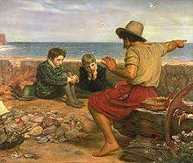
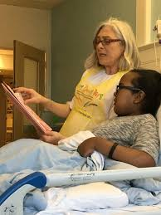
Story Telling for Hospitalized Children
Story telling an ancient part of human civilization.
Our minds are soothed by stories. Provide meaning and order; a beginning, middle, end.
Hospitals include storytelling to children-patients.
Eases anxiety and fear. Provides a “mental vacation”.
May reduce pain.
https://storynet.org/groups/hsa/healing-story-alliance-hsa/

Slide 18
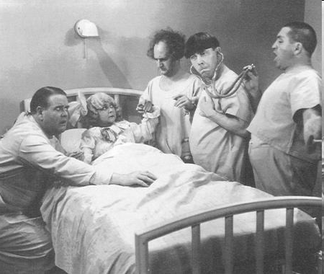
Class 24 Patient / Provider Communication

Slide 19
Why Providers Are Often Poor Communicators
Situation: Time pressed, competing demands (“Jerusalem to Jericho”)
Medical Training:
Communication and compassion not emphasized
Communication skills not modeled. MD training is itself inhumane.
Self Selection
Motives for becoming MD sometimes contrary to compassion/listening
prestige, wealth, status, authority
Some MD skills contrary to compassion/listening:
Detachment
Analytic / time-efficient / detail oriented
Personality qualities needed to get into med school
Competitive:
Cerebral
Technical

Slide 20
MD Failure to Listen
Beckman & Frankel (1984) study of MD initial response to patients
MDs know they are being observed, 74 patient visits
Patient given opportunity to explain problem:
23%
MD interrupts, directs pat. to particular disorder:
69%
18 seconds
MD interrupts pat. after _____________ of elapsed time.
Consequences?
1. Patients don’t get a chance to fully explain symptoms, concerns.
2. MD doesn’t get all vital information

Slide 21
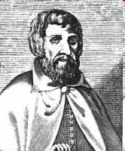
MD Communication Problems
1. Failure to listen
2. Use of jargon:
Hmm. Seems you have Ulag's Syndrome, which voraciously perturbs the ipsilateral medulla of the flataboig.
Arnold of Villanova (1235-1311): [Tell the patient that] he has an obstruction of the liver, and particularly use the word obstruction because patients do not understand what it means.

Slide 22
MD Communication Problems (contin.)
3. Baby talk: “Is you got a boo-boo on your spleen?” Might especially be a problem for older patients (e.g., Giles, 1991).
4. Depersonalization:
MD sees pat. as condition, not a person
Refer to pat. in third person, in front of pat. “Need to get his name and address, and what’s his primary symptom”
Functions: Manages pat., improves efficiency in emergency
Effect on Pat:
Can calm: Help dissociate from fearful situation
Can alarm: “I see this condition terminating in negative status”

Slide 23
Inappropriate Emotions
MD looks frightened, distressed, frustrated.
“Holy Toledo, look at that spot on your X-ray!!!!”
Women who get mammogram, if MD appears worried, they:
a. Remember less b. See situation as worse
c. Higher pulse rates

