Slide 1
Class Business
Short Class Today Because of Quiz 2
Diary Study:
Should complete Diary 5 today
Instructions for write up on April 16

Slide 2
Review Question 1
Women often get poorer medical treatment than do men for coronary heard disease (CHD) because of the belief that:
____ A. Diagnostic machines overly sensitive to women’s bodies
____ B. Women are generally healthier than men
____ C. Women have more pain receptors than do men
____ D. When stressed, women exaggerate their symptoms
____ E. None of the above

Slide 3
Review Question 2
Ethnic minority patients are least comfortable with doctors who show which pattern of beliefs:
____ A. High explicit racism and high implicit racism
____ B. High explicit racism and low implicit racism
____ C. Low explicit racism and high implicit racism
____ D. Low explicit racism and low implicit racism
____ E. None of the above
X

Slide 4
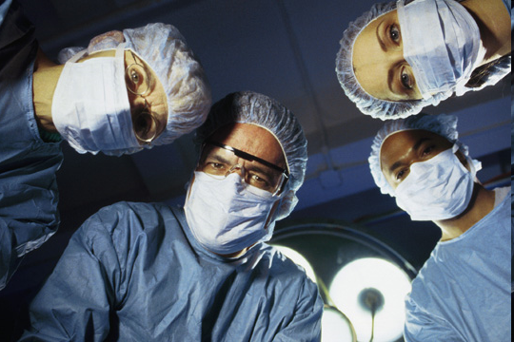
Class 23: Being a Patient

Slide 5
GUESS THAT PERSON
Mystery Person #1: Assigns readings
Grades exams
Conducts lectures
The person is a: _____________________
Mystery Person #2: Works with a variety of woods
Uses hammers, nails and saws
Builds cabinets and frames houses
The person is a: _____________________
Mystery Person #3: Confined to small space
Follow orders or face bad consequences
Little control over meals or socializing
The person is a: _____________________
Teacher
Carpenter
Hospital patient

Slide 6
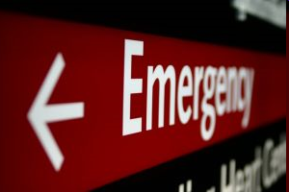
Experience of Being a Hospital Patient
You are walking to class. Suddenly you get very dizzy. Room spins. You wake up in an ambulance, siren wailing, wearing oxygen mask.
What are you feeling? What are you thinking?
Anxiety over condition
Nature of problem? Pain Loss of functioning Will I die?
Real world worries Job Family Etc. House, car, pets, bills

Slide 7
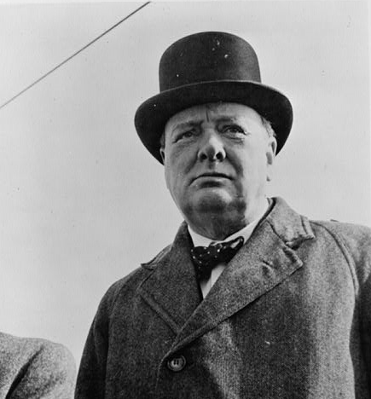
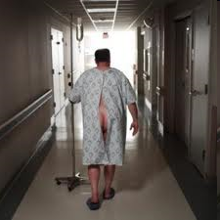
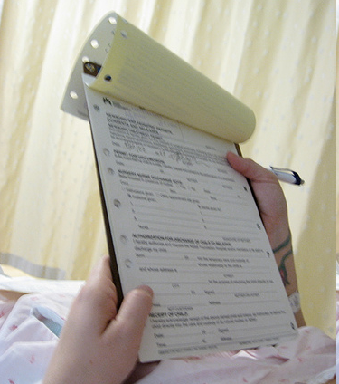
First Encounters with Hospital
Patients enters hospital scared, hurt, anxious. What do they want to hear upon admission?
What do they hear upon admission?
“Do you have insurance?”
Hospital garb: Why?
Ease of access
How do you look to others?
Childish, infirmed, low-status
How does garb affect how you feel about yourself?
Weak, embarrassed, dependent

Slide 8
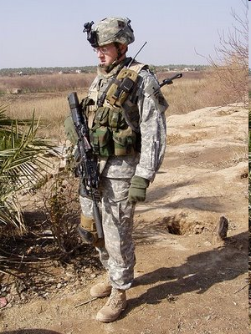
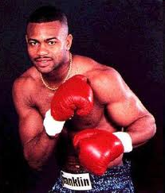
Who’s the Fighter?
How does hospital garb affect “fighting spirit” and morale of patients?
How does this relate to psychosocial resources, stress, and coping?
Could there be an alternative?

Slide 9
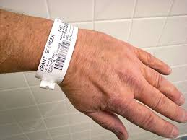
ID Wristbands
Why the wristband?
Name, Date of Birth, SSN, photo
Medical record, medical history
Medications, dosages, surgeries, allergies
Medical team head, team
How does it feel once the wristband is in place?
How does if feel once it is removed?
92%
What percent of patients favor wristbands? _____
Don’t want to experience medical/treatment errors.
About 400,000 hospitalized patients experience preventable harm annually.
Why?

Slide 10
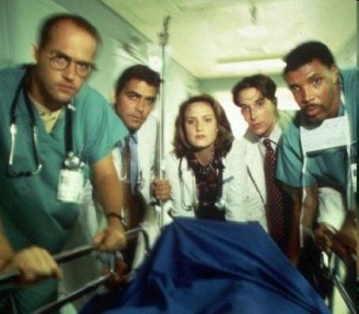
Hospitalization from Patient’s Perspective
Fragmented care
Many different staff, doing different tasks Minimal contact
Patient transformed from person to object
A broken arm to be X-Rayed A Body due its pain meds.
Information is often withheld from patients. Why?
You wish!
Staff too busy to answer questions Staff, specialists, don’t communicate with each other Staff deliberately withhold information: Patient won’t understand; will freak-out, require more care Lack of information one of patients’ biggest complaints. Why?

Slide 11
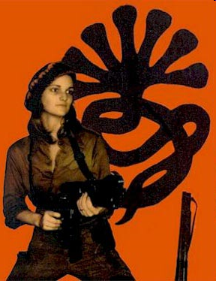
Reactions to Being Hospitalized
Main points of hospital situation
Strong negative emotions: Fear, worry, pain, confusion Stripped of authority, dignity, identity Lose clothes, bossed by nurses, MDs, becomes a “thing” Reminded of 1000 ways fate depends on kindness of strangers Deprived of vital information Expected to be cooperative, passive—seen but not heard
Dependent, needy, controlled, ignorant is like being a: ________
Child
Leads to regression: Attempt to get needs met by pleasing others
Stockholm Syndrome, Patty Hearst

Slide 12
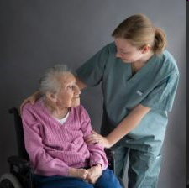
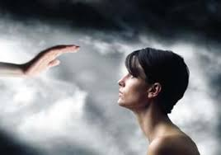
Hospital Patient Role
Hospital wants patients to do as told: a. Reduce chances of things getting worse b. Increase chance of recovery c. Reduces demands on over-taxed staff
Patients often want to be “good patients.” Why?
a. Appease “powerful” staff, MDs 1. Staff dictate daily life 2. Staff have power of life and death.
b. Curry favor, to get more/better attention
c. Superstitious faith in power of medical institutions and providers 1. Healers have god-like power to heal, save life 2. Variant on “just world” beliefs

Slide 13
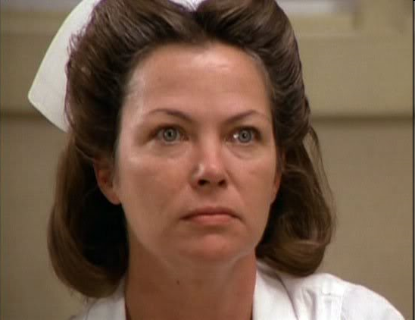
Is There Truth to “Good Patient” Beliefs?
You are hospitalized, feel staff are not fully attending to you. Should you be a “nice” patient or a strongly assertive patient?
Patients report, and there is some evidence to suggest, that “troublesome" patients are:
-- Overmedicated -- Ignored -- Discharged prematurely
http://www.youtube.com/watch?v=RGRD6JBnHrU
46 seconds in
Caution: Vulgar language.

Slide 14
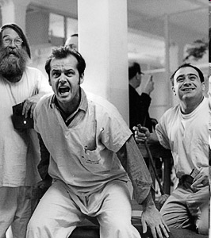
Reactance
What percent of patients fall into the following patient roles?
25%
____ Good patient ____ Average patient (minor complaints) ____ Bad patient: Seriously ill and complain, not ill but complain anyway
50%
25%
Very bad patients: Harass nurses, violate hospital rules, self- sabotage (don’t take meds, risk own health). Why?
Reactance: People have basic need for personal freedom. Work to regain freedom taken in ways that appear unfair. Hospitals can induce reactance by being arbitrary, withholding info, treating pats. like children.

Slide 15
Why Do Hospitals Demoralize?
Hospitals want to help patients. Why do they cause patients to fall into “good patient” role, or into “bad-patient” reactance?
Biomedical Model:
Body is a machine—fix the parts, the body is OK, job is done. "Person" is irrelevant.
Real world constraints:
Hospitals forced to do more with less. HMOs, cost cutting, related pressures.

Slide 16
Good Weekend!

