Slide 1
ANNOUNCEMENTS
Quiz 2 is on Thursday (April 4)
15 multiple choice questions + 2 Extra Credit questions
20 minutes to complete
Diary Study
You should complete Dairy 4 today
Diary Study instructions and materials on Blackboard
3. Extra Credit R-Points:
Subject pool now open for experiment-based extra-credit
1 Extra Credit for every 30-minute experiment
6 Extra Credit points available for class

Slide 2
REVIEW QUESTION 1
What kinds of reactions do people commonly have to those who have a stigmatizing disability?
___ A. Fear
___ B. Revulsion
___ C. Sympathy
___ D. Curiosity
___ E. All the above

Slide 3
REVIEW QUESTION 2
Hastorf, Wildfogel, and Cassman found that a disabled person was liked more when he/she did what?
___ A. Reacted angrily to being stigmatized
___ B. Acted in ways that invited sympathy
___ C. Acknowledged their disability
___ D. Disclosed something personal, unrelated to their disability
___ E. Acted as if there was nothing unusual about themselves

Slide 4
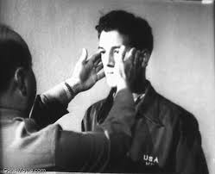
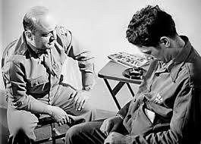
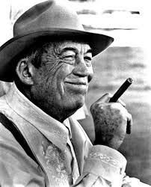
Let There Be Light
John Huston, 1946
Purpose: To inform public about PTSD among WW II vets.
To counteract stigma of psychiatric wounds
Filmed at Edgewood State Hospital, Long Island
US Military bans film
Fears it will demoralize potential recruits
Film finally released in 1980s
John Huston, 1906-1987
http://www.youtube.com/watch?v=kDNoaSMKx0g GO to Minute 44.45

Slide 5
Stigma for a Day Survey Data
Main Correlations (n = 44, 2022 + 2024)
Bandaid Size: Others Avoided (r = .32*), Embarrassed (r = .43**)
Treated Differently: Embarrassed (r = 32*), Angry (r = .38*)
Glad Done: Bandaid Size (r = .28⁺), Others Stared (r = .39**), Embarrassed (r = .44**),
Angry (r = .32*), Comfortable (r = -.28⁺).
Gender Differences (only trends)
 | Females (n = 30) | Males (n = 14) | Significance
Others Avoided | 2.73 | 2.29 | .18
Treated Differently | 2.73 | 2.21 | .14
Embarrassed | 3.13 | 3.71 | .16

Slide 6
Stigma for a Day Observations
Others’ ambivalent reactions: Others are embarrassed, concerned, stare, look away, amused. Children openly stare. Often very kind, solicitous.
Own ambivalent reactions: Afraid, amused, angry, anxious, curious, defiant, vulnerable.
Dominant feelings: Courage and fear. Over time, became more resilient to others’ stares. Band-aid becomes “symbol of defiance”.
Bodily reactions: Heart pounding, heart racing. Physical “burden”
Perception: The “weight of curiosity”, time seems to drag, Band-aid feels like a beacon, drawing attention to it and to self. Heightened sense of surroundings/vigilance—hyper-alert to others.
Resources: Support from others (e.g., co-workers, strangers), self-affirmations.

Slide 7
Ethnicity, Gender, and Health Care

Slide 8
Stereotypes Interfere with Treatment
Ethnic status: Black, Hispanic, low-Income people get:
Less information
Less emotional support,
Less proficient treatment
Elderly: Less often resuscitated in ER
Women: Taken less seriously

Slide 9
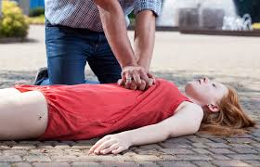
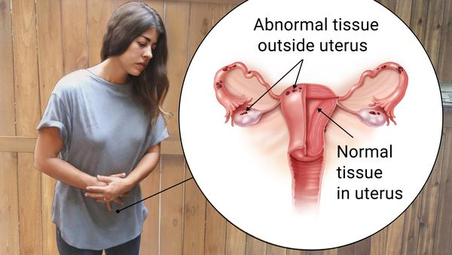
Gender Differences in Medical Treatment
Schopen, 2018
CPR (cardiopulmonary resuscitation) given less to women 39% than to men (45%); men 23% more likely to survive public cardiac arrest.
Why? Perhaps worry of touching women’s torsos.
Physical pain: Men get pain killers
Women get sedatives
Endometriosis: Tissue that normally lines the uterus grows outside it. Very painful.
10% of all women have this disease. But diagnosis takes 7-8 years. Why? Often told “pain is in your head”.
Common theme: Women too emotional; emotions → complaints.

Slide 10
Gender Stereotypes Affect Diagnoses
Medical professionals are given the following scenario:
Mr. Kendler complains of sudden, sharp headaches
Ms. Kendler complains of sudden, sharp headaches
Possible stroke?
Yes for Mr. Kendler, No for Ms. Kendler
Emotional problem?
Yes for Ms. Kendler, No for Mr. Kendler

Slide 11
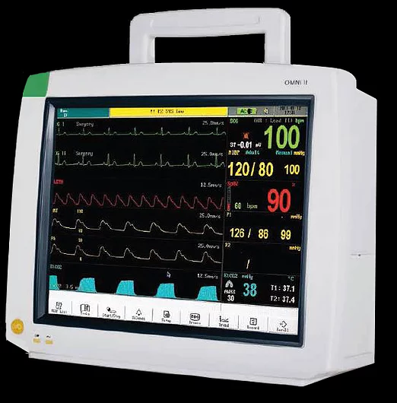
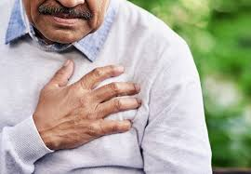
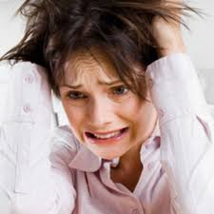
Gender Stereotypes Affect CHD Diagnoses: The “Stress” Explanation Chiaramonte & Friend, 2006
Coronary Heart Disease (CHD) kills more women than men, and the trend is increasing.
Yet women are less likely to be tested for, and diagnosed with, CHD than are men. Why?
Stereotype that CHD is
a “man’s disease”
OR
Stereotype that women over-complain when they are stressed?

Slide 12
Gender Stereotypes Affect CHD Diagnoses: The “Stress” Explanation Chiaramonte & Friend, 2006
Subjects: 56 medical students, equal men and women.
Method: Read vignette of patient with:
1. Objective signs of CHD (Blood pressure, pulse, fatigue, overweight, age)
2. Did patient score high / low on stress measures?
3. Was patient a man or a woman?
Results: Gender diffs in diagnosis, referrals BUT ONLY when stress score are high.
CHD Diagnosis
Cardiologist Referral

Slide 13
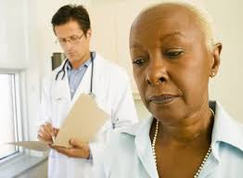
Interactions Between Black Patients and Non-Black MDs
Patient and MD interactions are a critical part of successful health care (more in future lecture).
75% of Black patient interactions are with a non-Black MD. Makes a difference:
* Less patient trust in MD
* Less positive emotions during MD visit
* Fewer attempts at relationship building by MD
* Less joint decision making
Does MD racial bias contribute to these problems?

Slide 14
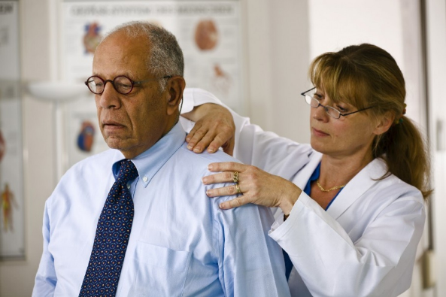
Painful Effects of Prejudice:
False Beliefs Among MDs about Race and Pain
African Americans are routinely under-treated for pain, compared to whites.
Emory U. Study of ER patients with bone fractures
74% of whites receive painkillers
50% of blacks receive painkillers
Why?
False beliefs that blacks are less sensitive to pain than whites, based on unconscious stereotypes

Slide 15
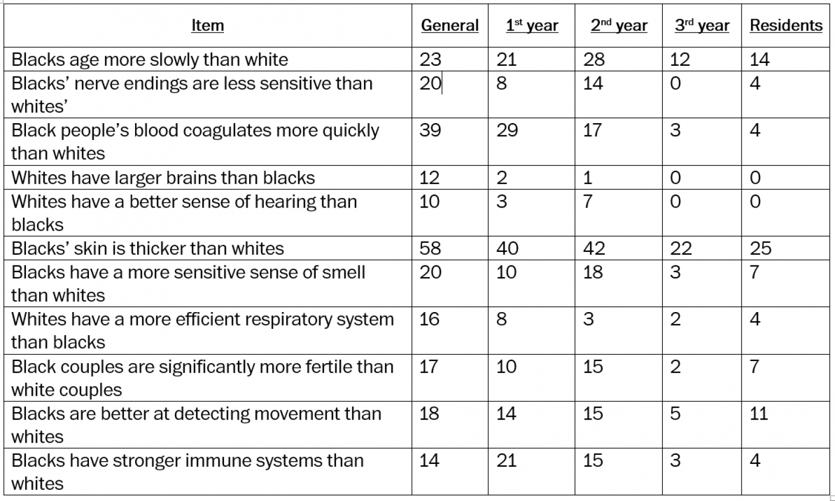
False Beliefs Among General Public, Medical Students, and Hospital Residents about Race and Pain
Note: Numbers represent percent agreeing with statements.
Also, false beliefs diminish with increased training.

Slide 16
Aversive Racism and MD Interactions with Black Patients
Penner, Dovidio, et al., 2010
Aversive Racism
AMBIVALENCE based on:
A. Believing in social justice, equality, non-biased society
PLUS
B. Wanting to see oneself as non-prejudiced, fair
BUT
C. Having internal, automatic feelings of hostility to minorities

Slide 17
“Signature” of Implicit Racist
Explicit Racism Measure
I oppose civil rights laws
Racism is not a major problem
Employers should hire who ever they want
Complaints about prejudice lack merit
Explicit Racism Measures:
Score low
Implicit Racism Measures:
Score high
Implicit Association Task (IAT)
How fast make choice when:
Positive word paired with Black
Negative word paired with Black
Positive word paired with White
Negative word paired with White
Black White
Pleasant Unpleasant
?
Happiness

Slide 18
Penner et al. Study Design
Subjects
15 MDs: 7 female, 8 male. 12 Indian, Pakistani, Asian; 3 White
150 Patients: All African American: 112 female, 38 male
Procedure
MDs complete explicit measure of prejudice
Q 1. It’s really a matter of some people not trying hard enough; if blacks would only try
harder they could be just as well off as whites.
Q 8. Over the past few years, blacks have gotten more economically than they deserve.
MDs complete IAT (measure of implicit prejudice)
MDs and patients interact in regular consultation.
Outcome Measures
1. On same team? 2. Treatment decisions (MD & Pat. both complete)
3. Was treated warmly? 4. Satisfied with treatment? (Pat. completes)
Aversive racist: Low explicit racism
High implicit racism

Slide 19
Patient Reaction to MD (Based on all 4 Measures) Due to MD Explicit and Implicit Prejudice
Which MDs did Black patients like the least?
High explicit and high implicit prejudice
High explicit and low implicit prejudice
Low explicit and high implicit prejudice
Low explicit and low implicit prejudice
NOTE: Lower scores mean less positive response to MD by Black Patient.
Liking of MD
Why would patients like this combination the least?
Total Racist
Semi- Racist
Aversive Racist
Non- Racist

Slide 20
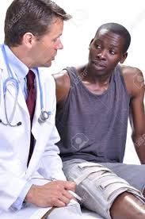
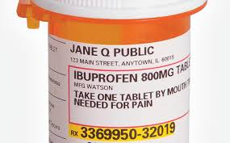
Time Talking During Consultation: MD vs. Patient
Hagiwara, Penner, et al. 2013
Question: How much time do non-Black MDs and Black Patients Talk Relative to Each Other?
Set up: Same subjects as from Penner et al. 2010 study
Outcome: Ratio of MD words to Patient words.
Which MDs dominated conversation the most?
High explicit and high implicit prejudice
High explicit and low implicit prejudice
Low explicit and high implicit prejudice
Low explicit and low implicit prejudice
Adherence: Adherence refers to how well patients follow MD instructions.
Adherence lowest among Black patients who saw an aversive racist MD (low explicit / high implicit prejudice).

Slide 21
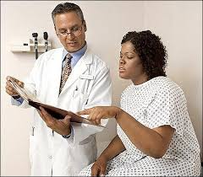
On The Same Team: Method to Improve Interactions Between Non-Black MDs and Black Patients
Method: MDs and Patients assigned to
1. “Common Identity” orientation
2. Standard Health Info (control) orientation
Outcome (4 and 16 weeks After Orientation)
1. Greater trust in MD
2. Greater adherence to MD advice

Slide 22
Is Racism a Health-Risk Stressor?
Bichell, 2017
Charlottesville, Virginia, 2017

Slide 23
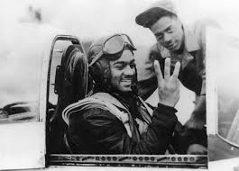
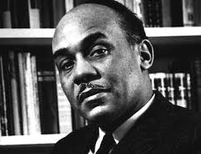
Chronic Racism is a Chronic Stressor
Tuskeegee Airmen:
Where’s the pilot?
Ralph Ellison
Invisible Man
Roberto Montenegro, MD
“Park my car”
Racist events are experienced as threats.
Body goes into fight/flight mode (Cannon’s SAM stress model).
Cortisol, adrenaline spike.
Impairs immunocompetence, heart health, endocrine system.
Drip drip drip of chronic racism is chronic stressor. Like daily hassles.

Slide 24
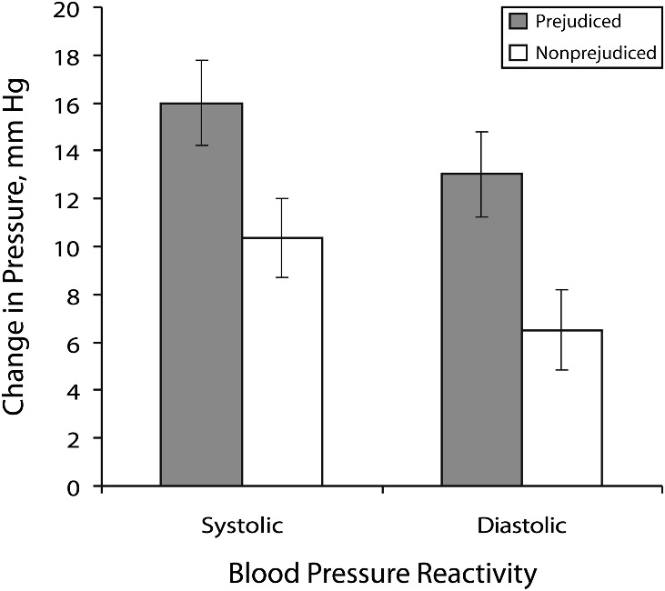
Anticipated Prejudice and Blood Pressure Elevation
Sawyer, et al., 2012
Latina subjects led to believe White conversation partner is/is not racist.
Before actual interaction (never occurs), Latinas in “racist partner” condition show:
1. Higher threat-related emotions
2. Greater cardiovascular reactivity

Slide 25
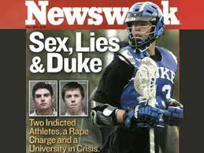
March, 2006, three members of Duke lacrosse team charged with raping Crystal Magnum, African American stripper at a party.
Charges ultimately dropped, due to perjury by Ms. Magnum and her attorney.
Event created intense racial tension.

Slide 26
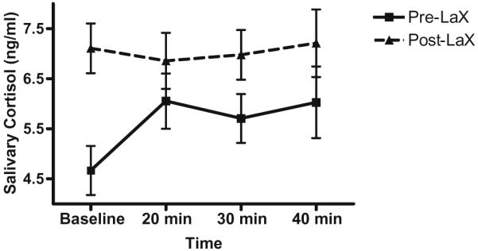
Cortisol Levels in Blacks Before and After Duke University Lacrosse Scandal
Richman & Jonassaint, 2009
Black Duke U. students assigned to “Student Identity” or “African Identity” conditions.
Watch happy Duke sports events OR
Videos of major Black achievements.
Then prepare brief speech.
Provide cortisol samples 4 times.
NONE OF THIS MATTERS.
BUT, experiment coincides with Lacrosse scandal.
Compare stress responses of pre-scandal to post-scandal subject.
Cortisol (stress hormone) spikes in days after scandal.
NOTE: This was a “group threat” rather than personal threat.

Slide 27
Take Home Points: Prejudice and Health
Stereotypes interfere with treatment
Quality of interactions with MD
Severity of diagnoses
Intensity of treatment
Improves when patient and MD on “same team”
2. Racism is a health-risk
a. Chronic racism impairs immunocompetence
b. Interactions with potential racist boosts blood pressure
c. Racially charged news events increase cortisol.

