Slide 1
ANNOUNCEMENTS
Quiz 2 is on Thursday (April 4)
15 multiple choice questions + 2 Extra Credit questions
Diary Study
You should complete Dairy 3 today
Diary Study instructions on Canvas and on my website: http://nwkpsych.rutgers.edu/~kharber/healthpsychology/diary%20study/
3. Extra Credit R-Points:
Subject pool now open for experiment-based extra-credit
1 Extra Credit for every 30-minute experiment
6 Extra Credit points available for class
Contact Subject Pool Coordinator for info: rutgersrpoints@psychology.rutgers.edu
Stigma for a Day is due today.

Slide 2
REVIEW QUESTION 1
Following rules and personal growth are both family values.
How can these two family values lead to psychological problems?
____ “Rules” are almost always bad
____ “Growth” is problematic
____ Both of these values are dangerous to family well-being
____ These two values become a problem when they conflict
____ None of the above
X

Slide 3
REVIEW QUESTION 2
In families that overvalue homeostasis, a child can “rescue” the family from the crisis of disruptive conflicts by:
____ Teaming up with one of the conflicting parties
____ Taking over being a parent
____ Getting sick
____ Interrupting conversations
____ Sharing the contents of a sibling’s diary
X

Slide 4
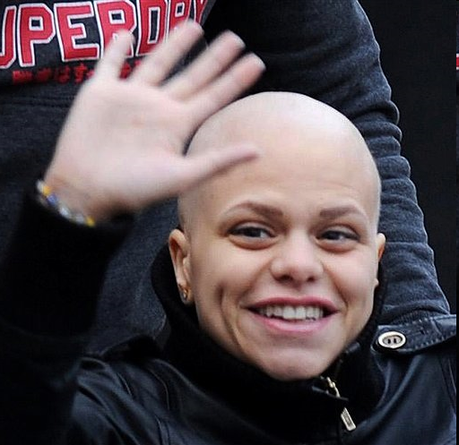
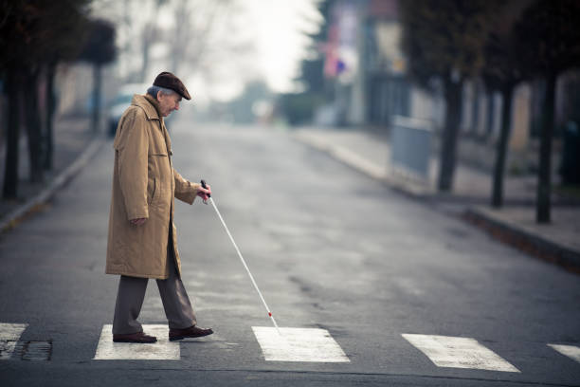
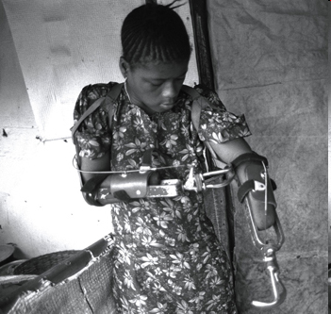
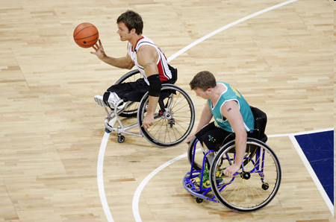
Class 21: Illness and Stigma

Slide 5
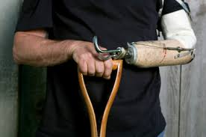
How Do People React to the Stigmatized?
Fear
Revulsion
Concern/pity/sympathy
Fascination/curiosity
Confusion/uncertainty
Mixture of all the above: ambivalence

Slide 6
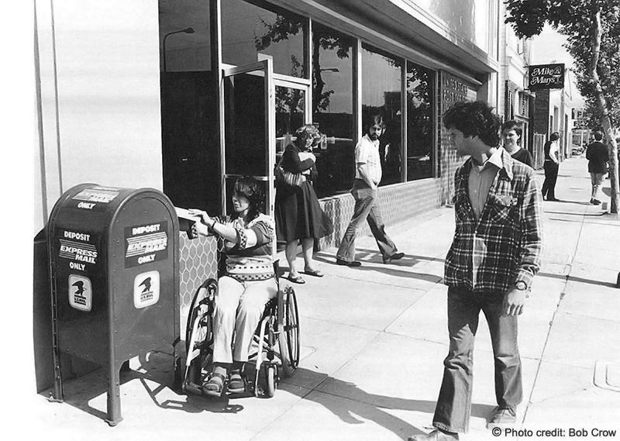
Marked and Markers: The Players in Stigmatized Relationships
Marked: Those with a characteristic (physical disability, racial identity, past history, etc.) that distinguishes them from others, typically in a negative way.
Markers: Those who do not deviate extremely from the norm, and through their strong reactions and because of their in-group status, have the motive and the power to assign marks to deviant others.
Is stigmatizing others a distinctly human behavior?
Do other species “mark” those who are disabled or different?

Slide 7
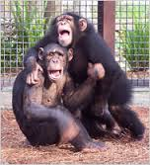
Chimps' Reaction to Anesthetized Fellow Chimp
"...Don, under Nembutal, was wheeled on a hand cart up to the cages of nine other adults. Ami, Nira, and Vera showed fear, and Dean and Bokar did also but then followed this by a show of aggression at a distance; Kambi showed generalized excitation in screaming only; Frank, with hair erect, spat at the anesthetized Don, Pam first avoided then attacked through the cage wire; and Lelia, with general excitation but not avoidance, also attacked.
The youngsters in the infants' enclosure were afraid, one very much so, and all showed signs of marked excitation."
Hebb and Thompson, 1954 in Jones, et al., 1984.

Slide 8
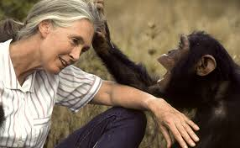
Chimps’ Rejection of Handicapped
Jane Goodall and chimps with polio
Over time, members get used to crippled chimp, and:
Cruelly reject
But also
b. Behave with kindness

Slide 9
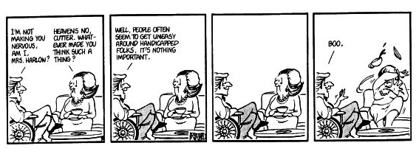
Interactions with the Disabled, C/O Bloom County /Berke Breathed
What’s happening here?

Slide 10
Responses to Disabled:
Statements Versus Actions
Hastorf, et al. 1979
Verbal Report:
1. Say they prefer meeting with a disabled vs. able-bodied
2. Express opinions that match those of disabled person
B. Non-verbal behavior
1. Terminate interview sooner
2. More motor inhibition (sit rigidly) .
Why the mismatch? .

Slide 11
Socially Managing a Disability
How do able-bodied (e.g., “markers”) feel around disabled?
Disturbed, anxious, self-conscious, curious, ambivalent.
Do disabled know what affect they have on able- bodied?
Generally, yes. How could they not?
Should handicapped acknowledge handicap or ignore it?

Slide 12
“Elephant in the Room”: A Wise Debate Tactic?
https://www.youtube.com/watch?v=_nSVAUZUMGA

Slide 13
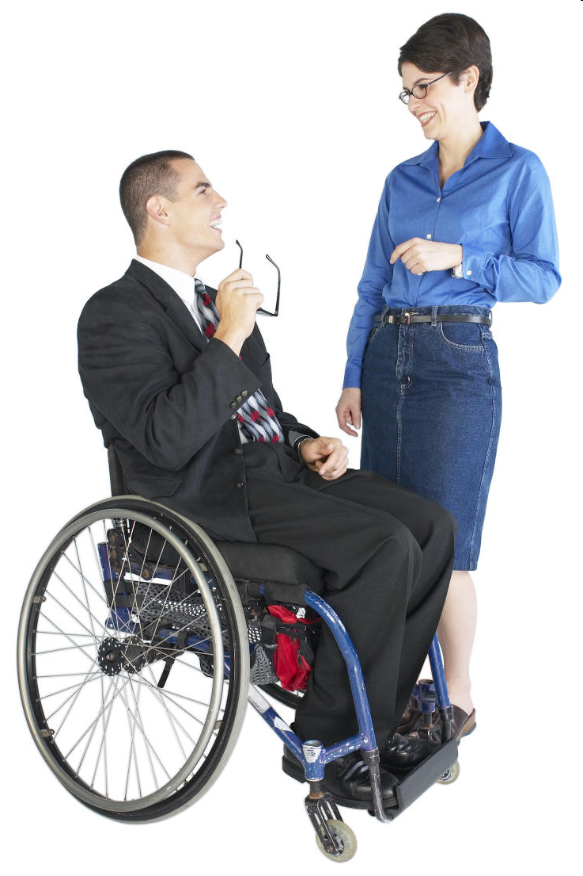
Acknowledging the Disability Hastorf, Wildfogel, & Cassman, 1979
Question: Do people prefer disabled person who acknowledges disability?
Method—Study 1:
Ss watch video of disabled student interviewed about starting college.
Student acknowledges/doesn’t acknowledge disability
Ss rate how much they like student, how much want to work with him.
71
_____% like acknowledger more than non-acknowledger
____% prefer working with acknowledger over the non-acknowledger
79

Slide 14
Acknowledging the Disability Hastorf, Wildfogel, & Cassman, 1979
______
_______
Study 1 found: Being open and acknowledging a disability increases liking.
Problem: How many causes are tested here?
Method—Study 2:
Ss watch video of disabled person who acknowledges:
a. Disability
b. Girlfriend problem (“weird religious trip girlfriend’s mom laying on me”)
Which disabled person is like more?
_____ Acknowledges disability ____ Acknowledges other problem
X

Slide 15
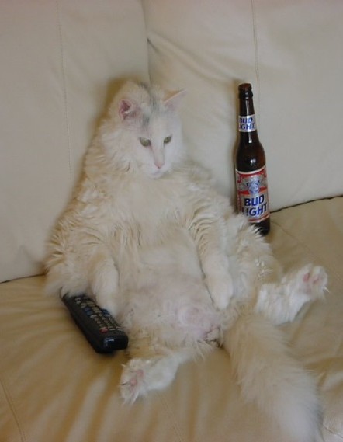
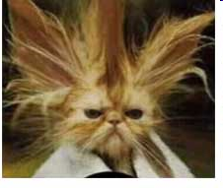
Acknowledging the Disability: Stressed and Open vs. Cool and Avoidant Hastorf, Wildfogel, & Cassman, 1979
Hastorf et al. predict that the style of disclosing disability will matter. They expect Ss will not like disabled person who discloses uncomfortably. Why?
Disabled person’s discomfort will make Ss uncomfortable → dislike. You agree? Why / why not?
Ss prefer person who: a. Acknowledges but with clear discomfort and awkwardness. b. Does not acknowledge but is very poised and cool.
X
Why?
Perhaps courage is attractive.

Slide 16
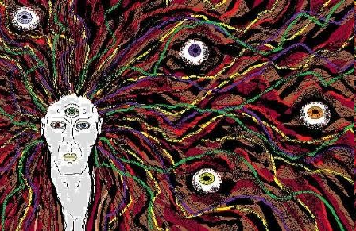
Staring at Strange Strangers
Ellen Langer, 1976
Disabled can be disturbing, upsetting.
Do we want to avoid looking or do we want to stare?
Why?
Langer Study 1: Do people want to stare at physically unusual?
Ss can stare at a typical, a pregnant woman, a person in leg brace.
Who do Ss stare at more?
Spend more time staring at pregnant woman, leg-brace, than typical.
Conclusion: People fascinated by the unusual.

Slide 17
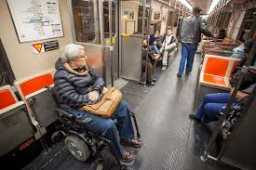
Staring at Strange Strangers, cont.
Ellen Langer, 1976
Is it ever OK to stare at the disabled?
What happens if we try to suppress desire to stare (recall Wegner White Bear studies)?
Langer Study 2: Ss can stare, or not stare, at person wearing a leg brace.
Ss then talk with person.
Who sits closer, those who stared or those who didn’t stare?
Ss sit closer to person in leg-brace if they first had chance to stare. Why?
Discomfort of trying to suppress curiosity is gone.

Slide 18
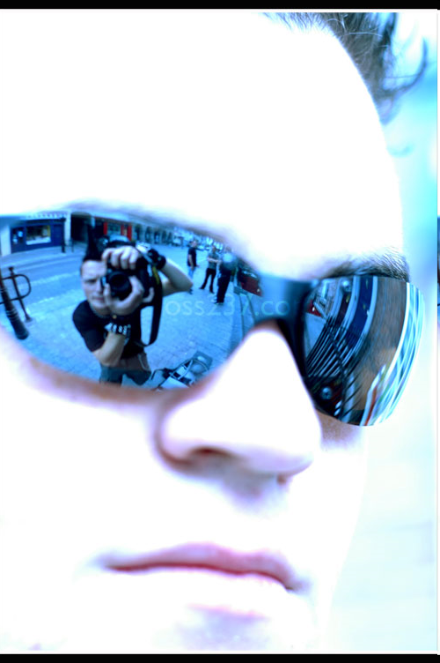
How Stigma Affects the Stigmatize: The Looking Glass Self
* We know who we are based on the way others respond to us.
* Others' responses serve as a social mirror.
* Let's us know if we're liked/disliked, attractive/unattractive, smart/limited, etc.
* Helps us gauge our own emotional reactions to difficult, unusual events.
* Provides us feedback about the appropriateness of our own actions.
How would stigma affect the social looking glass/mirror?

Slide 19
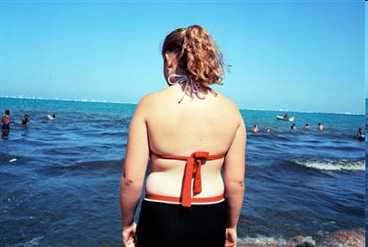
Stigma and the
Warped Looking Glass
I always felt when I went into some boutique, that all the salesgirls were staring at me.... I always felt that the first thing anyone would notice is that I was fat...and they would know why I was fat.
They would know I was neurotic, that I was unsatisfied, that I had problems. They could tell immediately that I was out of control.
I always look around to see if there was anyone as fat as me. I always wondered when I saw a fat woman, "Do I look like that?"

Slide 20
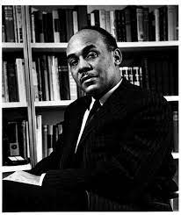
Being Both
Hyper-visible and Invisible
Hypervisible: Everyone notices you because of the mark—the facial disfigurement, the radiation-treatment hair loss, the wheelchair.
Invisible: But people still seem to not see you.
I am invisible, understand, simply because people refuse to see me. ...it is though I have been surrounded by mirrors of hard, distorting glass. When they approach me they see only my surroundings, themselves, or figments of their imagination—indeed, everything and anything except me. Ralph Ellison, Invisible Man, 1947

Slide 21
Stigma Corrodes Self Esteem:
The Darkened Looking Glass
One of the most direct effects of stigma is threat to self-esteem.
-- Defined in terms of stigma
-- Avoided, shunned, ostracized
-- Non-stigmatized features are overlooked
Self-stigmatizing—Internalizing other's negative view of oneself.
“Not just that one is fat or gay or blind or alcoholic, but rather that one is therefore fundamentally flawed as a person—sick, weak, immoral, or evil. In Goffman's terms, one has ‘a spoiled identity’ ".

Slide 22
How Disability Can Change Self Schema
Pre Disability
Post Disability
Paraplegic
Many Opportunities
Many Opportunities
X
Anxious
X
Busy
Busy
Dependent
SELF
SELF
Avoided
X
Athletic
Athletic
X
Popular
Popular
X
X
Runner
Biker
Runner
Biker

Slide 23
Creating New Reference Groups
After acquiring a stigma (cancer, , AIDS, paraplegia, etc.) it can help to develop ties to others with similar condition. Why?
a. Social comparison
b. Recognition of one's own non-stigmatized features.
c. Recognizing difference from others who share stigma.
BUT, important to not belong ONLY to community of stigmatized. Why?
a. Need to reenter mainstream.
b. Need to get feedback from "markers", which may be more realistic

Slide 24
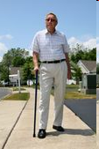
In-Between Stigma Status
Some people are not fully stigmatized, not fully "normal"
* Partially deaf, partially blind
* Loss of one limb, but otherwise can walk
These people are not fully accepted by mainstream, but also not fully accepted by the stigmatized group.
The "unblinded"--and their unexpected social challenges.

