Slide 1
Class Announcements
Diary Study (15% of course grade) starts today. Be here!
Quiz 2 on April 4. Everything from Midterm to April 2 class.
Extra Credit Updates:
The Subject Pool is now open for extra credit. You can get up to 4 points of extra credit via the Subject Pool
rutgersrpoints@psychology.rutgers.edu
Stigma for A Day. Due Thursday March 28 end of class. Bring hard copy to class. Instructions available today

Slide 2
Emotions Diary Exercise
Emotion Diary Project = 15 points toward your final grade. It is an
easy way to make points, if you complete as instructed.
Packet of 8 diaries, including today's
No need to make copies, I’ve done that for you!
Complete diary at start of class, from today (Mar. 21) to Apr. 16; or do so twice a week in any case.
On Apr. 16 I will provide materials for writing up your diary sets.
NOTE: I will not see your individual diaries—they are yours. What you write on them is for your eyes only! However, you are welcome to share Diary content in your write-up if you wish to do so. All Diary reports will be held in strict confidence.
Get the diaries on my webpage: http://nwkpsych.rutgers.edu/~kharber/healthpsychology/diary%20study/

Slide 3
Date: March 21

Slide 4
REVIEW QUESTION 1
Why did the traditional medical establishment resist the health effects of social support?
___ A. MDs cannot bill for social support
___ B. There is no scientific connection between social support
and physical health.
___ C. Social support contradicts the one-cause for any illness
approach.
___ D. Social support has no relation to mortality
___ E. None of the above
X

Slide 5
REVIEW QUESTION 2
Cohen et al. showed that social support reduces illness by first asking people about their social support and then:
____ A. Asking people how often they went to the doctor
____ B. Asking people what physical symptoms they have had
____ C. Checking subjects’ MD records
____ D. Giving people the cold virus via nose drops
____ E. None of the above
X

Slide 6
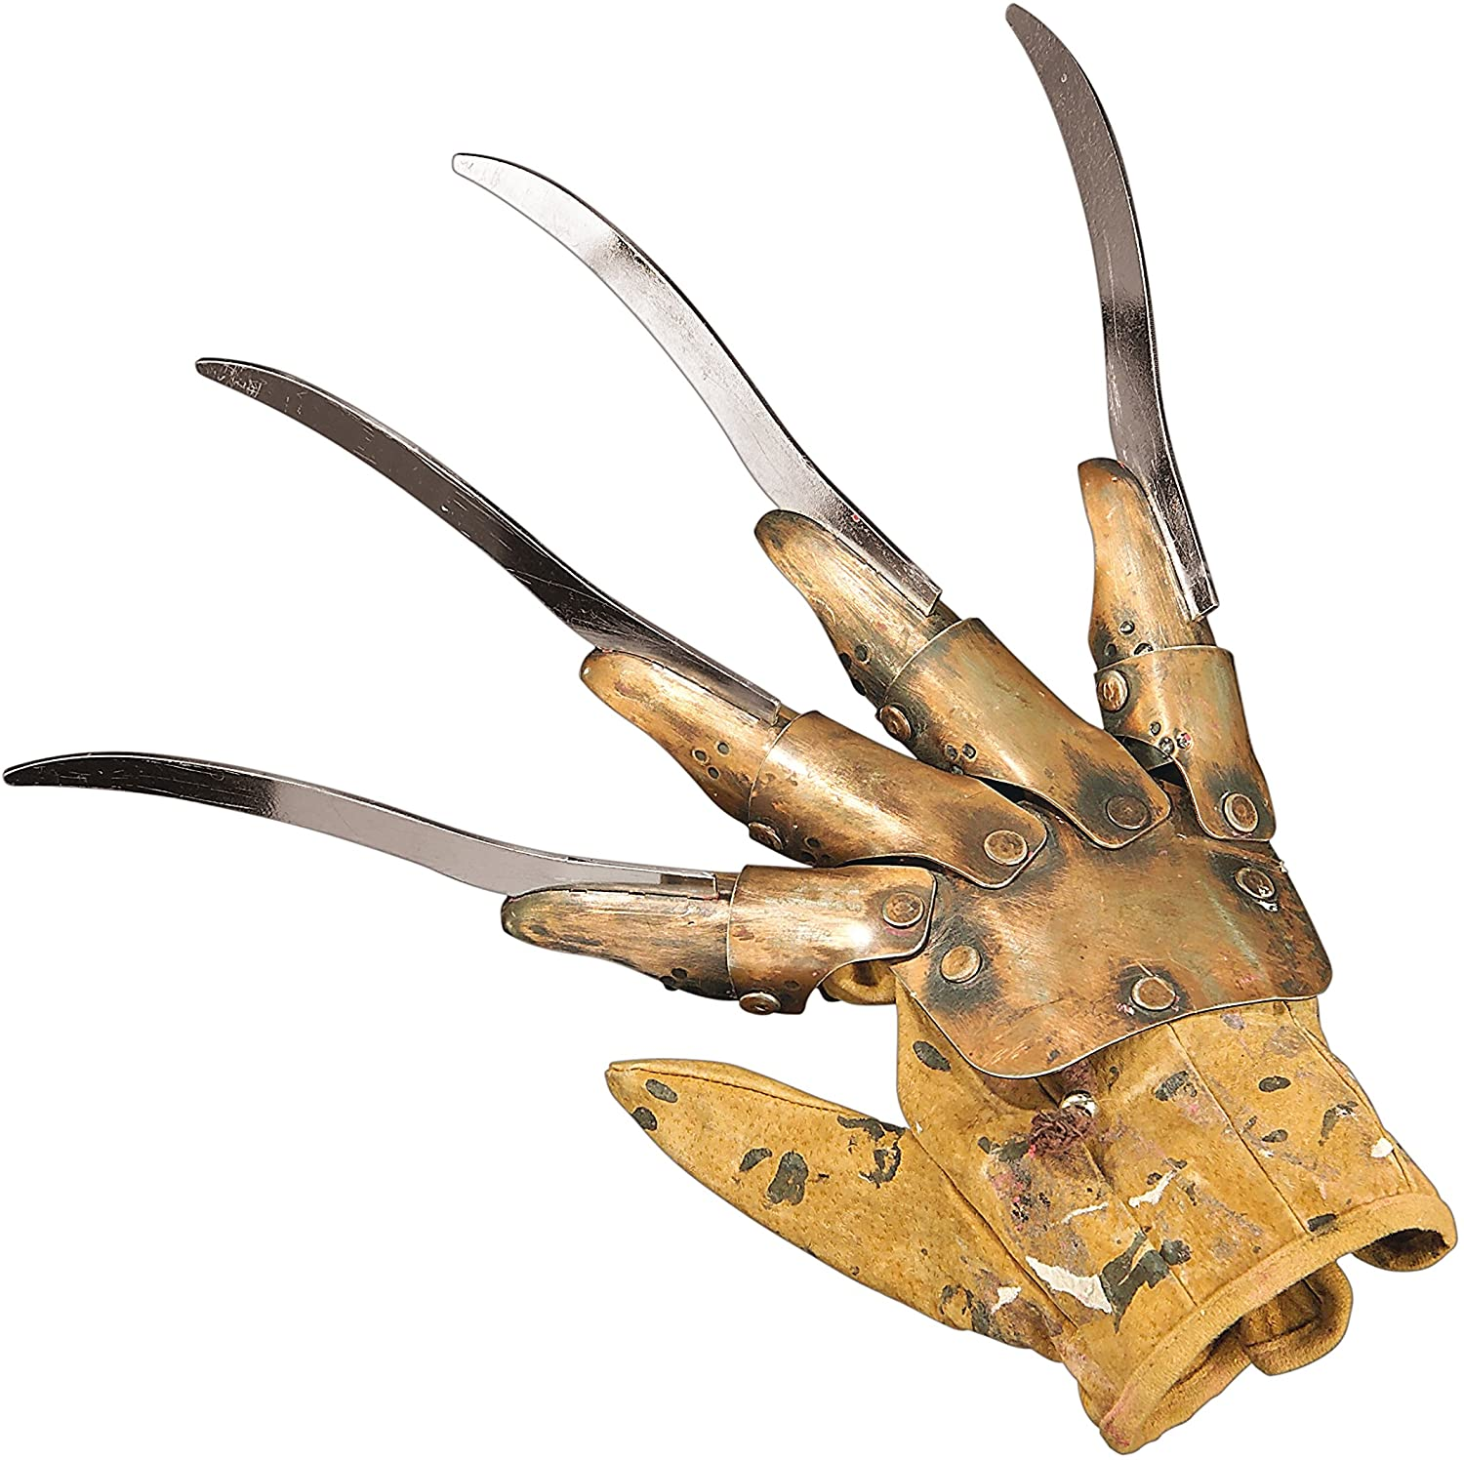
Class 18:
Social Support and Negative Social Support

Slide 7
Summary of Social Support Benefits
1. General health promoter—effects all physio-systems
2. Reduces rates of illness
3. Reduces death rates (e.g., post MI)
4. Quicker recovery from major illness
5. Sustains life for people with terminal illness
However, people’s helping efforts can also fail. How so? What are ways in which people made it worse by trying to make it better?

Slide 8
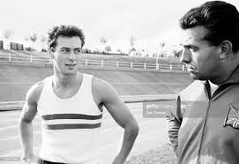
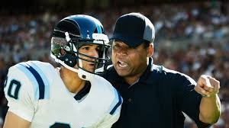
What is the "Right" Kind of Social Support?
Listen sympathetically
Avoid telling people what they should do
OR
Take action
Give people clear and direct advice

Slide 9
Your Friends Feels Bad: How Do You Help?
Your friend has been feeling down. He’s eating a lot, not getting exercise, and complaining about feeling sluggish. Missing classes, not socializing.
Do you:
Give direct and specific advice?
Listen sympathetically and avoid advice?

Slide 10
Your Friends Feels Bad: You know what works for you. How do you help?
What if you’ve just changed your diet and completed a 10-week gym class, lost 14 pounds, feel much better about your mood, and gotten complements from friends and co-workers?
Give direct and specific advice?
Listen sympathetically and avoid advice?

Slide 11
You’ve been going through a tough time: You know what works for you. How do you help?
You’ve been depressed, down. A lot going on in your life, not sure where to start. You’ve been hanging-out at home, eating too much, not exercising. You call your friend. What would help you?
Getting direct and specific advice?
Being listened to, with minimal if any advice?

Slide 12
Inventory of Nondirective and Directive Support (INDIS)
Harber, Schneider, Everard, & Fisher, 2004
Directive |  | Nondirective
Decided what help I needed |  | Knew when to back off from helping
Solved problems for me |  | Helped me w/o making me helpless
Organized my schedule for me |  | Helped w/o taking over.
Decided who could help me |  | Tried not to take over.
Took charge of my problem
Directive is related to: Increased depression, loneliness
Nondirective is related to: Increased hope, optimism.
However, failure to give directive support when appropriate is regarded as absence of caring.

Slide 13
EFFECTS OF DIRECTIVE AND NON-DIRECT SUPPORT ON COPING
Harber, et al. 2005
From Family
From Friends
Non-
Directive
Non-
Directive
Directive
Directive
Hope
Hope
Optimism
Optimism
Depression
Depression
Loneliness
Loneliness

Slide 14
EFFECTS OF DIRECTIVE AND NON-DIRECT SUPPORT ON HEALTH BEHAVIOR
Stewart, Gabriele, & Fischer (2012)
Subjects: n = 304, Age = 52, 77% female
 | Physical Activity | Fruit/Veg Intake | Alcohol Consumption
Non-Directive Coaching | Increased | Increased | Decreased
Directive Coaching | No Change | No Change | No Change

Slide 15
Why is Directive Support Often Harmful?
Why is Non-Direct Support Often Helpful?
Implicit message of Directive Support:
Implicit message of Non-Directive Support:
* You are not capable
* You don’t make sense
* You are not in charge
* My care is conditional:
Do what I say or I quit.
* You are in charge
* I’m not judging you
* I believe you can work this out
* My care does not require you to
follow my instructions.
When is Directive Support appropriate?
Emergencies, dire situations.
YOU: There is a rabid dog in my house! FRIEND: How does that make you feel?

Slide 16
Why do People Give Directive Support?
Recall Basic Beliefs
World is just
World is well ordered
Self is good
What does hearing about others’ troubles do to these beliefs?
Hearing other’s stories disturbs feelings of control
Threatens “just world” beliefs → Blaming
Threatens sense that the self is competent

Slide 17
Personality Differences In Giving Directive and
Non-Directive Social Support
Harber, Jussim, Kennedy, Freyberg, & Baum, 2008
People who Prefer to Give Directive Support
People who Prefer to Give Non-Directive Support
Need for Certainty
Empathy: Concern
Just World Beliefs
Empathy: Perspective
Emotional Range & Clarity
Use Emotions as Information

Slide 18
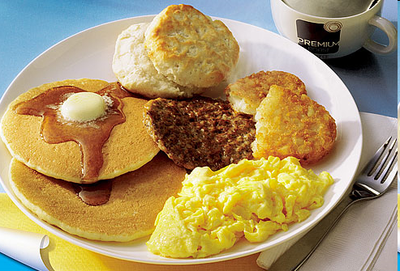
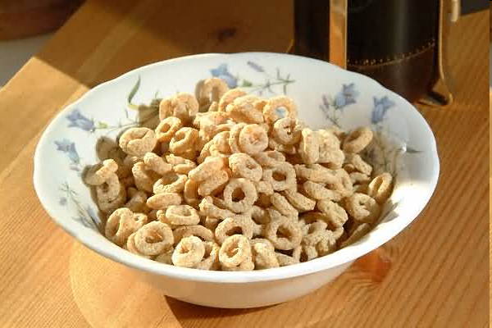
“Recipe” for Negative Social Support:
Husbands of Dieting Women
91% of men support wives’ attempts to lose weight.
Study observes behavior of husbands and dieting wives at dinner.
Finds that husband, compared to wives, are:
Four times more likely to offer food.
Seven times more likely to discuss food
Ratio of criticism to praise: 12:1
Solution: Tell husband to just be uninvolved =
Actively involve husband in dieting training

Slide 19
Why Would Social Support from Close Others "Go Bad"?
Continues over time
Requires higher level of commitment
Draws on past history

Slide 20
Social Support as an Interaction
Action | Actor's Intent | Partner's Interpretation
1. Husb. wants to carry object | To be helpful, show ability | Husband is at risk.
2. Wife says "don't carry" | To protect husband | Wife is overreacting
3. Husb: "don't be worrier" | I can do this, it's OK | Feels dismissed, insulted
4. Wife: it's right to worry | Sit. is serious, I have stake in your health | Feels manipulated, insulted
5. Husb. “I have a right to make my own choices" | Don't treat me like a child | Feels misunderstood, under-appreciated.
6. Wife leaves in a huff | You need to understand me. | What happened?
Few minutes later, husband feels slight chest pain. What does he say to his wife?

Slide 21
Phases of Negative Social Support
Coyne, et al. 1988
Initial phase: high morale
Flagging morale
Re-definition of situation
Overwhelmed phase
Stalemate

Slide 22
Support Statement at Initial Phase
“I gave him repeated pep talks and assured him we were going to lick this awful thing that had ruined our lives”.
What is good about this statement?
What may be a problem with this statement?
We’re a team. In this together.
Your boundaries aren’t your own. I’ll assume I know what you’re feeling. I might take charge.

Slide 23
Phase II: Flagging Morale Helper
Helper
1. Reassurance and support statements become forced, not sincere
2. Signs of worry, concern become more common
Recipient
1. Increased pressure to inhibit and fake.
2. No-win of inhibition
a. Blamed for not disclosing
b. Blamed for complaining

Slide 24
Redefinition of Problem
Problem persists —helpers and copers become emotionally exhausted
Inability to fix problem --> threatened sense of control
Helpers want to take direct action to regain personal control
a. Advice giving: "Try harder", "Do more"
b. Monitoring
Effects of helper's actions
a. Close monitoring undermines performance
b. Undermines intrinsic motivation to cope

Slide 25
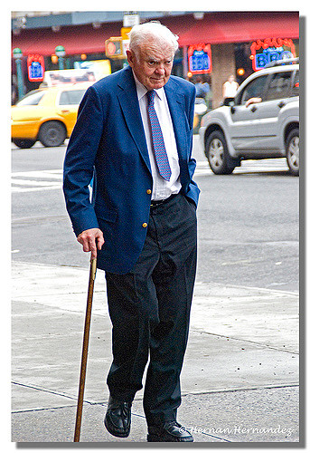
Statement of Over-involvement
“When I tell you to lift your leg and stop dragging it, I am only doing it for your own benefit, because if you concentrate hard enough on lifting that leg you are physically able to do it”.
Wife's comments to her stroke-disabled husband.
What’s going on here?

Slide 26
Causes of Negative Social Support
1. Nature of illness: How acquired, duration, limitations
2. Nature of symptoms: Objective vs. Subjective
3. Orientation to situation:
Motives (affection vs. guilt)
Choice to be in helping role
Helpee’s responsibility for illness
4. Tasks that helper takes on: Clearly defined vs. ambiguous
5. Social network: Backup supporters vs. isolated
6. Relationship factors
Degree of affection pre-illness
Quality of communication pre-illness

Slide 27
How to Maintain Good Social Support?
1. Realistic expectations
2. Coordinate perspective of helper and helpee
3. Provide specific tips on how to help
4. Prepare both parties for possible set-backs
5. Describe miscarried helping
6. Inform helpers how own anxiety → over-involvement
7. Urge both helper and helpee to focus on own, personal needs

