Slide 1
Class Announcements
Diary Study (15% of course grade) starts Thursday. Be here!
Quiz 2 on April 4. Everything from Midterm up to and including April 2 class (Race, Gender, Class, and Health).
All grading now appears on Canvas

Slide 2
HEALTH PSYCHOLOGY EXTRA CREDIT
You can earn up to 6 points to your total class grade, as follows:
Experiments: 4 points (Studies offer 1-3 points)
Stigma for a Day: 2 points
TOTAL POSSIBLE POINTS = 6
Note: This means if you have a: Low B (83-84 pts) + 6 Pts (89-90 pts) → A
Low C (73-74 pts) + 6 pts (79-80 pts) → B
Low D (63-64 pts) + 6 pts (69-70 pts) → C

Slide 3


Health Psychology Research Journals
Psychological Stress and Mitochondria
Positive Affect and Negative Affect and Allostatic Load
Childhood socioeconomic status, cortisol, stress
Childhood trauma and sleep disorders in adulthood
Racial discrimination, hostility, adrenal response
Time-varying social support and time of death –CHD
Mental health treatment and physical healthcare costs
Marital satisfaction and mortality
Social nudging: Effects of social feedback on vaccines
Fruit and veg. intake and mental health among Mex. Americans
Social support, loneliness, and telomere length for POWs.

Slide 4
Review Question 1
Days after the Loma Prieta Earthquake Harber and Knutson handed out quake-coping surveys to people in the Bay Area. People eagerly agreed to complete the surveys because:
____ The surveys were expertly prepared.
____ People in the Bay Area were bored.
____ The survey gave people a chance to disclose.
____ The survey helped people suppress quake-related thoughts
____ None of the above
X

Slide 5

Review Question 2
During the “Inhibition Phase”, about weeks 2-6 after wide-scale disasters, people are more likely to:
____ Have disaster-related dreams
____ Get into more arguments
____ Joke about the disaster
____ Commit more aggravated assaults
____ All of the above

Slide 6
Class 18: Social Support
No se vive sin amour.
(One cannot live without love)

Slide 7

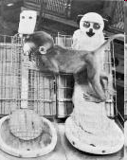
Harlow "Wire Mother" Studies
https://ryeberg.com/curated-videos/wire-or-cloth/ 4:20

Slide 8
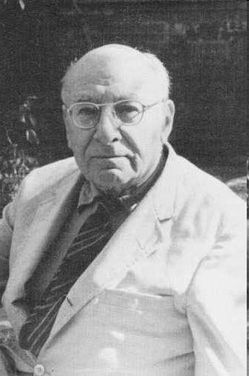
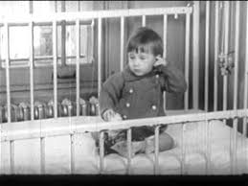
Rene' Spitz Foundling Home Study
http://https://www.youtube.com/watch?v=iW3UHcYfCPI
https://www.youtube.com/watch?v=bF3j5UVCSCA

Slide 9
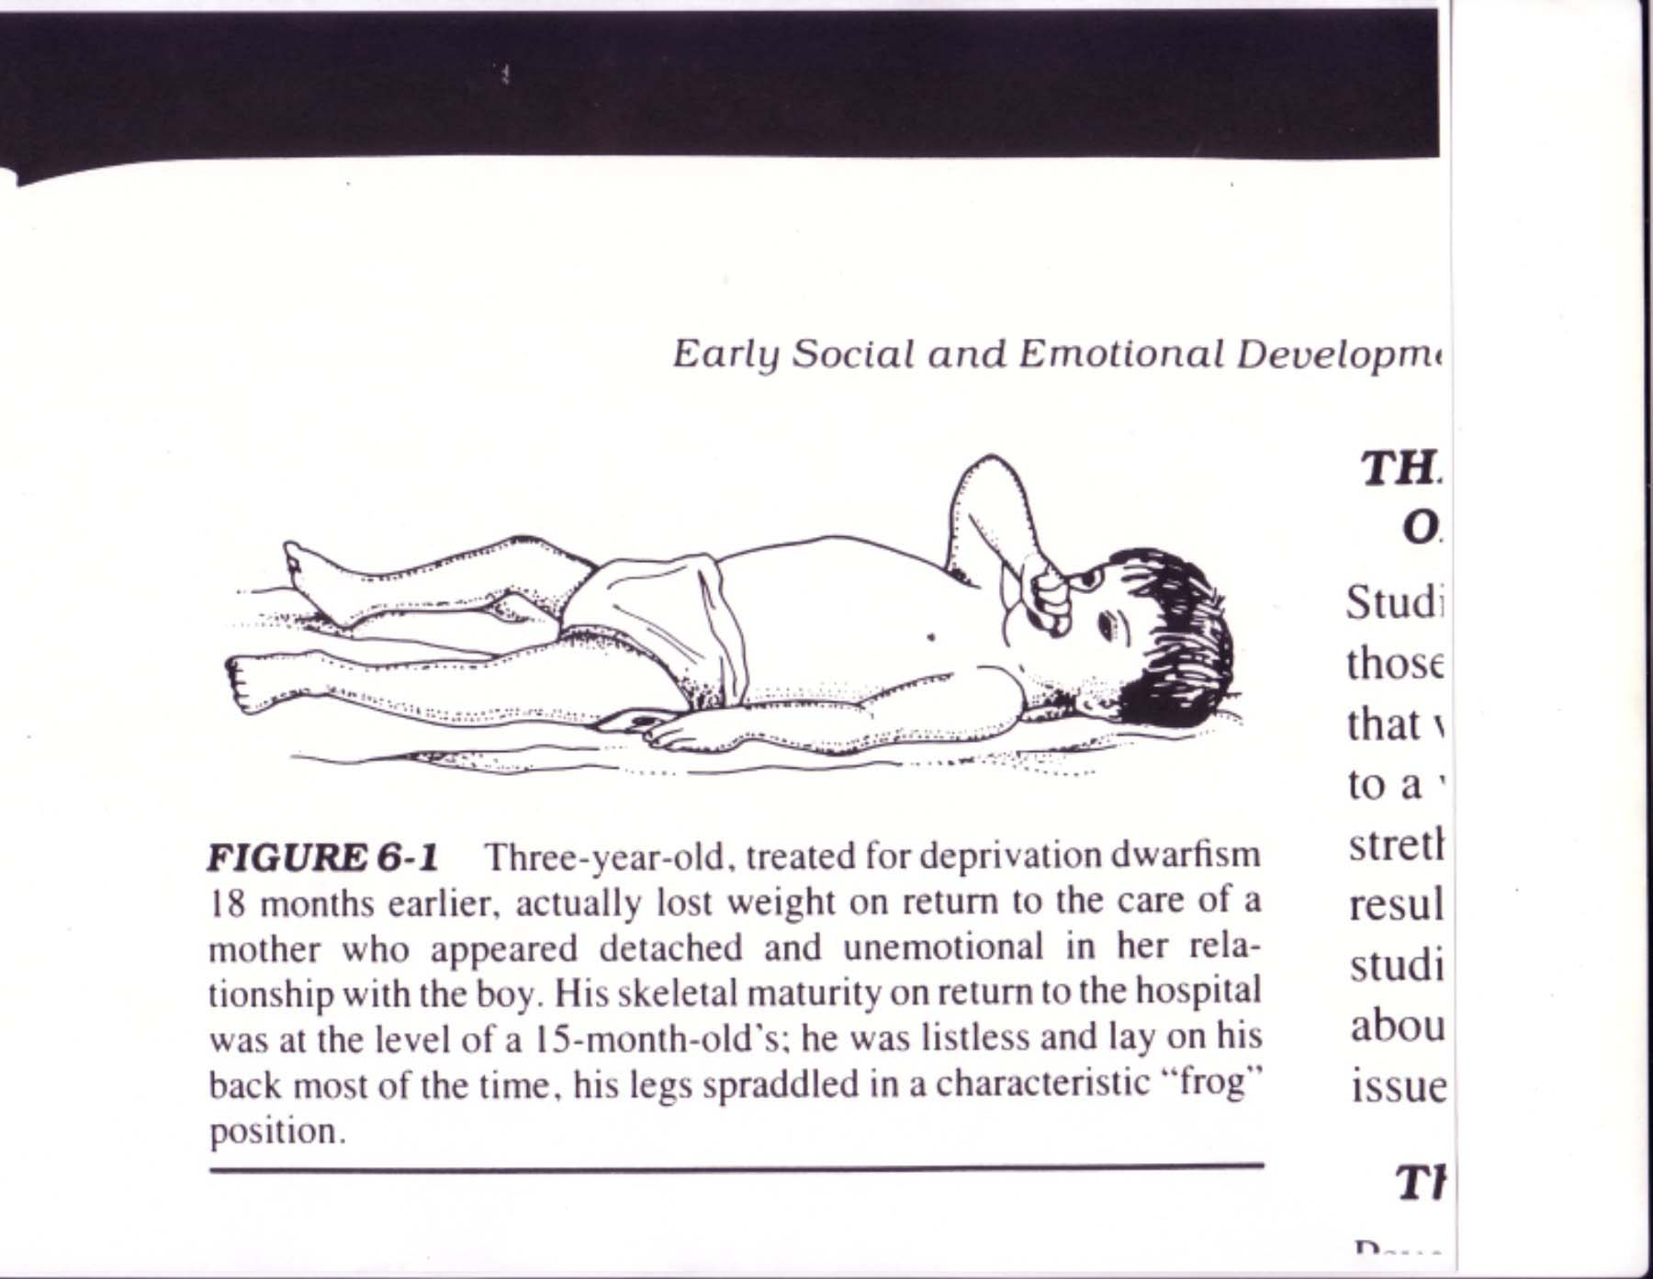
DEPRIVATION DWARFISM

Slide 10
What is Social Support?
Knowledge that one is not alone; that one belongs, is cared for; that one has emotional care when facing stressors.

Slide 11


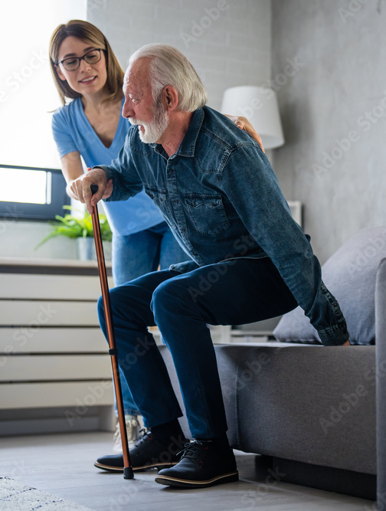
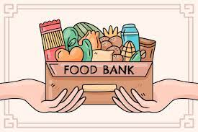
What Are Types of Social Support?
Emotional Informational
Instrumental Tangible
Emotional | Informational | Instrumental | Tangible
Disclosure | How to get help | Transportation | Provide funds
Belonging | Nature of problem | Help clean | Provide materials
Worthiness Affection | Poss. solutions | Track meds.

Slide 12


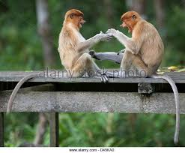
Social Support and Coping:
When Just Being There Matters

Slide 13

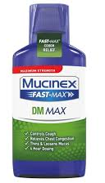
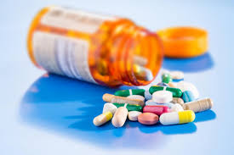
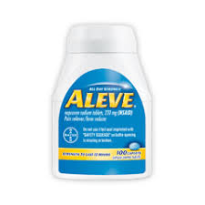
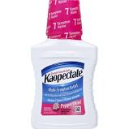
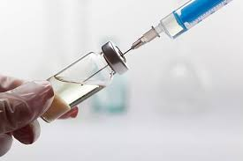
Social Support and Biomedical Model of Health
Social support challenges the bio-med model. Why?
Biomed model predicts 1 cause for illness, specific to illness. Social support indicates multiple, general causes for specific illness.
“Over the last 150 years of medical research from Pasteur, Koch onward, research has proceeded successfully along lines of identifying one cause of one disease with the theory of disease specificity being one of the major advances in our thinking over the last century.”

Slide 14
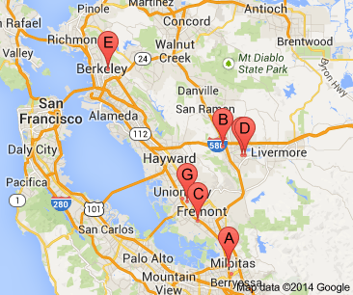
Community Based Studies, 1979-1984 Lisa Berkman
Alameda County: Men and women w/o support were 1.9 to 3.1 times more likely to die in 9 year follow up.
What was main cause of death?
___ Heart Disease ___ Stroke ___ Cancer ___ Respiratory ___ Gastrointestinal
X
X
X
Problems with this study: Doesn't account for pre-study illness
X
X
N. Karelia, CA Study: Focuses only on CHD Admits only patients with pre-existing CHD/CHD risks
Isolated men (but not isolated women) higher CHD mortality

Slide 15
12 Additional Studies Associate Social Isolation with Mortality
Emotional Isolation Pre-MI, Mortality Post Myocardial Infarction (MI)

Slide 16

Social Support as Non-Specific Resistance
Stress: Non-specific health threat. Why?
Effects cardiovascular, respiratory, digestive, emotional health.
Social Support: Non-specific resistance factor. Why?
Effects cardiovascular, respiratory, digestive, emotional health.

Slide 17
Illnesses Related to Social Isolation
1. Pregnancy complications
2. Herpes outbreaks
3. Arthritis pain
4. Cancer
5. Diabetes mismanagement
6. Cardiac illness and recovery
7. Suppressed recovery from other illnesses

Slide 18
Social Support Affects Multiple Biological Mechanisms
Immune system functioning
Neuroendocrine functioning
Cardiovascular functioning

Slide 19
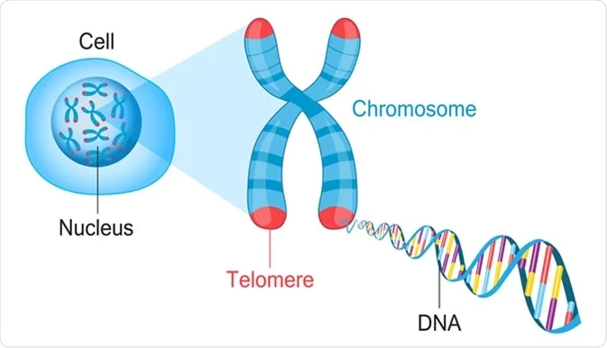
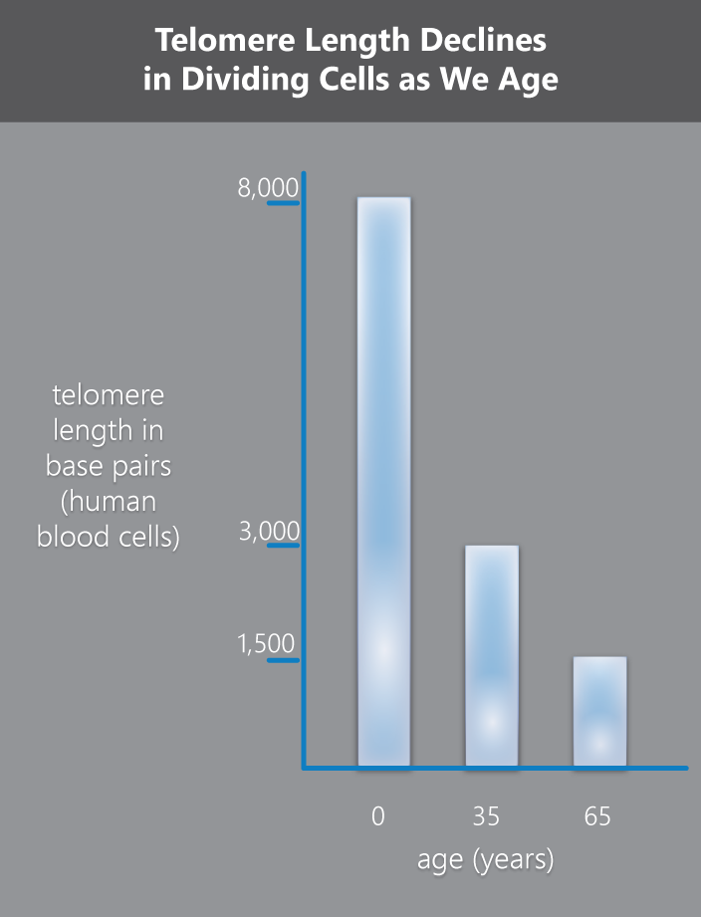
Social support, loneliness, and telomere length for POWs.
Stein, Levin, et al. (2018) Health Psychology, 37, 1067-1076.
Telomeres (TL) are protective caps on the ends of DNA
Telomeres shorten with cell division, and below a critical length cell stops dividing, or dies.
Longer TL → greater cell health → greater longevity.
Returned POWs surveyed about loneliness, social support.
Loneliness → shorter TL
Lack of support → shorter TL

Slide 20

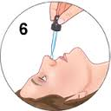
Social Support, Hugging, and Resistance to Cold Virus
Cohen, et al., 2015
Healthy volunteers report degree of social support
Vols. Get nasal drops that contain cold virus
Outcome: Who gets more colds?
Daily Hugs
Daily Tension
Infection

Slide 21
Social Support and Resistance to Cold Virus
Cohen, et al., 1997
Healthy volunteers report degree of social support
Vols. Get nasal drops that contain cold virus
Outcome: Who gets more colds?
Also important:
Range of social connections
Sociable personality
X
___ Low Social Support
___ High Social Support

Slide 22
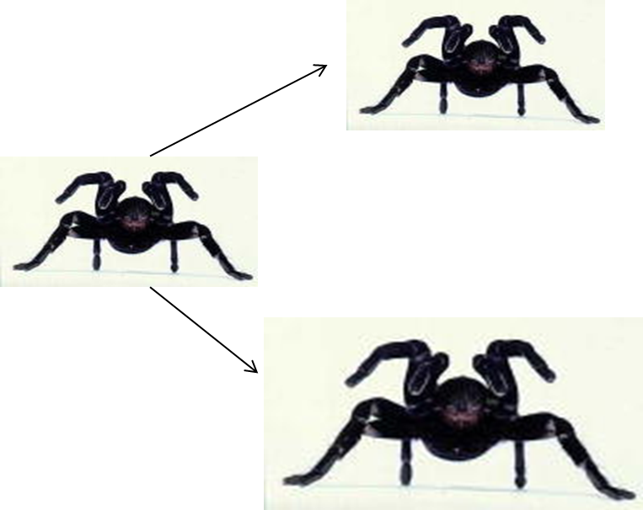
Perceiving Stressors as Less Extreme → Less Extreme Stress
Stressful Events
Primary Appraisal
Self Relevance
Psycho-social
Resources
Secondary Appraisal
Appraisal of Adaptive Capacities
Stress
Stressor Perception

Slide 23
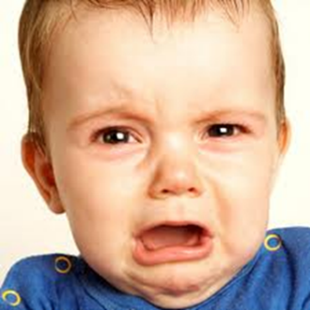
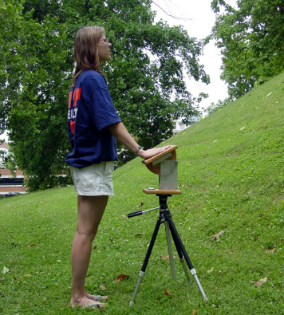
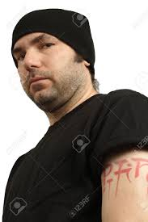
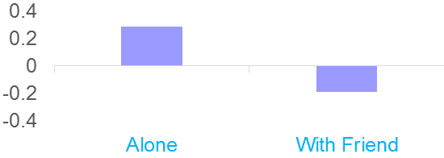
Social Support and Stressor Perception

Slide 24
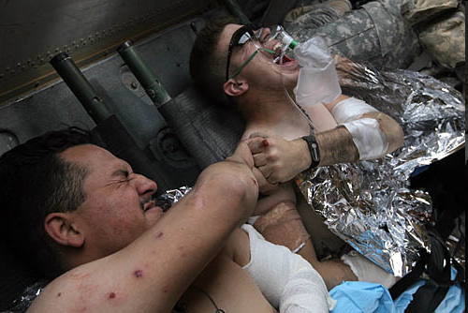
Lending a Hand Coan, Shaefer, & Davidson, 2006
What's happening in this photo? Why?

Slide 25
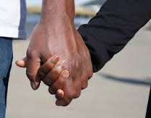
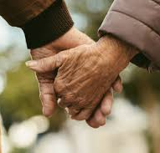
Lending a Hand Coan, Shaefer, & Davidson, 2006
Thesis: Social contact helps people regulate disturbing emotion.
Method:
16 married women expected to receive painful shocks
Women placed in fMRI scanner with shock electrodes on ankle.
Women receive signal indicating shock/no shock will be delivered.
Fear measured at signal onset. This is repeated for 3 blocks of 12 trials.
During these trial blocks, women hold: 1) husband's hand 2) Experimenter's hand 3) no hand.

Slide 26
Lending a Hand
Coan, Shaefer, & Davidson, 2006
Unpleasantness of Expected Shock
Phys. Arousal Due to Expected Shock
Effect of spousal hand holding on neural threat response was moderated by relationship quality: Closer relationships led to lower threat response, but only when holding husband's hand.

Slide 27

Social Support:
Better to Give Or to Receive?
Brown, Nesse, Vinokur, & Smith, 2003

Slide 28
Social Support:
Better to Give than to Receive?
Brown, Nesse, Vinokur, & Smith, 2003
Design: Prospective study conducted over five years.
Subjects—Older couples, where husband is 65 + years old
Time 1 measures:
a. Receive social support
b. Supply social support
c. Dependency
d. Age, gender, physical health, mental health, SES,
personality.
Time 2 measure: Mortality.

Slide 29
Effects of Giving Vs. Receiving Support on Mortality
Note: Anyone seemed "hurt" here by support delivery/receipt?
What's that about?

Slide 30
Summary of Social Support Benefits
1. General health promoter—effects all physio-systems
2. Reduces rates of illness
3. Reduces death rates (e.g., post MI)
4. Quicker recovery from major illness
5. Sustains life for people with terminal illness
However, people’s helping efforts can also fail. How so? What are ways in which people made it worse by trying to make it better?

