Slide 1
Class 16
Collective Coping

Slide 2
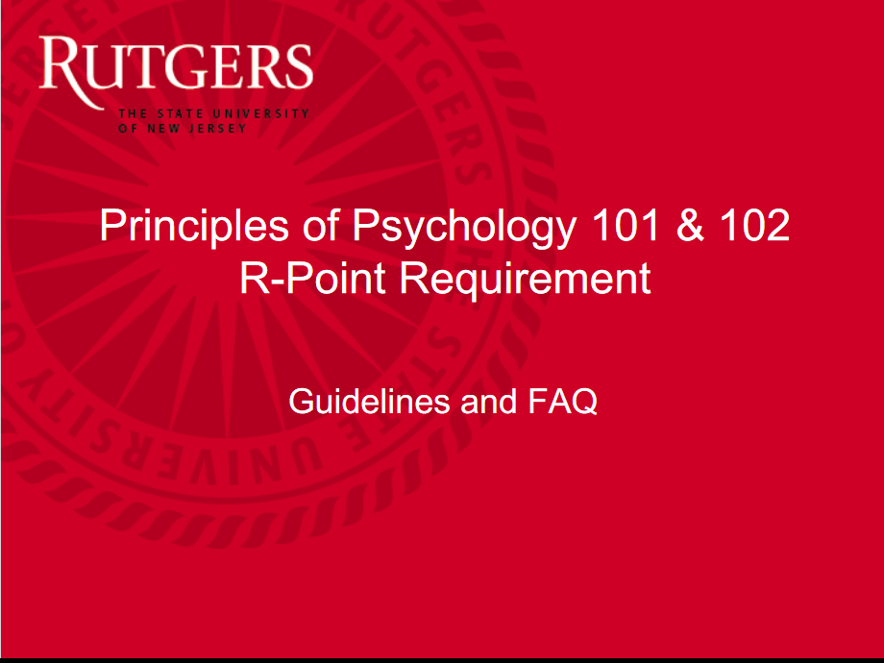
How To Get Extra Credit R-Points
PDF of this document posted to Canvas and my Health Psych webpage.
For more information, contact RutgersRpoints@psychology.Rutgers.edu
POSTING TEST GRADES ON CANVAS: Will do this soon.

Slide 3
Review Question 1
Pennebaker conducted a study of people whose spouse had died the previous year. What aspect of these people determined whether or not they themselves became ill following their partner’s death?
___ They had new financial burdens
___ Their partner was killed in a car accident
___ Their partner had committed suicide
___ They did not talk to others about their partner’s death
___ All of the above
X

Slide 4
Review Question 2
Pennebaker, Kiecolt-Glaser, and Glaser used a mitogen test to show that emotional disclosure has what effect?
___ Improves metabolism
___ Stimulates antibody production
___ Slows heart rate following stressor
___ Decreases cortisol production
___ Facilitates homeostasis

Slide 5
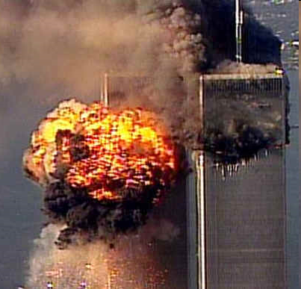
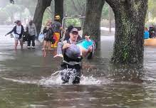
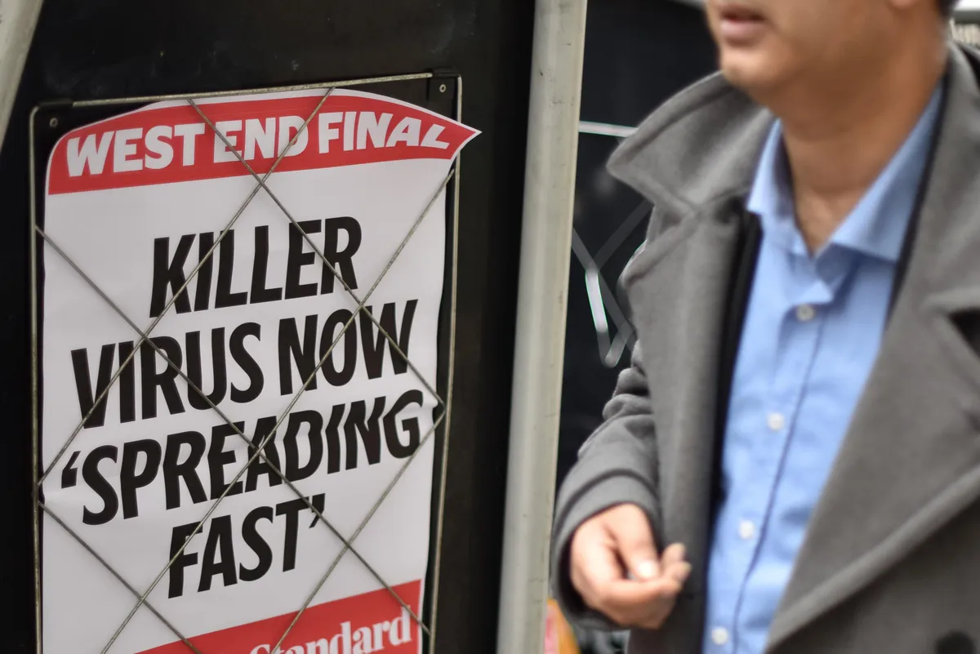
Class 17: Collective Coping

Slide 6
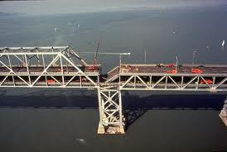
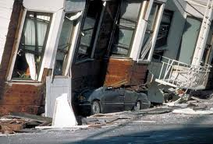
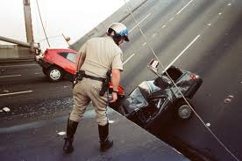
The Loma Prieta Earthquake, CA 1989
Characteristics of Quake
7.1 on Richter scale
Duration: 15 seconds
Most intense seismic event since 1906 quake, which destroyed SF
Effects of Quake
Deaths = 60 +
Injured = 3700
Displaced = 12,000
Damage = $6 billion

Slide 7
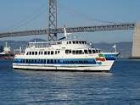
My Quake Survey Journey
SF to Oakland Ferry
Jack London Square
Office Worker's Survey request
Husband's survey request
What was going on?

Slide 8
Disclosure and Coping
Schacter Anxiety and Affiliation Studies
a. Clarify causes of distress
b. Validates own emotions
Sympathetic Listening as Key to Social Support
a. Making sense of trauma
b. Perspective, insight
Failure to Disclose is a Health Risk
a. Suppression physically effortful
b. Prolonged suppression → chronic stress
c. Disclosure stops suppression, reduces illness

Slide 9
Health Benefits of Disclosure
Immediate Lowered heart rate
Lowered skin conductance
Reduced muscle tension
Long term health Fewer MD visits
Fewer symptoms
Stronger immune system
Long term coping Reduced depression, stress
higher grades, less absenteeism
Quicker re-employment after loss

Slide 10
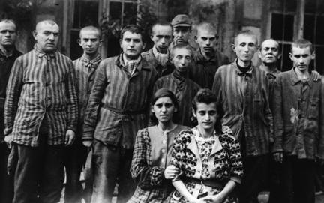
Listening Isn’t Easy
Contagion of Distress
Holocaust survivors study
Victims disclose, bodies relax Students listen to stories, bodies show stress
Vicarious traumatization among therapists Nightmares, phobias, flashbacks
Avoidance of the supporter role
Pseudo-sympathetic responses
“When the going gets tough, the tough get going” “It’s always darker before the dawn”
Outright rejection

Slide 11
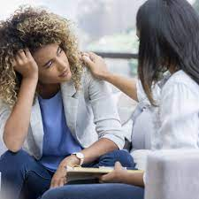
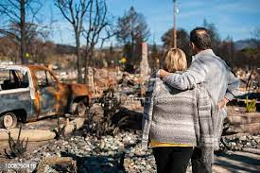
Social Dilemma of Collective Coping
People simultaneously placed in two roles:
1. Seek out others for support
2. Sought out as a support source for others
AND
1. Telling your problem advances coping
2. Hearing others disclose is a stressor

Slide 12
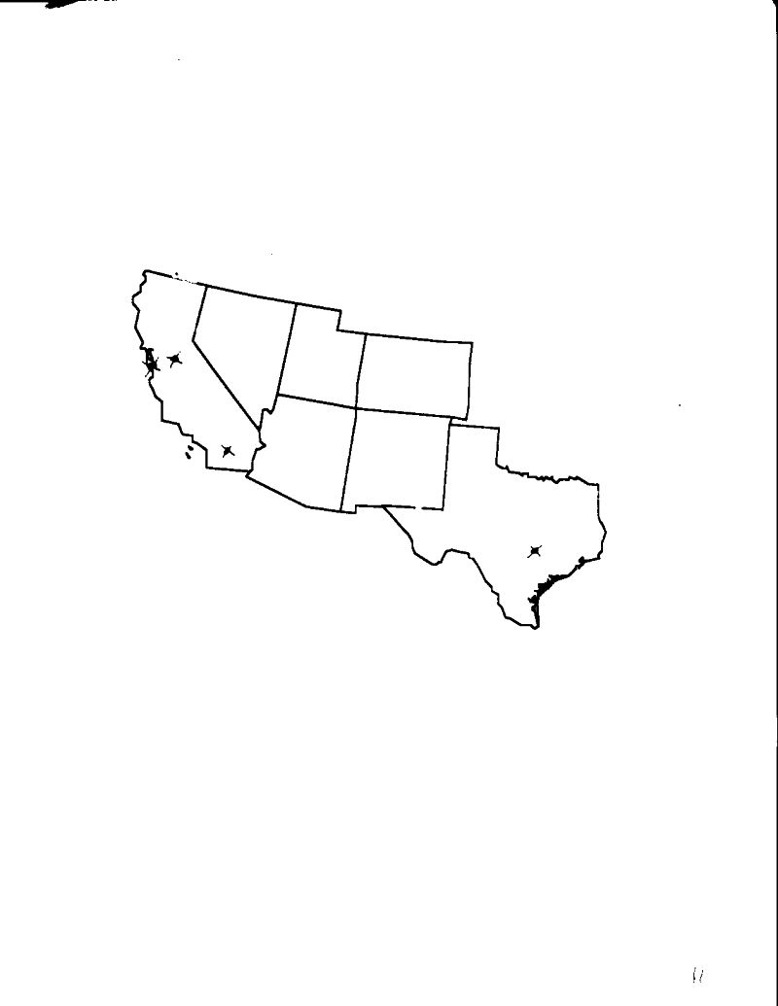
Quake Study Survey Locations
Sacramento, CA
San Francisco, CA
Los Angeles, CA
Dallas, TX
Survey conducted 8 times after quake:
Weeks 1, 2, 3, 6, 8, 16, 28, 50

Slide 13
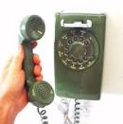
Quake Study Method
Sample size: 789 residents (SF, Sac, S. Cal, Dallas)
Data gathering method:
Phone survey
Random digit dialing
Calls made 6:30 – 9:30, weeknights only
Survey lasts 10 minutes

Slide 14
Survey Content
Communication: Thinking, talking, listening
Emotional reactions
Physical symptoms
Coping tactics: praying, joking, drinking

Slide 15
Rates of Talking and Thinking Following the Loma Prieta Earthquake: Bay Area Only
Talking rate/Thinking rate: Week 1 = 73%
Week 3 = 36%

Slide 16
Why Weren’t People Speaking During Weeks 2-6?
“Thank you for not sharing your earthquake experience with me.”
T-shirts in Palo Alto during weeks 3-6 after the quake.

Slide 17
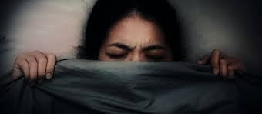
Percent Reporting an Earthquake-Related Dream, SF vs. Other Locations

Slide 18
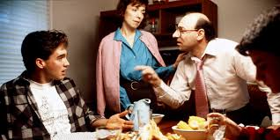
Percent Reporting an Argument with Family or Co-Workers During the Prior Week

Slide 19
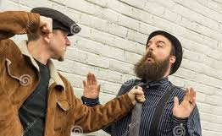
Percentage Change in Aggravated Assaults From Year Before Quake to Year After Quake

Slide 20
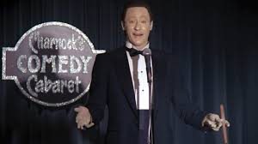
Rates of Quake Related Joking

Slide 21
A need to be shaken and stirred: To What Degree were you glad you experienced the earthquake?
“But deep in my heart I know not that a major disaster would be deliverance from my drab, wretched life – salvation from the old week-by-week, a chance for two-bit heroics blown up on the front page … . I’ve talked to others, and I’m not alone. Maybe we crave a chance to be stouthearted for once and have a real situation to cope with.”
Michael Hood, NPR Reporter
Commenting on minor quake in Seattle, WA
05/09/96

Slide 22
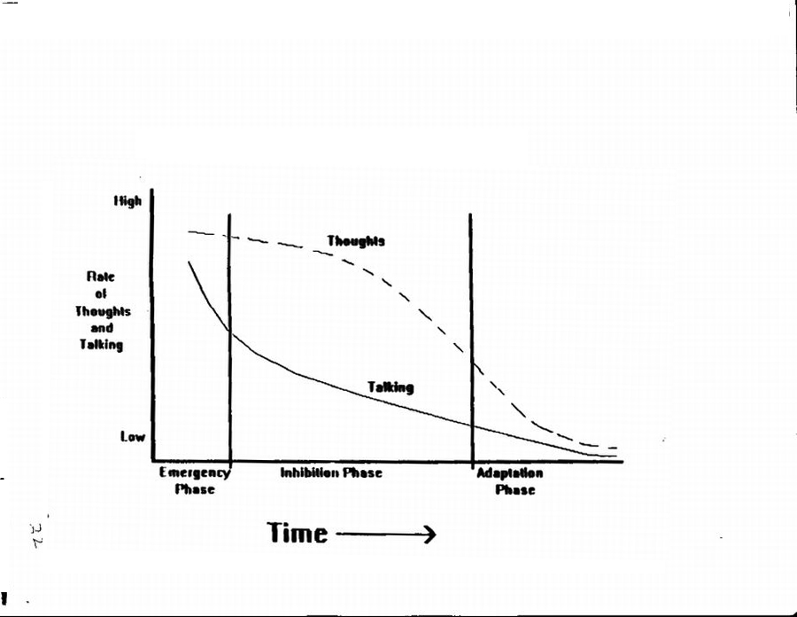
The Three Stage Model of Collective Coping
The Three Stage Model of Collective Coping

Slide 23
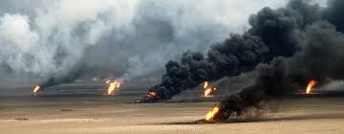
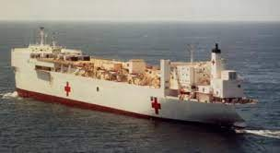
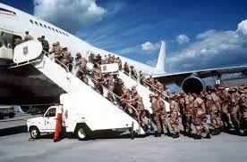
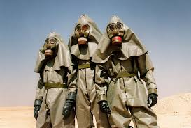
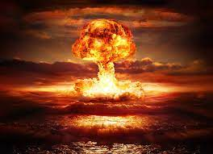
Persian Gulf War I

Slide 24
Rates and Talking and Thinking Following the Persian Gulf War

Slide 25
Rates of Event-Related Dreaming, Following the Quake and Following the War

Slide 26
Rate of Increased Aggravated Assaults, Dallas, 1991 (War) vs. 1990 (Pre-War)

Slide 27
Implications of Collective Coping Research
Coping appears to occur in a three-stage manner
Emergency: Weeks 1-2
Inhibition: Weeks 2-6
Recovery: Weeks 6 on
Public safety should be on especial alert during inhibition stage
Emotions are negotiated events. We need to know how to share the burdens of disclosure and listening.

Slide 28
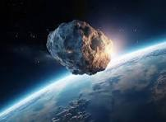
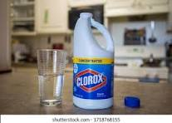
Coping with COVID: An Infodemic
COVID leads to bogus beliefs:
Disease arrived by asteroid
Disease is fake, invented to benefit businesses
Disease can be treated by ingesting bleach
COVID leads to denial of facts (“Denialism”)
Vaccines DON’T work.
Elderly and young ARE NOT especially vulnerable
“Long haul COVID” DOES NOT exist.
Why bogus beliefs? Why denialism? What’s going on?

Slide 29
Why do People Adopt Odd Beliefs During Collective Crises?
Disaster leads to search for answers (recall “Basic Beliefs”).
Why did this happen?
Who is responsible?
How can it be prevented?
Bogus beliefs satisfy this need.
Give people feelings of meaning and control
Provide simple answers to complex problems
Identify specific “bad actors”
Make people feel that they are in the know.
Turns fear into anger

Slide 30
Research Questions Harber & Vila, 2023
Does distress increase bogus beliefs, denialism?
Do psychosocial resources reduce bogus beliefs, denialism?
Method:
Survey of COVID beliefs: Bogus and Factual
Survey of stresses: Daily stresses, COVID stresses
Survey of resources: Esteem, Social Support, Purpose, Hope

Slide 31
COVID BELIEFS SURVEY SAMPLE ITEMS
Bogus Beliefs Items
Socio-Political
The Coronavirus is a hoax, designed to control the stock market
The national government is creating mass camps for the homeless
II. Medical
1. Covid can be cured by teas and essential oils.
2. Inhaling hot air from a hair dryer can reduce COVID symptoms
III. Spiritual
COVID is divine punishment for a sinful world.
COVID is the first part of the End of Days.
Factual Items
Socio-Political
1. The national government was unprepared for COVID
2. Many people are out of work because of COVID
Medical
Washing your hands can reduce COVID spread
A person can have COVID and not feel it.

Slide 32
Results
 | General Distress | Resources
Bogus Beliefs | r = .75 | r = -.47
Factual Beliefs | r = -.28 | r = .42
Survivalism | r = .56 | r = -.29
Follow CDC Advice | r = -.40 | r = .54
Distress leads to: More bogus beliefs, more denialism, survivalism, neglect of CDC.
Resources lead to: Less bogus beliefs, more factual beliefs, less survivalism, more attention to CDC

