Slide 1
Class 14: Tell Me a Story:
Suppression, Disclosure, and Coping

Slide 2
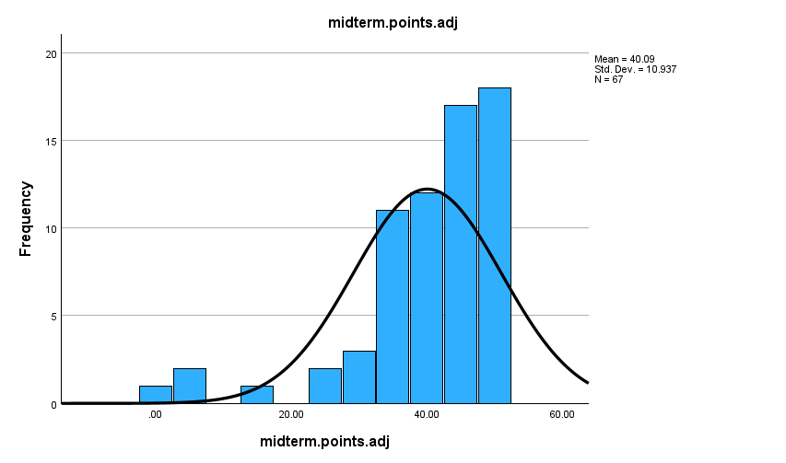
MIDTERM GRADES
NO. CORRECT AND GRADES
44-50 A
39-43 B
35-38 C
29-34 D
00-28 F
NOTE: Number Correct = total correct + 5 pts bonus. 50 is highest possible score.
MIDTERM = 30% of total course grade.

Slide 3
EXAM DAY EMERGENCIES
A number of students have health, family situations on the day of exams.
If you have such and emergency, I will make an accommodation.
However, the emergency must be first verified by the Dean of Students: 973 353-5063; deanofstudents@newark.Rutgers.edu

Slide 4
Extra Credit
Subject Pool: Up to 4 points extra credit by participating in 4 credits of experiments. Each 30 min. = 1 experiment credit.
Stigma for a Day: Earn 2 extra credits by completing the Stigma for a Day exercise. Handed out today, and on Canvas and on my Webpage.

Slide 5
Stigma for a Day Extra Credit
Purpose: Experience (mild) physical stigma and relate to class lectures and readings.
Task: a. Medium/large band aid on face, but without impairing vision or breathing
b. Walk in public for at least 1 hour. Alone, not with friends
c. Note others’ reactions to you
d. Note your reactions to others, to yourself
Complete survey on back of instructions.
Write-up: One page, double spaced: Your experience, plus 2 cites to readings/lectures.
Where you were, how long, impressions of others’ reactions, your own
experience.
Due March 28, end of class
Counts for 2 points toward total class grade.

Slide 6
Response to Death of Spouse (From J.W. Pennebaker, Opening Up)
Group A Group B
Strenuous exercise. Seek understanding of what
Stay mentally occupied. happened, and why.
Stay socially active.
Develop new interests. It’s OK to hurt, feel pain.
All emotions are OK
Don’t allow yourself to cry.
Accept that your life changed Let true friends hear your story,
Be up-beat, don’t depress others feel your pain.

Slide 7
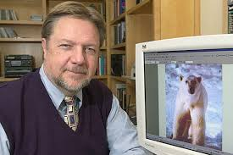
Dan Wegner "White Bear" Studies
For the next 2 minutes think about anything you wish. Anything at all.
HOWEVER, do not think about a WHITE BEAR.
YOU MUST NOT THINK ABOUT A WHITE BEAR.
Every time you do think about A WHITE BEAR, knock on your desk.
Now, close your eyes and think about anything but A WHITE BEAR
Rebound Effect: More one tries to suppress thoughts, more they fill consciousness.
Effect is stronger for arousing content (e.g., “Sex” vs. “Dean of Arts and Sciences”)

Slide 8
Suppression vs. Repression
Suppression is ACTIVELY, CONSCIOUSLY hiding or not- showing arousing thoughts and/or feelings.
-- Upset in argument with boss, don't want to show it -- Stifling a fit of giggles in church. -- Attracted to someone, but don't want to be obvious
Suppression is NOT repression, which is done unconsciously.
Suppression = Intentionally hide thoughts/feelings from others
Repression = Unconsciously hide thoughts/feelings from self

Slide 9
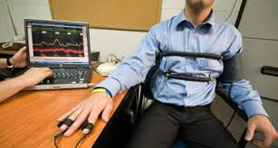
Serendipity and Scientific Discovery: Pennebaker’s Inhibition and Illness Hypothesis
Serendipidy: Making desirable discoveries by accident, good fortune; Finding something valuable when not looking for it.
Communication studies:
People like groups more when they get to talk more.
Polygraph (lie detector) studies:
Liberation through confession
3. Personal Experience:
Asthma and parents; Relief about marital problems;
Career problems through writing

Slide 10
Warren: A Suppression Case Study
COMMENTS
TOPIC
HEART RATE
Girlfriend
77
Some disagreements about intimacy, but we are close.
College courses
71
Most have been interesting … tests another matter
Failing exams
76
It’s been hard on my ego.
Parents
84
We were a close family until divorce
Parents’ divorce
103
It was no big deal, really.
The future
79
It scares me.

Slide 11
Reviewing Clues Leading to Inhibition and Illness Hypothesis
1. People like to talk and learn from talking about themselves.
2. Certain kinds of events create communication conflicts— want to talk but afraid to talk.
3. Response to this conflict is inhibition, which is a stressor.
4. Confronting difficult topics reduces inhibition, reduces stress.

Slide 12
Inability to Discuss Trauma
“I had always been close to my mother. If she had known what [my stepfather] was doing to me, it would have broken her heart. I wanted to tell her so much.”
“Looking back on it all, the very worst thing was that I couldn’t talk to my mother anymore. I had to keep a wall between us. If I wasn’t careful, the wall might crumble and I’d tell her everything.”
NOTE: Those who report trauma have more health problems than other groups in survey.

Slide 13
ADDITIONAL EVIDENCE LINKING TRAUMAS TO ILLNESS
Psychology Today Survey, May 1982
a. Question: Ever had a sexual trauma? b. 22% women, 10% men report trauma c. Traumas linked to ulcers, infections, heart problems. d. Childhood traumas most health-debilitating. Why? Hardest to talk about.
Zale Corporation employee study
a. Interviews employees b. Those with childhood trauma most often ill c. Nature of trauma (sexual, death of parent, etc.) didn't determine illness. What did?
d. Whether or not person talked about trauma.

Slide 14
Effects of Disclosure on Health, College Survey Samples
Number Illnesses Last Year

Slide 15
Bereavement and Disclosure Study
Are all kinds of traumas equally "disclosable"? Are some kinds more likely to be kept to yourself, others easier to share?
Someone close to you dies.
What is a "socially acceptable" kind of death?
What is a "socially unacceptable" kind of death?
Pennebaker interviews people who loose spouse due to auto accident or suicide.
Predicts which group will suppress more? Predicts which group will get more illnesses?
Spouses of suicide
Spouses of suicide
Finds: NO Differences between spouses of accident/suicide
BUT: Among all survivors, those who DON’T disclose get sick more often

Slide 16
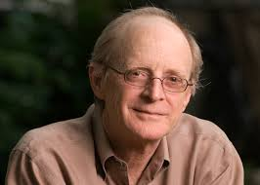
James Pennebaker Inhibition and Illness Model
1. Inhibiting thoughts and feelings is stressful
2. In short term, suppression leads to physiological arousal.
3. Over the long term, suppression leads to immunocompromise.
4. The result is increased susceptibility to a wide range of illness.
Note: Long term stress → immunocompromise fits with what stress and health theorist?
Selye

Slide 17
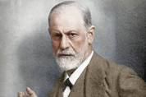
Disclosure: Resolves Emotions, Boosts Resources
Freud’s “Talking cure”
Expressing taboo thoughts and feelings brings profound relief.
Cures “hysterical paralysis”
Explanation: “Catharsis” = purging, expelling negative feelings. Like “primal scream therapy”.
Notes:
However, there is an alternative to suppression—emotional disclosure
Freud’s great insight that expressing forbidden, taboo thoughts and feelings brought relief. But Freud distained experimental psych, and experimental psychologists returned the favor. So the efficacy of disclosure was never fully, and widely appreciated.
This changed 100 yrs later, when James Pennebaker conducts controlled experiments showing that emotional disclosure promotes physical health.
More recent research shows that disclosure boosts a host of psychosocial resources, that can themselves help people manage feelings of threat.
And for those in the back who can’t see the print, this is Freud here, and this is Pennebaker here.

Slide 18
Catharsis vs. Insight
Why do people need to disclose?
Catharsis
Insight
* Emotional buildup causes stress.
* Release pent-up emotions (catharsis) releases stress.
* Language provides an outlet for venting pent up emotions.
* Uncompleted problems are emotionally arousing.
* Uncompleted tasks stay alive until finished.
* Language helps people get “closure” on unfinished business.

Slide 19
Initial Test of the Inhibition of Health Model
Pennebaker & Beal, 1986
Subjects (n = 46) assigned to one of four writing conditions:
1. Thoughts and Feelings (Insight)
2. Emotions only (Catharsis)
3. Facts only (Suppress)
WRITE ABOUT
PAST NEGATIVE EVENT
4. Trivial topics (Control)
WRITE ABOUT NEUTRAL TOPIC
Subjects write on four consecutive days, 15 minutes each time.

Slide 20
Initial Test of the Inhibition of Health Model
Pennebaker & Beal, 1986
Subjects (n = 46) assigned to one of four writing conditions:
1. Thoughts and Feelings (Insight)
2. Emotions only (Catharsis)
3. Facts only (Suppress)
4. Trivial topics (Control)
Conditions 1-3 write about some past, negative event.
Condition 4 writes about trivial, non-emotional topic
Subjects write on four consecutive days, 15 minutes each time.

Slide 21
“Insight Writing” Instructions
“I want you to write continuously about the most upsetting or traumatic experience of your entire life. Don’t worry about spelling, grammar, or sentence structure. In your writing, I want your deepest thoughts and feelings about your experience. …. Ideally, it should be something you have not talked about with others in detail.”
“It is critical, however, that you let yourself go and explore those deepest emotions and thoughts that you have. Your choice of trauma for each session is up to you.”

Slide 22
Types of Traumas Disclosed
Parents’ divorce: “ Son, the problem with me and your
mother was having kids in the first place. Things haven’t been
the same since you and your sister’s birth”.
2. Responsibility for grandmother’s death.
3. Molestation by grandfather, at age 13.
4. Hiding sexual orientation from parents
“Family abuse, alcoholism, suicide attempts, public humiliation
were frequent topics”

Slide 23
Pennebaker & Beale (1986) Results
Immediate Moods: Thoughts & Feelings (T & F) lowest
Health Center visits over 6 months:
Thoughts & feelings = 0.5 visits
All other groups = 1.5 visits
Long term coping (after 4 months)
T& F higher on: * Moods
* Optimism
* Self-reported health

Slide 24
Disclosure and Immunocompetence Pennebaker, Kiecolt-Glaser, & Glaser, 1988
Questions: 1. Are initial disclosure and health findings "real"? 2. Does disclosure improve immune functioning?
Method: Same as initial study, but 1. Just two groups: Thoughts & Feelings vs. Control 2. Write 20 min., over 4 days
Blood samples taken at: 1. Day one of study 2. Last day of writing 3. 6 weeks after study ends
Use "mitogen test" --
Mitogens are bodies that stimulate antibody production

Slide 25
Disclosure and Immunocompetence (continued)
Results: Which group produced more antibodies to mitogen?
X
Thoughts and Feelings
Control group
Role of Insight: 80% of T&F writers report insight-related benefits (perspective shift, new ideas about self, etc.)
Quality of Writing: Writing that improved health was:
1. More emotional 2. Images and analogies 3. Clear organization: Beginning, middle, end.

Slide 26
Other Disclosure Studies Show:
Disclosure → Higher T-Cell count
→ Improved antibody response to Epstein-Barr virus
→ Improved antibody response to Hepatitis B virus
Improved management of chronic illness:
Diabetes
Asthma
Other chronic illness
Effect replicated in many studies, by many different researchers

Slide 27
Why Does Writing Promote Coping?
Harber & Pennebaker, 1991
Thought intrusions classic symptom of trauma
Ironic effect of suppression
Emotions and recurring thoughts

Slide 28
Emotions and Schemas
Popular cola, not Pepsi
Coke
A short funny story with a punch line is a:
Joke
Mighty tree that sheds acorns is a:
Oak
Where there is fire there is:
Smoke
White part of an egg is:
Albumin

Slide 29
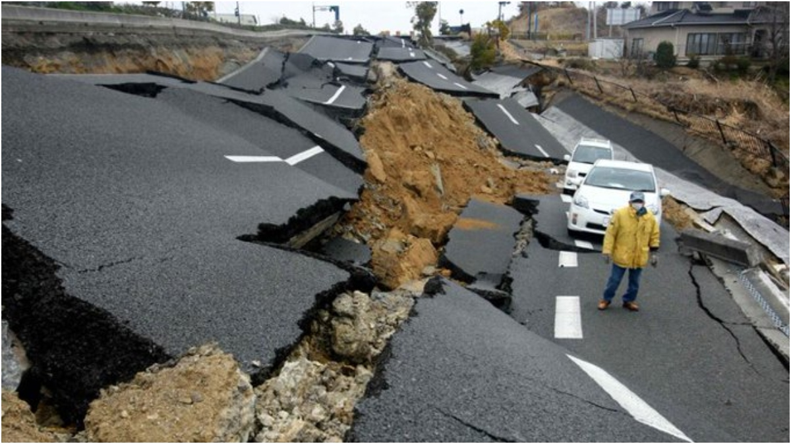
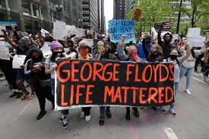
Discrepancy Theories of Emotion and Trauma
Emotions arise from schema violations
Emotions alert us when schemas (beliefs) and experience (facts) conflict
Emotions stay active until schemas and experience difference is resolved
Traumas arise when fundamental beliefs are violated by experience
World is well-ordered
World is just
Self is good, competent, worthy

Slide 30
So If Disclosing Reduces Trauma, Why Doesn’t Everyone Just Talk?
Internal Resistance
Changing fundamental beliefs very hard, people resist doing so
Victim blaming, traumatic amnesia, emotional dissociation
External Resistance
Listeners don't want to hear stories that offend their own basic beliefs.
Double Bind
Trauma victims in compound double bind: Internal and external
resistance to revealing trauma.

Slide 31
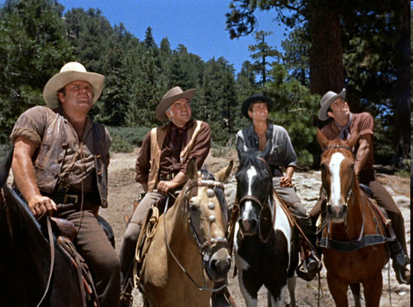
Bonanza Model of Writing and Traumatic Recovery

Slide 32
Self-Affirmation Mediates Disclosure and Health
Creswell, et al., 2007
Subjects: 63 early-stage female breast cancer patients
Method: Disclose / Don’t Disclose regarding condition
Outcome: Cancer related symptoms (coughing, fatigue)
Self-Affirmation
r = -.41**
r = .40**
Cancer-Related Symptoms
Disclosure
Direct Path r = .-37**
Direct Path when accounting for Self-Affirmation r = -.22

