Slide 1
Class 12: Personality III
Announcements
Mid Term: Thurs., Oct. 20
Covers Class 1 up to and including Class 13
50 Multi-choice Questions + 4 Extra Cred Ques
Study Guide: Available in class and on-line

Slide 2
Review Question 1
Which of the following is true of optimism?
___ It co-occurs with seeing successes as based on
internal and stable causes.
___ It leads to lower blood pressure when in a positive mood.
___ It is associated with an illusion of invulnerability.
___ It is affected by having complete information about one’s own risks in comparison to others’ risks.
___ All the above.
X

Slide 3
Review Question 2
Depression has what physical consequence?
___A. Constricts the brain stem
___B. Increases the size of the amygdala
___C. Shrinks the hippocampus
___D. Increases brain plasticity
___E. Mutes the dorsal horn
X

Slide 4
Review Question 3
People with a hostile personality have increased cardiac activity after they experience:
___A. Microbiome diversification
___B. Ostracism
___C. Scary movies
___D. Downward social comparison
___E. The illusion of invulnerability

Slide 5
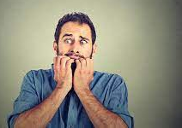
Class-Generated Question: Does Anxiety Induce Hypercortisolemia?
Vreeberg, et al. (2010). Salivary cortisol levels in persons with and without
different anxiety disorders. Psychosomatic Medicine, 72, 340-347.
Subjects
1. Current Anxiety Disorder: (n = 774)
2. Past but not current Anxiety Disorder: (n = 311)
3. Controls: Never Anxiety Disorder (n = 342)
Method
Cortisol measured 7 times: Morning through evening
Results
Elevated cortisol only among Current Anxiety Disorder
Especially if also have panic attacks, depression

Slide 6
Self-Identified Causes of Breast Cancer
Taylor, et al., 1983
a. Stress, esp. relationship 41%
b. Carcinogen 32%
c. Hereditary 26%
d. Diet 17%
e. Freak event 10%
Note: Some women listed multiple causes, thus total more than 100%
Almost NO women said there was no cause. Why?

Slide 7
Patients’ Behavioral Responses to Their Cancer
Change diet
Quit other meds that they (wrongly) think may be associated with cancer
Educate self on cancer
Control side effects:
* Imaging: Chemo as cannons
* Instruction to body: "Cut this shit out“
Not clear any of these responses actually cure cancer—why do them?

Slide 8
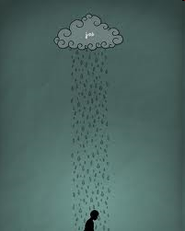
Bad Events Threaten Self Esteem
When people suffer bad events, they feel bad about selves, even if they are not responsible. Why?
Just world beliefs: Good things happen to good people, bad things happen to bad people. Therefore, if something bad happened to me…
People are very good at restoring self worth. Even after disfiguring surgery, painful treatment, constant threat of cancer recurrence.
How do they do it?

Slide 9
Downward Social Comparison Among Breast Cancer Patients
Woman who underwent lumpectomy
I had a comparatively small amount of surgery. How awful it must be for women who have had a mastectomy. I just can’t imagine, it would seem so difficult.
Woman who had a mastectomy
It was not tragic. It worked out okay. Now if the thing had spread all over, I would have had a whole different story for you.
An older woman
The people I really feel sorry for are these younger gals. To lose a breast when you’re so young must be awful. I’m 73; what do I need a breast for?
A young woman (apparently having lost a breast)
If I hadn’t been married, I think this thing would have really gotten to me. I can’t imagine dating or whatever knowing you have this thing and not knowing how to tell the man about it.

Slide 10
Who Are More Likely to Maintain Illusions:
Depressives or Non-Depressives?
“Depressive Realism”: Depressives less likely to:
Inflate views of themselves
Ignore or dismiss negative feedback
Overestimate personal control
Overly claim credit for success
Yet non-depressives often cope better. Why?
Illusions can improve short-term coping.

Slide 11
Summary of Types and Benefits of Illusions
Types of Illusions
1. Downward social comparison
2. Unsupported causal explanations
* Cancer due to diet
* “Cells have re-aligned. Now I'm safe.”
* Can stop cancer via imaging, positive thinking
3. Denial
Benefits?
1. Enhance control
2. Enhance self-worth
3. Enhance persistence
4. Encourage coping behaviors

Slide 12
Class 13
Illusions and Coping II
Resources and Coping

Slide 13
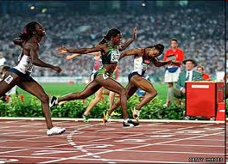
"Undoing": The Toxic Aspect of Illusion of Control
Two Olympic sprinters lose in finals; one comes in second to last, the other second to first. Who has done better? Who feels worse? Why?
Undoing: AKA "counterfactuals"--the mental process of thinking how negative outcomes could have been prevented.
Parents of Sudden Infant Death Syndrome (SIDS) infants (Davis, et al., PSPB, 1995).
Undoing related to: Guilt, Anger, Depression, Anxiety 18 mos. later
"I thought about maybe if I'd stayed awake or woke up more frequently [to] check on the baby. I keep thinking of different ways..."

Slide 14
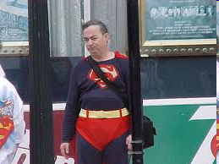
Coping = Illusions?
Is coping all about self-serving "spin"?
Is avoiding reality the best way to cope with uncontrollable negative events?

Slide 15
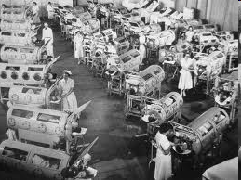
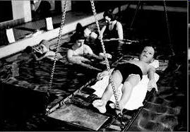
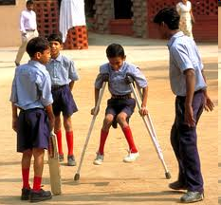
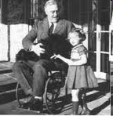
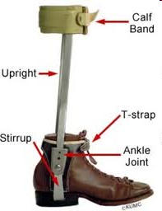
Kriegel: "Falling into Life"

Slide 16
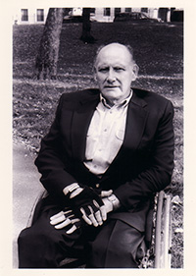
Kriegel: "Falling into Life"
Every time I was removed from the hot water and placed on a stretcher by the side of the pool, ... , I was fed salt tablets. Even today, more than four decades later, I shiver at the mere thought of those salt tablets. ...To be an eater of salt was far more humiliating than to endure pain. ...we dreaded eating salt. It was that, rather than the pain we endured, that anchored our sense of loss and dread.
Leonard Kriegel
What aspect of trauma does this passage reflect?
___ Counterfactuals
___ Denial
___ Belief that Self Is Good
X

Slide 17
Kriegel: "Falling into Life"
But I am still grateful that no one—told me that my chances of regaining the use of my legs were nonexistent. At the age of 11 I needed to weather reality, not face it.
What aspect of trauma does this passage reflect?
___ Downward social comparison
___ Denial
___ The world is just
X

Slide 18
Kriegel: "Falling into Life"
1. I hungered for the approval of those in authority.
2. I wanted to do whatever was supposed to be "good" for me. I believed absolutely as I have ever believed in anything that rehabilitation would finally placate the hunger of the virus.
X
___Self is good.
___World is just.
___Denial
___Downward social comparison
What aspects of trauma do these passage reflect--In terms of Basic Beliefs?
X

Slide 19
Kriegel: "Falling into Life"
“All you have to do is let go”…”The other boys do it. Just let go”. Shame plagued me—and shame is the older brother to disease. Flushing with shame…I would hear myself whimper, “I’m sorry. But I can’t. I can’t let go”. My therapist pleaded, ridiculed, cajoled, threatened, bullied. But I couldn’t let go and fall. Ashamed as I was, I wouldn’t allow myself to be bullied out of terror”.
What is Kriegel afraid of?
He is afraid of accepting reality of being permanently disabled.

Slide 20
Kriegel: "Falling into Life"
So it was that I stood above the mat and heard myself sigh and let go. I dropped. I hit the mat. I was kissed by space.
And then, terror simply evaporated. It was as if I had served enough time in that prison. "That's it" my therapist triumphantly shouted. "You let go! and there it is!"
Yes, and you discover not terror but the only self you are going to be allowed to claim anyhow. You fall free, and then you learn that those padded mats hold not courage but the unclaimed self.
What has happened here? What’s changed? What is the “prison”? What is the “unclaimed self”?
Key Point: Accepting, embracing reality is crucial to moving forward in life.

Slide 21
Psychosocial Resources and Threat Perception

Slide 22
Psychosocial Resources and Coping
Resources
Social Support Self Worth Optimism
Self Esteem Self-Efficacy Hope
Emotional Disclosure Perceived Control
Resources enhance coping
Reduced depression and anxiety
Reduced cardiovascular response to stress
Better immune functioning
Fewer colds, fewer heart attacks, quicker recovery post-MI, reduced cancer, easier childbirth, etc.

Slide 23
Emotional Support and Mortality After Heart Attack (Berkman et al., 1992)
Key Outcome: Survival 6 months after heart attack

Slide 24
How Do Emotional Resources Work?
Affect the way stressors are experienced
Instrumental and informational benefits
Psycho-social benefits
Belonging
Enhanced self worth
Basic Beliefs: Meaningfulness, control, ordered world
Affect the way that stressors are perceived?

Slide 25
Social Support and Perception of Hill Steepness Schnall, Harber, Stefanucci, & Proffitt (2008). Journal of Experimental Social Psychology, 44, 1246-1255
Participants Passersby at campus walk
Alone (n = 14)
Same-sex friend pairs (n = 17; both participate)
All wear heavy backpack, face steep hill
Measures
Verbal: “How steep is this hill, in degrees?”
Visual Judgment: hand protractor
Haptic: palm board
Hand protractor
Palm board

Slide 26
Social Support and Slant
Steepness in Degrees
Line represents actual slant
Verbal: p < .05
Visual: p < .06
Hapitic p < .93
Hill appears even less steep when:
a. Friend is known longer
b. Feel closer to friend

Slide 27
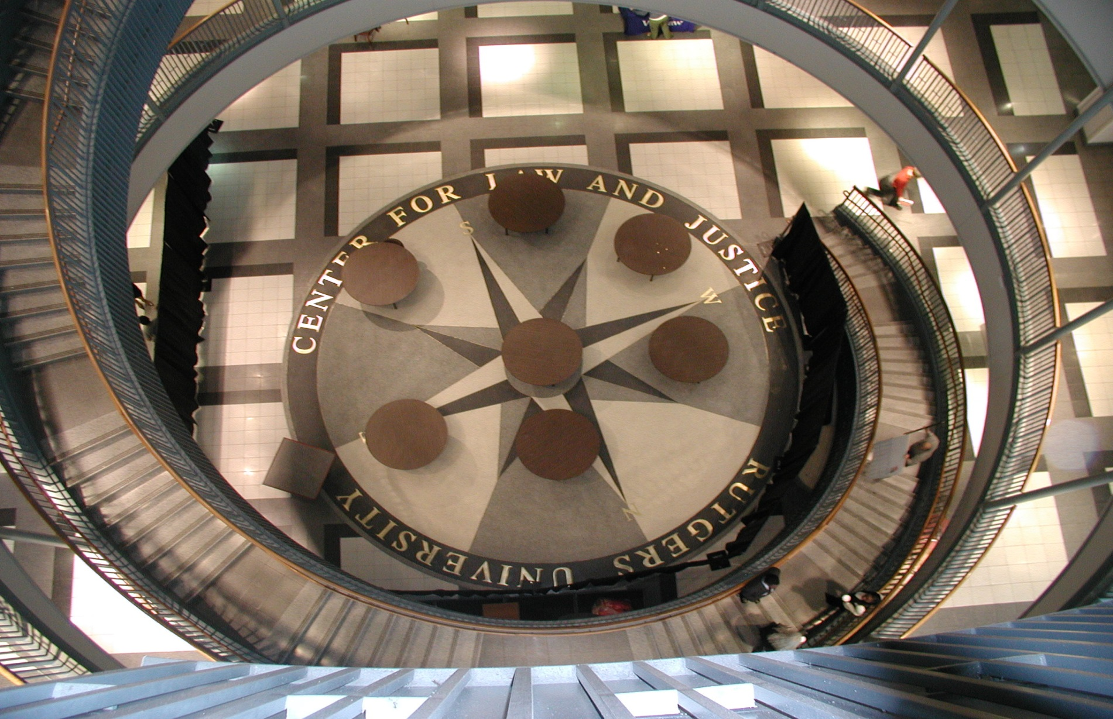
Self Esteem, External Support, and Height Judgments Harber, Yeung, & Iacovelli, 2011
PHOTO LOOKING DOWN STAIRWELL
N = XXX, XX% female, age = XX.XX

Slide 28
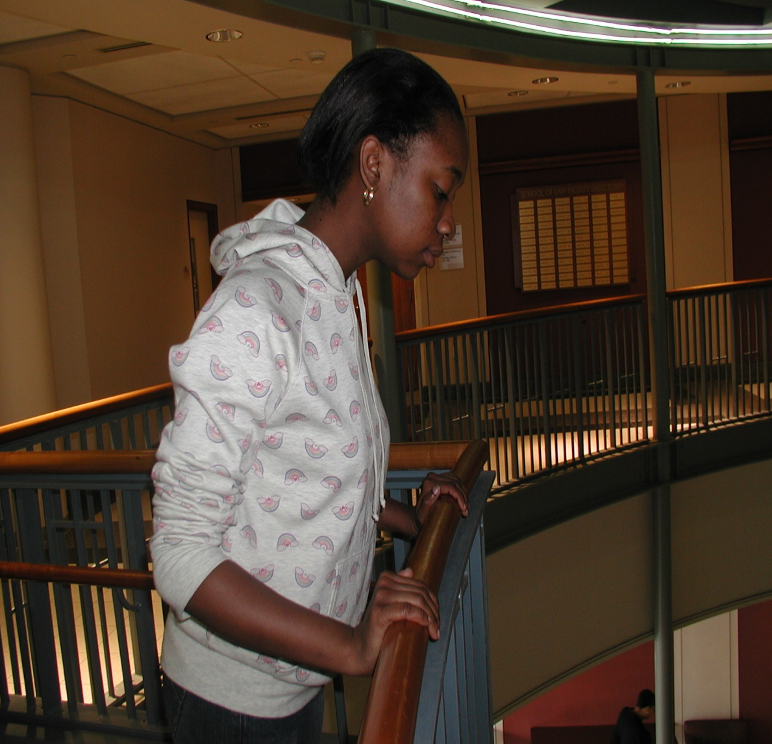
Do resources moderate height judgments?
Does trait self esteem operate as a resource?
Do internal resources supplement external resources?
What is this person’s external resource?
Handrail

Slide 29
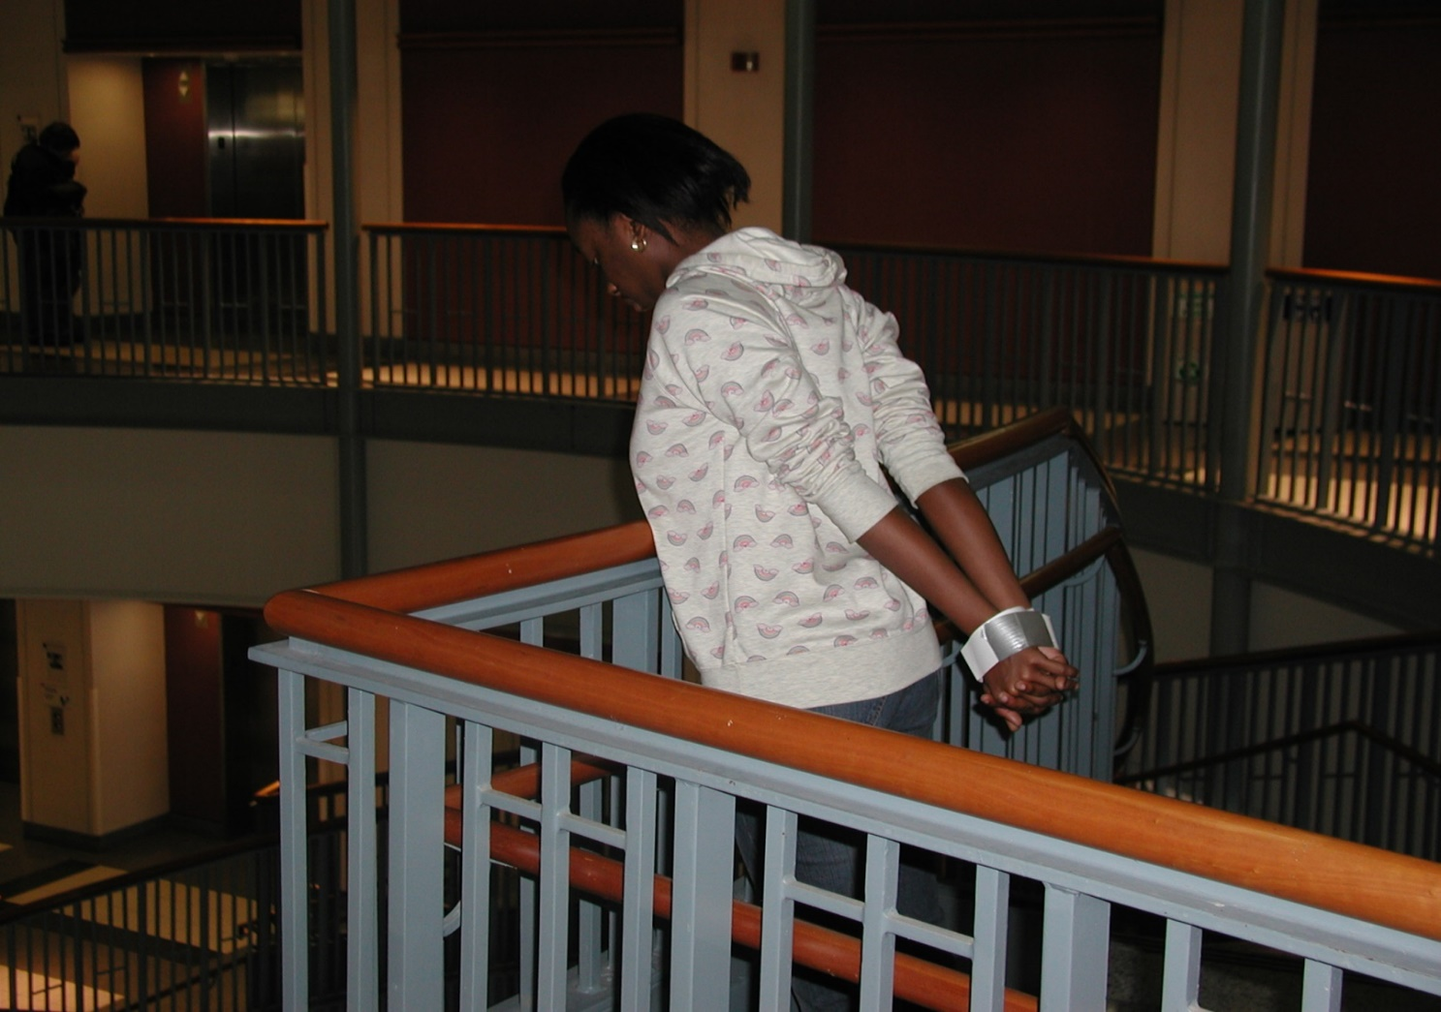
External resource is now absent.
What other resource available to this person?
Internal resource: Self-Esteem.

Slide 30
Self Esteem, External Support, and Height Perception
Actual Height

Slide 31
Self Esteem, External Support, and Height Perception
Actual Height

Slide 32
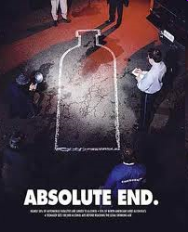
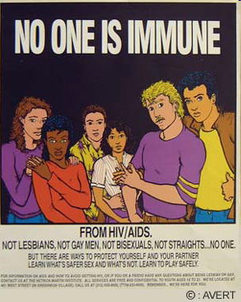
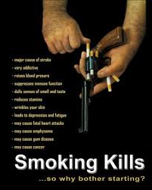
Health Risk Education Approaches

Slide 33
Fear as Health-Behavior Tactic
Do health campaigns based on fear work? What are the possible problems with them?
Think about:
Yellowlees & Ruffin – Near Miss Asthma Death (NMAD) Weinstein – Unrealistic optimism Taylor – Self-serving illusions
Illusion of invulnerability
Denial
Downward comparison
What are tactics people use to cope with threatening information?

Slide 34
Actual Health Risk and Perceived Health Risk
Who is more likely to reject research showing smoking causes cancer?
X
____ Heavy smoker ____ Non-smoker
Who is most critical of news article claiming that caffeine causes breast cancer? (Kunda, 1987)
X
____ men who drink caffeine ____ women who drink caffeine
____ men who don’t drink caffeine ____ women who don’t drink caffeine
Take home point?
Self-threat leads to defensiveness and resistance to threat-related information.

Slide 35
Health Messages and Self-Affirmation Sherman, Nelson, & Steele, 2000
Why would people block out health relevant information?
Sherman et al.: Health risk info is a self threat. Disturbs need to see self as moral, capable, and adaptive. [FUNDAMENTAL BELIEF]
If people resist info most relevant to them b/c this info threatens their “self-affirmation” needs, what could be done to lower resistance?
Boost self-worth/Self-affirmation needs
Self-Affirmation prediction: Self-affirmation should make it easier to accept self-threatening information. It should reduce denial and rationalization.

Slide 36
Study 2: Self-Affirmation and Acceptance of AIDS Risk Info
AIDS (and other STD) risk among college students
Percent of college students sexually active = ____% Percent of college students using condoms = ____%
AIDS video leads to greater risk perception among: ___ Virgins ___ Non-virgins
86
21
X
Purposes of Study 2 1. To show that self affirmation reduces resistance to AIDS info. 2. To show that self-affirmation increases protective behavior

Slide 37
Study 2: Self-Affirmation and AIDS & Behavior
Percent Who Purchased Condoms
Percent Who Took an AIDS Brochure

Slide 38
SUPPLEMENTARY MATERIALS
WILL NOT BE ON MIDTERM

Slide 39
Cancer Diagnosis and Adopting New Attitudes
New attitude toward life
I feel as if I were for the first time really conscious.
I have much more enjoyment each day, each moment. All those things you get entangled with don’t seem to be part of my life right now.
Increased Self knowledge
It’s a bit like holding up a mirror to one’s face when one can’t turn around.

Slide 40
Kriegel: "Falling into Life"
To create an independent self, a man had to rid himself of both the myths that nurtured him and the myths that held him back. ... I understood that the most dangerous threat to the sense of self I needed was an inflated belief in my own capacity.
What does Kriegel mean by “myths”?
What was the “sense of self [he] needed”?
Why was inflated belief “the most dangerous threat” to that sense
of self?
How do Kriegel’s experience and his insights relate to positive illusions and coping?

Slide 41
Effects of Friendship Duration and Mood on Slant Perception
Friendship Duration
(in months)
Verbal r = -.49, p < .05
Visual r = -.50, p < .05
Haptic r = -.14, p = ns
Mood
(negative)
Verbal r = -.01, p = ns
Visual r = -.13, p = ns
Haptic r = .01, p = ns

Slide 42
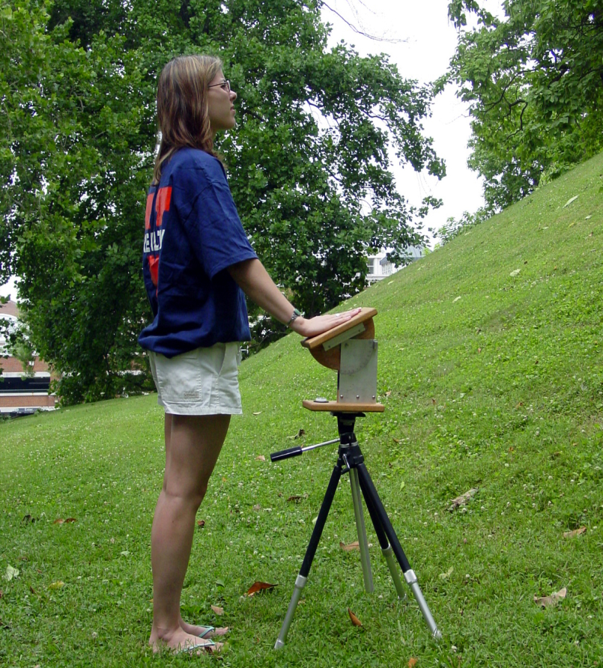
Social Support and Slant Perception Schnall, Harber, Stefanucci, & Proffitt (2008). Journal of Experimental Social Psychology, 44, 1246-1255
Conscious slant perception of hills is exaggerated (5% is seen as 20%, etc.).
Slant distortion is lessened under lower physical load
-- Light back pack vs. heavy back pack
-- Physically refreshed vs. fatigued
-- Good physical cond. vs. poor cond.
-- Younger vs. older
Is slant distortion reduced under lower psychological load?

Slide 43
Actual Health Risk and Perceived Health Risk
Who is more likely to reject research showing smoking causes cancer?
X
____ Heavy smoker ____ Non-smoker
Jermott et al (1986) tell Ss that they do have OR don’t a valuable (fictitious) enzyme. Who rated the enzyme as less valuable?
X
____ “Enzyme absent” subs ____ “Enzyme present" subs
Who is most critical of news article claiming that caffeine causes breast cancer? (Kunda, 1987)
X
____ men who drink caffeine ____ women who drink caffeine
____ men who don’t drink caffeine ____ women who don’t drink caffeine
Take home point?
Self-relevance of threat leads to defensiveness and resistance to threat-related information.

Slide 44
Study 1: Caffeine, Cancer, and Self-affirmation
Subjects: Female college students who are/are not caffeine drinkers
Threat Manip: Ss read article “Caffeine and Women: A New health risk”
Self Affirmation: Ss complete task that boosts vs. no change on self-worth
Outcome: Ss rate how much they accept the “Caffeine and Women” article
Self-Affirmed
Not Self-Affirmed
X
Caffeine Drinkers
Caffeine Non-drinkers
Who is least accepting of article?

Slide 45
Study 1: Caffeine and Self-Affirmation Results

