Slide 1
Class 13:
Positive Illusions, Self Affirmation, and Coping

Slide 2
Midterm
Thurs., Feb 29
Covers Class 1 up to and including today’s class
Today’s class covers positive illusions and coping
(Taylor article and Kriegel essay)
And Self-Worth and Threat Acceptance
Ignore Harber, Cohen, and Lang article.
50 Multi-choice Questions + 4 Extra Cred Ques
Study Guide: Available in class and on-line: Ignore sections on Psychosocial Resources
Midterm only includes materials covered in class

Slide 3
Review Question 1
Which of the following is true of optimism?
___ It co-occurs with seeing successes as based on
internal and stable causes.
___ It leads to lower blood pressure when in a positive mood.
___ It is associated with an illusion of invulnerability.
___ It is affected by information about one’s own risks compared to others’ risks.
___ All the above.
X

Slide 4
Review Question 2
Depression has what physical consequence?
___A. Constricts the brain stem
___B. Increases the size of the amygdala
___C. Shrinks the hippocampus
___D. Increases brain plasticity
___E. Mutes the dorsal horn
X

Slide 5
Review Question 3
People with a hostile personality have increased cardiac activity after they experience:
___A. Microbiome diversification
___B. Ostracism
___C. Scary movies
___D. Downward social comparison
___E. The illusion of invulnerability

Slide 6
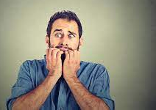
Class-Generated Question: Does Anxiety Induce Hypercortisolemia?
Vreeberg, et al. (2010). Salivary cortisol levels in persons with and without
different anxiety disorders. Psychosomatic Medicine, 72, 340-347.
Subjects
1. Current Anxiety Disorder: (n = 774)
2. Past but not current Anxiety Disorder: (n = 311)
3. Controls: Never Anxiety Disorder (n = 342)
Method
Cortisol measured 7 times: Morning through evening
Results
Elevated cortisol only among Current Anxiety Disorder
Especially if also have panic attacks, depression

Slide 7
Taylor Article: Adjusting to Threatening Events
Meaning is key to coping. But what about bad situations where there is no clear cause?
Subjects in Taylor article are: _______________________
women with breast cancer
No
Is cause of breast cancer (on individual level) known? ____
Do women with breast cancer typically accept that there is no single, diagnosable cause? ____
Why is this?
No

Slide 8
Self-Identified Causes of Breast Cancer
Taylor, et al., 1983
a. Stress, esp. relationship 41%
b. Carcinogen 32%
c. Hereditary 26%
d. Diet 17%
e. Freak event 10%
Note: Some women listed multiple causes, thus total more than 100%
Almost NO women said there was no cause. Why?

Slide 9
Patients’ Behavioral Responses to Their Cancer
Change diet
Quit other meds that they (wrongly) think may be associated with cancer
Educate self on cancer
Control side effects:
* Imaging: Chemo as cannons
* Instruction to body: "Cut this shit out“
Not clear any of these responses actually cure cancer—why do them?

Slide 10
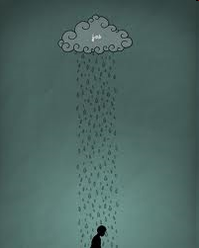
Bad Events Threaten Self Esteem
When people suffer bad events, they feel bad about selves, even if they are not responsible. Why?
Just world beliefs: Good things happen to good people, bad things happen to bad people. Therefore, if something bad happened to me…
People are very good at restoring self worth. Even after disfiguring surgery, painful treatment, constant threat of cancer recurrence.
How do they do it?

Slide 11
Downward Social Comparison Among Breast Cancer Patients
Woman who underwent lumpectomy
I had a comparatively small amount of surgery. How awful it must be for women who have had a mastectomy. I just can’t imagine, it would seem so difficult.
Woman who had a mastectomy
It was not tragic. It worked out okay. Now if the thing had spread all over, I would have had a whole different story for you.
An older woman
The people I really feel sorry for are these younger gals. To lose a breast when you’re so young must be awful. I’m 73; what do I need a breast for?
A young woman (apparently having lost a breast)
If I hadn’t been married, I think this thing would have really gotten to me. I can’t imagine dating or whatever knowing you have this thing and not knowing how to tell the man about it.

Slide 12
Summary of Types and Benefits of Illusions
Types of Illusions
1. Downward social comparison
2. Unsupported causal explanations
* Cancer due to diet
* “Cells have re-aligned. Now I'm safe.”
* Can stop cancer via imaging, positive thinking
3. Denial
Benefits?
1. Enhance control
2. Enhance self-worth
3. Enhance persistence
4. Encourage coping behaviors

Slide 13
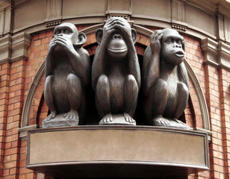
Does Accepting Harsh Reality Do Any Good?
Are denial/distortion/positive illusions the best ways to cope with major negative events?

Slide 14
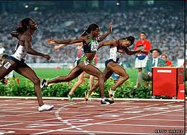
"Undoing": The Toxic Aspect of Illusion of Control
Two Olympic sprinters lose in finals; one comes in second to last, the other second to first. Who has done better? Who feels worse? Why?
Undoing: AKA "counterfactuals"--the mental process of thinking how negative outcomes could have been prevented.
Parents of Sudden Infant Death Syndrome (SIDS) infants (Davis, et al., PSPB, 1995).
Undoing related to: Guilt, Anger, Depression, Anxiety 18 mos. later
"I thought about maybe if I'd stayed awake or woke up more frequently [to] check on the baby. I keep thinking of different ways..."

Slide 15
Who Are More Likely to Maintain Illusions:
Depressives or Non-Depressives?
“Depressive Realism”: Depressives less likely to:
Inflate views of themselves
Ignore or dismiss negative feedback
Overestimate personal control
Overly claim credit for success
Yet non-depressives often cope better. Why?
Illusions can improve short-term coping.

Slide 16
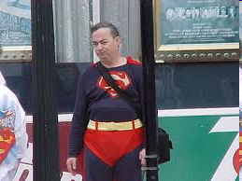
Coping = Illusions?
Is coping all about self-serving "spin"?
Is avoiding reality the best way to cope with uncontrollable negative events?

Slide 17
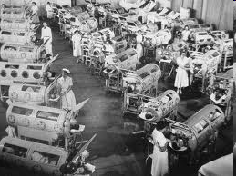
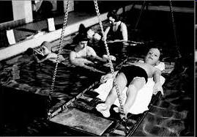
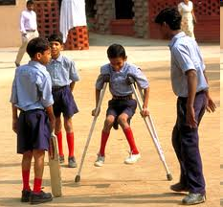
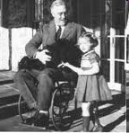
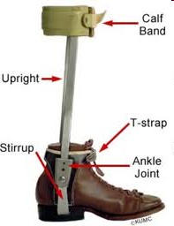
Kriegel: "Falling into Life"

Slide 18
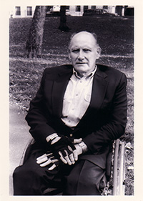
Kriegel: "Falling into Life"
Every time I was removed from the hot water and placed on a stretcher by the side of the pool, ... , I was fed salt tablets. Even today, more than four decades later, I shiver at the mere thought of those salt tablets. ...To be an eater of salt was far more humiliating than to endure pain. ...we dreaded eating salt. It was that, rather than the pain we endured, that anchored our sense of loss and dread.
Leonard Kriegel
What aspect of trauma does this passage reflect?
___ Counterfactuals
___ Denial
___ Belief that Self Is Good
X

Slide 19
Kriegel: "Falling into Life"
But I am still grateful that no one—told me that my chances of regaining the use of my legs were nonexistent. At the age of 11 I needed to weather reality, not face it.
What aspect of trauma does this passage reflect?
___ Downward social comparison
___ Denial
___ The world is just
X

Slide 20
Kriegel: "Falling into Life"
1. I hungered for the approval of those in authority.
2. I wanted to do whatever was supposed to be "good" for me. I believed absolutely as I have ever believed in anything that rehabilitation would finally placate the hunger of the virus.
X
___Self is good.
___World is just.
___Denial
___Downward social comparison
What aspects of trauma do these passage reflect--In terms of Basic Beliefs?
X

Slide 21
Kriegel: "Falling into Life"
“All you have to do is let go”…”The other boys do it. Just let go”. Shame plagued me—and shame is the older brother to disease. Flushing with shame…I would hear myself whimper, “I’m sorry. But I can’t. I can’t let go”. My therapist pleaded, ridiculed, cajoled, threatened, bullied. But I couldn’t let go and fall. Ashamed as I was, I wouldn’t allow myself to be bullied out of terror”.
What is Kriegel afraid of?
He is afraid of accepting reality of being permanently disabled.

Slide 22
Kriegel: "Falling into Life"
So it was that I stood above the mat and heard myself sigh and let go. I dropped. I hit the mat. I was kissed by space.
And then, terror simply evaporated. It was as if I had served enough time in that prison. "That's it" my therapist triumphantly shouted. "You let go! and there it is!"
Yes, and you discover not terror but the only self you are going to be allowed to claim anyhow. You fall free, and then you learn that those padded mats hold not courage but the unclaimed self.
What has happened here? What’s changed? What is the “prison”? What is the “unclaimed self”?
Key Point: Accepting, embracing reality is crucial to moving forward in life.

Slide 23
Self Esteem, External Support, and Height Judgments Harber, Yeung, & Iacovelli, 2011
PHOTO LOOKING DOWN STAIRWELL
N = XXX, XX% female, age = XX.XX

Slide 24
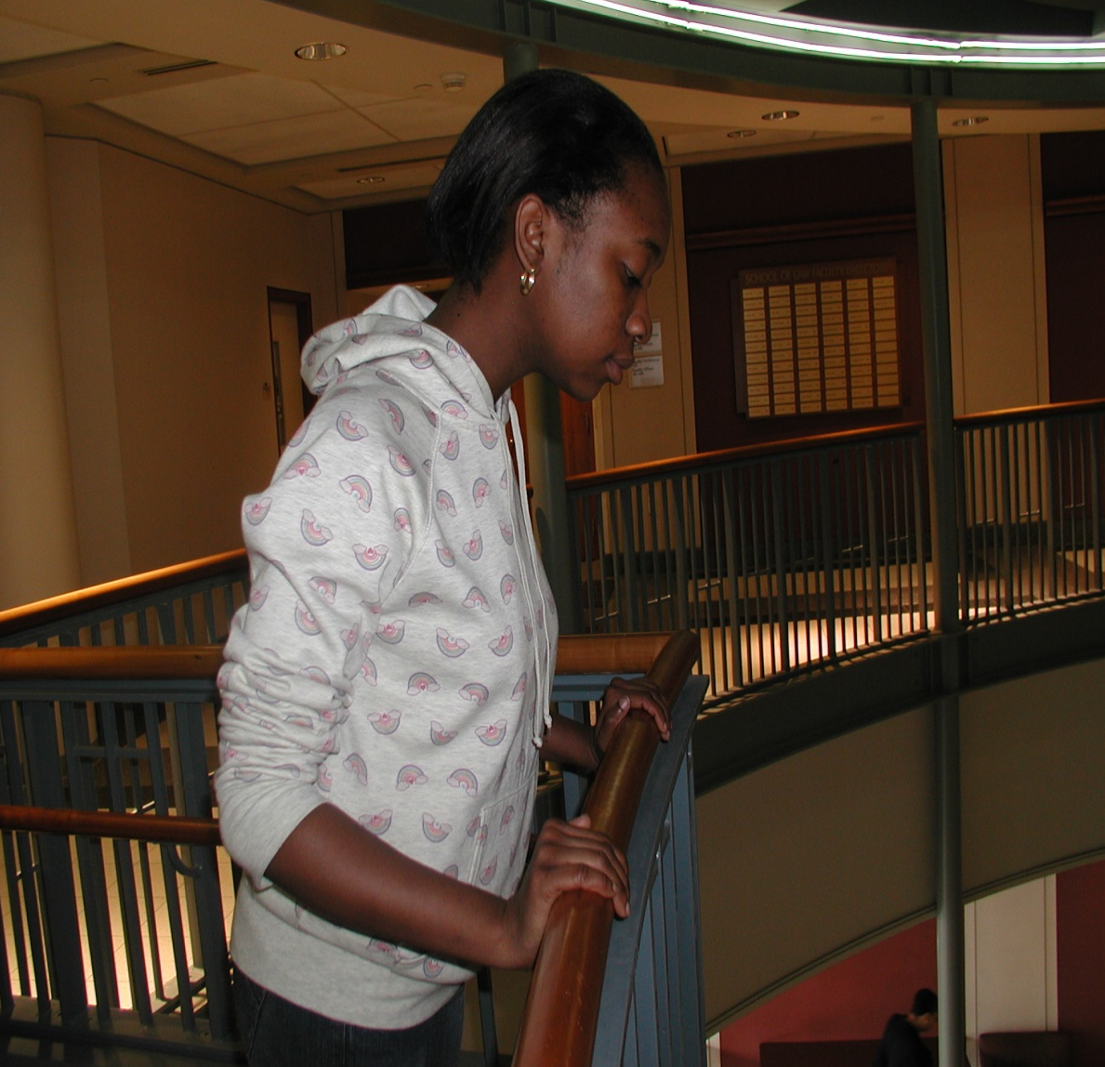
Do resources moderate height judgments?
Does trait self esteem operate as a resource?
Do internal resources supplement external resources?
What is this person’s external resource?
Handrail

Slide 25
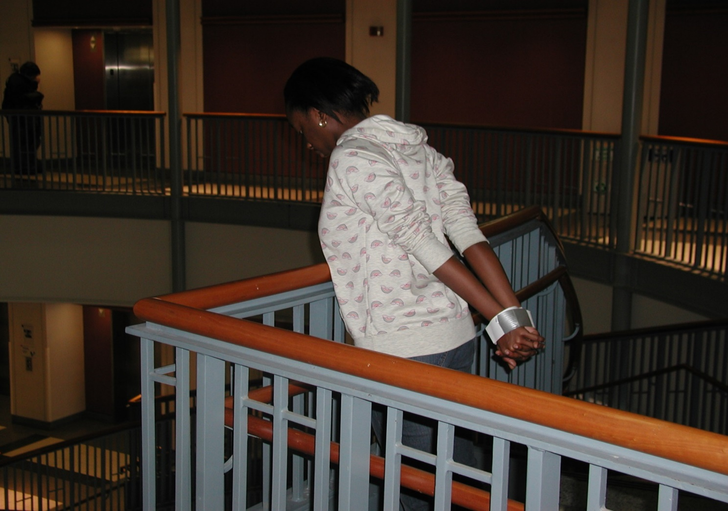
External resource is now absent.
What other resource available to this person?
Internal resource: Self-Esteem.

Slide 26
Self Esteem, External Support, and Height Perception
Actual Height

Slide 27
Self Esteem, External Support, and Height Perception
Actual Height

Slide 28
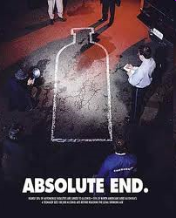
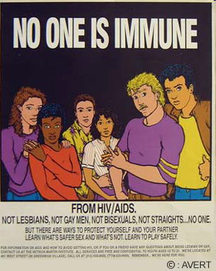
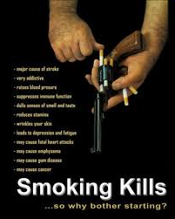
Health Risk Education Approaches

Slide 29
Fear as a Health-Behavior Tactic
Do health campaigns based on fear work? What are the possible problems with them?
Think about:
Yellowlees & Ruffin – Near Miss Asthma Death (NMAD) Weinstein – Unrealistic optimism Taylor – Self-serving illusions
Illusion of invulnerability
Denial
Downward comparison
What are tactics do people use to cope with threatening information?

Slide 30
Actual Health Risk and Perceived Health Risk
Who is more likely to reject research showing smoking causes cancer?
X
____ Heavy smoker ____ Non-smoker
Who is most critical of news article claiming that caffeine causes breast cancer? (Kunda, 1987)
X
____ men who drink caffeine ____ women who drink caffeine
____ men who don’t drink caffeine ____ women who don’t drink caffeine
Take home point?
Self-threat leads to defensiveness and resistance to threat-related information.

Slide 31
Health Messages and Self-Affirmation Sherman, Nelson, & Steele, 2000
Why would people block out health relevant information?
Sherman et al.: Health risk info is a self threat. Disturbs need to see self as moral, capable, and adaptive. [FUNDAMENTAL BELIEF]
If people resist info most relevant to them b/c this info threatens their “self-affirmation” needs, what could be done to lower resistance?
Boost self-worth/Self-affirmation needs
Self-Affirmation prediction: Self-affirmation should make it easier to accept self-threatening information. It should reduce denial and rationalization.

Slide 32
Study 2: Self-Affirmation and Acceptance of AIDS Risk Info
AIDS (and other STD) risk among college students
Percent of college students sexually active = ____% Percent of college students using condoms = ____%
AIDS video leads to greater risk perception among: ___ Virgins ___ Non-virgins
86
21
X
Purposes of Study 2 1. To show that self affirmation reduces resistance to AIDS info. 2. To show that self-affirmation increases protective behavior

Slide 33
Study 2 Procedure
Personal Values Ranking Task
Write brief (5 min.) essay on:
Affirmation Condition: Top rated value and when they had acted on it.
No Affirmation Condition: 9th rated value and why it might be important to average student.
3. View AIDS video: AIDS sufferers describe how having AIDS affected their lives. Scary.
4. OUTCOME Measures:
A. Willingness to purchase condoms
B. Willingness to take home an AIDS info brochure

Slide 34
Study 2: Self-Affirmation and AIDS & Behavior
Percent Who Purchased Condoms
Percent Who Took an AIDS Brochure

