Slide 1
Class 12: Personality III
Depression, Hostility, Traumatic Events
Midterm
Thurs., Feb 29
Covers Class 1 up to and including Class 13 “Psychosocial Resources, Threat, and Health”
50 Multi-choice Questions + 4 Extra Cred Ques
Study Guide: Available in class and on-line
Midterm only includes materials covered in class

Slide 2
Review Question 1
The Bandura et al. study had subjects place their arms in icy water, called the “cold presser test”. Which group of subjects had the highest pain thresholds (took longest to feel pain)?
___ Low efficacy, injected with placebo
___ High efficacy, injected with placebo
___ Low efficacy, injected with opioid blocker
___ High efficacy, injected with opioid blocker
___ None of the above
X

Slide 3
Review Question 2
Who is more likely to deny the risks of Near Miss Asthma Death (NMAD)?
____ People who have no asthma and aren’t affected by it
____ People with asthma who never had NMAD
____ People with asthma who had an NMAD experience
____ All people with asthma (had or hadn’t had NMAD event)
____ None of the above
X

Slide 4

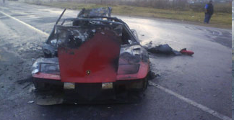
Is Optimism Always a Good Thing?

Slide 5
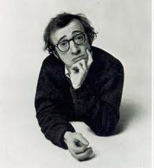

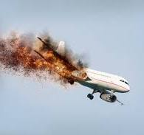
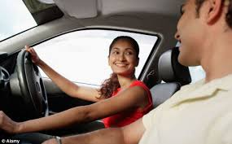
Illusion of Invulnerability
Belief that: Self is immune from bad events
Self will not be injured or harmed even when taking risks. Risks apply more to others than to oneself.
Arises from:
1. Easier to think up things that reduce risk than things that increase risk.
2. Lack of info about others' risk prevention efforts.
3. Egocentric dismissal of other's efforts to reduce risk.

Slide 6
Weinstein Unrealistic Optimism Study
GROUP 1
COMPLETE INFO: ABOUT SELF AND ABOUT OTHERS
Your Risk Factor for Heart Attack Me Others
1. Cigarettes smoked per week __9___ ( 7 )
2. # Family members with heart ailments __4___ ( 2 )
3. Hours of exercise per week __2___ ( 3 )
GROUP 2
PARTIAL INFO: ABOUT SELF ONLY, NO COMPARISON TO OTHERS
Your Risk Factor for Heart Attack Me Others
1. Cigarettes smoked per week __9___ ?
2. # Family members with heart ailments __4___ ?
3. Hours of exercise per week __2___ ?
GROUP 3
NO INFO: NO TRACKING OF SELF, NO COMPARISON TO OTHERS
------------------------------------------------------------------------------------------
Represents actual average

Slide 7
Weinstein Unrealistic Optimism Study
All subjects next answer the following question:
Compared to other Rutgers students of my sex,
1. My chances of having a heart attack are: [HIGH RISK]
2. My chances for tooth decay are: [MILD RISK]
Much Below Average | Below Average | Slightly Below Average | Average for Rutgers students | Slightly Above Average | Above Average | Much Above Average
-3 | -2 | -1 | 0 | +1 | +2 | +3

Slide 8
Results of Weinstein Study
High Risk
Low Risk
Severe Risks
Mild/Mod Risks

Slide 9
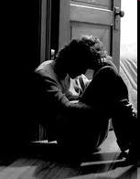
Depression: The High Costs of Being Low
1. 15% of all people suffer depression
2. Chronic depression --> brain damage
* Poorer Memory
* Failed concentration
3. ____ Men / ____ Women 2 X more likely
to get depressed.
X
https://www.youtube.com/watch?v=K-F9f1nJAW0

Slide 10
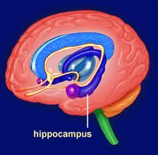
Hypercortisolemia and Hippocampus Damage
Hippocampus functions include:
a. Long term memory b. Spatial navigation
Rats given cortisol show atrophied hippocampus.
Hippocampus in depressed women smaller than in non-depressed women.
What does this add up to?
Depression --> cortisolemia --> hippocampus atrophy --> memory loss

Slide 11
Linking Depression to Hippocampus Atrophy
Depressed people have smaller hippocampus, therefore depression → hippocampus atrophy, right???
Why doesn’t this clear association between depress. & hippo. atrophy establish depression as cause?
Depression
Hippo. Atrophy
Brain Virus, for example
What kind of study would allow us to determine causality?

Slide 12
Confirming that Depression → Hippocampus Atrophy
Experiment: Make some people depressed, others not depressed, for three years. Then check on hippocampus. Problems?
Ethically wrong!!!
Prospective Experiment:
TIME 1
Depressed subjects, all at same age (e.g., 20) Half get psychotherapy, Half get no therapy.
TIME 2 (e.g., 5 years later)
Measure depression Measure hippocampus size
Artificial Data

Slide 13

Depression: Serious and Treatable
Depression is a major health risk:
Suicide Reckless behavior
Addiction Job/academic disruption
Self-Injury
Neg. Cycle: Depress → poor sleep → no exercise, bad diet → immunocompromised → illness.
SAMHSA’s National Helpline – 1-800-662-HELP (4357)
Main page content
SAMHSA’s National Helpline is a free, confidential, 24/7, 365-day-a-year treatment referral and information service.
RUN Student Counselling: counseling@newark.rutgers.edu

Slide 14
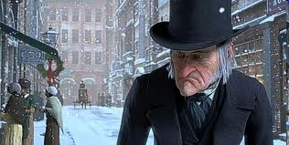
Hostile Personality
Hostility is considered to be an attitudinal set—perhaps a personality trait—which stems from an absence of trust in the basic goodness of others and centers around the belief that others are generally mean, selfish, and undependable.
Williams, Barefoot, & Shekelle, 1985

Slide 15
Hostility Scale
(Cook and Medley, 1954)
 |  | YES | NO
1 | No one cares much what happens to you
2 | I have often met people who were supposed to be experts who were no better than I.
3 | Some of my family have habits that bother and annoy me very much.
4 | I often have to take orders from someone who did not know as much as I did.
5 | It makes me feel like a failure when I hear of the success of someone I know well.
6 | People often disappoint me.
7 | It is safer to trust nobody.
8 | I have often felt that strangers were looking at me critically.
9 | I tend to be on my guard with people who are somewhat more friendly than I expected.
10 | My way of doing things is apt to be misunderstood by others.

Slide 16
Hostility as a Health Threat
Cannon: A person confronted with a major stressor goes into one of two modes:
Fight
OR
Flight
Distrusts others, believes others are mean, anticipates insult?
Fight
Imagine someone in chronic “fight” mode, always ready for attack or defense
How would he/she appraise situations? Other people?
More threatening, as self-serving, un-trustworthy, dog-eat-dog world
What would this person’s social and interpersonal behavior be like?
Socially abrasive, smaller social network, avoid others when in need

Slide 17

Case Study of Hostile Personality
https://www.youtube.com/watch?v=_n77eoOfRPE
Why do people get angry at inanimate objects?
Anger bursts release opioids. Being angry feels good.
Downside to opioid release?
Immunocompromise

Slide 18
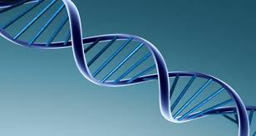
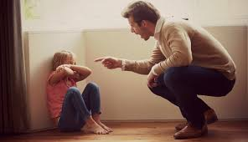

Origins of Hostile Personality
Heredity: High reactivity types.
Parental Disciplinary Style
History of being bullied
Person with this history develops hostility mind-set.
Ken Dodge research on attributions of hyper-aggressive kids.

Slide 19
Health Correlates of Hostility
Blockage of blood vessels
Coronary Heart Disease (CHD) (1.5 time greater odds)
20-year increased risk of death due to:
* CHD
* Malignant Neoplasms (cancer)
* All causes of death combined

Slide 20
Hostility and Coronary Heart Disease Among MDs
Barefoot, et al., 1983
Shows incidence from med school to 25 years later.

Slide 21
MD Survival Rates Post Heart Attack
Over 25 Years:
Low Hostile vs. High Hostile

Slide 22
Pathway From Hostility to Heart Disease
Appraisal of threat higher → defensive mode (fight) →
more cardiac output → ↑ cortisol → atherosclerosis
What seems to be common biochemical culprit in link between health risks and: Stress, Depression, Hostility?
Cortisol

Slide 23
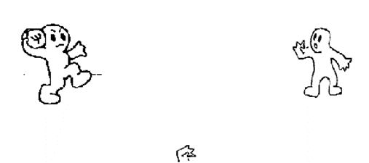
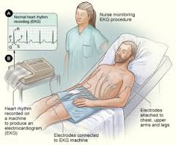
Change in Heart Rate Due to Ostracism and Hostility
Kipling Williams, 2007
p < .01

Slide 24
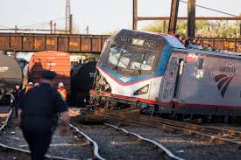
Reactions to Negative Events
What question would you ask?
Why did this happen?
Responses to unsolvable events:
“It was fate”, “It was Lord’s will”.
Why?
Regain control, meaning

Slide 25
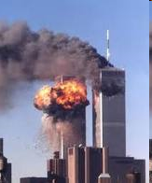

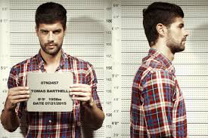
Fundamental Beliefs
1. World is just.
2. World is sane, well ordered, non-random
3. The self is good
Traumas: Events that seriously violate one or more of these beliefs.

Slide 26
Fundamental Beliefs and Misfortune
In which case a fundamental belief been violated, and which one?
The Self is Good, The World is Well Ordered, The World is Just
___A. Person hurt by meds that sometimes conflicts with patient chemistry
___B. Person hurt by meds her MD is using to test his personal theory.
X
The world is just
___A. Train passenger injured b/c a cow wandered on to the tracks
___B. Train passenger injured, but cause of crash is never determined
X
The world is orderly, not random
___A. Person whose child gets cancer due to second-hand smoke at home
___B. Person whose child gets cancer due to heredity
X
The self is good

Slide 27
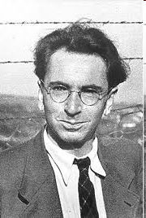
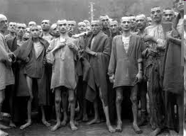

How People Restore Sense of Meaning Following Trauma
1. Seek out causes of event.
2. Re-adjust way of seeing life, and themselves.
Victor Frankl

Slide 28
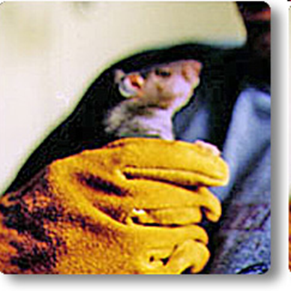
Cognitive Strategies for
Overcoming Threatening Events
1. Achieve a sense of meaning out of the event.
2. Regain mastery over the event, or over life in general
3. Enhance self-esteem
NOTE: But what about people who can’t find meaning, despite trying? Loss of child, victim of parental abuse? We will discuss in coming weeks, but your thoughts?
Maybe like learned helplessness.

Slide 29
Taylor Article: Adjusting to Threatening Events
Meaning is key to coping. But what about bad situations where there is no clear cause?
Subjects in Taylor article are: _______________________
women with breast cancer
No
Is cause of breast cancer (on individual level) known? ____
Do women with breast cancer typically accept that there is no single, diagnosable cause? ____
Why is this?
No

Slide 30
Self-Identified Causes of Breast Cancer
Taylor, et al., 1983
a. Stress, esp. relationship 41%
b. Carcinogen 32%
c. Hereditary 26%
d. Diet 17%
e. Freak event 10%
Note: Some women listed multiple causes, thus total more than 100%
Almost NO women said there was no cause.

Slide 31
Adopting New Meanings About Life
a. New attitude toward life
I feel as if I were for the first time really conscious.
I have much more enjoyment each day, each moment. All those things you get entangled with don’t seem to be part of my life right now.
b. Self knowledge
It’s a bit like holding up a mirror to one’s face when one can’t turn around.

Slide 32
Patients’ Behavioral Responses to Their Cancer
Change diet
Quit other meds that they (wrongly) think may be associated with cancer
Educate self on cancer
Control side effects:
* Imaging: Chemo as cannons
* Instruction to body: "Cut this shit out“
Not clear any of these responses actually cure cancer—why do them?

Slide 33
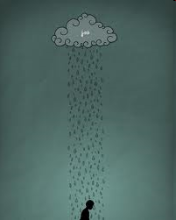
Bad Events Threaten Self Esteem
When people suffer bad events, they feel bad about selves, even if they are not responsible. Why?
Just world beliefs: Good things happen to good people, bad things happen to bad people. Therefore...
People are very good at finding ways to restore sense of self worth. Cancer patients do so even after disfiguring surgery, painful treatment, constant threat of cancer recurrence. How do they do it?

Slide 34
Downward Social Comparison Among Breast Cancer Patients
Woman who underwent lumpectomy
I had a comparatively small amount of surgery. How awful it must be for women who have had a mastectomy. I just can’t imagine, it would seem so difficult.
Woman who had a mastectomy
It was not tragic. It worked out okay. Now if the thing had spread all over, I would have had a whole different story for you.
An older woman
The people I really feel sorry for are these younger gals. To lose a breast when you’re so young must be awful. I’m 73; what do I need a breast for?
A young woman (apparently having lost a breast)
If I hadn’t been married, I think this thing would have really gotten to me. I can’t imagine dating or whatever knowing you have this thing and not knowing how to tell the man about it.

Slide 35
Who Are More Likely to Maintain Illusions:
Depressives or Non-Depressives?
“Depressive Realism”: Depressives less likely to:
Inflate views of themselves
Ignore or dismiss negative feedback
Overestimate personal control
Overly claim credit for success
Yet non-depressives often cope better. Why?
Illusions can improve short-term coping

Slide 36
Summary of Types and Benefits of Illusions
Methods
1. Downward social comparison
2. Unsupported causal explanations
* Cancer due to diet
* “Cells have re-aligned. Now I'm safe.”
* Can stop cancer via imaging, positive thinking
3. Denial
Benefits?
1. Enhance control
2. Enhance self-worth
3. Enhance persistence
4. Encourage coping behaviors

