Slide 1
Class 11
Denial, Optimism/Pessimism, Hope, and Coping

Slide 2
Review Question 1
Which of the following is NOT TRUE of people with a Negative Affect personality?
___ Have more physical symptoms
___ Engage in unhealthy behaviors
___ Are stoic and uncomplaining
___ Have poorer health
___ Find many situations difficult to manage
X

Slide 3
Review Question 2
Rats are exposed to a stressor, like electric shock. Rats with no control over the stressor will produce more of what chemical substance?
___ Oxytocin
___ Opioids
___ Blood platelets
___ CO²
___ None of the above
X

Slide 4
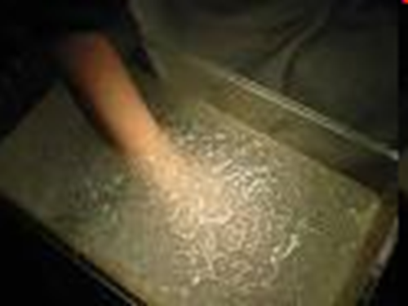
General Self Efficacy
Schwarzer & Jerusalem, 1995
Who can tolerate icy water longer:
___ High Efficacy
___ Low Efficacy

Slide 5

Evidence that Efficacy Moderates
Stress --> Illness Connection in Humans
Bandura, Cioffi, Taylor, & Brouillard, 1988
Prediction: Failure --> stress --> opioids --> less pain (--> immunocompromise)
Four groups:
1. Success, pain, opioid blocker
2. Success, pain, no opioid blocker
3. Failure, pain, opioid blocker
4. Failure, pain, no opioid blocker
Remember: Stress → Endorphins (opioid) → Less Pain
→ Immunocompromise

Slide 6
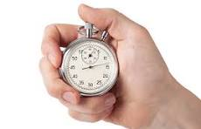
Efficacy Manipulation
High Efficacy Group
(2 X 7 + 15)
(9 X 8 - 12)
(73 - 15 X 3)
At own pace
Low Efficacy Group
(2 X 7 + 15)
(9 X 8 - 12)
(73 - 15 X 3)
At difficult pace
Change in self-perceived math efficacy

Slide 7
Psychological Effects of Math-Test Manipulation (Manipulation Check)
High Efficacy Condition
Low Efficacy Condition

Slide 8
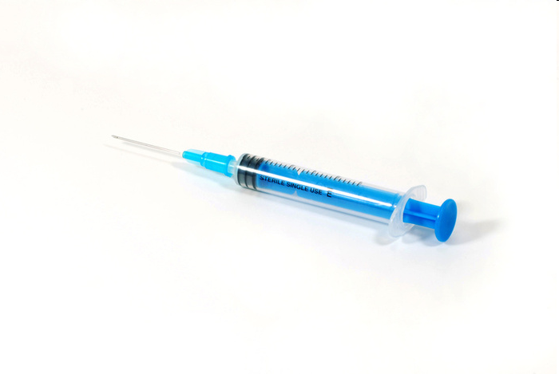
Opiate Blockage
Purpose: If stress increases opiates, and opiates reduce pain, then ___High efficacy OR ___ Low efficacy condition will have higher pain tolerance (i.e., how long until pull hand from ice water)?
HOWEVER, if opiates are blocked, which group should have higher pain tolerance, ____ High efficacy OR ___ Low efficacy?
X
X
To show this, need to block opiates to some subjects
Naloxone: Opiate antagonist (BLOCKER); 100% effective
Subs get Naloxone or saline. Why use saline?
Control condition

Slide 9
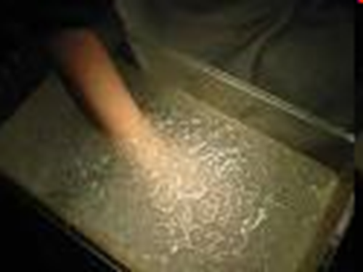
Experiment Design and Predictions
Saline (Placebo) Naloxone (Opioids not Blocked) (Opiate Blocker)
High Efficacy
Low Efficacy
Moderate Tolerance
Moderate Tolerance
High Tolerance
Low Tolerance
Pain Tolerance (How long pain can be tolerated; until pull hand from ice water)

Slide 10

Evidence that Efficacy Moderates
Stress --> Illness Connection in Humans
Bandura, Cioffi, Taylor, & Brouillard, 1988
Low efficacy + placebo: More stress → more opioids → less pain
Low efficacy + opioid blocker: More stress → no opioids → more pain
So what? Self-efficacy reduces opioid release, should therefore increase or decrease immunocompetence?

Slide 11
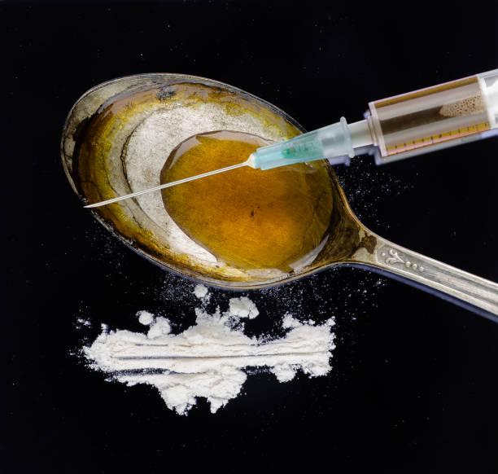
Do Pharmaceutical Opioids Suppress the Immune System? Class-generated question.
Stress → Endorphins → Immunocompromise
Endorphins are opioids produced by the body
What about opioids made by a pharmacy lab--morphine, heroin, etc.? Do they also suppress the immune system?
Lisanne M. Plien & Heike L Rittner, (2017). Opioids and the Immune System – Friend or Foe? Brit. Journ. Pharmacology, 175, 2717-2725.
Findings inconsistent, but:
Morphine, fentanyl: Impair macrophages (white blood cell), natural killer cells, and weaken gut barrier.
So, the answer is a qualified YES

Slide 12
Health Outcomes Questions
1. Compared to most other college students, what is your risk of an alcohol- related injury?
Much Below Average | Below Average | Slightly Below Average | Average for Rutgers students | Slightly Above Average | Above Average | Much Above Average
1 | 2 | 3 | 4 | 5 | 6 | 7
2. Compared to most other college students, what is your risk of getting into a car accident?
Much Below Average | Below Average | Slightly Below Average | Average for Rutgers students | Slightly Above Average | Above Average | Much Above Average
1 | 2 | 3 | 4 | 5 | 6 | 7

Slide 13
Compared to most students what’s your risk of alcohol-related injury?
n = 48 Mean = 2.46 Median = 2.00 Mode = 1 SD = 1.64

Slide 14
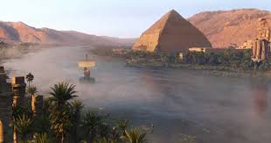
Denial and Coping
Psychological defense: Minimize or deny existence of threat
Is denial good or bad?
Good*
_______ Early in crisis
_______ Chronic (ongoing)
Bad
On-going denial can stop people from taking necessary action.
NMAD = Near Miss Asthma Death
Who denies more: ___ Asthmatics who experienced NMAD
___ Asthmatics who have not experienced NMAD
___ Non Asthmatics
X
* Sometimes

Slide 15
Denial Among NMAD Survivors, “Regular” Asthmatics, and Non-Asthmatics
Yellowlees & Ruffin, 1989

Slide 16
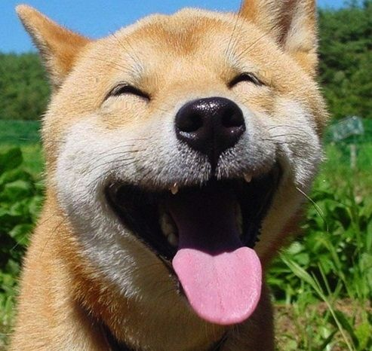

Optimists vs. Pessimists
Optimists
1. Expect positive outcomes
2. Expect to cope with adversity
Pessimists
1. Expect negative outcomes
2. Do not expect to cope with adversity

Slide 17
Life Orientation Test: Optimism Measure Scheier, M.F., Carver, C.S., & Bridges, M.W. (1994)
1. | In uncertain times, I usually expect the best.
2. | It's easy for me to relax. (Filler item)
3. | If something can go wrong for me, it will. *
4. | I'm always optimistic about my future.
5. | I enjoy my friends a lot. (Filler item)
6. | It's important for me to keep busy. (Filler item)
7. | I hardly ever expect things to go my way. *
8. | I don't get upset too easily. (Filler item)
9. | I rarely count on good things happening to me.*
10. | Overall, I expect more good things to happen to me than bad.
Responses: 1 = Not at all; 2 = a little; 3 = somewhat; 4 = A lot; 5 = A Great Degree
* = “Reverse Coded”

Slide 18
Pessimistic vs. Optimistic Attribution Styles
Pessimist | Optimist
I bombed the math test. | I bombed the math test.
I just couldn't get myself to study. | All the noise outside my apartment made it hard to study | A
I don't have good math ability | I didn't really try hard enough | B
Basically, I'm just not academically skilled. | Math is my one weak area. | C
A. Internal vs. External Cause
B. Stable vs. Transitory Cause
C. Global vs. Specific Cause

Slide 19
Explanatory Causes and Styles
I won the tennis match because my opponent wasn’t trying hard.
___Internal cause ___ External cause
I lost my keys because I'm such a dope.
___Internal cause ___ External cause
I showed up late for my date because I didn’t plan far enough in advance..
___ Stable Cause ___ Transitory Cause
I showed up late for my date because I am so bad at planning.
___ Stable Cause ___ Transitory Cause
My cholesterol went up because I’m not exercising.
___ Specific Cause ___ Global Cause
My cholesterol went up because I’m a lazy slob.
___ Specific Cause ___ Global Cause
X
X
X
X
X
X

Slide 20
Optimistic and Pessimistic Explanatory Styles
Success
Failure
Internal Cause
Optimist
Pessimist
External Cause
Pessimist
Optimist
Stable Cause
Optimist
Pessimist
Transitory Cause
Pessimist
Optimist

Slide 21
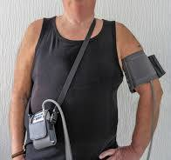
Optimism, Pessimism, and Ambulatory BP Raikkonen, et al. (1999)
Prediction Pessimism & Anxiety + ANY moods → increased ambulatory BP Optimism + BAD moods only → increased ambulatory BP
Subjects
100 volunteers, 50% female, ave. age = 37
80% white, 10% black, 10% other
Procedure
1. Pre-assessment
a. Resting BP
b. Complete survey battery
1. Optimism (LOT)
2. Trait anxiety
3. Other background
2. Daily Monitoring
a. Wear BP device, 3 days, activates every 30 seconds
b. Daily diary: Mood, Context (where, what doing,...)
Ambulatory Blood Pressure

Slide 22
Results of Raikkonen, et al. (1999)
1. Optimism
Pessimists have higher BP, all moods
Optimists only affected by bad moods
2. Trait Anxiety
High anxious → higher BP
Mood affects only low anxious
3. Conclusions
a. Results real, not due to posture, activity, etc.
b. Chronic high BP is a health risk: Can lead to hypertension
c. Pessimists and high anxious may be at greater long-term risk
d. Neg. Affectivity is a real health risk, not just a “whining” artifact.
Diastolic Blood Pressure

Slide 23
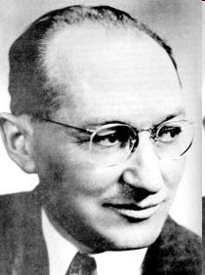
Kurt Lewin: Morale, Not Simply Rosy Outlook
Empty Optimism
Diagnosed with heart disease risk
My heart health will improve
Morale
Diagnosed with heart disease risk
I’ll sign up at a gym I’ll change diet
I’ll meet MD every 3 mos
My heart health will improve

Slide 24
C. Synder "Hope" Measure (Really a Measure of Morale)
P _____ 1. I can think of many ways to get out of a jam.
A _____ 2. I energetically pursue my goals.
F _____ 3. I feel tired most of the time.
P _____ 4. There are lots of ways around any problem.
F _____ 5. I am easily downed in an argument.
P _____ 6. I can think of many ways to get the things in life that are most important to me.
F _____ 7. I worry about my health.
P _____ 8. Even when others get discouraged, I know I can find a way to solve my problem.
A _____ 9. My past experiences have prepared me well for my future.
A _____10. I've been pretty successful in life.
F _____11. I usually find myself worrying about something.
A _____12. I meet the goals that I set for myself.
--------------------------
A = Hope Agency P = Hope Pathways F = Filler

Slide 25
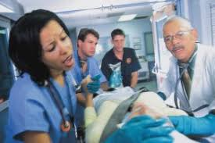
Hope, Stress, and Eustress Among Nurses
Simmons & Nelson, 2001
Nursing one of the most stressful jobs.
Also experienced by many nurses as meaningful.
Does Hope determine the kind of stress nurses experience?
Nurses who score higher on Snyder Hope measure had:
More positive emotions, more meaning at work, better health, and more encounters with death (!!!)
Less role ambiguity, lower workload

Slide 26

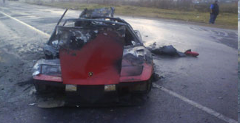
Is Optimism Always a Good Thing?

Slide 27
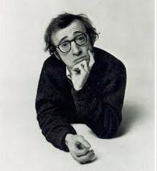
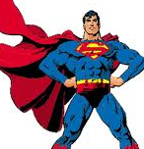
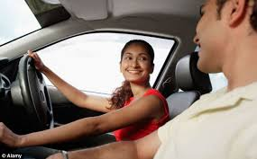
Illusion of Invulnerability
Defined: Belief that one is immune from bad events, or that one will not be injured or harmed even when taking risks. Risks apply more to others than to oneself.
Arises from:
1. Easier to think up things that reduce risk than things that increase risk.
2. Lack of info about others' risk prevention efforts.
3. Egocentric dismissal of other's efforts to reduce risk.

Slide 28
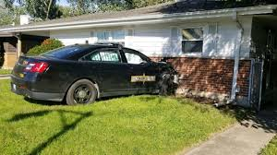
Health Outcomes Questions
Compared to most other college students, what is your risk of getting into a car accident?
Much Below Average | Below Average | Slightly Below Average | Average for Rutgers students | Slightly Above Average | Above Average | Much Above Average
1 | 2 | 3 | 4 | 5 | 6 | 7

Slide 29
"Rational" Expected Results

Slide 30
Risk of Auto Injury, Compared to Most Students
n = 48 Mean = 3.15 Median = 3.00 Mode = 4 SD = 1.58

Slide 31
Weinstein Unrealistic Optimism Study
GROUP 1
COMPLETE INFO: ABOUT SELF AND ABOUT OTHERS
Your Risk Factor for Heart Attack Me Others
1. Cigarettes smoked per week __9___ ( 8 )
2. # Family members with heart ailments __4___ ( 2 )
3. Hours of exercise per week __2___ ( 3 )
GROUP 2
PARTIAL INFO: ABOUT SELF ONLY, NO COMPARISON TO OTHERS
Your Risk Factor for Heart Attack Me Others
1. Cigarettes smoked per week __9___ ?
2. # Family members with heart ailments __4___ ?
3. Hours of exercise per week __2___ ?
GROUP 3
NO INFO: NO TRACKING OF SELF, NO COMPARISON TO OTHERS
------------------------------------------------------------------------------------------
Represents actual average

Slide 32
Weinstein Unrealistic Optimism Study
All subjects next answer the following question:
Compared to other Rutgers students of my sex,
1. My chances of having a heart attack are: [HIGH RISK]
2. My chances for tooth decay are: [MILD RISK]
Much Below Average | Below Average | Slightly Below Average | Average for Rutgers students | Slightly Above Average | Above Average | Much Above Average
-3 | -2 | -1 | 0 | +1 | +2 | +3

Slide 33
Results of Weinstein Study
High Risk
Low Risk
Severe Risks
Mild/Mod Risks

