Slide 1
Personality and Coping I: Mediation, Moderation, Negative Affect, Self-Efficacy and Endogenous Opiates
Class 10

Slide 2
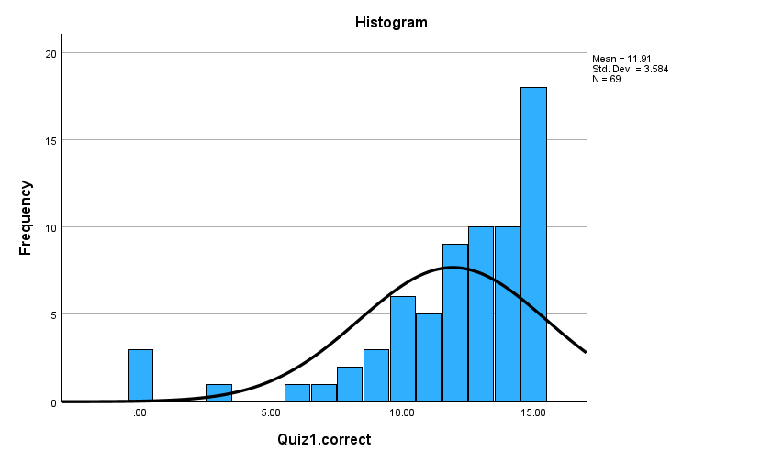
13-15 = A
= B
10-11 = C
= D
0-7 = F
POINTS
15 = 10.0
14 = 9.3
13 = 8.7
12 = 8.0
11 = 7.3
10 = 6.6
09= 6.0
08 = 5.3
07= 4.7
06= 4.0
05= 3.3
04= 2.7
03= 2.0
02= 1.3
01= 0.7
00 = 0.0
Quiz 1 Results

Slide 3
Review Questions
Which of the following is NOT true of the Holmes and Rahe Social Readjustment Scale?
___ It measures how people feel about stressful situations
___ It assigns a numeric value to different kinds of stresses
___ It focuses on external stresses
___ A score of 300+ leads to a 90% chance of illness
___ None of the above
X

Slide 4
Review Questions
A couple survive Hurricane Katrina but both suffered PTST. Their child, born several years later, is highly susceptible to PTSD. This is evidence of:
___ Misophonia
___ Epigenetics
___ Moral stress
___ Self-Complexity
___ None of the above
X

Slide 5
Immune System Review
Primary function: Distinguish self from non-self, attack foreign elements.
Main components:
Humoral response – anti-bacterial, prevent viral re-infection. Attack “foreign agents”.
Cell-mediated response – T cells from Thymus gland, T cells attack cells infected by antigens, produce anti-antigen toxins.
Other blood-borne components of immune system
Mitogen Test: Introducing chemical that stimulates cell production. Serves to test how “energetic” is immune system—e.g. how many white blood cells produced after mitogen introduced.
Mitogen is safe version of Antigen, which is foreign substance that attacks body (e.g., bacteria, virus), causing antibody production.

Slide 6
Immunocompetence and Immunocompromise
Immunocompetence: How well immune system is working, in terms of:
Quantities of immune agents (T cells, white blood cells)
Functioning of immune agents 1. Activity 2. Proliferation 3. Transformation 4. Cytotoxicity: Potency of, e.g. Tc cells’, antibody toxins
Immunocompromise: When immune system is impaired
Key Point: Stress can lead to immunocompromise

Slide 7
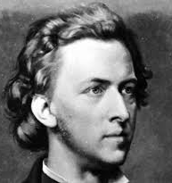
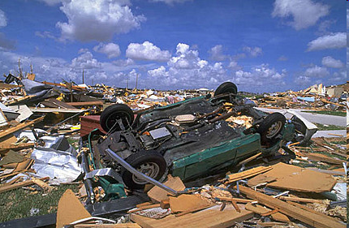
Stress and Immune Functioning
Stress and immunocompromise shown in:
Animal studies: Stressed rats display immune dysfunction
Observations: TB white blood cells less robust after stress
Accumulated Research: 38 studies show more stress → immunocompromise
The bigger the stressor, the worse the compromise.
Chopin
Hurricane Andrew (1992), Natural Killer (NK) cell cytotoxicity (ability to kill infected cells) decreases. Tied to lack of sleep.
NOTE: This outcome fits which with measure ____Holmes & Rahe ___ Cohen et al.
X

Slide 8
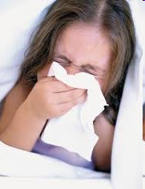
Stress-Induced Immunocompromise and Illness
Stress → Immunocompromise → colds, flu, herpes flare-ups
Daily hassles → reduced Natural Killer cell activity
Anticipatory stress → less robust T_{Helper} cells. Mt. St. Helens/Pennebaker
School stress: 5 yr olds have increased cortisol, immunocompromise, upon starting kindergarten. Esp. if earthquake co-occurs!

Slide 9
Chronic Stress and Acute Stress
Chronic |  | Acute
On-going illness |  | Natural disaster
Family responsibilities |  | Major family conflict
Workload |  | Auto accident
Environmental noise |  | Job loss
Financial worries |  | Loss of loved one
Immunocompetence
Days Exposed to Stressor
1 2 3 4 5 6 7 8 9 10 11 12 13 14 15 16 17 18 19
X
This outcome fits with which stress model: ___Cannon-Bard ___ Selye

Slide 10
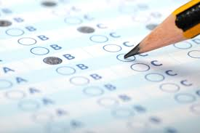
Eustress: When Stress is Healthy
“Stress leads to illness. Quizzes causes stress. Is Health Psychology bad for my health?”
Acute Stress: Brief intense stressful events (e.g. quizzes)
Chronic stress: Prolonged stress, day in / day out. (e.g., financial worries, family struggles).
Acute stressors can actually be good for you, “Eustress”.
Short-term Stress boosts vaccine effectiveness
1. Subject do math test OR exercised OR do nothing
2. Get vaccine
3. Math takers, Exercisers, have more antibodies than the “do nothings”
Short bursts of stress followed by rest may be especially good:
Improve memory and learning
Increases brain plasticity (ability to reshape and grow)
Dangerous Stress: Non-stop, traumatic, lack of control, poverty

Slide 11
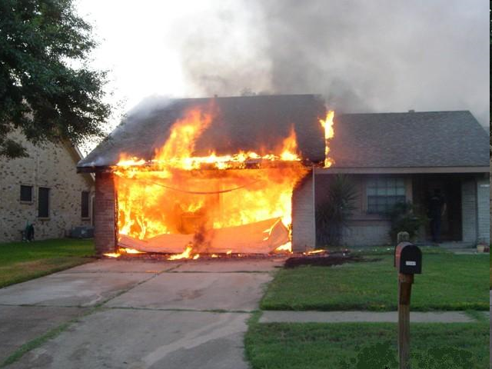
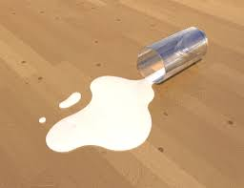
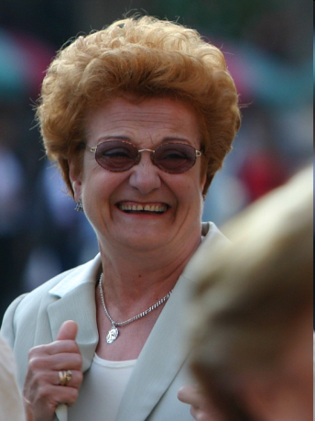
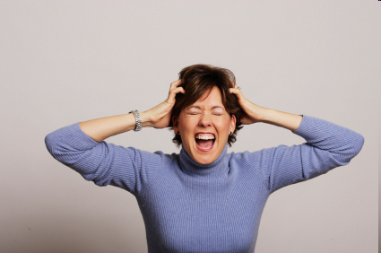
Relation Between Stress and Health Not Perfect

Slide 12
Moderators
Predictor
A. Stress
A
B. Social Isolation
C. Illness
B
C
A*B. Stress * Social Isolation
A * B
Moderator
Moderation

Slide 13
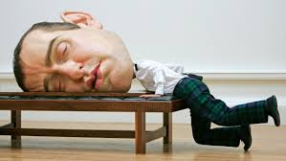
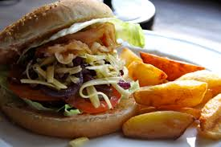
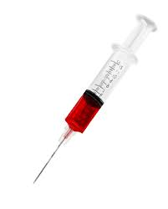
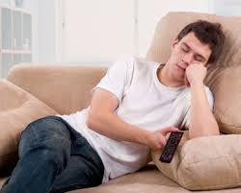
Moderators of the Stress and Health Connection
Physical Constitution
1. Genetic make-up (infant reactivity study)
2. Age (very young, very old)
3. Material resources
Behavior
1. Sleep
2. Diet
3. Substance abuse
4. Isolation
5. Exercise
Personality
Social Connections

Slide 14
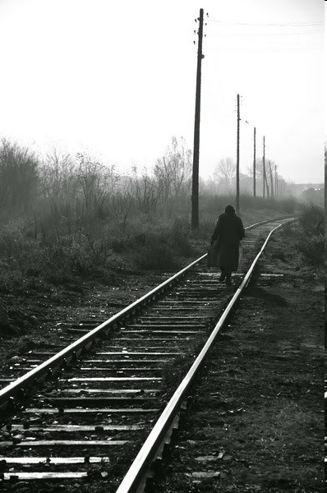
Social Relations, Stress, and Illness
Personal relationships are key moderators of stress/illness connection.
(More on this when we discuss Social Support)
Rat pups separated from mothers show immunocompromise
Social Conditions linked to illness?
Bereavement (but mainly if linked to depression)
Loneliness
Marital separation

Slide 15
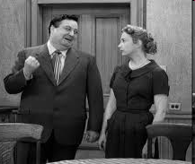
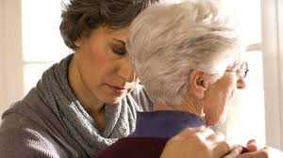
Social Connections as a Health Risk
Newlyweds Study
90 newlywed couples, discuss marital problems
Style of discussion coded as: a. Negative/hostile b. Positive/collaborative
Assessed immune functioning after discussions.
Which group shows immunocompromise?
____ Neg/hostile ___ Pos/collaborative
X
Caregivers of chronically ill
Produce fewer immune agents, wounds heal slowly, weaker reaction to flu vaccine. Why?

Slide 16
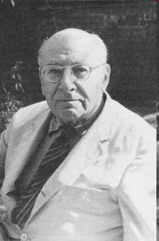
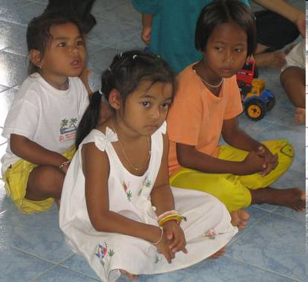
Spitz Foundling Home Studies
René Spitz
Orphaned babies, in foundling homes, all material needs met
Do not have an emotional care-giver
Tragically high levels of grief
Highly susceptible to disease
High mortality rate
https://www.youtube.com/watch?v=iW3UHcYfCPI
FYI: https://www.youtube.com/watch?v=bF3j5UVCSCA

Slide 17
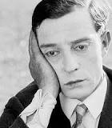
Negative Affect (Watson, Clark, & Tellegen)
Defined: Pervasive negative mood marked by anxiety, depression, and hostility.
Find many situations difficult to manage
Resort to unhealthy coping behaviors (e.g., overeating, escapism)
Related to poor health: Asthma, arthritis, ulcers, headaches, CHD
Related to excess complaining:
a. More symptoms b. Higher use of health services c. Higher rates of self-reported illness d. These people may compromise validity of self-reported illness

Slide 18
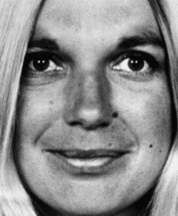
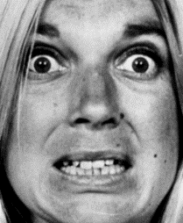
The Coping Sequence: Folkman & Lazarus
Stressor
Primary Appraisal (Harm, Threat, Challenge)
External Moderators
Secondary Appraisal
Tangible help
+
+
External Resources and Impediments
Internal Moderators
Social Support
−
Other life stressors
Negative Affect
Internal Resources and Impediments
Other personality factors
Stress Response

Slide 19
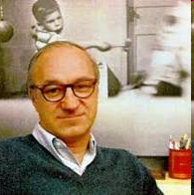
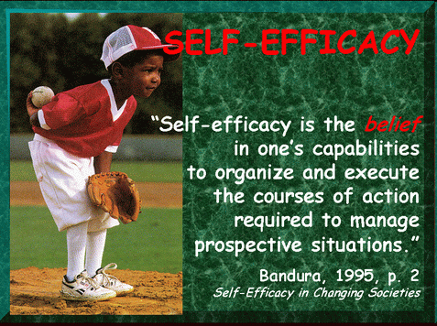
Self Efficacy and Health: A Moderator / Mediator Story
Robt. Bandura

Slide 20
Mediators
Mediator: If A → B → C, then “B” is what mediates
the relation between A and C.
B
A
C
Opioids
Stress
Pain Tolerance

Slide 21
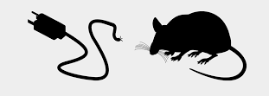
Efficacy, Stress, and Immunocompetence
Study Design
Animals exposed to stressor (shock)
Group A: Believes has control (High Efficacy)
Group B: Believes has NO control (Low Efficacy)
Outcome: Opioids in system
Which animals produce MORE opioids?
Group B--No Control

Slide 22
Stress, Opioids, and Immunocompetence
Stress --> ______ path → ______ stim → _____ → opioids
How do opioids affect immune system? ____________
Thus, → more stress → MORE or LESS opioids
More opioids → IMMUNOCOMPETENCE or IMMUNOCOMPROMISE
ACTH
adrenal
cortisol
DEPRESS IT
ACTH = Adremocorticotropic hormone; part of Selye’s Hypothemalic-pituitary-adrenocortical (HPA) pathway of stress

Slide 23
About Reading Research Articles
1. Focus on Introduction and Discussion
2. Skim "Methods", know what was done.
3. Skip over "Results" section

Slide 24
Evidence that Efficacy Moderates
Stress --> Illness Connection in Humans
Bandura, Cioffi, Taylor, & Brouillard, 1988
Prediction: Failure --> stress --> opioids --> less pain (--> immunocompromise)
Four groups:
1. Success, pain, opioid blocker
2. Success, pain, no opioid blocker
3. Failure, pain, opioid blocker
4. Failure, pain, no opioid blocker
Remember: Stress → Endorphins (opioid) → Less Pain

Slide 25
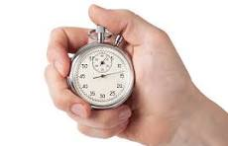
Efficacy Manipulation
High Efficacy Group
(2 X 7 + 15)
(9 X 8 - 12)
(73 - 15 X 3)
At own pace
Low Efficacy Group
(2 X 7 + 15)
(9 X 8 - 12)
(73 - 15 X 3)
At difficult pace
Change in self-perceived math efficacy

Slide 26
Psychological Effects of Math-Test Manipulation (Manipulation Check)
High Efficacy Condition
Low Efficacy Condition

Slide 27
Opiate Blockage
Purpose: If stress increases opiates, and opiates reduce pain, then ___High efficacy OR ___ Low efficacy condition will have higher pain thresholds (i.e., be better able to withstand pain longer)?
HOWEVER, if opiates are blocked, which group should have higher pain thresholds, ____ High efficacy OR ___ Low efficacy?
X
X
To show this, need to block opiates to some subjects
Naloxone: Opiate antagonist; 100% effective
Subs get Naloxone or saline. Why use saline?
Control condition

Slide 28
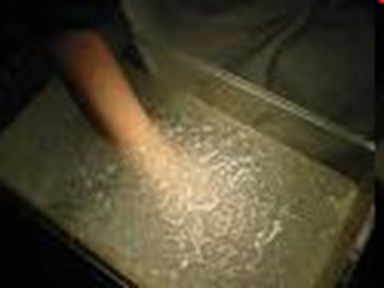
Experiment Design and Predictions
Saline Naloxone (Placebo) (Opiate Blocker)
High Efficacy
Low Efficacy
Moderate Tolerance
Moderate Tolerance
High Tolerance
Low Tolerance
Pain Threshold (Ability to Tolerate Hand in Freezing Water)

Slide 29
Evidence that Efficacy Moderates
Stress --> Illness Connection in Humans
Bandura, Cioffi, Taylor, & Brouillard, 1988
Low efficacy + placebo: More stress → more opioids → less pain
Low efficacy + opioid blocker: More stress → no opioids → more pain
So what? Self-efficacy reduces opioid release, should therefore increase or decrease immunocompetence?

