Slide 1
Class 8: Stress II

Slide 2
Quiz 1
Quiz Time: 25 minutes
Format: 15 multiple choice + 2 extra credit. Complete extra credit even if just guessing.
Do not sit directly next to someone else during quiz. At least one empty seat between you and others.
Questions? Come up to me and I will answer, if I can.
Make sure you print your name CLEARLY. No need to enter RUID
NOTE: SHORTER CLASS TODAY B/C OF QUIZ 1

Slide 3
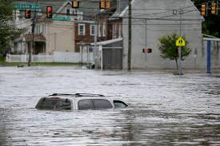
Qualities of Stressful Events
Negative events. But not ONLY negative, also:
Uncontrollable events
Ambiguous events
Overload
Challenges to central domains of life
Do objective and subjective aspects both matter?

Slide 4
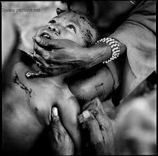
Stress: A Matter of Perspective?
Subjects view gruesome film of tribal initiation rites.
Given one of following frames:
Intellectual description
De-emphasize pain, focus on excitement
X
Emphasize pain and suffering
X
No Framing
Which frames produce the most stress in subjects?
Why?
Not just “objective event” but how it is perceived.
But is it all about perspective? Do objective aspects of stressors also matter?

Slide 5
Objective and Subjective Stress
What matters, objective stress or subjective stress?
Air traffic Controllers (Repetti, 1993)
Objective stressors: * Amount of Air Traffic, Weather
Subjective stressors: * Relations with supervisors, Bad mood
Common Cold Study (Cohen et al., 1993)
* 395 health subs complete stress measures: objective, subjective
* Subs all exposed to cold virus, quarantined—why quarantined?
* Higher stress scores → more likely to be ill
What mattered in Repetti Study and in Cohen et al. study, Objective Stress? Subjective Stress?
* Both objective stress AND subjective stress Mattered

Slide 6
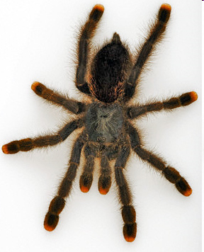
Lazarus Two Factor Model of Stress Appraisal
Folkman and Lazarus, 1984
Primary Appraisal
___Pos ___ Neutral ___ Negative
If Neg: How harmful now? In future?
Stress
Potential Stressor
Secondary Appraisal
Internal coping resources adequate?
External coping resources adequate?
Internal Resources:
External Resources:
Efficacy, esteem, purpose, grit
Social ties, job, safety

Slide 7
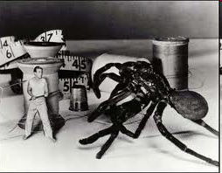
Stress as Function of Person-Environment Fit
Relation of Resources to Challenge
Stress Level
Resources >> Challenge
Resources ≥ Challenge
Resources < Challenge
Low
Medium
High

Slide 8
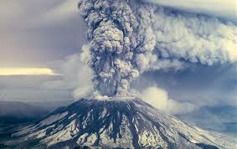
Primary Appraisal, Secondary Appraisal and the Volcano that Destroyed (almost) Washington State
Pennebaker & Newtson, 1983
Primary appraisal: Determine event: Positive, negative, neutral
If negative: Harm = damage done
Threat = Potential harm
Challenge or Threat Response = Appraised ability to manage event
Pennebaker Interviewed people who:
Had been flooded due to volcano
Were in path of possible flood
Who felt more stress?
__ Damaged by volcano
__ Waiting for possible damage
X
Mt. St.Helens

Slide 9
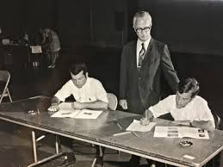
Temporal Dimension of Stress
You are informed of a major stressor (e.g., big exam) will occur in 6 weeks.
Your Stress is highest: ___ When informed of the stressor
___ The day before the stressor
___ The day of the stressor

Slide 10
Temporal Dimension of Stress
Your stress is highest: ___ When informed of the stressor
___ Day before the stressor
___ Day of the stressor
X
X
Stress anticipation: At least as stressful as actual stressor
Med Students and Exam Study (Sausen et al., 1992)
44 male med students: HR, BP, stress
Stress equally high before exam as during exam. Why?

Slide 11
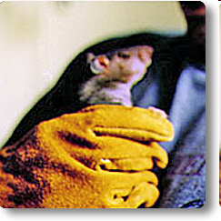
Learned Helplessness, Stress and Surrender Martin Seligman, 1970s
“Learned Helplessness” occurs when a person (or any animal) repeatedly encounters a stressor and has no control over it.
In Cannon’s terms, neither fight
nor flight do any good.
If you can’t control a previous threat, how does that affect FUTURE coping?
Seligman put rats in two conditions:
Helpless: held in strong grip until they quit struggling.
Not helpless: Grip relaxes due to struggling.
Then places them in severe stressor: See next slide

Slide 12
Learned Helplessness and Surrender Martin Seligman, 1970s
Non-helpless rats last?
“Helpless” Rats last?
60 hrs.
30 min.

Slide 13
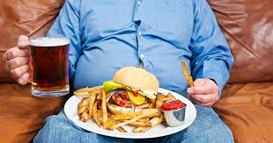
Learned Helplessness and Health
“Helplessness” affects health:
1. Increases stress, causes people to perceive
situations as uncontrollable, unmanageable.
2. They are less likely to change unhealthy patterns:
Neglect diet
Avoid Exercise
Not seek / not follow medical treatment

Slide 14
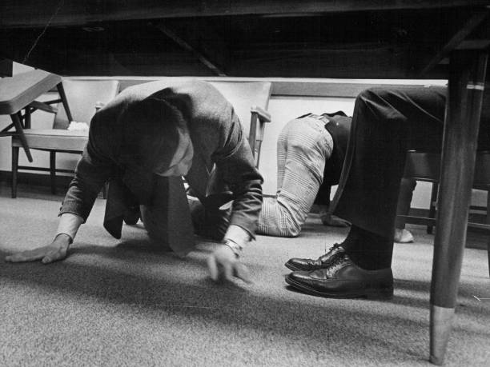
Do Task Stress and Environment Stress Affect Helping?
Cohen & Spacapan, 1978
Stressor: Subjects go to e.g. bookstore, on busy shopping day (High Density) or weekday (Low Density). Either record 5 best sellers (Load Task Load) or 10 best sellers (High Task Load) under time pressure.
Stress and social behavior. After task is done, nearby stranger shouts: Where’s my contact lens? Please help! (Cohen & Spacapan, 1978)
Helping after Unavoidable stress ___ Increases helping.
___ Decreases helping
X
Unavoidable stress in this study: Experiencing crowding (Density)

Slide 15
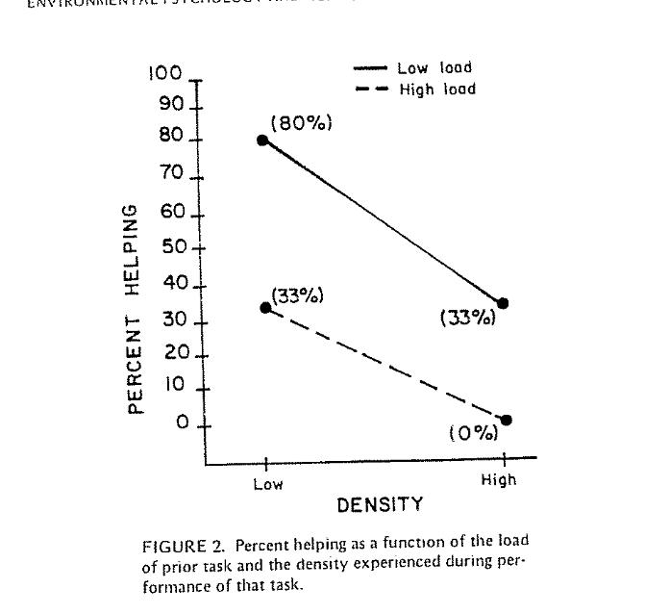
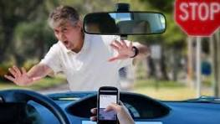
Task Stress, Environment Stress, and Helping
Cohen & Spacapan, 1978
Why do task load plus social crowding depress helping?
Authors’ Conclusion: Attention is limited. Crowing + Task Load distract would be helpers, don’t “see” other persons need. Like driving while texting.

Slide 16
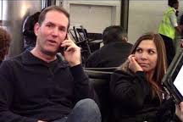
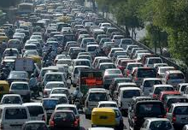
What Stresses You? Who are You?
Noisy people at restaurants, on subways?
Loud talkers on cell phones?
Stop and go traffic?
Upsetting movie scenes?
Random noises when you try to sleep?
Something nasty someone said earlier?
People who eat noisily, with mouth open?
Are you now / were you as a kid, shy and cautious?
Do you need to be alone to recharge/re-center?

Slide 17
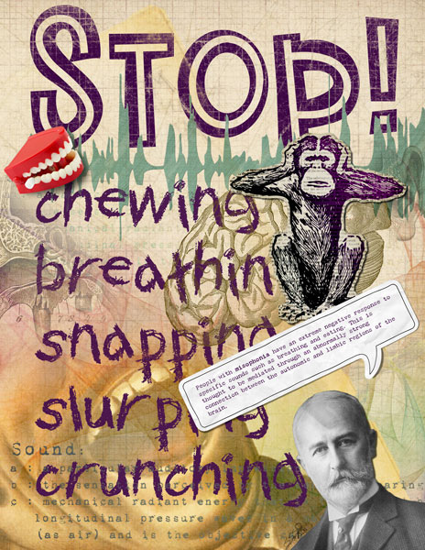
Misophonia:
Sensitivity to Small, Soft Sounds

Slide 18
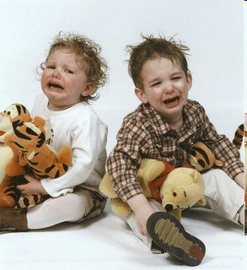
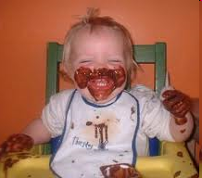
Reactivity and Stress Vulnerability
People vary in stress reactions
NOT just a matter of being mentally tough / whimpy
Physical constitutions differ
Autonomic NS Neuroendocrine response Immune response
Study of children 3-5 yrs old, reactivity Measure reactivity to stressor: a. Cardio (HR, BP) b. Immune Parents track stressor reactions, illness for 12 weeks Result: Stress leads to more illness among:
____ Low Reactive ____ High Reactive
X

Slide 19
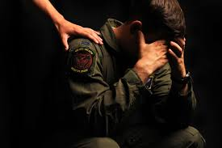
Aftereffects of Stress: Post Traumatic Stress Disorder
Cause: Experiencing or witnessing overwhelming event(s)
Onset: Immediately after, or days, or even years after event
Cognitive Symptoms: Flashbacks, nightmares, uncontrollable thoughts,
problems with memory, concentration.
Emotional Symptoms: Mood swings, high alarm, irritability, guilt, shame
Behavioral Symptoms: Withdrawal, detachment, depression
Health threats: Suicide

Slide 20
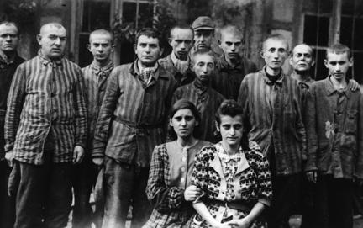
Epigenetics and the Heritability of PTSD
Children of trauma survivors, such as Holocaust, are more likely to show PTST vulnerability:
Greater mental health problems
Heightened vulnerability to stress
Greater cortisol reaction to stress
Greater vulnerability to depression, anxiety
Trauma can alter cells in their children and grandchildren. “Epigenetic changes”. Confirmation in rat studies.

