Slide 1
ANNOUNCEMENTS
Quiz 1 THURSDAY FEB 8
Covers Class 1 through Class 7
Administered at start of class
15 Questions + 2 Extra Credit Questions
All questions multiple choice
Questions similar in format to review questions
25 min. to complete
Feb. 8 lecture will be shortened accordingly

Slide 2
Studying Tips for Quizzes and Tests
Start early—this weekend. Class covers a lot of material.
Use Power Points
If not on Power Points, not on the test
Do not rely only on Power Points—use readings
Read Power Points as “stories”. What are main points?
What are main themes, and what points support them?
Use the Review Questions as guides to test questions.

Slide 3
Review Question 1
Which of the following challenges the Cartesian model of pain?
___ The specificity model of pain
___ The pattern model of pain
___ The role of A-Delta pain fibers
___ The role of C pain fibers
___ World War II wounded soldiers’ response to pain
X

Slide 4
Review Question 2
By using a mirror box, Ramachandran was able to do what for people with phantom limbs?
___ Distract them from the trauma of losing a limb
___ Relieve them from the pain in their phantom limb
___ Provide a way for others to empathize with them
___ Help them develop new skills
___ None of the above
X

Slide 5
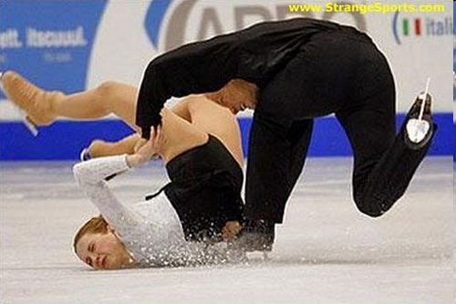
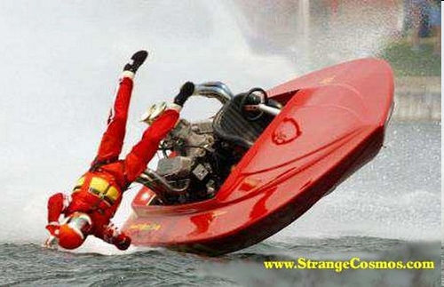
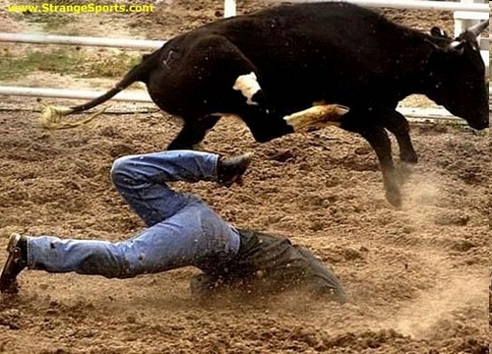
Class 6: Pain II

Slide 6
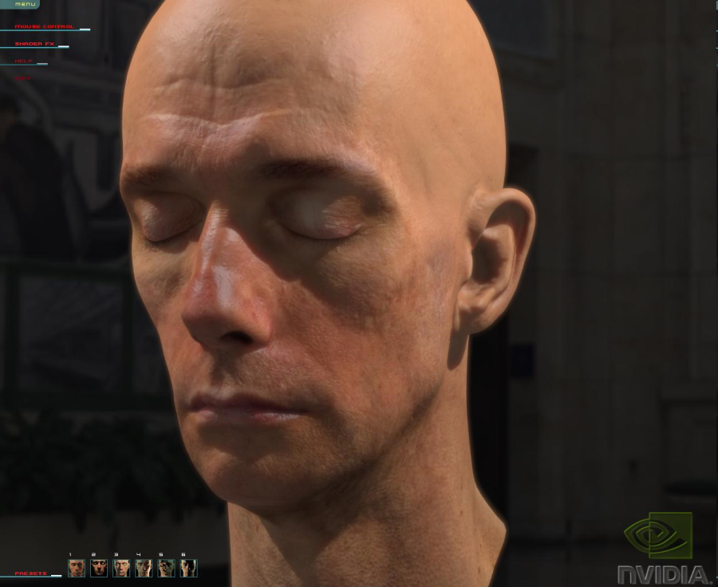
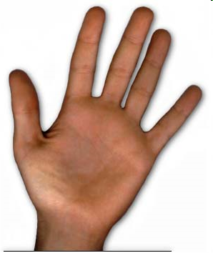
Neuromodule Model
Memories of previous injuries
Emotions
OWW!!
Injury to Periphery

Slide 7
Neuromodule Model
Memories of previous injuries
Emotions
OWW!!
Injury to Periphery

Slide 8
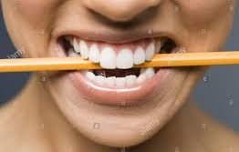
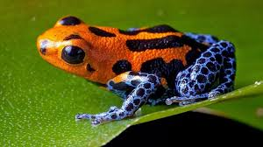
Neuromodule Approach to Pain
Fred. Lenz: Locates brain cells → panic attacks.
Smell and memory
Emotions launched via peripheral activity: Bite that pencil!
Neuromodules may explain "pain epidemics” e.g., carpal-tunnel epidemic
Neuromodule confirmed by new pain killers that reduce brain excitability.
Anti-epileptic drugs
Sea snail venom
ABT-594—from frogs. 200X more powerful than morphine.
Take home point: Pain is "all in the head"
Poison Dart Frog

Slide 9
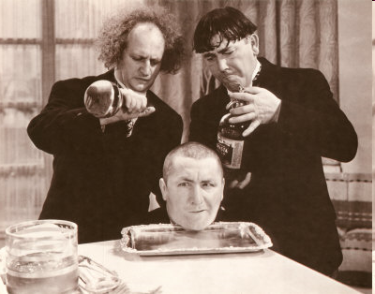
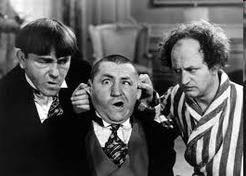
Musings on Responses to Others’ Pain
Why is others’ pain funny?

Slide 10
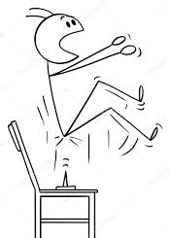
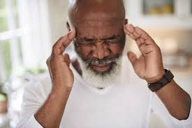
Acute Pain vs.
Chronic Pain
 | Acute Pain | Chronic Pain
Causes | specific injury --> tissue damage | Acute episode
Self Limiting? | Yes | No
Duration | Less than 6 months | 6 + months
Responsive to pain killers? | Yes | Minimally

Slide 11
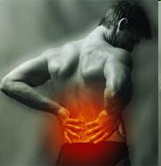
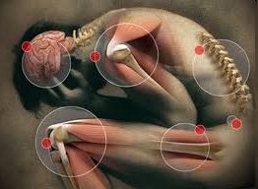
Types of Chronic Pain
a. Benign pain
1. Lasts for at least 6 mos.
2. Non-responsive to treatment
3. Example: lower back pain
b. Recurrent acute pain
1. Repeated episodes of sharp, acute pain, with pain free periods in between.
2. Last for at least 6 mos.
3. Example: Migraine headaches.
c. Chronic progressive pain
1. Duration: at least 6 mos.
2. Increases in severity over time
3. Example: Cancer, degenerate diseases

Slide 12
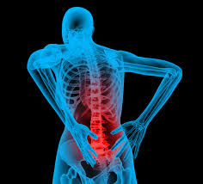
Life Meaning of Chronic Pain
You are in car accident, suffer chronic back pain that severely reduces your freedom of movement. What areas of your life would be affected?
Emotional toll: Depression
Work / Independence
Social / interpersonal implications
Leisure activities
Income / Standard of Living
Declined ability to deal with other life stresses

Slide 13
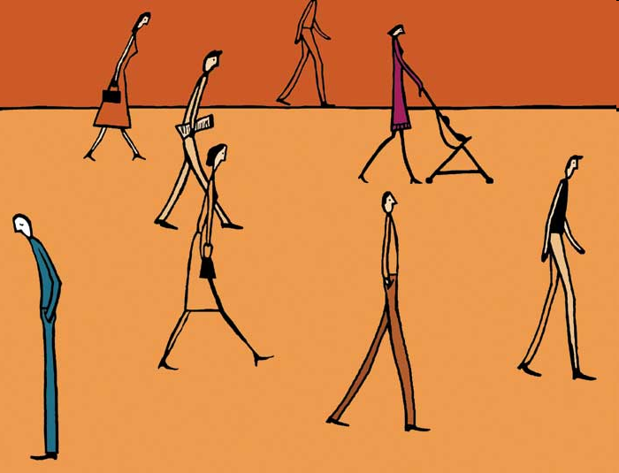
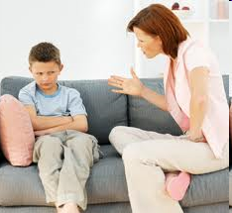
Psycho-social Complications of Chronic Pain
1. Counterproductive coping
a. Isolation
b. Negative beliefs
2. Social Support:
a. Hazards of no support
b. Hazards of positive support
Negative stereotypes
Medical complications and risks
5. Double binds (1-4, above)

Slide 14
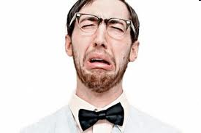
Pain Prone Personality
Are some personalities more prone to experiencing, reporting pain?
MMPI = Minnesota Multiphasic Personality Inventory
a. Acute pain pats: Hypochondriasis – overly attend to body Hysteria – extreme emotionality/exaggerate symps.
b. Chronic pain pats: Neurotic triad: Hypcondriasis + hysteria + depression
Secondary gain: What are social benefits of pain?
Attention, special identity
“Functional type”: neurotic triad + schizo / psychopathology / paranoia
Danger of “Pain Prone Personality” concept?
1. Negative stereotypes 2. Causal direction

Slide 15
Early Trauma and Increased Pain Sensitivity
1. Infant rats have paw injected with irritant, or not.
2. Mature rats exposed to hot surface:
* To injured paw
* To uninjured paw
* "Control" rats
3. Injured rats respond quicker, but only for hurt paw
4. Injured rats have more pain-nerve endings
5. Implications for humans:
* Surgery w/o anesthesia
* Treatment of premature infants

Slide 16
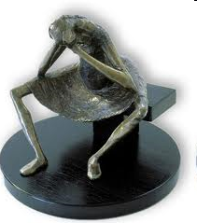
Pain and Depression
Wrong model:
Pain → Depression --- What’s missing?
Correct model:
Pain → ↓ activity → ↓ mastery → ↓ control → Depression

Slide 17
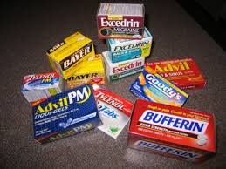
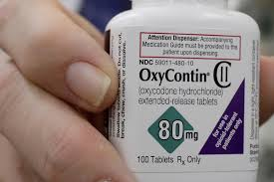
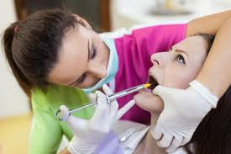
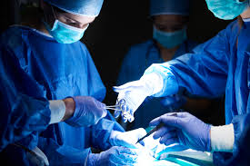
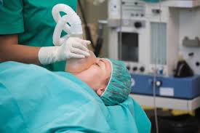
“MECHANICAL” PAIN REDUCTION TECHNIQUES
Drugs:
Topical, short acting
Opiates
Local anesthetic
General anesthetic
Surgery

Slide 18
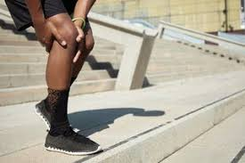
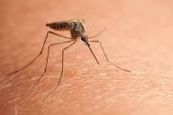
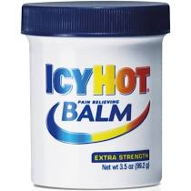
“MECHANICAL” PAIN REDUCTION TECHNIQUES: Counter-irritation
Counter-irritation stim. Dorsal horn cells → inhibit pain-transit cells.

Slide 19
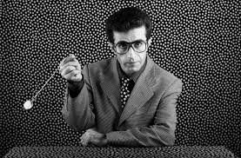
“PSYCHOSOCIAL” PAIN REDUCTION TECHNIQUES
Biofeedback
Relaxation
Hypnosis
Acupuncture
Distraction
Guided Imagery
Cognitive Reframing
Pain Management Programs

Slide 20
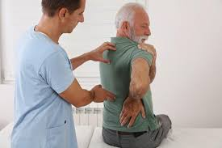
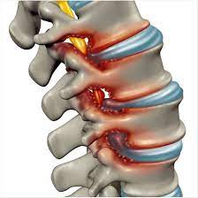
Treating Spinal Stenosis with Efficacy
Degenerative, painful, limits mobility, activity
Carlo Ammendolia
SELF EFFICACY MEASURE | Not At All True | Hardly True | Moderately True | Exactly True
1. I can always manage difficult problems if I try hard enough. | 1 | 2 | 3 | 4
2. If someone opposes me, I can find the ways and means to get what I want | 1 | 2 | 3 | 4
3. It’s easy for me to stick to my aims and accomplish my goals. | 1 | 2 | 3 | 4
4. I am confident I can deal efficiently with unexpected events. | 1 | 2 | 3 | 4
5. Thanks to my resourcefulness, I know how to handle unforeseen situations. | 1 | 2 | 3 | 4
6. I can solve most problems if I invest the necessary effort. | 1 | 2 | 3 | 4
7. I can remain calm when facing difficulties because I can rely on my coping abilities. | 1 | 2 | 3 | 4
8. When I am confronted with a problem, I can usually find several solutions. | 1 | 2 | 3 | 4
9. When I am in trouble I can usually think of a solution. | 1 | 2 | 3 | 4
10. I can usually handle whatever comes my way. | 1 | 2 | 3 | 4

Slide 21
Treating Spinal Stenosis with Efficacy
Carlo Ammendolia
Method: Exercises + Coaching + reframing
Outcomes: Pain lessened—somewhat
Depression and defeat lessened
Mobility—increased.
Take home Points: Separating pain from goals, efficacy.
Role of social support, encouragement

Slide 22
Summary Benefits of Psychosocial Approaches
Change meaning of experience
Provides skill set, reduces helplessness
Gives patients an active role in pain management
Success with techniques increases self-efficacy
Changes ways of thinking

Slide 23
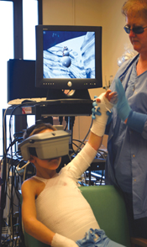
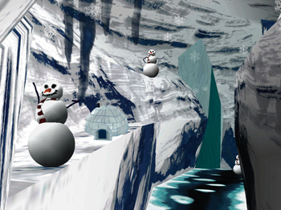
Pain Relief Through Virtual Reality
Severe burns one of most painful conditions to treat: cleaning, re-bandaging excruciating.
Pennebaker symptom research suggests that distraction should do what to pain?
Reduce it.
Why?
Competition of cues.
SnowWorld: Virtual Reality program designed for pain relief.
Patients enter SnowWorld during procedures
Shoot snowballs at snowmen, penguins
Report pain reductions 30%-50%
Note SnowWorld colors. Why?

Slide 24
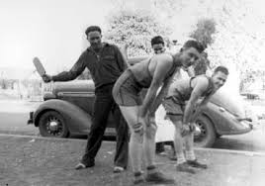
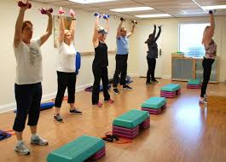
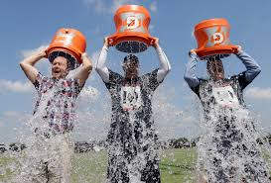
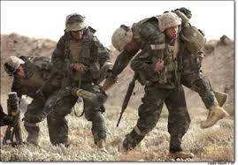
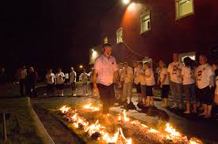
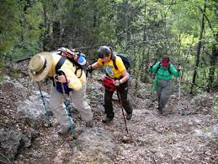
Why Do We Engage in Group Pain?

Slide 25
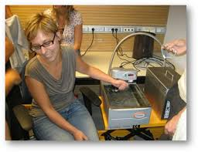
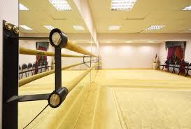
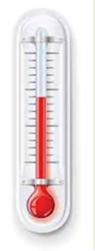
Pain and Bonding Study
Bastian, Jetten, Ferris, 2014
Pain Group
Non-Pain Group
I feel part of this group
I feel loyalty to this group

Slide 26
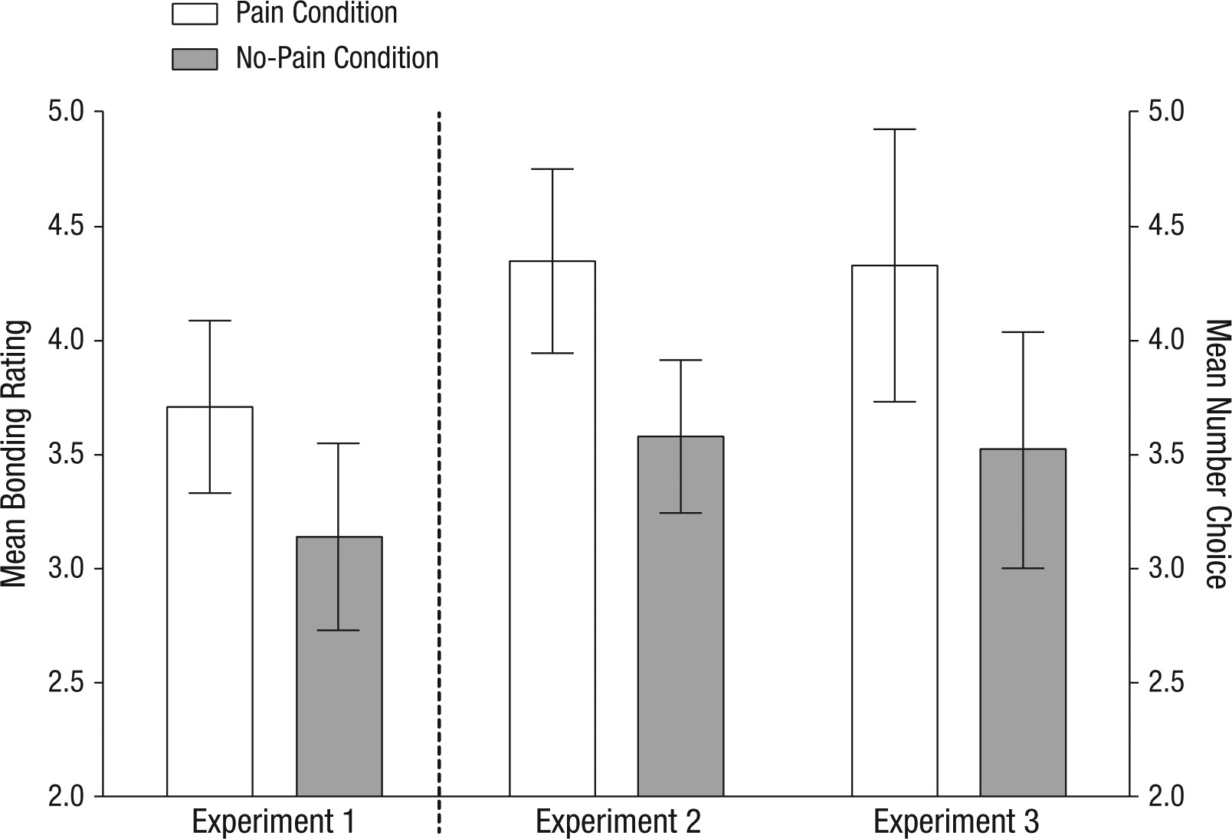
Pain and Bonding Studies: Closeness to Other Subjects Bastian, Jetten, Ferris, 2014

Slide 27
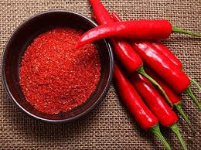
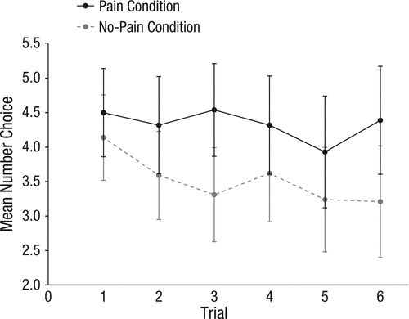
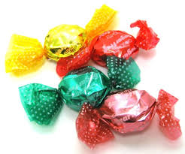
Pain and Bonding Studies: Cooperation and Generosity Bastian, Jetten, Ferris, 2014
Cooperation Task: Choose outcome that only benefits you (low score) vs outcome that benefits group (high score).
Pain Group
Non-Pain Group
Higher number = more cooperation

Slide 28
Why Would Pain Improve
Group Cohesion?
Misattribution Hypothesis
Pain → endorphins (endogenous opioids)
Endorphins elevate or depress mood?
Positive mood applied to others → increased liking
Empathy Hypothesis
Personal Pain → increased empathy
Empathy → helping
Attunement Hypothesis (reverse empathy)
Personal Pain → isolation, do others understand my situation?
Shared pain → others understand me → liking, cooperation

Slide 29
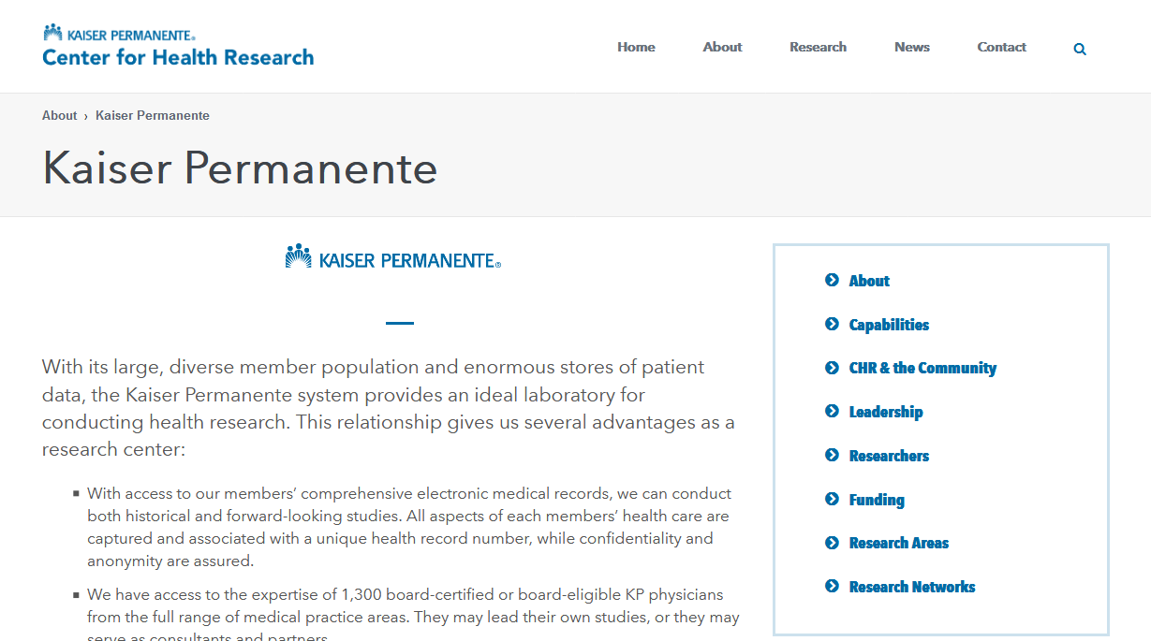
PAIN MANAGEMENT AND BEHAVIORAL MENTAL HEALTH: POLICY APPROACH AND CAREER OPTION

