Slide 1
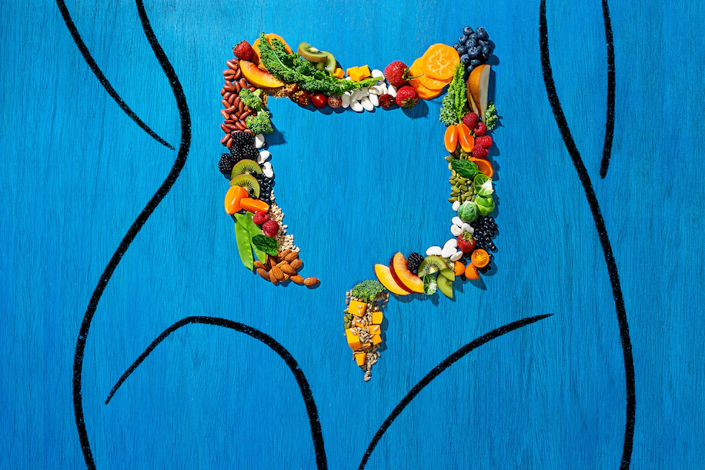
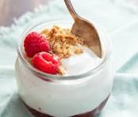
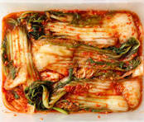
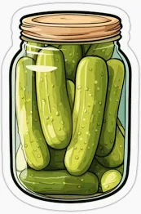
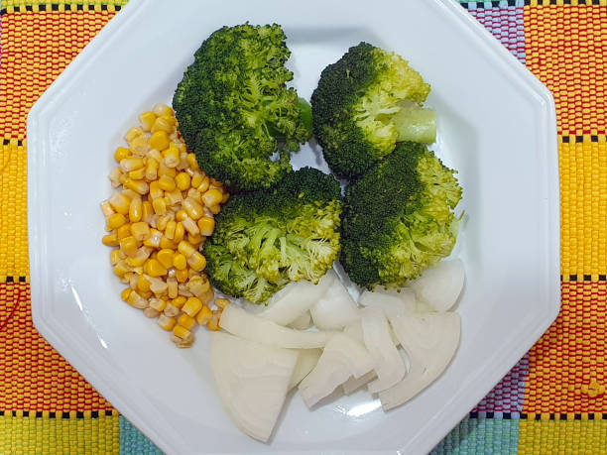
The link between our food, gut microbiome and depression
A new study takes an important step forward in understanding the relationship of gut bacteria to what we eat and how we feel
By Jessica Wapner, Washington Post, January 31, 2023

Slide 2
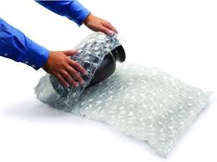
Wrapping Up Symptoms (Lecture 4)

Slide 3
Review Question 1
Which statement is true about symptom reporting?
____ Women report more than men
____ Older people report more than do younger people
____ People who live with 2-3 others report less than those living alone
____ People who live with 4 + people report more than those living alone
____ All the above
X

Slide 4
Review Question 2
Ruble (1972) told women that their menstrual period would occur 2 days earlier or 10 days later than was true. Women complained about premenstrual pain according to these false dates. This result most closely shows that symptoms are:
____ Shaped by schemas
____ Affected by running on an oval track
____ Unrelated to mental states
____ Not always conscious
____ Failing to see the ape among the ball tossers

Slide 5
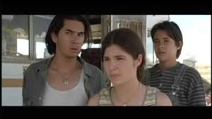
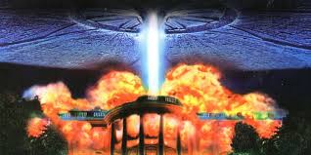
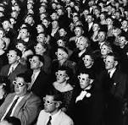
Coughing Study
Purpose: Can external cues distract people from internal reflex?
Ss see movie. Portions of movie pre-rated for interestingness.
Researchers count number of coughs at each 30 sec. portion.
← 1 = Boring 7 = Interesting →
Predict?
Fewer coughs at more interesting moments.
Result
Correlation of coughs to interestingness = -.57.

Slide 6
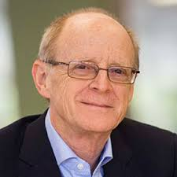
Symptom Defined
“A physical symptom … is a perception, feeling, or even belief about the state of our body. (It)… is often—but not always—based on physiological activity. Above all, a physical symptom …represents information about internal states.”
Pennebaker, 1983, p.1.
James Pennebaker
Does this mean that we are always conscious of our own symptoms? Can there be unconscious symptoms?

Slide 7
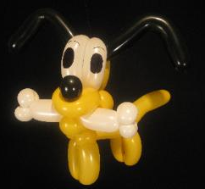
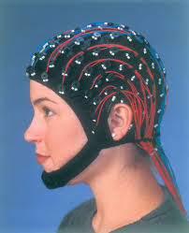
Unconscious Awareness of Symptoms
(Adams, 1980)
Can we have symptoms that we feel, but subconsciously?
Small balloon inserted into small intestine.
Balloon inflated, EEG (cortex) is monitored
Ss asked if they feel anything.
Say "Nope", but
EEG rises and falls with balloon inflation
People can be trained to detect balloon inflation
OK, cool. But why? Why have unconscious symptoms?
Can unconscious symptoms affect conscious thought?
EEG: Electroencephalogram

Slide 8
Do Symptoms Affect Opinions?
Dolf Zillman
Ss run on treadmill, get physically worked-up.
Ss rate how much they favor/disfavor politicians.
Ss assigned to three rating groups:
Group 1. Immediately after treadmill
Group 2. 10 min. after treadmill
Group 3. 20 min. after treadmill
Which Group rates politicians most extremely?
Extremely Extremely
Dislike Like
| | | | | | | | |

Slide 9
Do Symptoms Affect Opinions?
Dolf Zillman
Group 1 Group 2 Group 3
 | Time of Rating After Exertion | Immediate | 5-10 minutes | 15 minutes
 | Arousal Level | Much Higher, Evident | Higher, but not Evident | Low (baseline)
 | Nature of Rating
Moderate
Extreme
Moderate
Explanation: Group 1—know they are aroused, discount arousal
Group 2—feel relaxed but body is still aroused, misattribute
Group 3—feel relaxed and are relaxed, no arousal effect

Slide 10
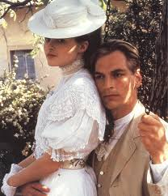
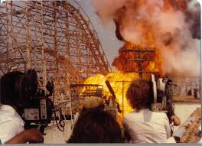
Symptoms, Misattribution, and Attraction
Which is the better movie to induce attraction?
____ Love: A Poem of the Yearning Heart
____ The Rollercoaster From Hell

Slide 11
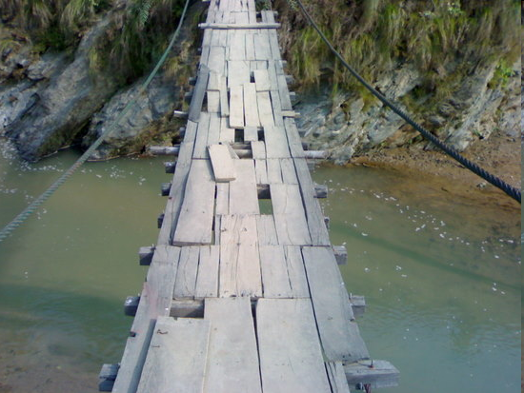
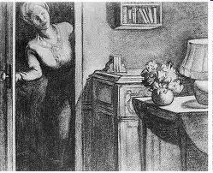
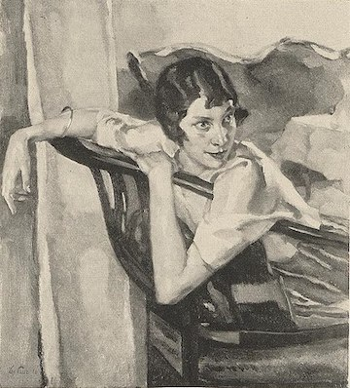
Symptoms, Misattribution, and Attraction
____ Love: A Poem of the Yearning Heart
____ The Rollercoaster From Hell
Which is the better movie to
induce attraction?
X
Swinging bridge study (Dutton & Aron,1974)
1. Male Ss cross / don't cross scary bridge
Ss then complete TAT cards with pretty experimenter
Ss interpret cards as more sexual if they crossed scary bridge. Why?
4. Ss more likely to phone experimenter for debriefing if crossed bridge.

Slide 12
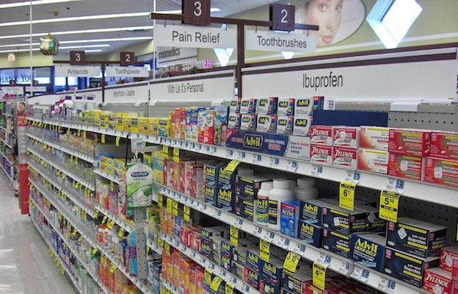
Class 5
Pain

Slide 13
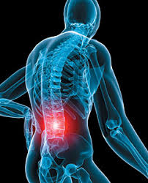
Why Does Pain Happen? The Mysterious Case of Rowland Scott Quinlan
Quinlan successful architect, has severe injury at job-site.
Surgery is a technical success, but Quinlan still has debilitating pain attacks.
Why?
Not organic; no evidence of major phys. trauma, no continued damage
Clues: Neg mood, depression induce pain
Pos. mood alleviates pain
Is Quinlan faking? Is he delusional?
His situation, in fact, is very common – extreme pain, no phys. cause.

Slide 14
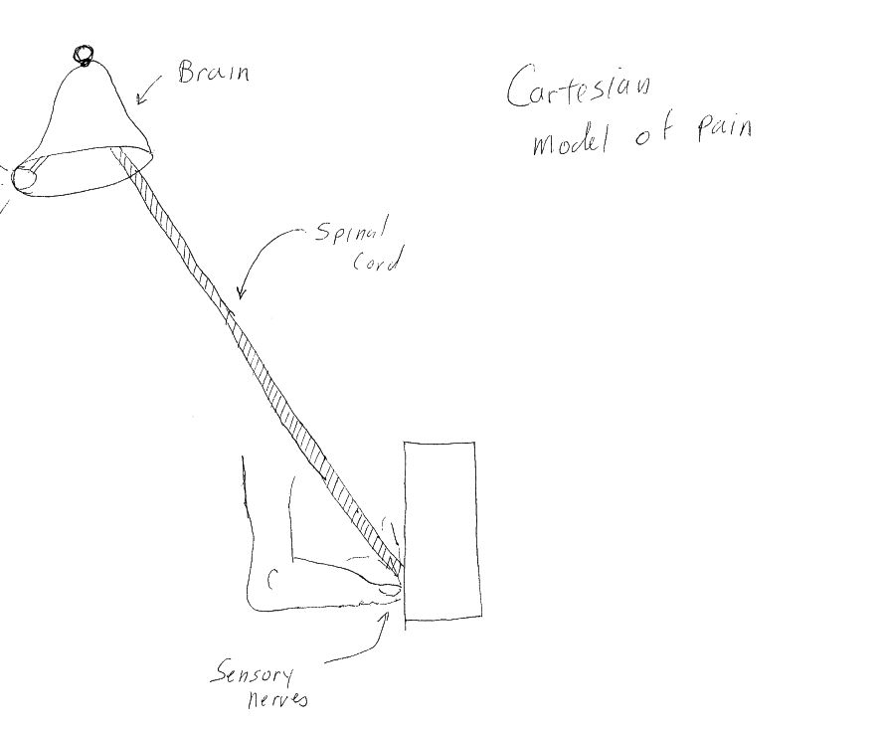
Cartesian Model of Pain
DeCarte
Dualism: Mind and body are separate.
Body produces sensations, mind is the passive receiver of body sensations.
One-to-one relation between injury and pain; bigger the injury, more intense the pain.
Pain path is unidirectional: From body to mind, not from mind to body.
The “bell” can’t pull the cord!

Slide 15
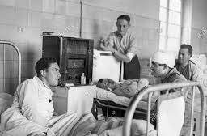
Implications of, Challenges to Cartesian Model of Pain
Implications of Cartesian Model
1. Pain seen as consequence of injury, but not a problem in itself
2. Med training neglects pain.
3. Patients disagree: Pain is THE most important issue
Challenges to Cartesian Model
Henry Beecher WW II observations of wounded soldiers.
72% with bullet wounds, torn limbs, broken bones—request no meds Only 28% request morphine.
Different Pain Responses: Athletes vs. shut-ins, dancers vs. non-dancers, extroverts vs. introverts

Slide 16
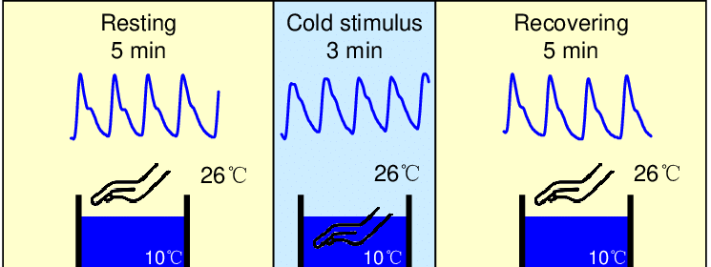
Measuring and Defining Pain. Bucket! It’s Cold!
Cold-Pressor Task:
Pain Threshold: When pain begins
Pain tolerance: When pain is unbearable.

Slide 17
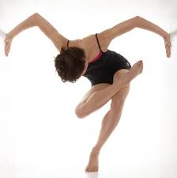
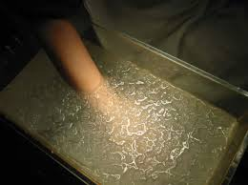
Dancing Through Pain
Subjects: Dancers and Non-dancers
Cold-Pressor Task:
Pain Threshold: When pain begins
Pain tolerance: When pain is unbearable.
Dancers’ pain threshold, pain tolerance 3 times greater than non-dancers.
Gender made no difference
Why? High pain efficacy; pain less fearful. Can separate physical pain from emotional distress.
Key terms: Pain threshold, pain tolerance

Slide 18
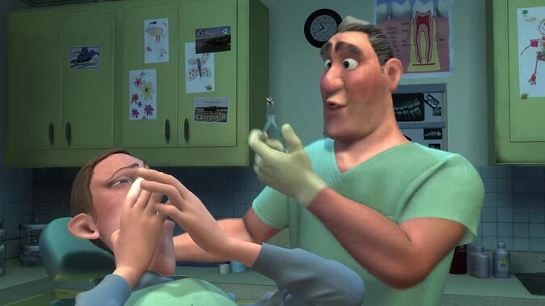
DENTAL PAIN PLACEBO STUDY
Dental patients in one of three pain treatment conditions. Which one feels least pain?
___ Placebo + reassurance that they won’t feel pain.
___ Placebo + no reassurance
___ Anesthetic + no reassurance
X

Slide 19
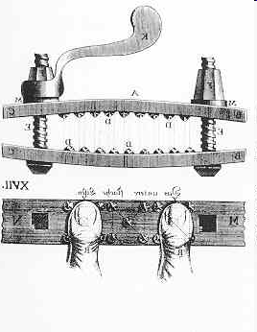
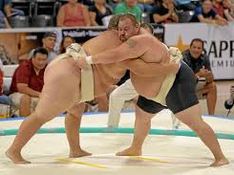
A History of Pain
Von Frey (1894): Specificity Model
Specific receptors, one dedicated to cause pain (others to pressure, touch, warmth)
Goldschneider (1894): Pattern Theory of pain,
one receptor, but pattern of input causes pain.
Current approach: Specificity + Pattern

Slide 20
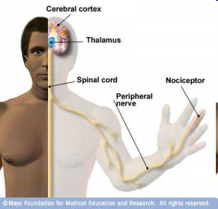
Nioception: The Physiology of Pain Perception
A-delta fibers: Myelinated, sharp/quick pain
C-fibers: Non-myelinated, slower, chronic dull pain
Influence emotional/motivated pain
Pain is result of balance of A-deltas + C-fibers ,
PLUS
Neurotransmitters: Substance P
PLUS
Cerebral activity: Attention, emotions, meaning
Nocicepeptor: Where pain is triggered.

Slide 21
Gate Theory of Pain
(Melzack & Wall, 1965; 1982)
Brain actively involved in pain experience, not just passive receiver.
Pain moderated:
a. From periphery (e.g., cut finger) on to brain via spinal cord b. From brain down to periphery
Operation of Gate Theory
1. Signals carried via A-Delta or C fiber up to spinal cord
2. Reach gating mechanism in dorsal horn of spinal cord
3. Gate is opened IF: Stim reaches threshold AND brain interprets signal as pain
4. Interpretation is influenced by emotions, prior learning
Anxiety --> more pain
Pos. emotions, distraction, FEAR --> less pain

Slide 22
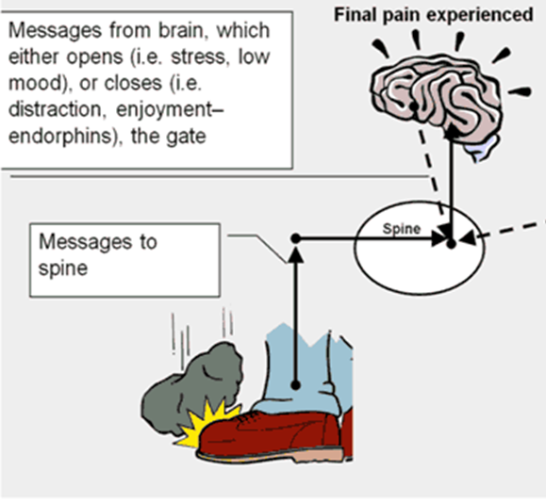
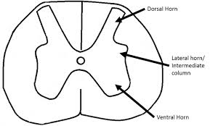
Gate Theory of Pain
(Melzack & Wall, 1965; 1982)
Dorsal Horn
Back of Spinal cord
Cross Section of Spinal cord

Slide 23
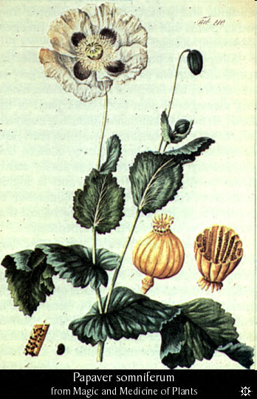
Mental States Affect Pain: Stress and Opioids
Opiate: Drugs from plants that kill pain. Morphine, heroin
Endogenous opioids (aka endorphins): Like opiate but produced by body.
Stress triggers endorphin production. But endorphins suppress immune sys.
Stress to Illness
Stress --> opioid release --> immune suppression --> increased illness.
(More on this in coming weeks)

Slide 24
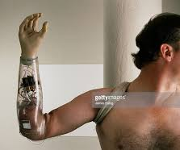
Neuromodule Approach to Pain
Melzack's Gate Theory is revolutionary, helpful, but limited!
Some people experience pain without ANY injury.
Gate Theory doesn’t explain injury-less pain, such as Quinlan’s
Pain should be triggered by major event (i.e., serious injury) but for some people pain program is trigged by minor event (i.e., bad mood).
Phantom limb pain
Pain occurs only because of CNS* activity—neuromodules.
Neuromodules are like lines of software code, or tracks on CDs
* CNS = Central Nervous System = Brain

Slide 25
Phantom Limb Pain: Evidence of “Mental” Pain
I placed a coffee cup in front of John and asked him to grab it [with missing hand]. Just as he said he was reaching out, I yanked the cup away. "Ow!" he yelled. "Don't do that!" "What's the matter?" "Don't do that," he repeated. "I had just got my fingers around the cup handle when you pulled it. That really hurts!"
Hold on a minute. I wrench a real cup from phantom fingers and the person yells, ouch! The fingers were illusory, but the pain was real - indeed, so intense that I dared not repeat the experiment.
V.S. Ramachandran Phantoms in the Brain
Phantom limbs will: Itch, twitch, gesticulate during conversation, and will take actions “on their own”.
Phantom limb paralysis: Brain “learns” that attempts to move missing limb fail, translate it into paralysis, creates excruciating cramps.

Slide 26
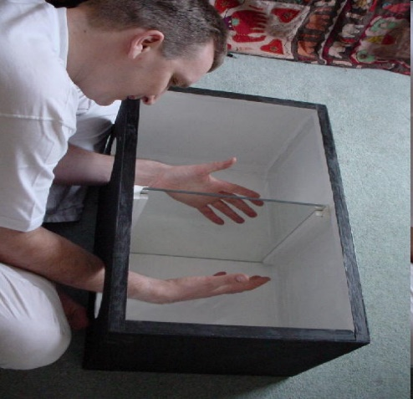
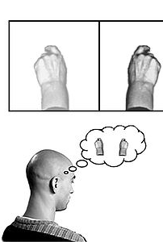
Alleviating Phantom Limb Pain
1. Patient places healthy limb and stump into mirror box.
2. Look through top, at angle, “see” two limbs.
3. Move healthy limb in “mirror symmetric movement”, like orchestra conductor or clapping hands.
4. Creates artificial visual feedback of phantom limb being intentionally controlled.
5. Patient then instructed to clench good hand, tightly—sees both hands clenched.
6. Patient told to slowly unclench “both hands”, and phantom limb relaxes, providing relief to chronic pain.
7. Repeated trials led one patient to “loose” phantom arm, but phantom hand now attached to shoulder!
Mirror Box

Slide 27
Phantom Limb Patient Using Mirror Box Ramachandran, Phantoms in the Brain
Philip rotated his body, shifting his shoulder, to "insert" his lifeless phantom into the box. Then he put his right hand on the other side of the mirror and attempted to make synchronous movements. As he gazed into the mirror, he gasped and then cried out, "Oh, my God! Oh, my God, doctor! This is unbelievable. It's mind boggling!"
He was jumping up and down like a kid. "My left arm is plugged in again. It's as if I'm in the past. All these memories from so many years ago are flooding back into my mind. I can move my arm again. I can feel my elbow moving, my wrist moving. It's all moving again.
V. Ramachandran

Slide 28
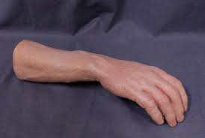
Can Healthy Limbs Be “Fooled”?
(From Ramachandran)
Purchase a realistic but fake arm/hand
- Sit at table with one hand resting on the table, the other beneath the table.
- Position the fake arm/hand on the table in the corresponding position as though both hands/arms are resting on the table.
- Have associate tap both real hand that is beneath table and the fake hand in synchrony as you watch the fake hand.
- Notice how sensations appear to originate from the fake hand/arm.

Slide 29
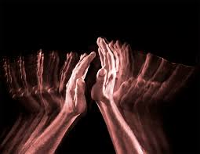
We’re Done! See you Thursday for Pain II

