Slide 1
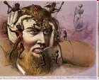
Class 4: Symptoms
NOTE: Past lectures/PowerPoints on Kent Harber webpage:
http://nwkpsych.rutgers.edu/~kharber/healthpsychology/
Current (2024) lectures on Canvas

Slide 2
REVIEW QUESTIONS PHYSIO II
The respiratory problem causes by insufficient oxygen (but unrelated to CO2) is [hint—World War II bomber crews]:
___ Asphyxia
___ Anoxia
___ Hay Fever
___ Asthma
___ Hyperventilation
X

Slide 3
REVIEW QUESTIONS PHYSIO II
The “Biome” refers to:
___ Nausea induced by non-compliance
___ National lab dedicated to health psychology
___ The massive colonies of bacteria in the gut
___ Medication that targets digestive tract
___ All the above
X

Slide 4
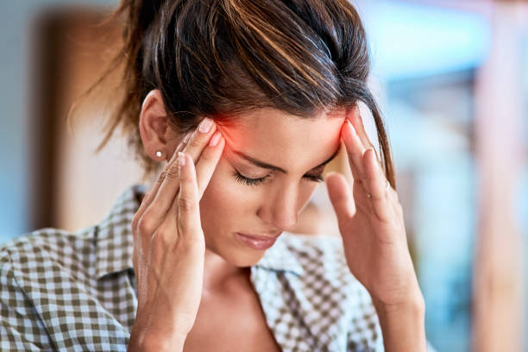
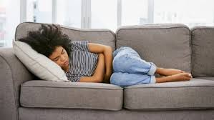
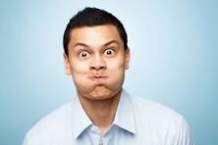
What is a Symptom?
How strongly did you feel symptoms?
How easy is it to name symptoms?
Did you feel any emotions with your symptoms?

Slide 5
Symptom Defined
“A physical symptom … is a perception, feeling, or even belief about the state of our body. (It)… is often—but not always—based on physiological activity. Above all, a physical symptom …represents information about internal states.”
Pennebaker, 1983, p.1.
James Pennebaker

Slide 6
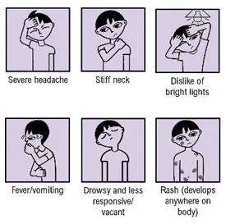
Functions of Symptoms
Why do we have symptoms?
Sign that problem exists
Provide clues to nature of problem
Locate problem
Provide means to inform others of problem
Provide clues how to treat/respond to problem

Slide 7
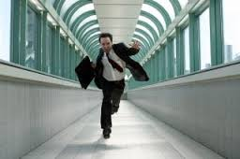
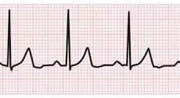
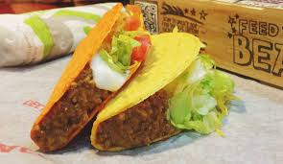
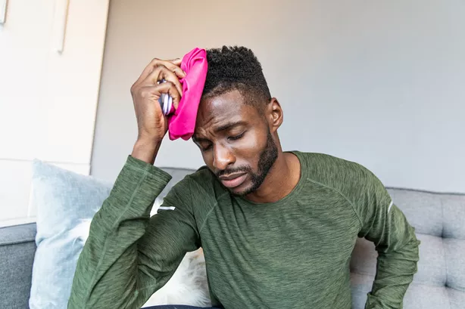
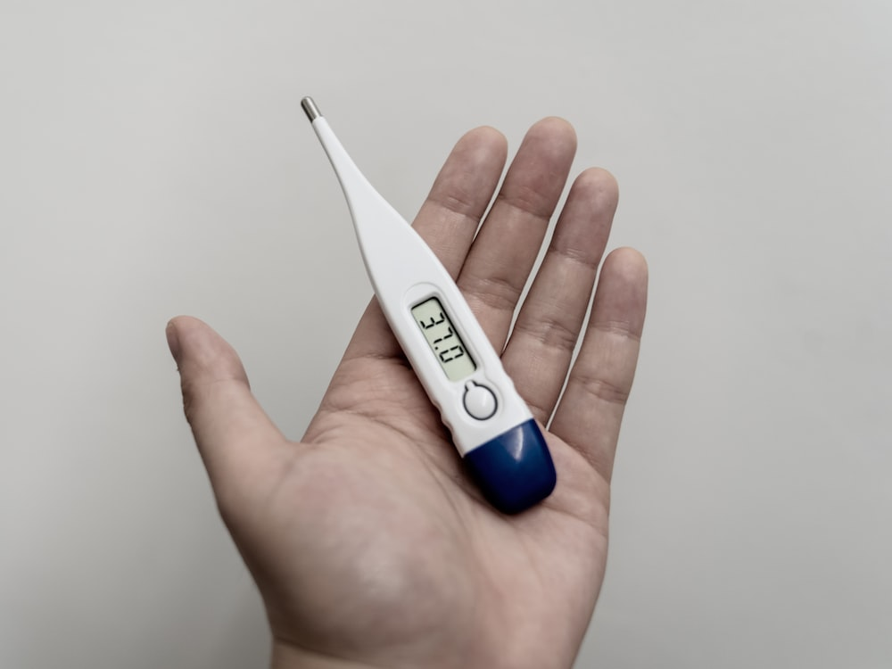
The Psychology of Symptoms: Main Questions
When do we first notice symptoms? How do we know that a symptom is “happening”?
How do our beliefs about illness and our own bodies affect the way we interpret symptoms?
How well do perceived symptoms match up with actual physical states?
OR
VS.

Slide 8
The Psychology of Symptoms: Main Questions
How do symptoms match with personality?
How do people differ in the ways that they label symptoms?
(go to next slide).
TYPE OF PERSON
 | ANXIOUS PERSONALITY | CARDIO-CONDITION
ANXIETY | CORRECT | INCORRECT
CARDIOLOGICAL | INCORRECT | CORRECT
TYPE OF SYMPTOM

Slide 9
Issue #5: Labeling Symptoms
Shortness of breath means?
____slow/labored
____rapid/shallow
Tense muscles makes you think of?
___Back ___Shoulders ___Chest ____Legs
"Dr., I have shortness of breath and muscle tension" could mean:
Slow, labored breathing Rapid/shallow breathing
Tense back, chest Tense shoulders, legs

Slide 10
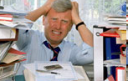
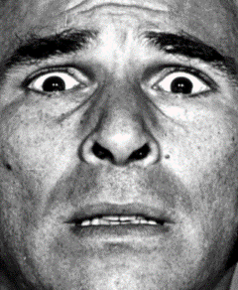
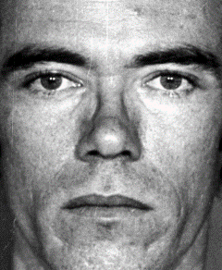
Who Are More Likely to Report Symptoms?
Psychological Profiles
Emotionality
Coping style
Demographics
Age
Sex
Marital status
Residential status
Occupational status
SES
Race and culture
Emotion focused
Problem focused
Anxiety, neuroticism, negative affect
(more so)
(less so)
Younger
Older
Men
Women
Married
Never married
Previously married
Alone
2-3 others
4+ others
Employed
Unemployed
Low SES
High SES
Irish > Italians, Blacks < Whites. Jews: danger, Yankees: be tough

Slide 11
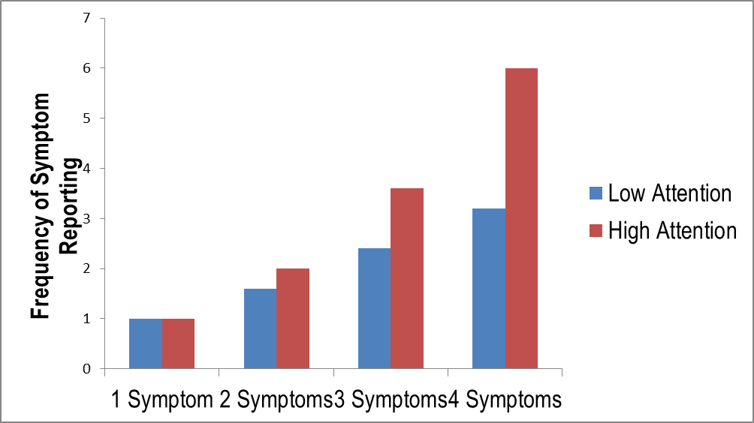
Symptom Reporting: Number of, Attention to Symptoms
X
____ Numbers of actual symptoms
Rates of symptom reporting could be due to:
X
____ Differential attention to symptoms
X
____ Number + Attention

Slide 12
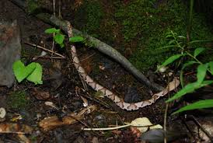
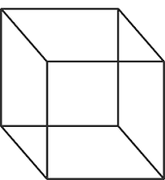
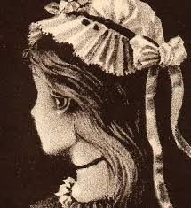
Perception of Symptoms Guided By Same Processes as Perception In General
Perception is motivated; Emphasizes survival cues.
Perception is often active;
We organize what we see in order to see.
Beliefs organize perception

Slide 13
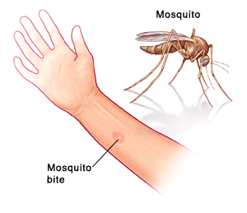
Conditions of Perception
Limited capacity to process information
Info exists inside and outside person.
Perception can be both passive and active
[Passive: Glance at arm, see bite→ itch]
[Active: Arm itches, roll up sleave, find bite]
Elements of Perception
1. Orienting: Does cue (event/sensation) get our attention Unique? Complex? Mobile?
2. Schemas: Expectations, pre-set ways of understanding events.
3. Inference: Drawing conclusions from available information
[Orienting + Schemas → Inference]

Slide 14
Schemas and Symptoms
Schema: Concept or framework that helps interpret or organize information.
Realtor
House tour as a:
Recall?
Thief
Premenstrual Syndrome and expectations of PMS symptoms (Ruble, 1972)
Women know about PMS and associated symptoms
Women told period due in 2 days or in 10 days – in fact, all due in 7 days.
All women asked “To what extent are you currently experiencing PMS?”
Result?
Women told period starts in 2 days report more current PMS symptoms

Slide 15
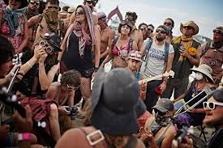
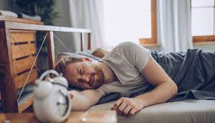
From Schema to Orientation to Inference: How Beliefs Shape Symptom Perception
Day 4
Days 1-3
Headache
Dizzy
Gastro-intestinal problems
Cough
Body Aches
Sore Throat
Reduced sense of smell
Confusion
Hung Over?
COVID-19?

Slide 16
Inference and Symptoms: Combining Orientation and Schemas
Inference: Drawing conclusion from symptoms, as guided by schemas.
Schema? Orientation? Inference?
I have a slight headache =
Orientation
Got new glasses; told might induce headache =
Schema
I probably have a headache b/c of new glasses =
Inference
Key terms: Orientation, Schema, Inference

Slide 17
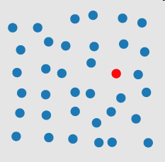
Perception is Driven By:
Cue Salience
(A. Triesman)
Person's Plans, Expectations
(D. Simons)
Person's Physical Condition/Physical State
(D. Proffitt)
http://www.youtube.com/watch?v=vJG698U2Mvo

Slide 18
Pennebaker Symptom and Exercise Studies
How does attending to internal cues or external cues affect feelings of exertion during exercise?
Symptom reporting is a function of (Internal Cues) minus (External Cues)
Prediction: Exercise with fewer external distracters will lead to more attention to internal cues.
Procedure Subjects all run same distance: oval track OR cross-country
Predictions
a. Who has more symptoms?
b. Who runs faster?
Result?

Slide 19
Pennebaker Symptom and Exercise Studies
How does attending to internal cues or external cues affect feelings of exertion during exercise?
Symptom reporting is a function of (Internal Cues) minus (External Cues)
Prediction: Exercise with fewer external distracters will lead to more attention to internal cues.
Procedure Subjects all run same distance: oval track OR cross-country
Predictions
Who has more symptoms? No difference
Who runs fasters? Cross Country
Result?
Cross-country run faster (9.2 min v. 10.1 min) no symptom diff.

Slide 20
Pennebaker Treadmill Study Design
Problem with running study: Did pace really differ b/c of attention to internal v. external cues?
Treadmill study done to address this problem
Ss run on treadmill, which keeps time and effort:
constant
Ss wear headphone, playing either:
a. Themselves breathing b. Street sounds c. Nothing at all
 | Day I | No Sound | No Sound | No Sound
 | Day 2 | Breathing | Street | No Sound

Slide 21
Pennebaker Treadmill Study Results
Conclusion: When exertion is held constant, Ss who focus on body (“breathing” condition) become more / less aware of their own physiological state.

Slide 22
Relevance of Running and Treadmill Studies
Who has more health complaints?
___ Depressed ___ Non-Depressed
___ Work/live alone ___ Work/live with few others
X
X
Do professional athletes distract from / attend to internal states?
___ Distract ___ Attend
X

Slide 23
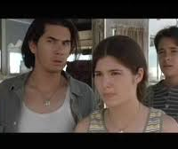
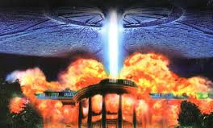
Coughing Study
Purpose: Can external cues distract people from internal reflex?
Ss see movie. Portions of movie pre-rated for interestingness.
Researchers count number of coughs at each 30 sec. portion.
← 1 = Boring 7 = Interesting →
Predict?
Fewer coughs at more interesting moments.
Result
Correlation of coughs to interestingness = -.57.

Slide 24
End of Class 4, with Procedural Comment
Covered a lot today; don’t want to overload. Figure 30 slides per class session
More on Symptoms, moved to start of Class 5
We will balance content with attentional demands
You will only be responsible (in quizzes, tests) for what is covered in lectures.

