Slide 1
Health Psychology
21 830 424
Spring, 2024
Professor Kent Harber
kharber@psychology.rutgers.edu

Slide 2
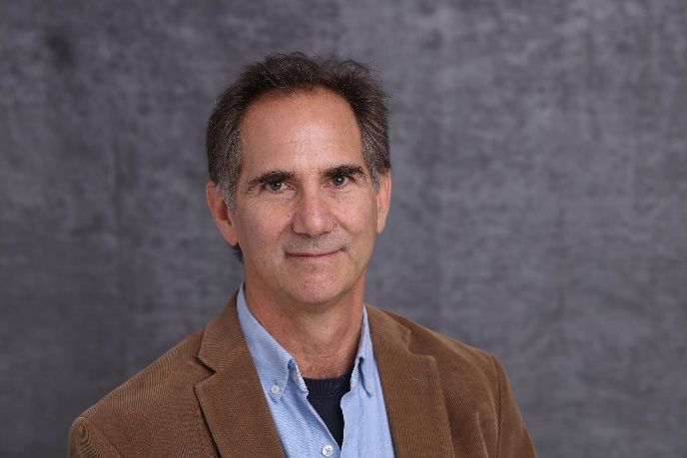
Hello Health Psych Class, Spring 2024!
I’m Kent Harber, Professor of Psychology, Rutgers Newark
I am a social psychologist; I conduct experiments to understand human nature.
My research interest relate to themes we will cover in class:
* Psychosocial resources and coping
* The benefits of emotional disclosure
* Fear of hope

Slide 3
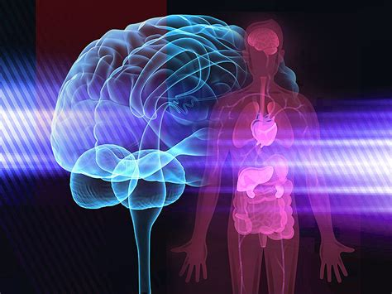
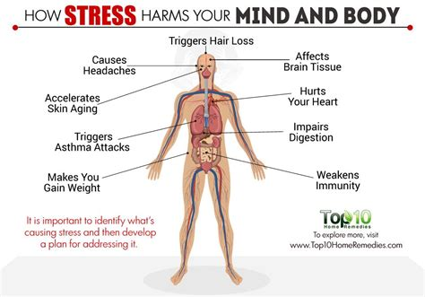
What This Class Will Cover
Defining Health Psych. Mind & Body
Physiological Systems: The body
Physical Symptoms and Pain, Interoception
Stress
Psychoneuroimmunology
Personality, Mood States, and Health
Coping with Threatening Events
Psychosocial Resources and Health

Slide 4
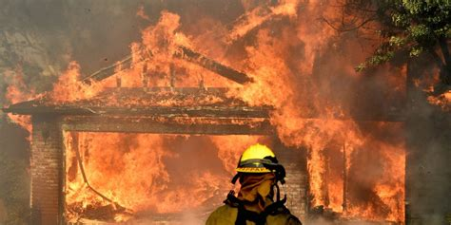
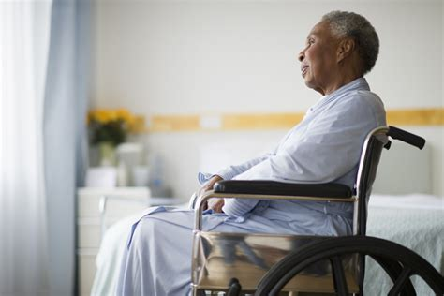
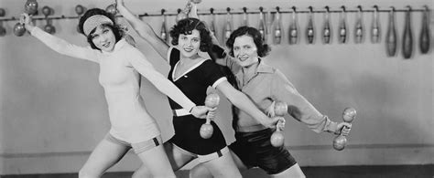
What This Class Will Cover Continued
Emotional Disclosure
Collective Coping
Positive and Negative Social Support
Stigma, Race, Gender, and Illness
Being a Patient
Being a Health Care Provider
Humor and Coping
Living a Healthy Life

Slide 5
Readings and Materials
Course Syllabus: On Canvas, my webpage.
Text: Taylor, S. (2008). Health Psychology, 7th Edition.
Available on Amazon, and also as an ereader at thebooksyclub https://thebooksy.club
The 11th Edition is available at the Rutgers Bookstore. But see readings.
Readings: All readings are posted on Canvas. I recommend that you read material prior to class. You should review readings prior to tests!
PowerPoint Slides: On Canvas and “previous version” on my website: http://nwkpsych.rutgers.edu/~kharber/healthpsychology/classes/
a. Download “previous version” before class for note taking, option.
b. Use “post class version” to study for exams.

Slide 6
Office Hours and Contact Info
Office Hour: Tuesdays, 2:00-3:00 and by appointment
Office Location: Smith 352
My email: kharber@psychology.rutgers.edu
This information is in the class syllabus

Slide 7
Grading
a. Quiz 1 10%
b. Mid-term 30%
c. Quiz 2 10%
d. Final 30%
e. Project 15%
f. Attendance 05%
100%
Extra Credit 6%
NOTE: All tests are multiple choice.

Slide 8
Extra Credit
You can earn extra credit by:
a. Completing “Stigma for a Day” exercise = 2 points
I’ll announce when this is available.
b. Completing up to 4 Subject Pool experiments
= 1 point for each 30-minute online experiment.
Information on signing up for subject pool
experiments will be forthcoming.
NOTE: You can earn no more than 6 extra credit points, total.

Slide 9
Tips on Reading, Studying, and Class Notes
1. Take notes during class. Don’t be a passive listener.
2. Read with your pen. Make margin notes, don't just highlight.
3. Empirical (research) articles
Read Intro and Discussion carefully, skim Methods and Results. I will cover methods and results in class.
PowerPoint Slides: Download and study these.
Tests require serious study.
Attend class and take notes
Download and study PowerPoints
Use Text and Readings to understand PowerPoints.

Slide 10
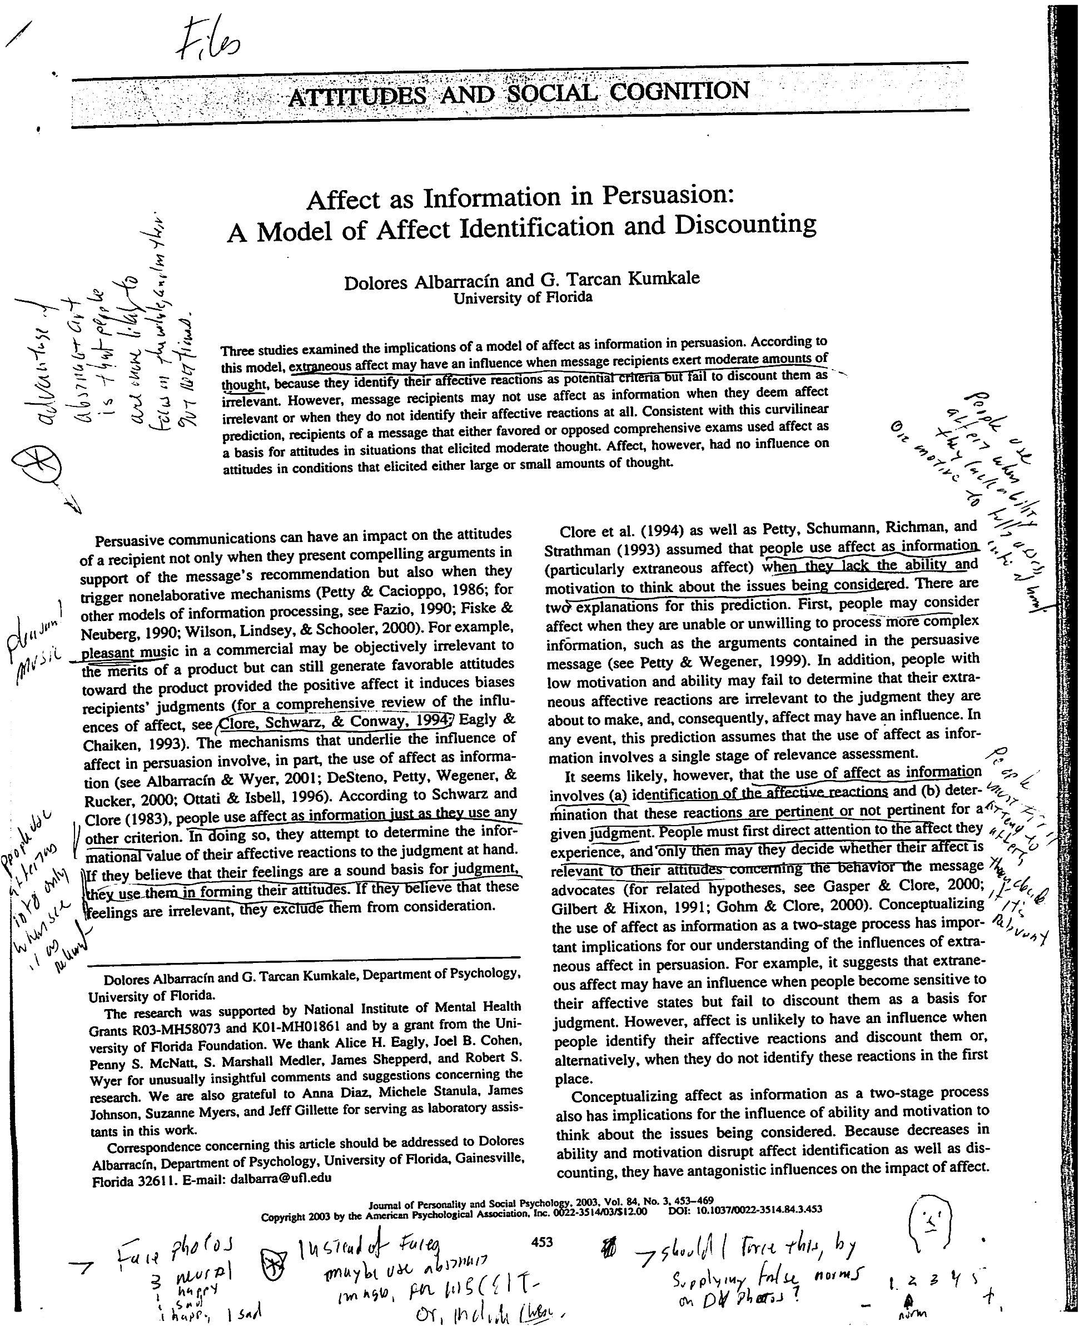
Reading With Your Pen

Slide 11
What to Expect from This Class
Workload: Reasonable, but not trivial
* Each class will fill 100 minutes, 25-30 Power.Pt slides per class.
* Multiple readings per class
* 2 quizzes, two tests, writing assignment
Grading: Moderately tough but fair grader
* Require you to follow lecture material fully
* Only test on material covered in lecture
* But don’t neglect readings. PowerPts are “postcards” from readings
* No “trick” questions, no super-narrow questions.
Is this class as hard as calculus, organic chem, physics? NO
Is this class cake, you just can cruise by? NO
Be prepared to work and be challenged.
Do the work, you’ll do fine. But do the work.

Slide 12
Health Psychology Defined
“Health psychology is devoted to understanding psychological influences on how people stay healthy, why they become ill, and how they respond when they get ill”.
Taylor, p. 3
“A complete state of physical, mental, and social well being and not merely the absence of disease or infirmity”.
World Health Organization (WHO)

Slide 13
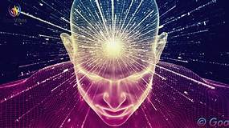
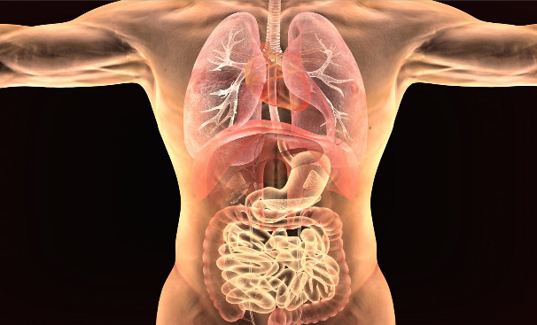
Mind-Body Problem
Are the mind and the body separate things?
Are they one united thing?
Modern medicine—mind and body different things. Body a machine.
Would you be you if your brain was transplanted into another body?

Slide 14
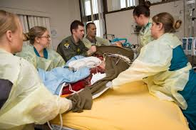
Modern Medicine: The Body as a Machine
=
“See this broken arm” said the attending physician to his team of interns.
“That arm is healing beautifully!” he beamed. “Now let’s move on.”
The man attached to the “beautifully healing arm” was himself dying of cancer.

Slide 15
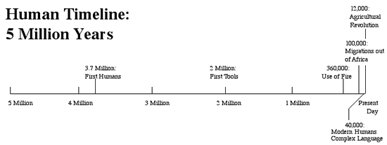
Human Knowledge of Human Body: Very Recent
Understanding of biology and medicine

Slide 16
A History of Mind and Body
Historic Era | World View | Knowledge Methods | Theories | Mind/Body Beliefs | Tools and Treatments
Prehistoric (up to 2000 BCE) | Nature is mysterious, dangerous, shaped by the supernatural. | Observation Oral tradition Faith-based | Spirit world | Mind and body are inter-connected | herbs, poultices, trephination
Greeks & Romans 600 BCE to 300 CE | World is ordered and rational | Observation Logic Association | Categories and elements Humoral Theory | Mind and body are interconnected | Potions, herbs, diet, bleeding
Dark/Middle Ages 400 CE to 1500 CE | World a battle between good and evil. | Bible + folk wisdom | God's will, satanic influence | Mind and body are interconnected | Torture, prayer and Herbs, poultices, bleeding, etc.
Modern Era 1700 to mid-20th Century | World ordered, knowable; separation of rational / spiritual. Dualism | Empiricism: Knowledge based on what you can see. | Cellular, mechanistic | Mind and body are separate | Modern medicine; microscopes, scanners, X-Ray, vaccines, etc.

Slide 17
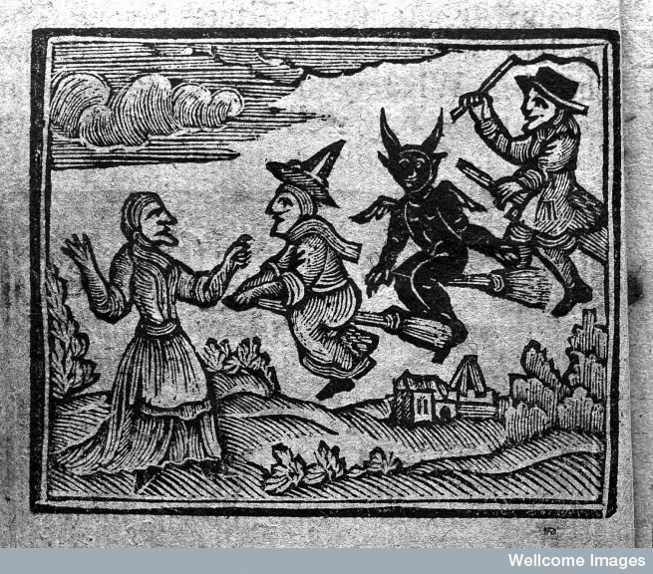
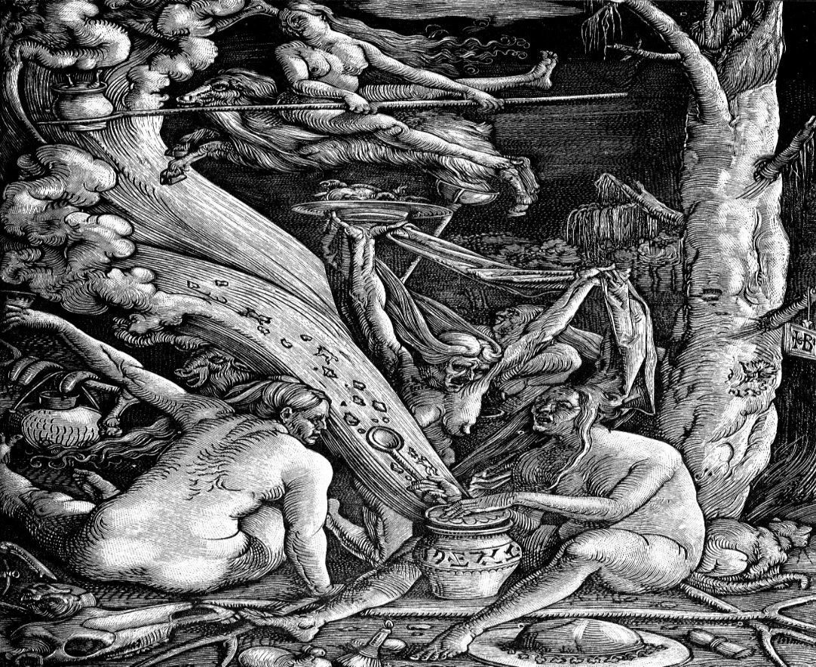
Pre-Science World: Wonders and Terrors
Bubonic plague kills up to 60% of Europeans; 75 million – 200 million die.
No idea what it is, how to treat it. So, heretics and non-believers killed.
Humans are meaning-making, can’t take “no answer” for an answer.
Terror of plagues, need for control, for meaning leads to superstitious beliefs about causes and cures.

Slide 18
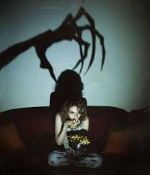
Terrifying, Mysterious, Magical World of Our Ancestors—Or Being Home Alone after Watching Scary Movie.
For early humans, diseases came from spirits, medicine men and witches, or the revenge of the departed. Few cures, and no real idea how cures worked.
How to connect to that world?
You’re home alone, seeing a scary movie with ghouls, zombies, cannibal clowns.
Then, lights out, you lie in bed, and hear a creak from somewhere in your home. Heart races, you freeze, afraid to make a sound.
That is a taste of what daily life was like for us 1,000 years ago.
And it helps explain how today beliefs, emotions, needs affect our bodies.

Slide 19
Humoral System: Defines Physical and Mental Health for Nearly Two Centuries
Body contains four circulating fluids:
Blood Yellow Bile Black Bile Phlegm
Illness: Humors are out of balance. T: Treatment: Return balance of humors; bleeding
Personality linked to humors.
Galen 129-216 CE
Phlegmatic
Mild, calm, thoughtful
Sanguine (blood)
Warm, passionate, cheerful
Choleric (yellow bile)
Ill-tempered, crabby
Melancholic (black bile)
Sad, low energy

Slide 20
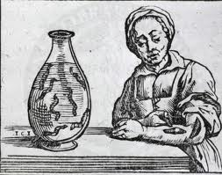
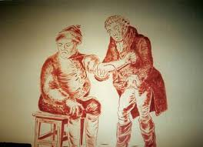
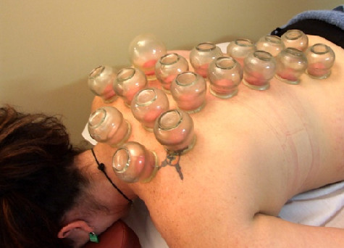
Med. Procedures Based on Humoral System: Leeches, Bleeding, and Blistering

Slide 21
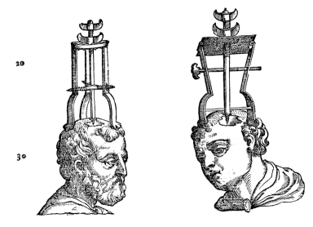
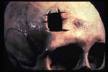
Trephination: Opening the Skull to Release Badness

Slide 22
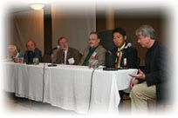
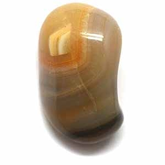
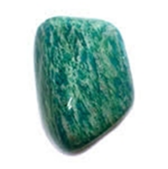
International Trephination Advocacy Group (ITAG)
The hypothesis here at ITAG has been that making an opening in the skull favorably alters movement of blood through the brain and improves brain functions which are more important than ever before in history to adapt to an ever more rapidly changing world.
If your mind is polluted with toxic negativity, clean it up with Amazonite. By flooding your heart and throat chakras with loving energy, amazonite opens you up to release that which has hurt you.

Slide 23
Why Do People Follow Failed Health Practices?
Humans need meaning. Can’t accept “no answer” for an answer.
Humans need hope: Fear of death, of illness, of pain—requires faith in remedy.

Slide 24
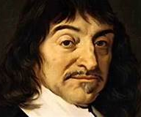
The Enlightenment (1600-1800): Separation of Powers and the Power of Separations
Separate Domains of Learning: Sciences, philosophy, theology
Separation of Church and State (US Constitution)
Separation of Powers (US Constitution): Executive, Legislative, Judiciary
Separations of Mind and Body
Des Carte: Dualism, mind and body are separate
Spinoza: Emotions are irrational, should keep them separate
from reason

Slide 25
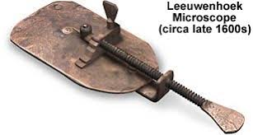
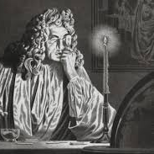
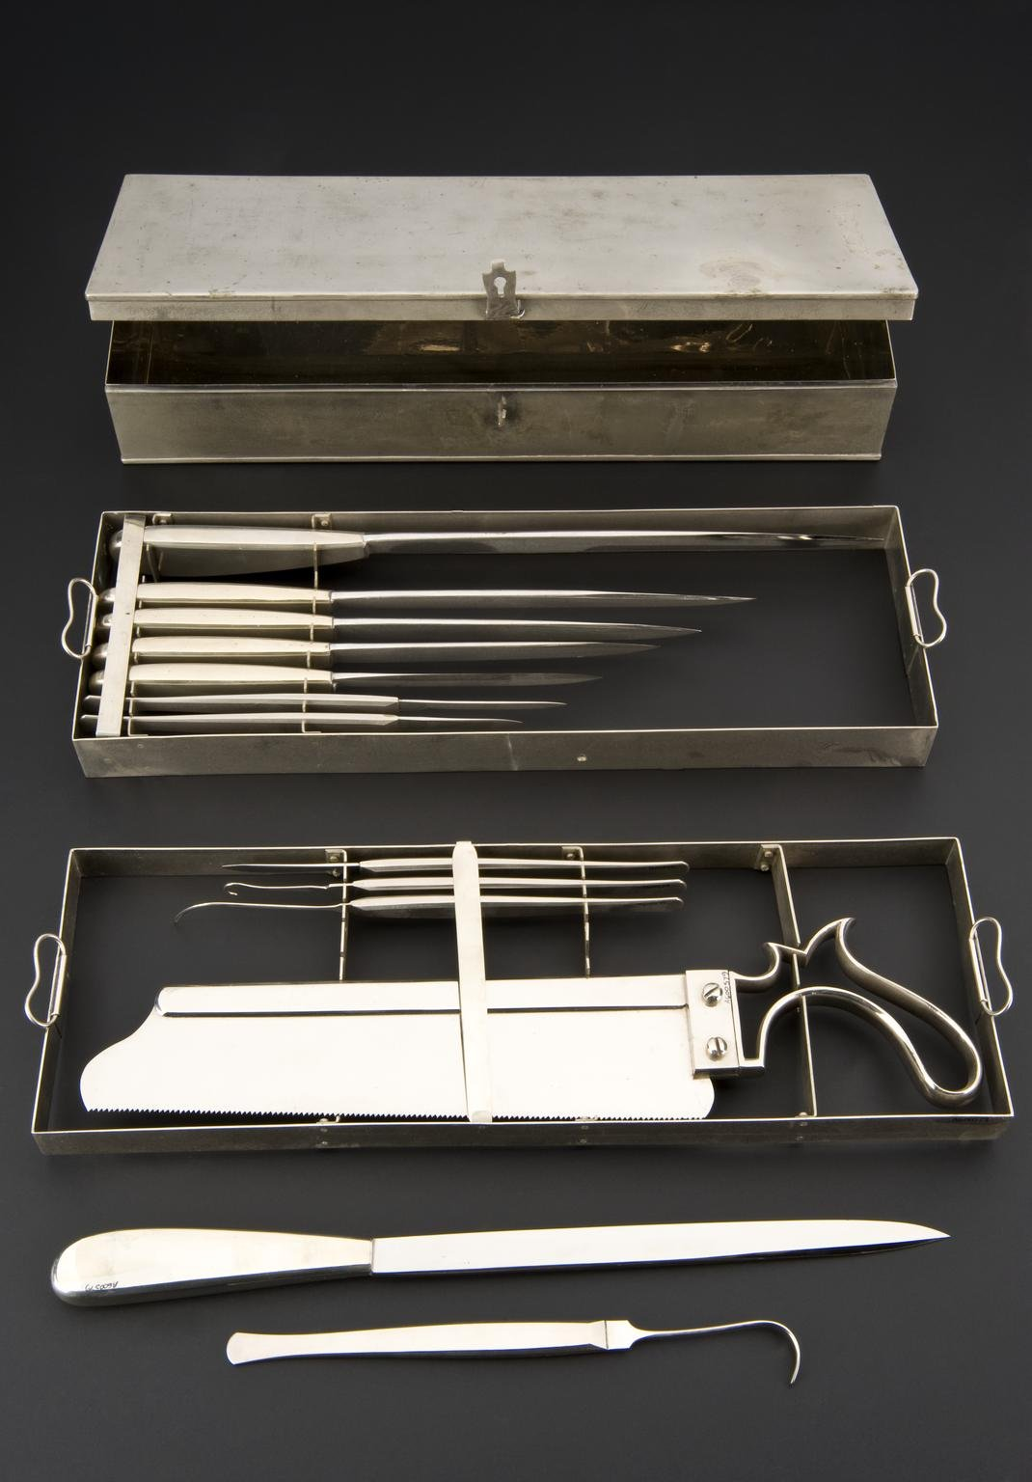
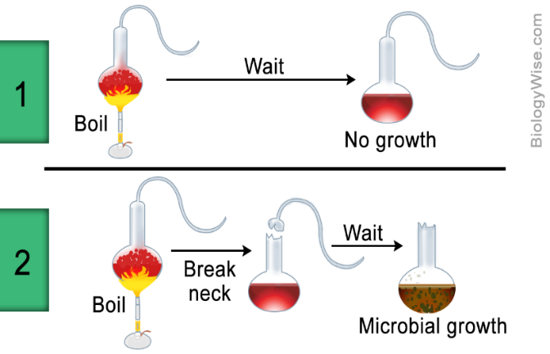
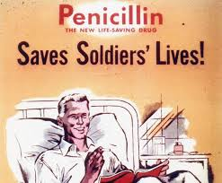
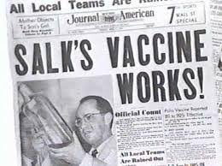
EVENTS THAT CHANGED MEDICINE
Microscope Invented
Pasteur Evidence of
Microbial Growth: 1860s
Medical Antisepsis
Discovery of Antibiotics: 1928
Discovery of Polio Vaccine: 1962

Slide 26
Separations and the
Return of the Mind to the Body
If body states are unrelated to mental states, then:
a. Beliefs should have no affect on health
b. Emotions should have no affect on health
c. Social relations should have no affect on health
d. Communication should have no affect on health
BUT ALL OF THESE AFFECT HEALTH!
Health Psychology dedicated to this issue.

Slide 28
Placebo in Drug Trials
Placebo can account for more than 30% of analgesic efficacy

Slide 29
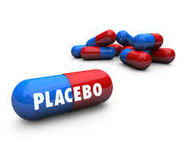
Power of the Placebo
Placebo means: “I will please”. Placebos have:
a. Lowered blood sugar in diabetics
b. Shrunken tumors in cancer patients
c. Relieved post-operative pain
d. Reduced cholesterol and mortality among cardiac patients.
e. Leads to withdrawal symptoms of chemical dependence.
30%-40% of most drug effects are due to placebo
What’s going on? A mere belief that something will affect health leads to health changes. The mind affects the body.

