Slide 1
R-Points for Extra Credit
Guidelines and FAQ

Slide 2
http://rutgers.sona-systems.com/

Slide 3
Some courses offer extra credit for r-point completion
  First-hand experience of the scientific methods of psychology
  Valuable data for our researchers!

Slide 4
In exchange for participating in research studies, students earn “R-Points”
R point deadline: Dec 12th, 2018, 5pm.
  ALL R POINT RELATED WORK MUST BE SUBMITTED BY ABOVE DATE/TIME!
Underage students (under the age of 18) may not participate in research
  An alternate assignment will apply [only applies to students under the age of 18!]
  Students will have the option to participate in research once they turn 18

Slide 5
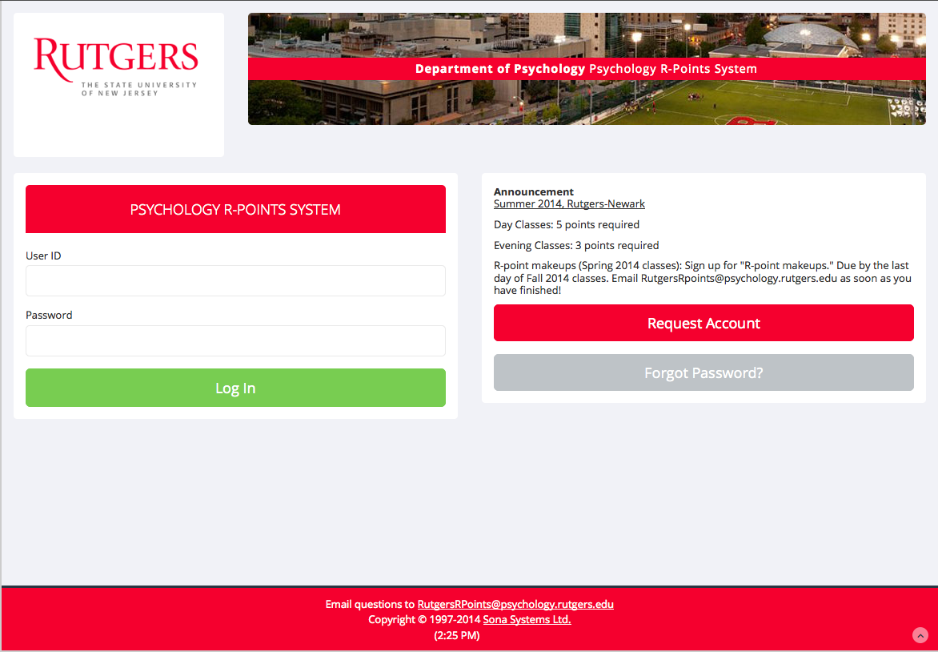
How do I earn R-Points?
Students over the age of 18 only:
Sign up for time slots on the Sona System website: http://rutgers.sona-systems.com/

Slide 6
Sona System: the psychology department’s research scheduling system
  Look for studies and read brief descriptions
  Sign up for times that fit your schedule
  Manage your schedule and cancel timeslots if needed
  Read frequently asked questions
  Find contact info for researchers
http://rutgers.sona-systems.com/

Slide 7
How do I create a Sona account?
http://rutgers.sona-systems.com/

Slide 8
If you have used the Sona System before, use your account from previous semesters.
Use your RUID # as your User ID
  The 9-digit Rutgers ID # from your student ID card
  Listed on Blackboard if you look at “Personal Information”
  Don’t have a net ID for Blackboard? Create a net ID at this site: http://oit.rutgers.edu/services/account/quick.html

Slide 9
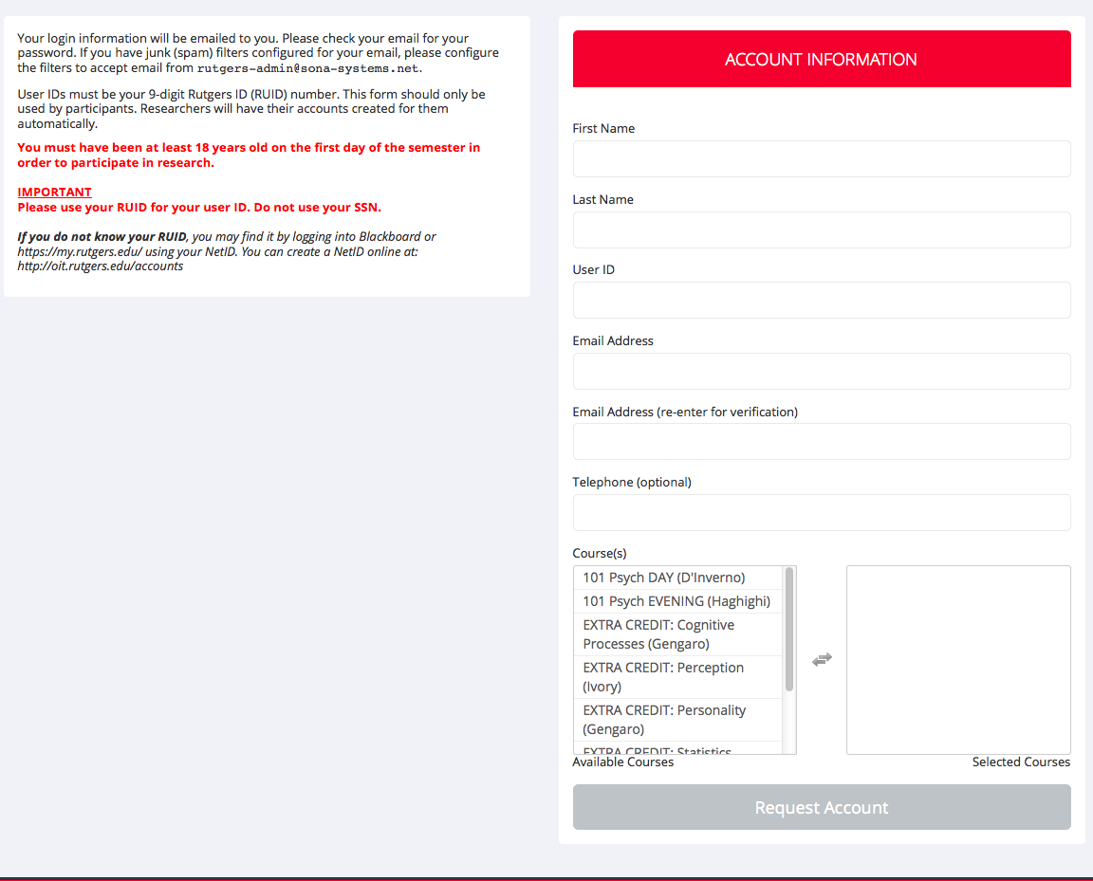
How do I sign up for an account?
1. Please use your RUID # as your User ID
2. Use an email address that you check regularly
3. Sign up for the CORRECT section(s)!

Slide 10
What if I’m taking Psychology 101 or 102 in the same semester?
Extra credit R-points do not count towards the 101 or 102 requirement.
Make sure to assign your points to the course that you wish for them to go.
  If you assign 4 points to 101 and 3 points to extra credit, you will end up with an incomplete in psych 101.

Slide 11
What if I have to make up points?
If you have to make up points from last semester, select “R-points makeups” in addition to your course(s)
Priorities:
  R-points Makeups (if you’re doing them)
  Current requirement (Principles 101/102)
  Extra Credit classes

Slide 12
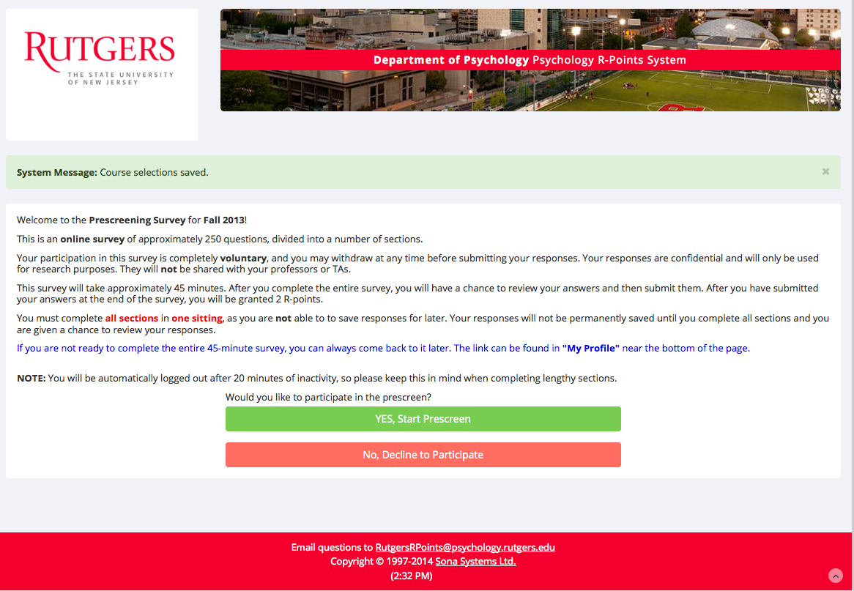
The first time you log in, you will be invited to take the PRESCREENING SURVEY
Voluntary, 60-minute online survey
Must be completed in 1 sitting
After submitting ALL answers, you will receive 2 R-points
If you decline, you can access the survey later by clicking on “My Profile” and looking for the “Take Prescreen” link

Slide 13
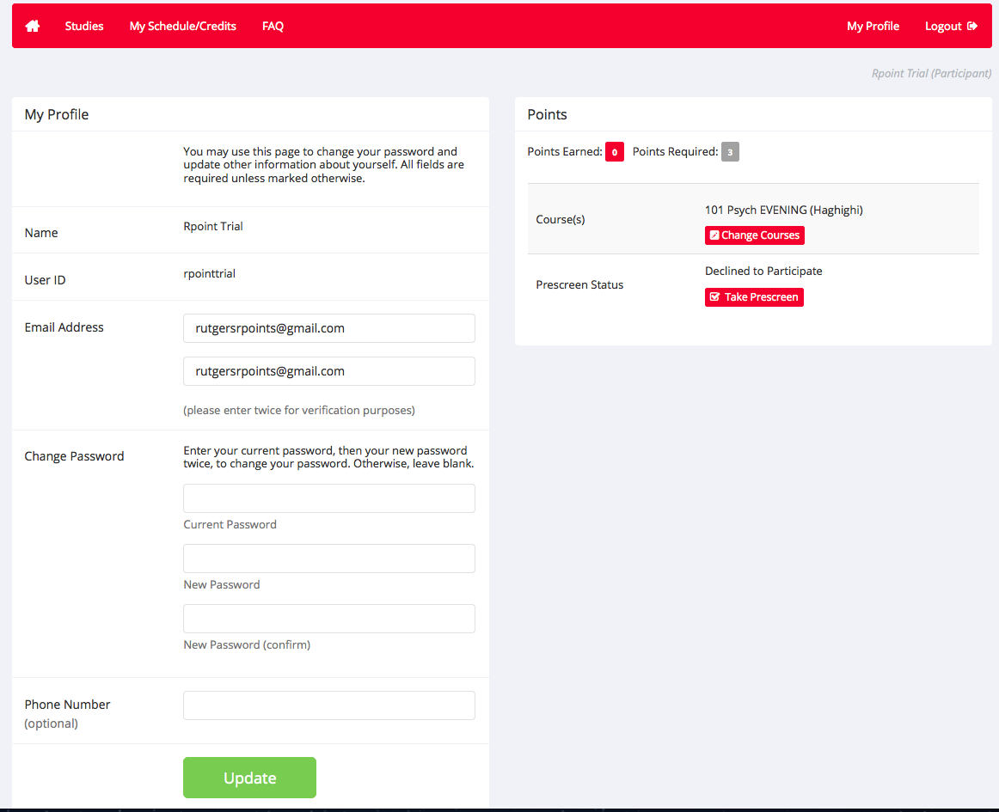
“My Profile”

Slide 14
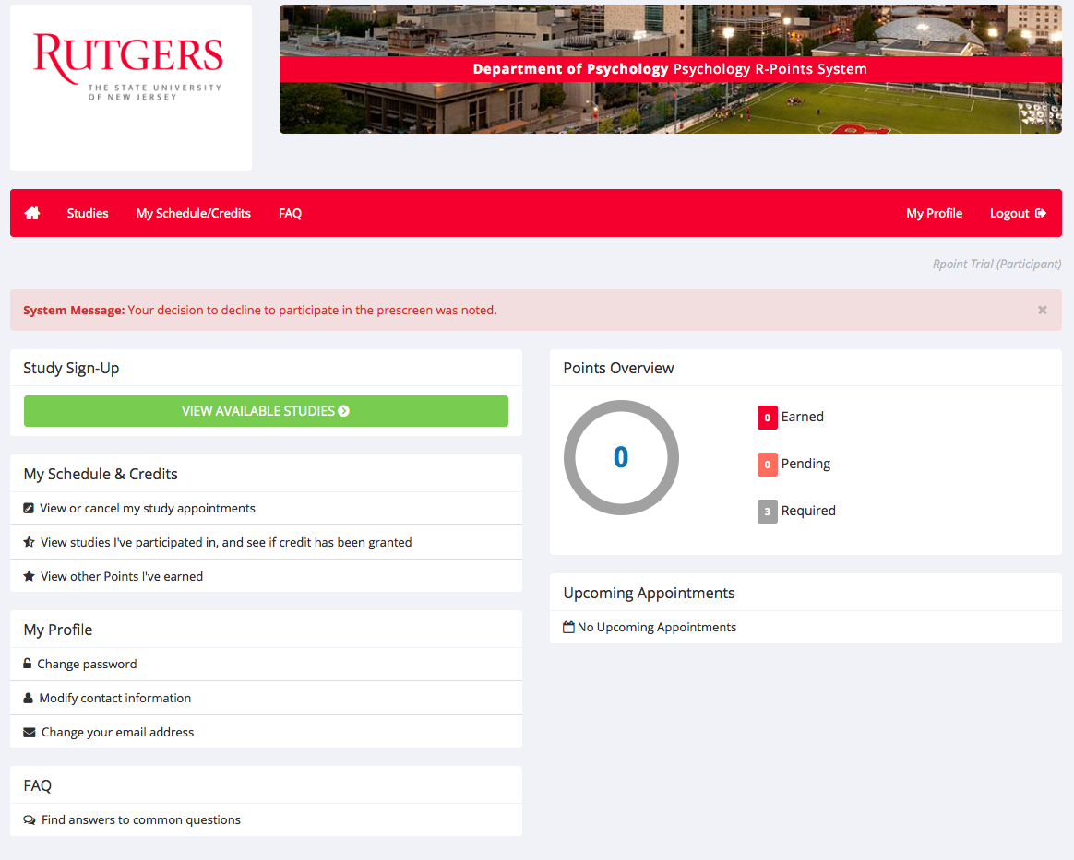
How do I sign up for studies?

Slide 15
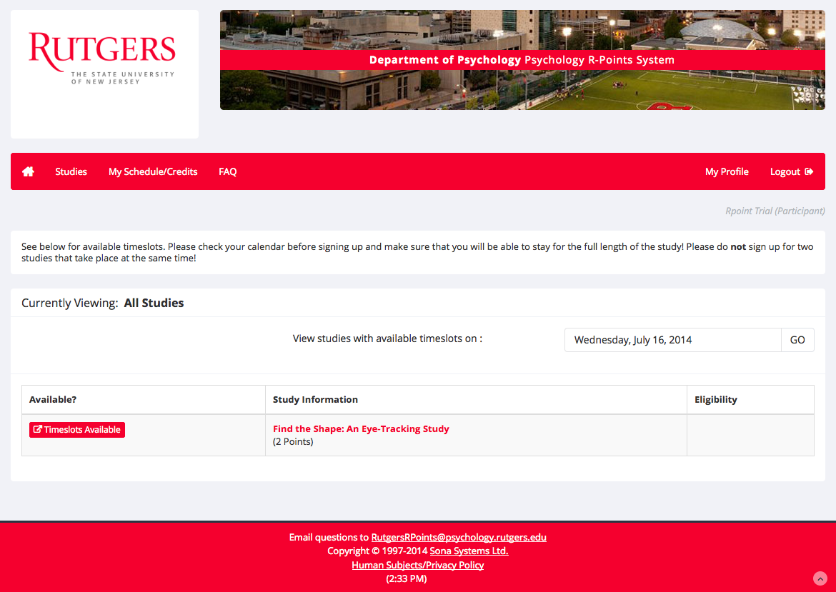
How do I sign up for studies? (continued)

Slide 16
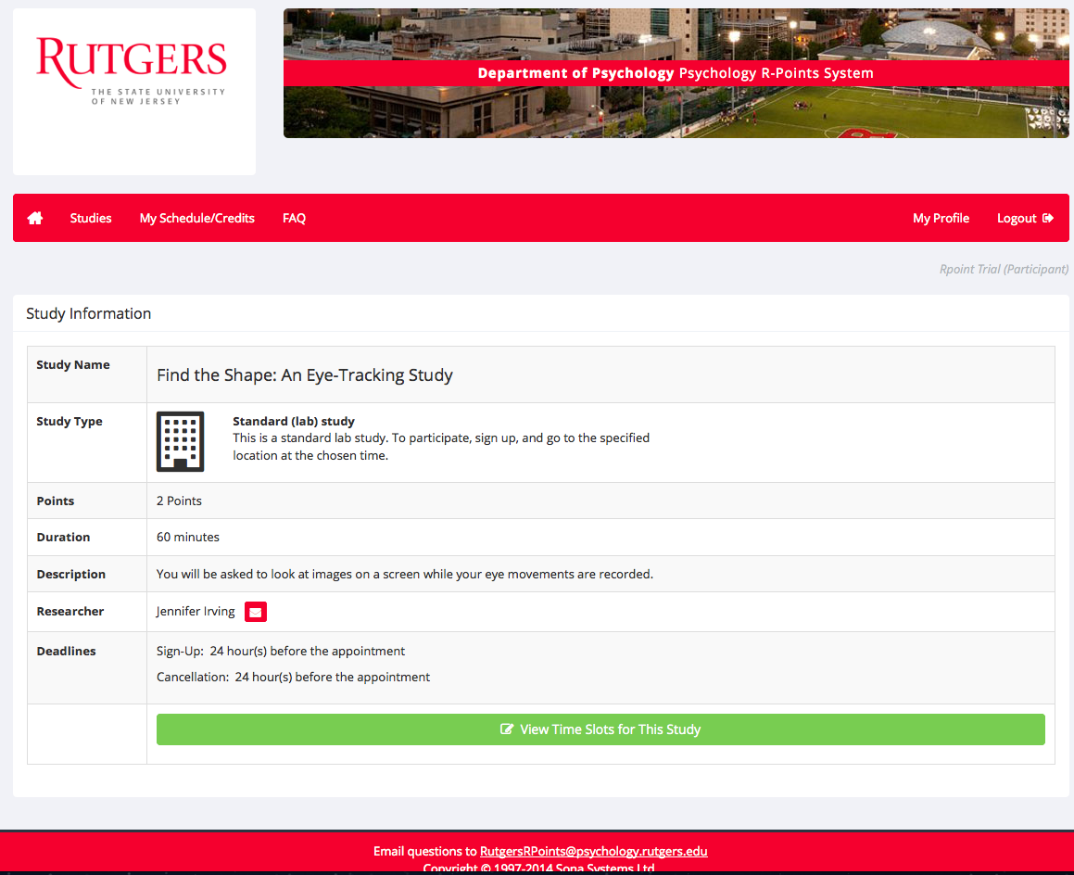
Study Information

Slide 17
How do I sign up for studies? (continued)

Slide 18
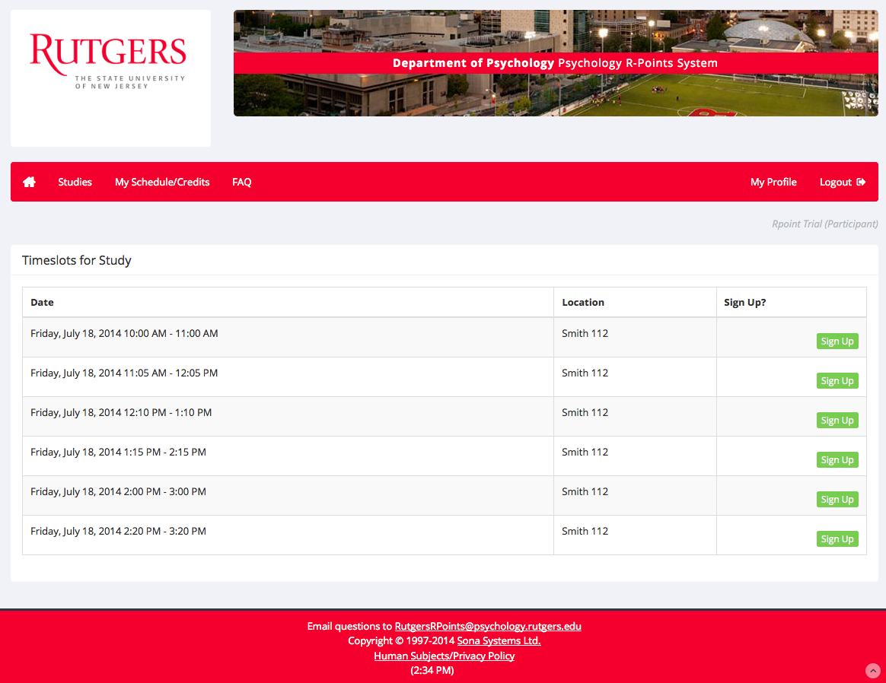
How do I sign up for time slots? (continued)

Slide 19
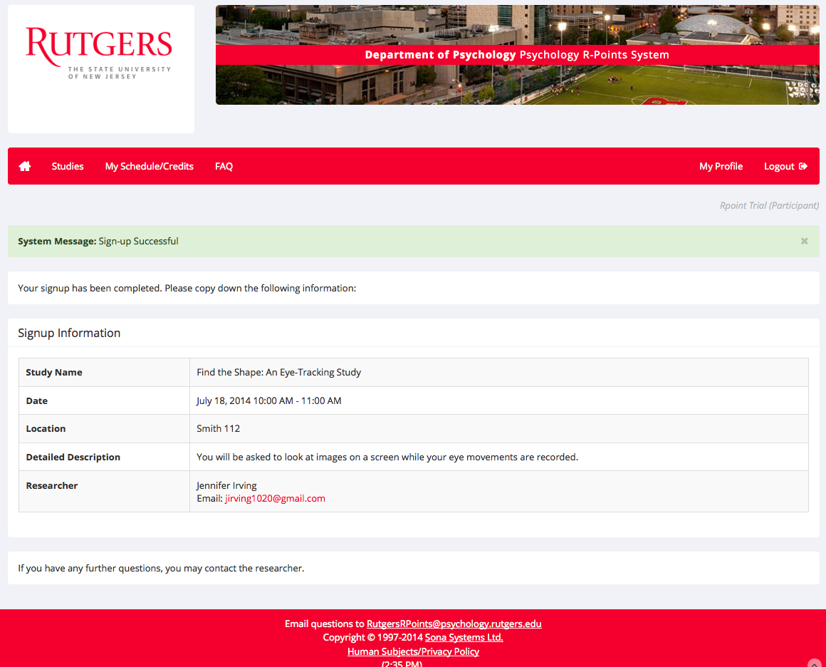

Slide 20
Now that you’re signed up….
Be there on time!
  Researchers are only required to wait 10 minutes before marking you as a no-show
Know where you’re going and how to get there
  Studies on Smith Hall 4th floor give phone numbers for a reason!
If you need to cancel, please do it in advance

Slide 21
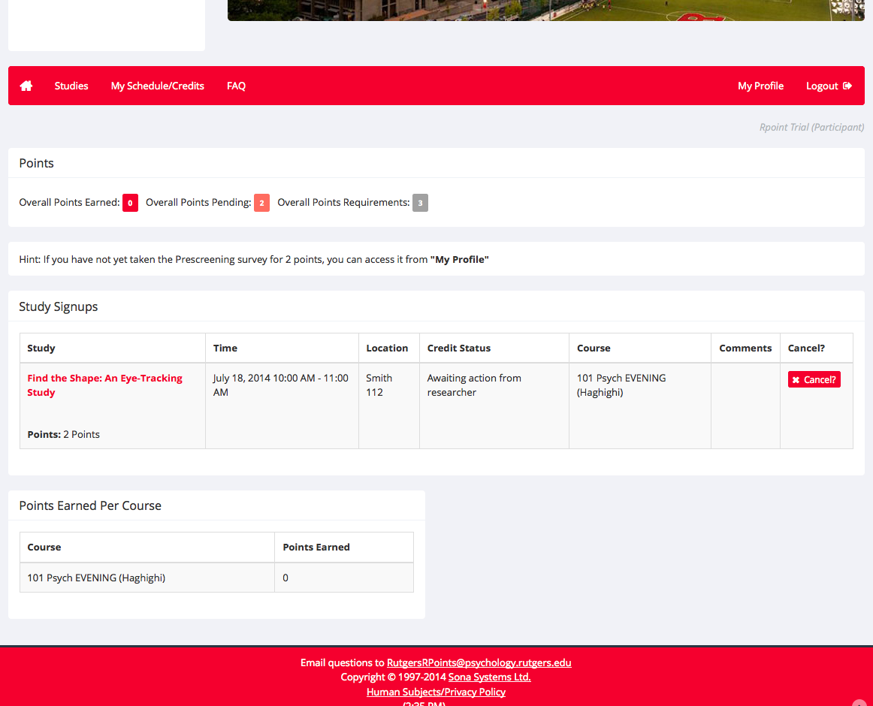
“My Schedule/Credits”

Slide 22
How do I cancel a time slot?
Click to view researcher contact information
Out of courtesy to our researchers, please make every effort to cancel your appointment in advance.
Notes:
If the cancel button is not available, click to find the researcher’s contact info. Send them an email (not me!)

Slide 23
What if the researcher cancels or does not show up for the study?
If you receive a cancellation e-mail 24 hours or more before the scheduled appointment, no points are rewarded to you.
If the researcher cancels the appointment via e-mail with less than 24 hours notice, you are entitled to 1 R-Point, regardless of the number of points the study is worth.
  If the researcher cancels the final slot in a multi-part study via e-mail with less than 24 hours notice, you are entitled to all points.
Please check your e-mail the day of your appointment for cancellations.
If the researcher has not cancelled and fails to show at the designated time, you are entitled to all of the R-Points for that study. If researchers are not present within 10 minutes of start time, please contact the subject pool coordinator at RutgersRpoints@psychology.rutgers.edu

Slide 24
What if I am under 18?
Students who are under the age of 18 are excluded from the subject pool.
Do not create a Sona account!
Underage students may write 1-page summaries of peer-reviewed journal articles in psychology.
Underage students MUST submit an experiment waiver form and provide proof of age to the subject pool coordinator, their professor, or their graduate student TA.
Experiment waiver forms are available by request via e-mail from the subject pool coordinator. If you are an underage student and you do participate in research via Sona, you will receive NO R-POINTS. If you create a Sona account, it will be deleted!

Slide 25
What happens when I turn 18?
Students who turn 18 during the semester will have two options:
  Students may fill out the underage waiver form and complete the alternate assignments
  Students may choose not to fill out the underage waiver form and instead participate in research upon turning 18.
If students turn in an underage waiver form, they will not have the option to participate in research for that semester.
If students do not turn in an underage waiver form, they will not have the option to complete the alternate assignment.

Slide 26
Where to turn in your waiver forms
Email rutgersrpoints@psychology.rutgers.edu to arrange a time and place to check id (Drivers license, passport, state issued id, etc) and submit waiver.
You may also drop the waiver off in the R points coordinator mailbox (Smith Hall 301).

Slide 27
Frequently encountered issues
Free-for-All
  Extra credit students are locked out from participating until free-for-all begins. This gives 101 and 102 students the opportunity to fulfill their requirements before the competition for openings becomes greater. Free-for-all generally begins mid semester.
Timeslots fill up quickly
  You may not find timeslots that work for you every time you sign in. Check back frequently to find ones that work for you. Researchers will be posting more as the semester goes on, so the more you check the better your options will be.
Don’t wait until the last minute
  Again, slots fill quickly and more people are in the system by the end of the semester. When free-for-all begins, try to schedule your appointments as quickly as possible.

Slide 28
Hints and suggestions
Take the prescreening survey first!
  It’s online, takes less than 60 minutes, and awards two points.
  Make sure you have time to complete it!
If you are unsure where to go for a study, look up the researcher’s contact info and ask for directions.
If your appointment is on the 4th floor of Smith Hall, remember to dial the number listed in the study info. If you follow someone through the locked door, you won’t know where to go, and the labs are all locked.

Slide 29

Ahmet Ceceli
R-points Coordinator
RutgersRpoints@psychology.rutgers.edu
http://rutgers.sona-systems.com/

