Slide 1

Psychology of Emotions Final Exam Review
Class 25

Slide 2
Important Dates and Times
DIARY STUDY DUE: April 30: TODAY
EXTRA CREDIT DUE: Friday, May 1: TOMORROW
UPLOADING MATERIAL: See Class 22, Emotion Mgt.
FINAL EXAM: Tuesday, May 12; 11:45-2:45
Covers everything after mid-term :
Class 15 Emotions and Social Judgment
to Class 24 Disclosure and Social Judgment
50 Multiple Choice + 4 Extra Credit
SIRS Course Evaluation: https://sirs.ctaar.rutgers.edu/sirsBlueQR.html

Slide 3
CLASS AGENDA
Review Questions from Class 24
Final Exam Study Guide
Tips and Strategies for Studying for Final
Goodbye!!!

Slide 4
Disclosing thoughts and feelings about someone who betrayed you leads to:
___ A. Moral disgust towards the betrayer
___ B. Willingness to retaliate against the betrayer
___ C. Greater feelings of closeness towards the betrayer
___ D. Greater attention towards those who resemble the
betrayer.
___ E. None of the above

Slide 5
Disclosing thoughts and feelings about someone who betrayed you leads to:
___ A. Moral disgust towards the betrayer
___ B. Willingness to retaliate against the betrayer
___ C. Greater feelings of closeness towards the betrayer
___ D. Greater attention towards those who resemble the
betrayer.
___ E. None of the above
X

Slide 6
One reason that people blame victims is:
___ A. Victims often are responsible for their bad situations
___ B. Victims threaten observers’ Just World Beliefs
___ C. Blaming helps victims regain a sense of responsibility
___ D. Blaming victims teaches others to be more careful
___ E. None of the above

Slide 7
One reason that people blame victims is:
___ A. Victims often are responsible for their bad situations
___ B. Victims threaten observers’ Just World Beliefs
___ C. Blaming helps victims regain a sense of responsibility
___ D. Blaming victims teaches others to be more careful
___ E. None of the above
X

Slide 8
According to the Emotional Broadcaster Theory, the urges and needs to disclose turn people into news broadcasters. Evidence in support of this theory includes:
___ A. The more upset a person is, the further their story travels
___ B. People often can’t stop themselves from disclosing
___ C. Well-told disclosures are the most therapeutic
___ D. Disclosures provide useful information to listeners
___ E. All of the above

Slide 9
According to the Emotional Broadcaster Theory, the urges and needs to disclose turn people into news broadcasters. Evidence in support of this theory includes:
___ A. The more upset a person is, the further their story travels
___ B. People often can’t stop themselves from disclosing
___ C. Well-told disclosures are the most therapeutic
___ D. Disclosures provide useful information to listeners
___ E. All of the above
X

Slide 10
A Guide to the Study Guide
Study guide is just that—a guide. It covers most, but not all, of the questions on the final.
Guide is set up as sets of questions. Be able to answer these questions
Use the study guide to review Powerpoints.
Remember that PowerPoints are “snap-shots” of key points in readings. Using Study Guide + Powerpoints + Readings is EXCELLENT method
If it is not in the PowerPoints, it won’t be on the Final!
Study Guide is available on Blackboard and on my Website: http://nwkpsych.rutgers.edu/~kharber/emotions/

Slide 11
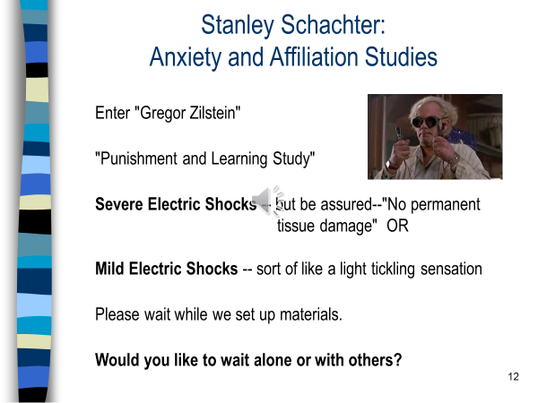
USING THE STUDY GUIDE
Class 15: Emotions and Social Judgment
1. Who was "Gregor Zilstein" and why did he assure subjects they would "suffer no
permanent tissue damage"?
2. In Schachter's study, who wanted to be alone and who wanted to be with others?
3. What are reasons why people sought affiliation when anxious?
4. How did cookies affect helping in Alice Isen's study?
5. What are some alternative explanations to Isen's Cookies study?
6. What was the point of Isen's "pay phone" study?
7. What is subliminal priming?
8. What caused subjects in Winkielman, et al. study to pour and drink more of a
beverage?
9. What subliminally primed mood state, positive, neutral, or negative, increases
stereotyping?
Zilstein? He was really just an actor, not a real researcher. He was there to scare subjects. To induce anxiety. So this crazy line about “no permanent tissue damage” was just to make subjects more anxious.

Slide 12
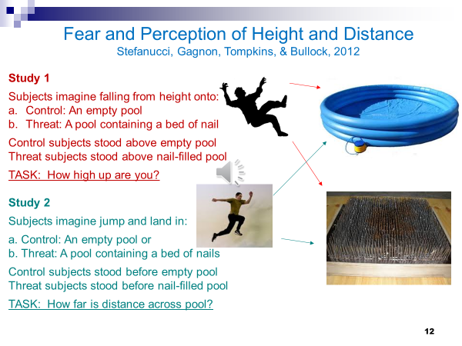
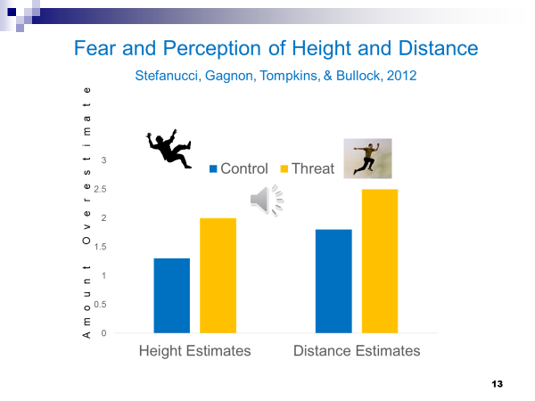
Class 16: Emotions and Perception
1. What was the main idea of the “New Look” approach in Social Psychology, and how did it
relate to a football game between Dartmouth and Princeton?
2. How did rich and poor kids perceive a $.25 coin versus a worthless metal slug?
3. In the Stefanucci studies, how does fear affect perception of height and of distance?
4. What are psycho-social resources?
5. Lack of what threat caused people to hear baby cries as more extreme in Harber et al.,
Study 1?
6. What resource-boosting activity in Harber et al. Study 2 counteracted the effect of this
threat?
7. What resource affected how people saw hill slants in the Schnall et al. studies? Did that
resource need to be physically present to be effective?
8. What live animal did Harber et al.2012 use to show that resources affect distance
perception? What resource was involved in this study?
9. People see heights (looking down) as more extreme if they have their hands cuffed behind
their backs and they lacked what resource?
Stefanucci et al. studies. Hmm. Oh yeah, subjects imagined falling into, or jumping across an empty pool or a pool filled with nails. The “nails” pool, why? Uh, to induce fear. That’s the point of Slide 12. What did they find? Next page, Slide 13, shows these graphs. “Fear” condition subjects are seeing the height as greater, and the distance across the pool as greater. Take home point? Fear leads to exaggerated perception. Just like the New Look, from previous slides!

Slide 13
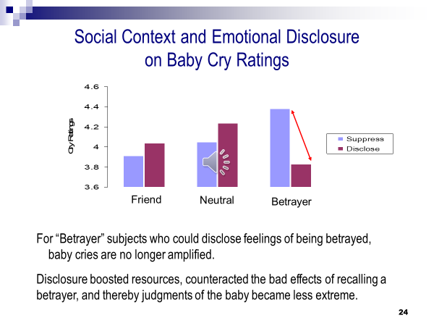
Notating PowerPoint Slides
So two things are going on here. 1. Just like Study 1, thinking of betrayer leads to hearing cries as more distressed.
2. Disclosure resupplies resources, and therefore counteracts “betrayer” neg. effects on baby-cry ratings.
Notating the PowerPoints will:
1. Push you to capture main points
2. Reinforce memory
3. Provide cues to recalling main points when re-reviewing
the Powerpoints.

Slide 14
Good-Bye!
You were an excellent class.
There are heroes among you.
I’m frustrated and aggressive to Study COVID for depriving me of direct face-to-face teaching with you.
But am grateful to have gotten to know you.
Have an excellent summer. Be well, be careful, but play and have fun.
Winnicott: Play is the best therapy. When we play, we are connected to our true self.

