Slide 1

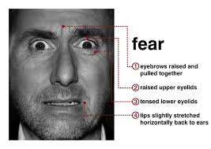
Fear and Anxiety
Class 21

Slide 2
UPDATES
Diary Study
  Should complete Diary 6 today
  Write-up instructions given on April 21
Note: Quiz 2 this Thursday
Covers Classes 15-20
15 Questions, multi-choice + 2 Extra Credit
Administered on Blackboard
25 minutes to complete
Complete any time on Thursday 7:30 AM – 11:00 PM
3. If you anticipate problem with quiz date, let me know

Slide 3
Warburton, Williams, and Cairns showed that subjects required another person to consume more hot sauce if the subjects:
___ A. Had been deprived of food and water
___ B. Had been poked with a needle by an unskilled nurse
___ C. Had been socially rejected in a ball-toss game
___ D. Failed in public task
___ E. None of the above

Slide 4
Warburton, Williams, and Cairns showed that subjects required another person to consume more hot sauce if the subjects:
___ A. Had been deprived of food and water
___ B. Had been poked with a needle by an unskilled nurse
___ C. Had been socially rejected in a ball-toss game
___ D. Failed in public task
___ E. None of the above
X

Slide 5
Which emotion can sometimes be good for relationships:
___ A. Anger
___ B. Contempt
___ C. Withdrawal
___ D. Whining
___ E. None of the above

Slide 6
Which emotion can sometimes be good for relationships:
X
___ A. Anger
___ B. Contempt
___ C. Withdrawal
___ D. Whining
___ E. None of the above

Slide 7
Fear and Anxiety (Öhman Chapter)
Fear Thoughts
Physiology
Behavior
Timing
Something bad now, very soon
Weak limbs, heart races, dry mouth
Flee, desire to escape
Occurs post-stimulus
Anxiety Thoughts
Physiology
Behavior
Timing
Something bad in the future
Tension
Limited responses
Occurs pre-stimulus

Slide 8
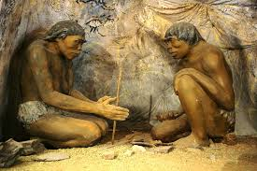
Evolutionary Basis for Fears
Social Fears
Mortality fears
Animals
Agoraphobia
Fear of Rejection Humans prey on humans
Humans only species aware of its own mortality
Predators Disease agents
Separation fears, lost in open space, lost in crowds

Slide 9
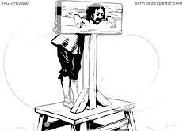
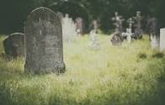
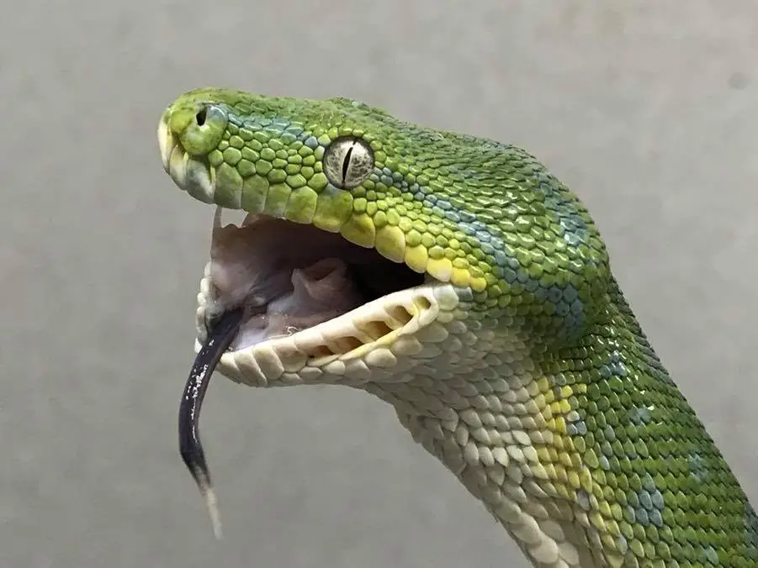
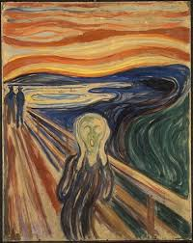
Classes of Fear Inducing Situations
Interpersonal Threat (rejection, ostracism, shaming)
Mortality Fears (death, injury, illness, blood, surgery)
Fear of animals (domestics, small ones, bugs, reptiles)
Agoraphobic fear (open/closed spaces, traveling alone)
Which of these is greatest fear?

Slide 10
Classes of Fear Inducing Situations
X
Interpersonal Threat (rejection, ostracism, shaming)
Mortality Fears (death, injury, illness, blood, surgery)
Fear of animals (domestics, small ones, bugs, reptiles)
Agoraphobic fear (open/closed spaces, traveling alone)
Which of these is greatest fear?

Slide 11
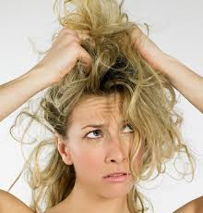
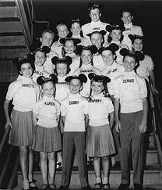
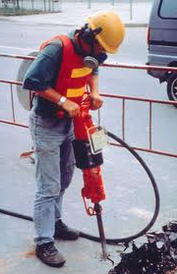
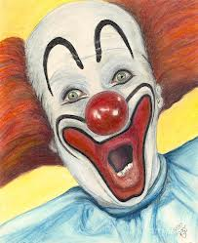
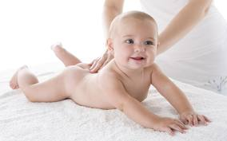
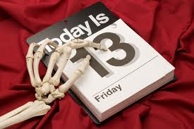

Phun With Phobias
1. Chaetophobia
2. Ephebophobia --
3. Coulrophobia
4. Ergasiophobia
5. Gymnophobia
6. Parakavedkeatriaphobia
7. Neophobia
Fear of hair
Fear of youths
Fear of clowns
Fear of work
Fear of nudity
Fear of Friday 13
Fear of newness

Slide 12
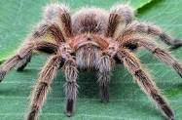
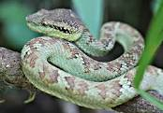
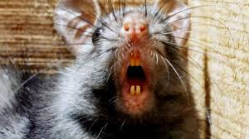
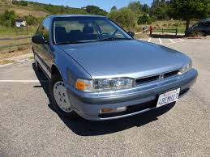
“Preparedness” as Evidence of Evolutionary Basis for Phobias
Which is the most scary?
Which is the most deadly?

Slide 13

“Preparedness” as Evidence of Evolutionary Basis for Phobias
Which is the most scary?
Which is the most deadly?

Slide 14
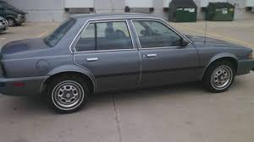
“Preparedness” as Evidence of Evolutionary Basis for Phobias
Which is the most scary?
Which is the most deadly?
X

Slide 15
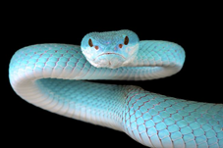
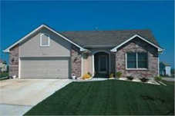
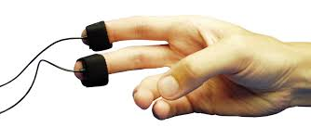
Experimental Evidence of Preparedness (Ohman et al., 1975)
UCS—Electric shock—paired with either
a. Conditioning phobic: Phobic stim
b. Conditioning neutral: Neutral stim
OR, c. Sensitize: Shocks only, but no pairing
OR, d. Control: Photos only, no shocks
MEASURE: Skin conductance response (SCR)
QUESTION: How long for conditioned response (CS) to extinguish (i.e., fade away; SCR lower) due to expt. condition (a-d)?
UCS = Unconditioned Stimulus

Slide 16

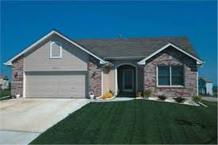
Extinction Rate of Conditioned Fear, When UCS (Pain) Paired with Phobic or Neutral Stimuli
Phobic Stims
Neutral Stims
SCR
SCR
“Condition” = Shock + Photo “Sensitize” = Shocks only “CS Alone” = Photos w/o shocks

Slide 17

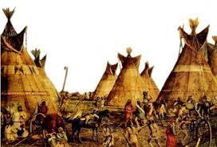
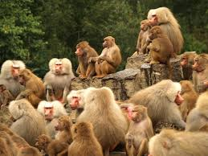
Why Do Phobias Exist? A Harber Speculation Moment
How we now live
Isolated
Protected by professionals
Few threats
Need for warning—low
How we used to live
Collectively
Protected by each other
Many threats
Need for warning—high
The Baboon “neurotic” who never overcame researcher phobia.

Slide 18
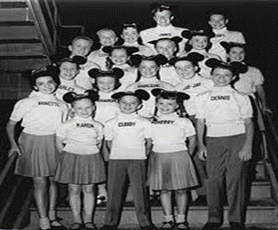
Break 1

Slide 19
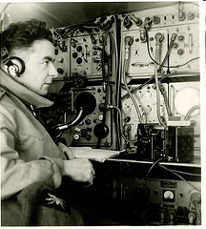
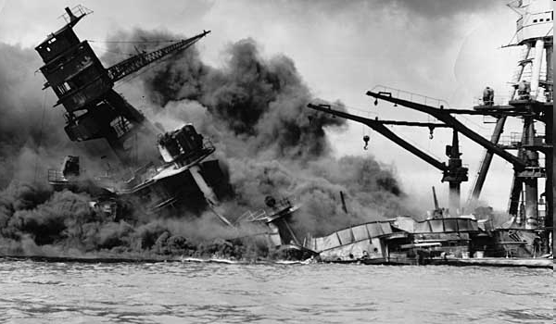
Hearing and Not Hearing Danger Signals:
“Best Mistake”?
___ A. Sound alarm, danger not real
___ B. Don’t sound alarm, danger is real
Dec 7, 1941 Honolulu, HI
Option should have taken: A
Option actually taken: B

Slide 20
Signal Detection: Where is it best to be wrong.
Danger Present
Danger Not Present
Sound Alarm
Hit
False
Positive
X
Don’t Alarm
False
Negative
Hit

Slide 21
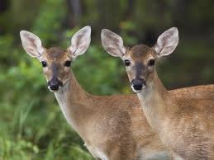
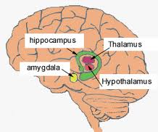
Why Humans “Favor” False Alarms
Humans faced signal detection dilemma for millennia
Evolved in a highly dangerous world
Evolutionary lessons “learned” by psyche are that:
1. Defenses must activate quickly
2. Must activate at hint of threat, not at certainty
3. Threat needs to be registered with minimal cues
Le Doux's "Fear Loop": Direct link: auditory nuclei to amygdala.
Bypasses thalamo-cortical path.
Threat doesn’t require high-level analyses

Slide 22
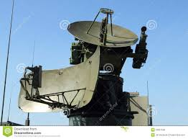
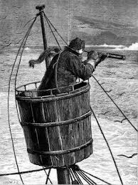


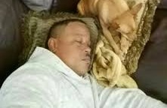
Problem of Attention and Threat
Where to point the "radar dish", to best detect threat?
2. Timing: How do look at the right place AT THE RIGHT TIME to find threats?
3. How do we do anything else, if focusing only on threat?

Slide 23
Automatic vs. Controlled Info. Processing
Automatic
Controlled
Gross characteristics
Fine characteristics
Unconscious, voluntary
Conscious, directed
Can’t suppress/distract
Can suppress/distract
Parallel--several modes
at once: hear + see + smell
Sequential--only one mode at a time: hear or see or smell
Does not require effort
Effortful
Can’t be observed by self
Can be observed by self
(introspection).

Slide 24
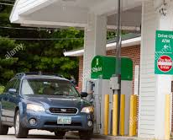
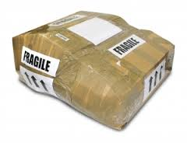
Gavin de Becker "Gift of Fear" Examples
Unexpected Apprehension: Woman at drive-up ATM: Flash of fear due to suddenness, speed, closeness of approaching person.
Dark Humor: Package without return address "I'm going back to my office before the bomb goes off." Bomb went off--Unibomber. Joke allows for socially safe way to express fear.

Slide 25
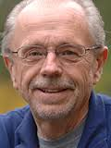
Automatic Processing and Threat Detection
Automatic, non-conscious mental activity gives us early warning system for detecting threat.
Implication: You can know and not know something at the same time--know it unconsciously, but not consciously
Arne Ohman studies: Show how this occurs
Basic technique: Backward masking
Arne Ohman

Slide 26
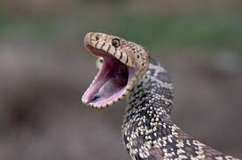
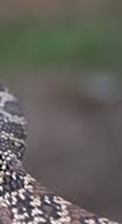


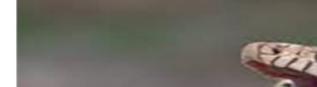
Backward Masking
1. Present picture of threatening stimulus very quickly (30 milliseconds)
2. Immediately after threat pix is shown, show a non-threatening picture. The second picture is a mask, blocks first picture from consciousness.
3. Reaction to first picture (e.g., snake) indicates unconscious processing
Mask

Slide 27
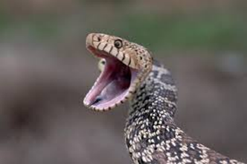
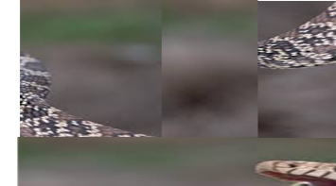
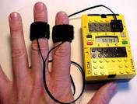
Automatic Processing of Fearful Stimuli (Ohman & Soares, 1994)
1. Pre-select people who are: Snake phobic, not spider phobic
Spider phobic, not snake phobic
Fear neither spiders or snakes
2. Targets: photos of snakes, spiders, flowers, mushrooms
3. Masks: Cut-up/reassembled target photos
4. Show target photo for 30 milliseconds.
5. Show mask for 100 milliseconds
6. Later, show target without mask
7. Outcome measure: GSR—a measure of anxiety.
8. All subjects exposed to photos of snakes, spiders,
flowers, mushrooms in masked and, later, un-masked condition.

Slide 28
Note: Response is to the brief subliminal stims, not to the masks that follows them.
Automatic Processing of Fearful Stimuli:
Results of Masked Stimuli Only
Masked Stims

Slide 29

Break 2

Slide 30
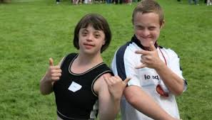
Stigma: Where fear, anger, and caring intersect.
Stigma—from “Stigmata”, a mark
Who are the stigmatized?
Those who violate social norms: Old, infirm, disfigured, disabled, social outcast, criminal, “the other”
Reactions to the stigmatized?
Fear, anger, fascination, disgust, interest, anxiety, derision

Slide 31
Why the Strong Reactions to the Stigmatized?
Learned : e.g., parents to young
Inborn : Part of evolutionary make-up
a. Strong attack weak in hierarchical species
b. Immediate fear and loathing to dead animals

Slide 32
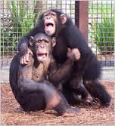
Reactions of Chimps to the Dead and Disabled
Reactions to anesthetized chimps (Hebb & Thompson, 1954)
Reactions to paralyzed chimps (Goodall, 1971)
Emotional reactions?
Fear, anger, disgust, distain

Slide 33
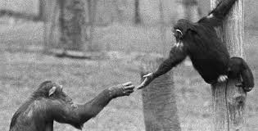
Are responses to stigma always negative?
Compassion: Some chimps adopted the polio victims
Fascination: Curious about people, who violate norms.
a. “Freak shows”
b. Tourists to East Village
Admiration:
a. Glamour of the rebel, bad boy/girl
b. Respect for courage—Helen Keller
Ambivalence: Emotions that go strongly in two directions at once—uncomfortable and powerful.

Slide 34
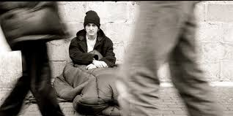
Stigmatized: Hyper-visible and invisible
Hyper-visible: Staring at the handicapped (Langer, et al. 1976)
Invisibility and being stigmatized?
Invisibility: People try to not see the stigmatized
I am invisible, understand, simply because people refuse to see me. … it is as though I have been surrounded by mirrors of hard, distorting glass. [People see] only my surroundings, themselves, or figments of their imagination—indeed, everything and anything except me.
Ralph Ellison, Invisible Man

Slide 35
