Slide 1
Positive Emotions
Class 19

Slide 2
UPDATES
Diary Study:
  Should complete Diary 4 today
  Write-up instructions given on April 13
Note: Quiz 2 on April 13, not April 11 Covers Classes from Class 16 (Emotions & Social Judgment) to April 21 (Fear & Anxiety)
15 Questions, multi-choice
3. Subject pool now open to Psychology of Emotions

Slide 3
MODIFIED LECTURES AND SYLLABUS
Shortening lectures: Remaining lectures no more than 30 slides (give or take).
April 13 is Quiz 2, therefore a much shorter lecture (about 20 slides).
Plan: Lectures will “carry over” to next class. For example, we will start Positive Emotions today and wrap it up next Tuesday, when we will start on Anger and Hostility, which itself will carry over to the next lecture, and so forth.
Cancel “Emotions and the Future of Humans” as a topic, use April 27 to wrap up preceding classes.

Slide 4
MODIFIED SYLLABUS
April 4: Positive Emotions Part I
April 6: Positive Emotions Wrap-up; Anger and Hostility I
April 11: Anger and Hostility Wrap-up; Fear and Anxiety I
April 13: QUIZ 2 Fear and Anxiety Wrap-up
April 18: Fear II and Disgust
April 20: Emotional Disclosure
April 25: Traumatic Events and Collective Coping
April 27: Disclosure and Social Judgment
April 29: Final Exam Review

Slide 5
REVIEW QUESTION 1
Evidence that needs, desires, and emotions affect perception include:
___ A. How fans see the behavior of their teams
___ B. How poor kids see the size of coins.
___ C. The width of an empty pool vs. a pool full of nails
___ D. All the above
___ E. None of the above
X

Slide 6
REVIEW QUESTION 2
Thinking about someone who betrayed you will make you hear baby cries as more extreme. What can you do to correct this internal amplification of baby cries?
___A. Play with your pet tarantula.
___B. Think about doing laundry
___C. Disclose your feelings about the betrayer
___D. Put your hands on a handrail
___E. None of the above
X

Slide 7
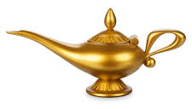
YOUR SINGLE LIFETIME WISH
A
B
C
D
1
Being the best in the world at anything you choose
An A in Harber’s class
2
Extreme wealth
The freedom to do any kind of work, craft, play for your entire life
True love, equally felt and given
3
Attaining true wisdom
The promise of fame for 1000 years
4
Perfect health to age 90
Freedom from sorrow for your entire life
An endless fun-filled vacation

Slide 8
YOUR SINGLE LIFETIME WISH
A
B
C
D
1
Being the best in the world at anything you choose
An A in Harber’s class
2
Extreme wealth
The freedom to do any kind of work, craft, play for your entire life
True love, equally felt and given
3
Attaining true wisdom
The promise of fame for 1000 years
4
Perfect health to age 90
Freedom from sorrow for your entire life
An endless fun-filled vacation

Slide 9
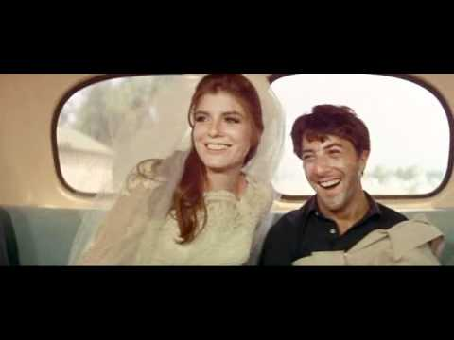

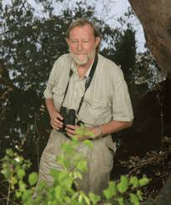
Is Romantic Love Common Across Cultures?
Study of 186 cultures, Criteria for “love” are:
1. It arouses personal anguish or longing
2. Love songs, poetry, etc.
3. Elopement due to mutual affection
4. Indigenous account of romantic love
5. Confirmation by anthropologist that love occurred
Percent of cultures that display romantic love?
90%

Slide 10
What is This Thing Called (Romantic) Love?
What is the formula for love?
What are the necessary ingredients?
Intimacy
+
Passion
=
Romantic Love

Slide 11
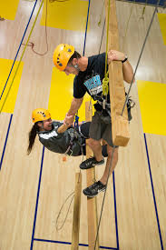
Elements of Intimacy
Intimacy + Passion = Love
Baumeister & Bratslavsky definition:
a. Mutual disclosure
b. Strong, positive attitude
c. Communication of affection
Other ingredients:
Concern
Interdependence: soldiers in battle, ropes courses
Vulnerability
Aron: Overlapping selves; individual "I" becomes a common "we"

Slide 12
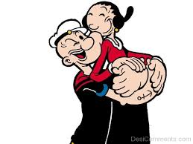
Elements of Passion
Intimacy + Passion = Love
Physiological arousal
Strong feelings of attraction
Desire to be united with partner
d. Sexuality: Can have sex w/o passion, but can’t have passion w/o sex
Passionate love = Physio arousal + attraction + desire for union

Slide 13
Time Course of Intimacy
Early Phase
Middle Phase
Later Phase
When is passion greatest, early phase, middle phase, or later phase?

Slide 14
Time Course of Intimacy
Early Phase
Middle Phase
Later Phase
When is passion greatest, early phase, middle phase, or later phase?
Middle Phase: Why? Passion is an emotion. Emotions occur when change occurs.

Slide 15
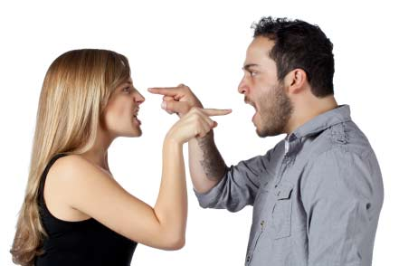
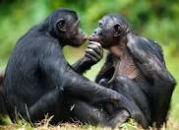
How to Keep Passion Alive
* New experiences (home childbirth)
* Risk of loss of loved one
* Fights, arguments, marital therapy
Evolutionary Innovation to enhance romantic intimacy:
Hint: Bonobo Apes do it, humans do it, no other species does it—this way.

Slide 16
How to Keep Passion Alive?
* New experiences (home childbirth)
* Risk of loss of loved one
* Fights, arguments, marital therapy
Evolutionary Innovation to enhance romantic intimacy:
Hint: Bonobo Apes do it, humans do it, no other species does it—this way.
Frontal Sex:
eye contact, communication → more intimacy → more passion

Slide 17
Is Romantic Love Common Across Cultures?
Criteria:
1. It arouses personal anguish or longing
2. Love songs, poetry, etc.
3. Elopement due to mutual affection
4. Indigenous account of romantic love
5. Confirmation by anthropologist that love occurred
Percent of cultures that display romantic love?:
90%

Slide 18
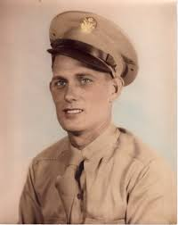
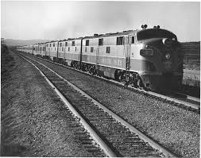
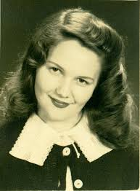
Lovers on a Train
On Monday Cpl. Floyd Johnson, 23 and then Ellen Skinner, 19, total strangers, boarded a train at San Francisco and sat across the aisle from each other. Johnson didn’t cross the aisle until Weds., but his bride said “I’d already made up my mind to say ‘yes’ if he asked me to marry him.” “We did most of our talking with our eyes,” Johnson explained. The couple got off the train in Omaha, crossed the river to …Iowa, where they were married on Friday.

Slide 19
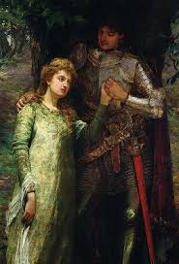
Falling in Love: Is it for real?
Falling in love, love at first sight, may be Western invention.
History of “romantic love”
1. Courtly love, Provence, France, 11th Century
2. Nobleman falls for Lady (typically married), commits to everlasting fidelity (Lancelot & Guinevere)
3. Contradictions:
a. Pledge fidelity in service of adultery b. Love based on sex. attraction, cannot be fulfilled.
Modern thinkers: “falling is love” a convenient fantasy

Slide 20
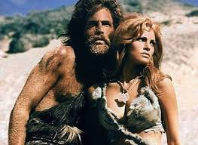
Evolutionary Theory and Sexual Attraction
David Buss
What explains attraction between the sexes?
David Buss’s evolutionary perspective
Both sexes driven by desire to pass on genes, But have different goals and therefore different attractions
Men want child-bearers:
* Youthful: young enough to be fertile
* Healthy enough to deliver, nurture kids
1. hip/waste ratio
2. Complexion
3. Good teeth
4. Lustrous hair

Slide 21
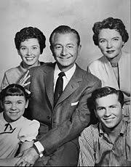
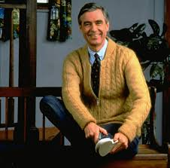
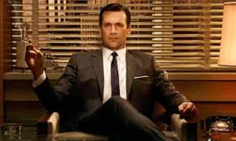
Evolution and Love, continued
Women want protectors/providers
Tall (confers social dominance)
Emotionally strong
Patient
Financially secure

Slide 22
How Men and Women Differ in Mate Attributes
Sprecher, Sullivan, & Hatfield, 1994
To what degree would you be attracted to someone who was:

Slide 23
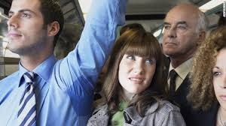
Love is in the Air—Literally!
Get me outta here!
I’m in Love!
Body odor (BO) conveys info. about the immune system
MHC = Major Histocompatibility Complex = genes that help immune system function
People differ in MHC mix—some good for fighting flu, some good for fighting strep, for example.
BO conveys info. of MHC, and this info affects sexual attraction
Why?

Slide 24

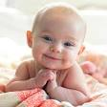
The Scent of Love, continued
How does MHC (via BO) → sexual attraction?
Hint 1a: People with same MHC ARE NOT mutually attracted.
Hint 1b: People with different MHC ARE mutually attracted.
Hint 2: MHC provides info about immune profile
Hint 3: People have sex to produce offspring
Hint 4: People want offspring to be healthy
Explanation: Differing MHC formulas mean kids have more comprehensive immune defense; anti-flu & anti-strep
John’s MHC:
Anti-flu
Sally’s MHC:
Anti-strep throat
Baby Jessica’s MHC:
Anti-flu & Anti-Strep

Slide 25
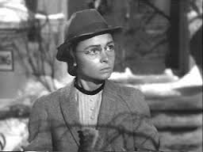
Erotomania: Love Gone Mad
Common among lonely, isolated people with no other psychiatric history.
Love object: someone of higher status
It is not erotic, more idealized
Convinced that object of affections loves them.
Lasts lifetime
Women more than men suffer from this

Slide 26
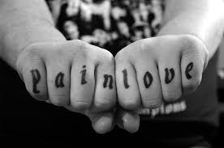
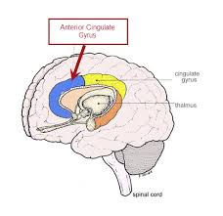
Love Hurts
100000 Country Western songs, pop songs, Italian Operas--lost love hurts.
Does love actually "hurt", as in "ouch" as in pain?
Neuroimaging studies show that after rejection, brain areas that moderate phys. pain are activated (Anterior Cingulate Cortex, aka ACC)
Subjects placed in fMRI scanner
See photo of ex-lover who dumped them, get physical pain-samples (heat).
Same brain area engaged when viewing ex-love and when getting "burned." Love hurts. Ouch.

Slide 27
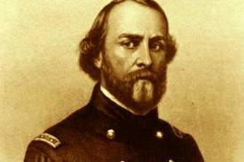
The Last Word on Love
Does romantic love boil down to:
Mania, Smells, Selfish Genes, Pain, Literary myths?
Major S. Ballou to Wife Sarah, 1861
https://www.youtube.com/watch?v=SqGeTWuF0Zc

Slide 28
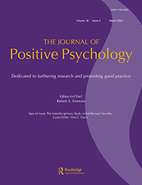
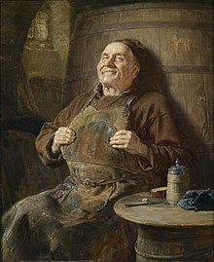
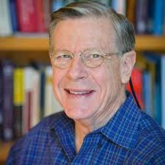
SUBJECTIVE WELL BEING
Ed Diener
1. Frequent positive affect
2. Infrequent negative affect
3. Cognitive evaluations of one’s own life satisfaction
(you are doing well, and you know you are doing well)

Slide 29
Subjective Well Being (i.e., Contentment?)
More Pleasant Emotions
Less Unpleasant Emotions
More Life
Satisfaction
Life Domain
Satisfactions
Joy
Guilt and shame
No desire to change life
Work
Elation
Sadness
Satisfaction w’ current life
Family
Contentment
Anxiety and worry
Satisfaction with past
Leisure
Pride
Anger
Satisfaction with future
Health
Affection
Stress
Sig. others’ view of one’s life
Finances
Happiness
Depression
Self
Ecstacy
Envy
One’s group

Slide 30
Subjective Well Being Measure

Slide 31
What Does, and Doesn’t, Predict SWB?
Does Not Predict SWB
Does Predicts SWB
Income
Social contacts, soc. integration
Age
Goals:
IQ
a. Congruent goals
Attractiveness
b. Meeting goals
Not having psychopathology
Genes (40%-80%)
Personality: (extroversion + optimism) – Neuroticism
Culture (+ in Latin countries)

Slide 32
SWB and Income
Income
Subjective Well Being
Income has increased, SWB hasn’t.
Shows income DOES NOT have a big effect on SWB

Slide 33
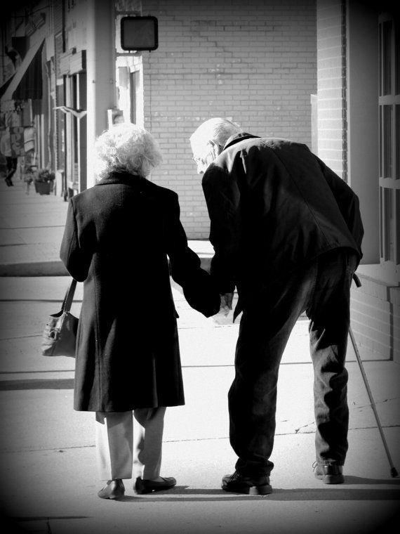
See you Thursday!

