Slide 1
Emotions and Perception
Class 18
(Diary 4)

Slide 2
Review Question 1
Prosocial behavior can be motivated by:
___A. Empathy
___B. Desire to look good to others
___C. Desire to look good to oneself
___D. Personal relief from others’ disturbing distress
___E. All the above
X

Slide 3
Review Question 2
The main point of Batson’s “Elayne Gets Shocked” study was that altruism (selfless helping) can occur if:
___A. Helpers are very smart people
___B. Helpers are not in a hurry
___C. Helpers feel empathy
___D. Helpers want to feel heroic
___E. Helpers want to get a free cookie
X

Slide 4
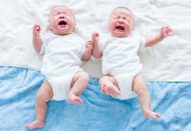
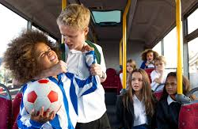
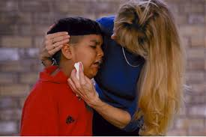
Empathy = Emotion Match + Perspective Taking
Not simply reacting to another’s emotions
Empathy ≠ Emotional Contagion
Not simply recognizing another’s distress
Empathy ≠ Personal Distress
Requires: 1. Emotions aroused by another
2. Matching between own/other’s feelings
3. Making sense of this match
Empathy = Emotional Response + Perspective Taking
Perspective Taking means not only feeling what the
other is feeling but also seeing the situation as he/she does.
Notes:
Empathy may be meta-cognition, once removed.

Slide 5
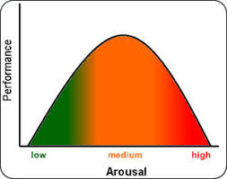
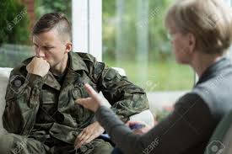
Emotional Challenge of Empathy
We use our own emotions to understand the other’s emotions.
“Affect as Information” (Schwarz & Clore, 1996).
But need proper distance from emotions to use them.
Too emotional → overwhelmed
Too analytical → detached
Empathy = Balancing emotional openness with mental calculation. Requires feeling and thinking, in balance.

Slide 6
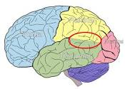
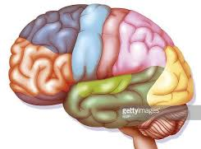
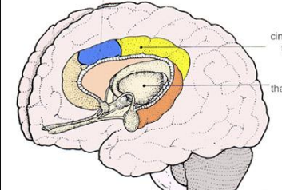
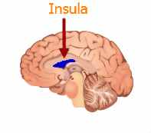
Empathy and Emotional Regulation
Decety, 2010
Emotional Understand Emotional
Arousal Own Emotion is Regulation / Response to Other Mental Control
+
+
+
Emotional
Response to Other
+
Theory
of Mind
Perspective Taking
Helpful Action
Limbic System
ACC
Insula
+
+
Prefrontal
Cortex
TPJ
LIMBIC SYSTEM
INSULA
TPJ
PREFRONTAL CORTEX
ACC
Notes:
Jean Decety, a prominent social neuroscientist who specializes in empathy, proposes that empathy involves three different mental states, and brain areas corresponding to these states. Arousal, mediated by limbic, ACC, and Insula; ToM/knowing experience arises from another—not oneself, moderated by TPJ (tempero-parietal junction). And perspective taking, which requires emotional control, mediated by prefrontal cortex. This is NOT a social neuro talk! But I draw on Decety’s work to emphasize that empathy requires feelings, thinking, and self-control.

Slide 7
The Ethics of Empathy
Paul Bloom, 2017
Sheri Summers is 9 years old. She had a fatal and painful disease. There is a treatment, but it requires being on a waiting list.
Patient Perspective: Take a minute and think about being Sheri; Being scared, in pain, seeing the fear in your parents’ eyes. Wondering what will happen to you.
OR
MD Perspective: Take a minute and think about being the chief of medicine, wanting to do the right thing for all your patients.
Should Sheri go to the top of the list for treatment?
Patient Perspective: YES
MD Perspective: NO

Slide 8
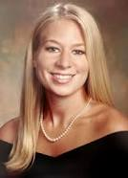
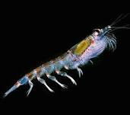
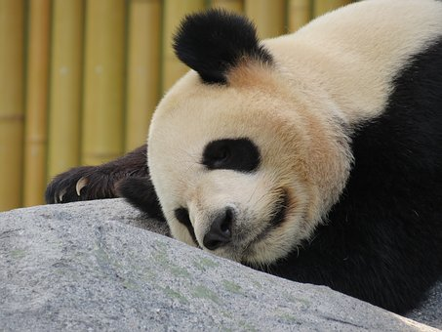
Can Empathy Be a Bad Thing?
Paul Bloom, 2017
versus
Single Sufferer Natalee Holloway
10000s Suffering in Darfur
versus
Cute Panda
Essential Plankton

Slide 9
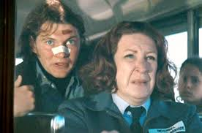
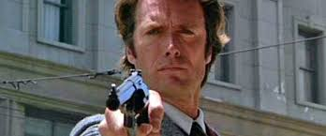
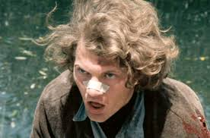
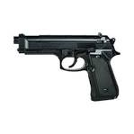
How Empathy for Victims Leads to Sadism to Victimizers
Bad Guy torments innocent nice people.
We empathize with victims.
Our empathy makes us dislike the bad guy.
Good Guy shows up.
He seeks to punish bad guy
We want bad guy punished.
“Go for it, Good Guy! Make our day!”
We feel good when bad thing happens to Bad Guy
Bottom line: More empathy for victims → less empathy for victimizer.
Makes it OK to enjoy another person’s (Bad Guy’s) suffering.

Slide 10
OUTLINE OF TODAY’S CLASS
How stress and anxiety affect perception
How Resources improve perception
What are resources
The Resources and Perception Model
Experiments showing how resources affect perception

Slide 11
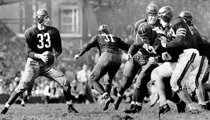
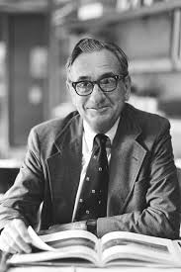
Emotions and Perception: The New Look
“New Look” research: Late 1940s – early 1960s
Basic Idea: Your emotions, needs, goals affect how you literally perceive things: How you see, hear, feel, taste things.
They Saw a Game Hastorf & Cantrel,1954.
Albert Hastorf
1921-2011
Princeton vs. Dartmouth football game. One of the nastiest on record.
Princeton fans: Dartmouth team committed way more penalties, refs were blind
Dartmouth fans: Princeton team committed way more penalties, refs were blind

Slide 12
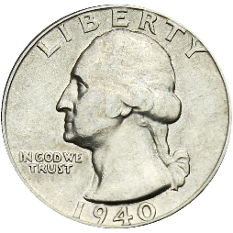
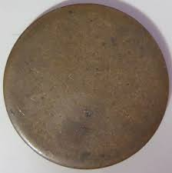
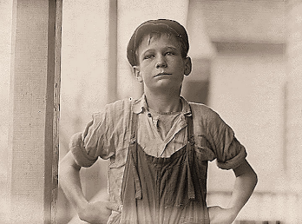
Emotions and Perception: The New Look
Value and need---in perception:
Bruner & Postman, 1947
What kids actually hold in their hands
Rich kid’s judgments of object’s size.
Rich kid
Poor kid’s judgments of object’s size.
Poor kid

Slide 13
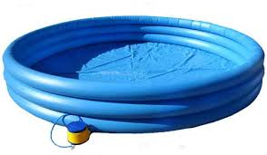
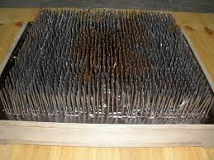
Fear and Perception of Height and Distance
Stefanucci, Gagnon, Tompkins, & Bullock, 2012
Study 1
Subjects imagine falling from height onto:
Control: An empty pool
Threat: A pool containing a bed of nails
Control subjects stood above empty pool Threat subjects stood above nail-filled pool
TASK: How high up are you?
Study 2
Subjects imagine jump and land in:
a. Control: An empty pool or
b. Threat: A pool containing a bed of nails
Control subjects stood before empty pool Threat subjects stood before nail-filled pool
TASK: How far is distance across pool?

Slide 14
Amount
Overestimate

Slide 15
Resources and Perception Model
Challenging things → negative arousal → amplified percept.
Psychological resources reduce negative arousal.
Resources should moderate perception of challenging things.
Boosted resources → less amplified perception
Depleted resources → more amplified perception

Slide 16
Psychosocial Resources
Social Support
Self Worth, Self Esteem
Self-Efficacy
Emotional Disclosure

Slide 17
Resources and Coping
Reduced depression and anxiety
Reduced cardiovascular response to stress
Reduced levels of norepinephrine, epinephrine, cortisol
Better immune functioning
Fewer colds, fewer heart attacks, quicker recovery post-MI, reduced cancer, easier childbirth, etc.

Slide 18
Emotional Support and Mortality After Heart Attack (Berkman et al., 1992)

Slide 19
Resources and Perception Theory
If stress amplifies perception
And if resources reduce stress
Then more resources → more accurate perception.

Slide 20
Resources and Perception Program
Resources will moderate:
Social Perception – others’ distress
Visual Perception – steepness, distance, height

Slide 21
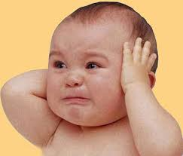
Social Perception and Cry Ratings Harber, Einav, & Lang, (2008). European J. Social Psych, 38, 296-314.
Social contact manipulation: Guided imagery task
Friend: Image the best person in your life (to boost support)
Neutral Person: Image a neutral person you know (support is unchanged)
Betrayer: Image someone who betrayed you (to weaken support)
Listen to and Rate 8 baby cries.
How distressed is the baby based on this cry?
1 2 3 4 5 6 7
Not at All
A Great Degree

Slide 22
Social Context and Emotional Disclosure
on Baby Cry Ratings
Subjects who thought about a friend heard the cries as least distressed
Subjects who thought about a betrayer heard the cries as most distressed.
Emotional Disclosure
What happens if subjects who could disclose their thoughts and feelings?

Slide 23
Social Context and Emotional Disclosure
on Baby Cry Ratings
Friend
Neutral
Betrayer
For “Betrayer” subjects who could disclose feelings of being betrayed,
baby cries are no longer amplified.
Disclosure boosted resources, counteracted the bad effects of recalling a betrayer, and thereby judgments of the baby became less extreme.

Slide 24
Psychosocial Resources and Physical Perception
Do resource affect our visual perception?
Do we literally see things differently under ample vs. depleted resources?
Do resources affect accuracy of perception?
Baby cry studies do not address accuracy.
Do resources other than social support affect perception?

Slide 25
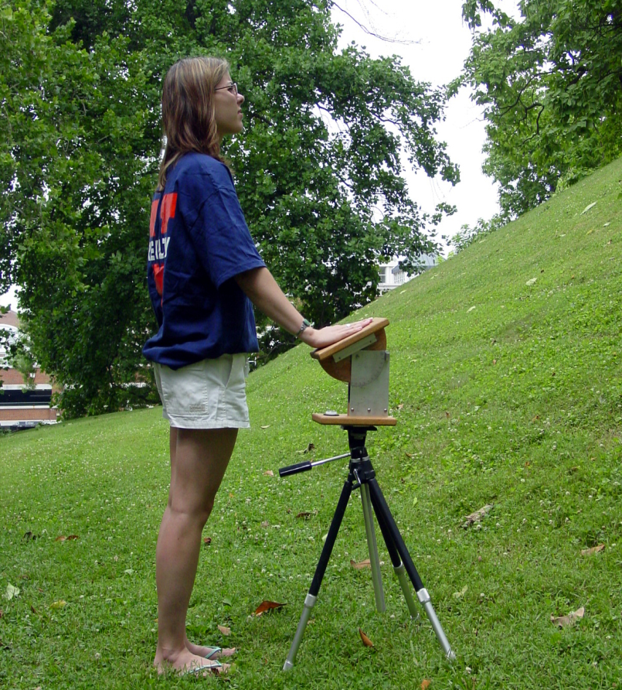
Social Support and Slant Perception Schnall, Harber, Stefanucci, & Proffitt (2008). Journal of Experimental Social Psychology, 44, 1246-1255
Conscious slant perception of hills is exaggerated (5% is seen as 20%, etc.).
Slant distortion is lessened under lower physical load
-- Light back pack vs. heavy back pack
-- Physically refreshed vs. fatigued
-- Good physical cond. vs. poor cond.
-- Younger vs. older
Is slant distortion reduced under lower psychological load?

Slide 26
Study 1: Do hills appear different when alone vs. with a friend?
Participants Passersby at campus walk
Alone (n = 14)
Same-sex friend pairs (n = 17; both participate)
All wear heavy backpack, face steep hill
Measures
Verbal: “How steep is this hill, in degrees?”
Visual Judgment: hand protractor
Haptic: palm board
Hand protractor
Palm board

Slide 27
Social Support and Slant
Note: Line shows actual slant
Being with a friend leads to less exaggerated, more accurate hill-slant perception
Verbal measure: “How many degrees is the hill slant?”
Visual measure: The protractor-device subjects used to show how steep the hill looked.
No difference on Haptic measure: The palm board capturing how their “body” saw the hill.

Slide 28
Effects of Friendship Duration and Mood on Slant Perception
Friendship Duration
(in months)
Verbal r = -.49, p < .05
Visual r = -.50, p < .05
Haptic r = -.14, p = ns
Mood
(negative)
Verbal r = -.01, p = ns
Visual r = -.13, p = ns
Haptic r = .01, p = ns
Friendship duration mattered: The longer you knew your friend, the less steep the hill appeared.
Mood did not matter: Being in a worse or better mood had no effect on hill slant perception.

Slide 29
Study 1 Alternative Explanations
Instrumental Support Social Desirability Social Facilitation Sampling Bias
Study 2 fixes these problems: “Just think about a good friend, a neutral person, a bad person”.
n = 36, 49% female
Imaged other: Think about Positive, Neutral, or Negative Person
Random Assignment

Slide 30
Slant Study 2: Imaged Support and Slant Perception
Note: Line shows actual slant
Results mirror Study 1:
People who recall a friend see hill as less steep, and more accurately, than those who thought about a neutral person or a nasty person.
Can’t be due to wanting to impress friend, or hoping to be rescued by friend, or being aroused by friend—because NO FRIEND IS ACTUALLY THERE!

Slide 31
Correlations Between Relationship Quality and Slant Perception
Verbal Visual Haptic
Measure Measure Measure
Close -.37* -.36* .10
Warm -.33* -.28 .22
Happy -.39* -.20 .12
Friendship closeness mattered: The closer you felt toward the person you thought about, the less steep the hill appeared.
Mood did not matter: Being in a worse or better mood had no effect on hill slant perception.

Slide 32
Resources and Distance Perception Harber, Iacovelli, & Yeung, 2012 (Study 1)
Will psychosocial resources affect distance perception?
Will self-worth serve as resource?

Slide 33
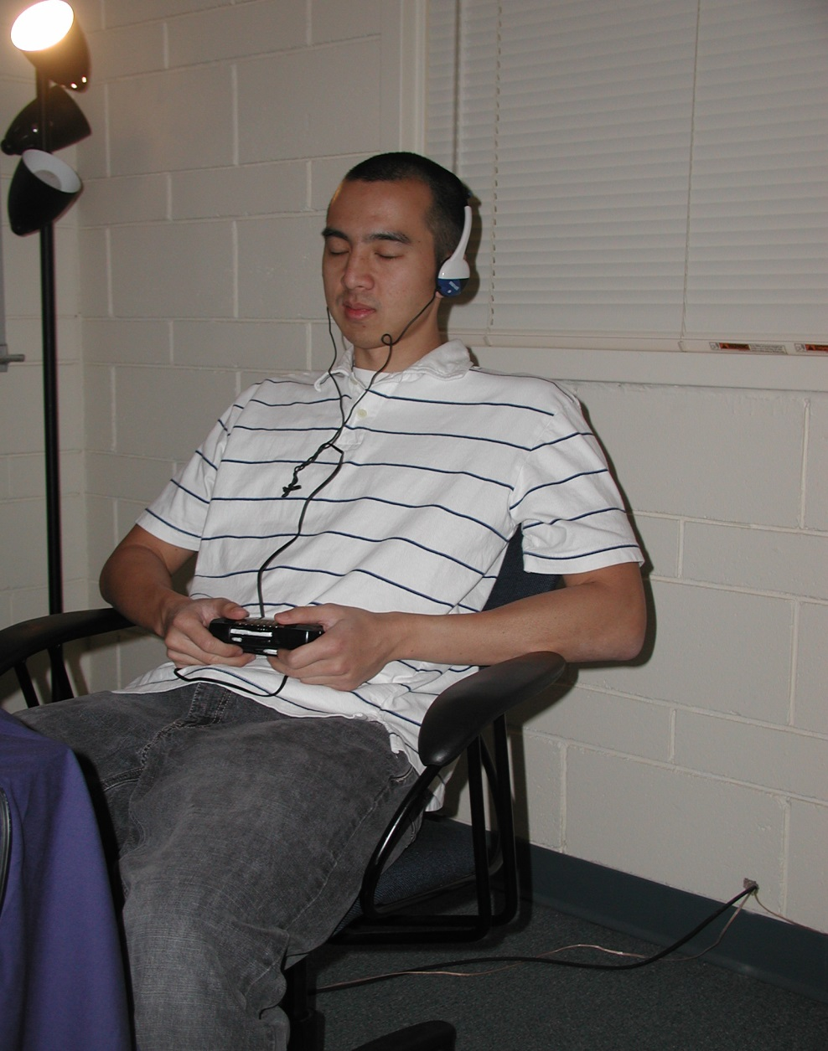
Self Worth Induction
Boosted: Imagine best success
Unchanged: Imagine doing laundry
Depleted: Imagine worst failure
N = 107, 63% female

Slide 34
Distance Estimation Task
Subjects put face in chin rest; room lights go off and table lights go on.
Turned the handle on fishing reel to pull clear plastic car (at far end of track) to their face.
Reported how far the car was from them a the yellow, green, and pink tabs.

Slide 35
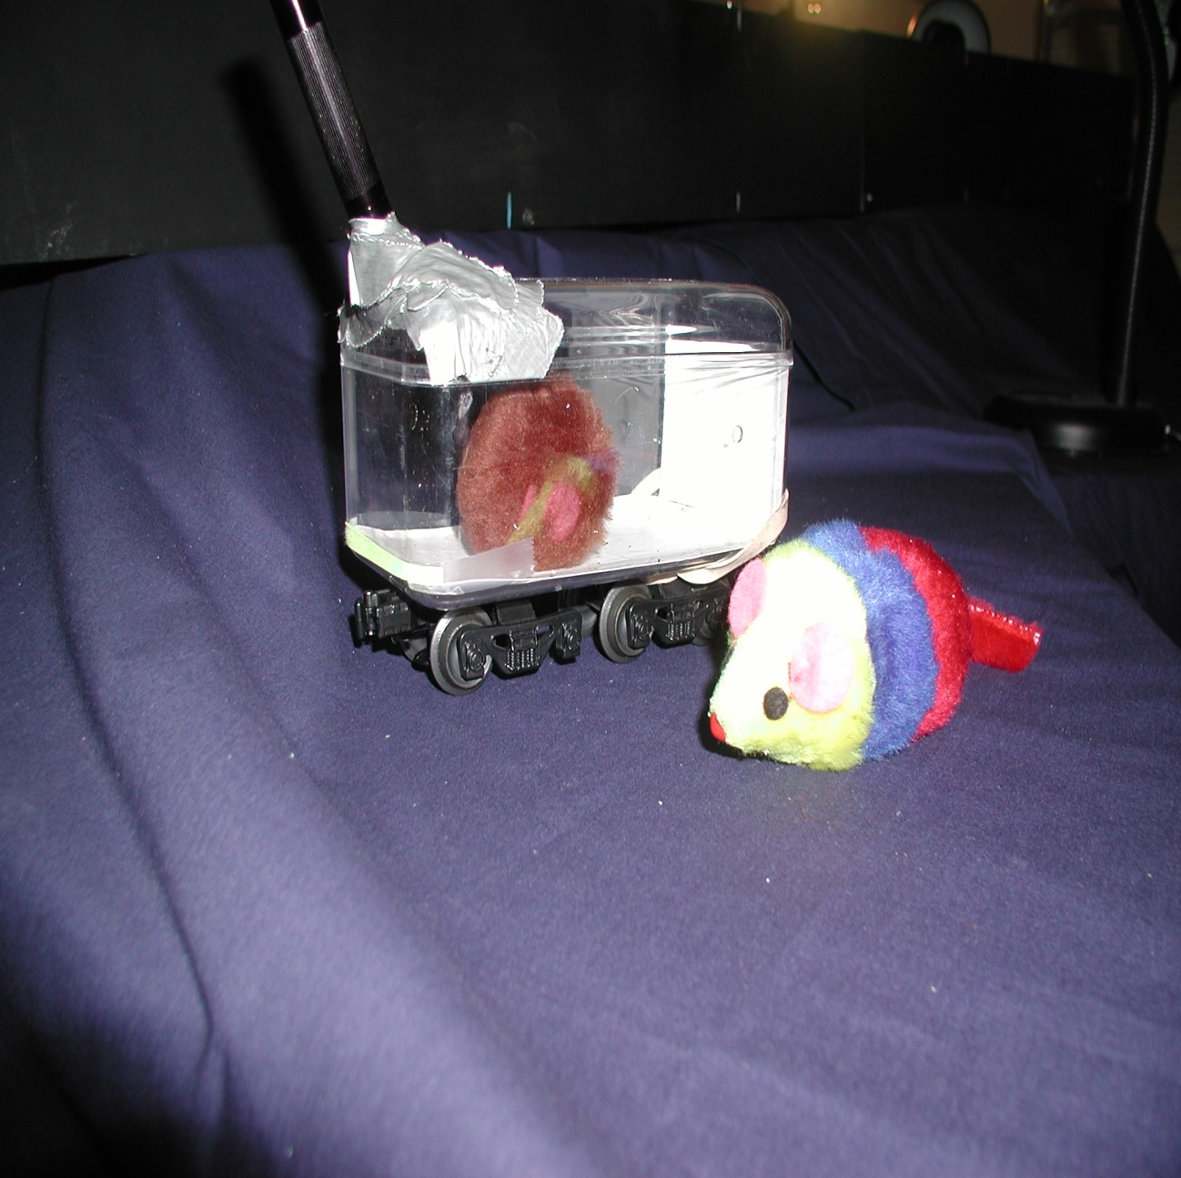
Target Objects
Low Threat
Plastic car contains cute cat toy.
High Threat
Plastic car contain a live tarantula

Slide 36
Resources and Distance Perception Study Design
 | Positive Self-Worth | Neutral Self-Worth | Negative Self-Worth
Cat Toy | No Diff | No Diff | No Diff
Tarantula | Accurate (Correct Distance) | Average (A Bit Too Close) | Inaccurate (Overly Close)

Slide 37
Distance Accuracy as for Low Threat (Cat Toy) Subjects, Due to Positive, Neutral, Negative Self-Image
This graph shows that self-image conditions did not differ for subjects in the cat toy (low threat) condition.
Note that a score of “0” means perfect accuracy, no exaggerated closeness. A score of 6 (for example) means the car was seen 6 inches closer than it was.

Slide 38
Distance Accuracy as for High Threat (Tarantula) Subjects, Due to Positive, Neutral, Negative Self-Image
This graph shows that self-image conditions did affect subjects in the tarantula high threat) condition.
“Tarantula” subjects who affirmed their selves were super accurate—even more accurate than the “Cat toy” Subjects. But Tarantula subjects who dis-affirmed their selves exaggerated closeness to the tarantula.
Recall that “0” means no difference between perceived distance and actual distance.

Slide 39
Evidence of Self-Worth Moderation
Felt good about self | r (55) = -.27 * | r (48) = -.01
Felt bad about self | r (55) = +.31 * | r (48) = .13
Tarantula Distance
Neutral Object Distance
Subjects who felt better about themselves saw the tarantula as further away (and more accurately). Subjects who felt worse about themselves saw the tarantula a closer (and less accurately).
Feeling good or bad about oneself had no effect on perceptions of the neutral cat toy.

Slide 40
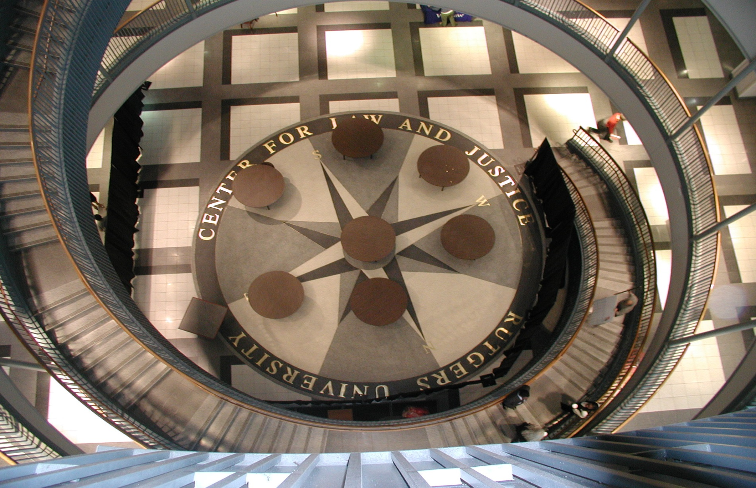
Self Esteem, External Support, and Height Judgments Harber, Iacovelli, & Yeung, 2012 (Study 2)
PHOTO LOOKING DOWN STAIRWELL
N = XXX, XX% female, age = XX.XX

Slide 41
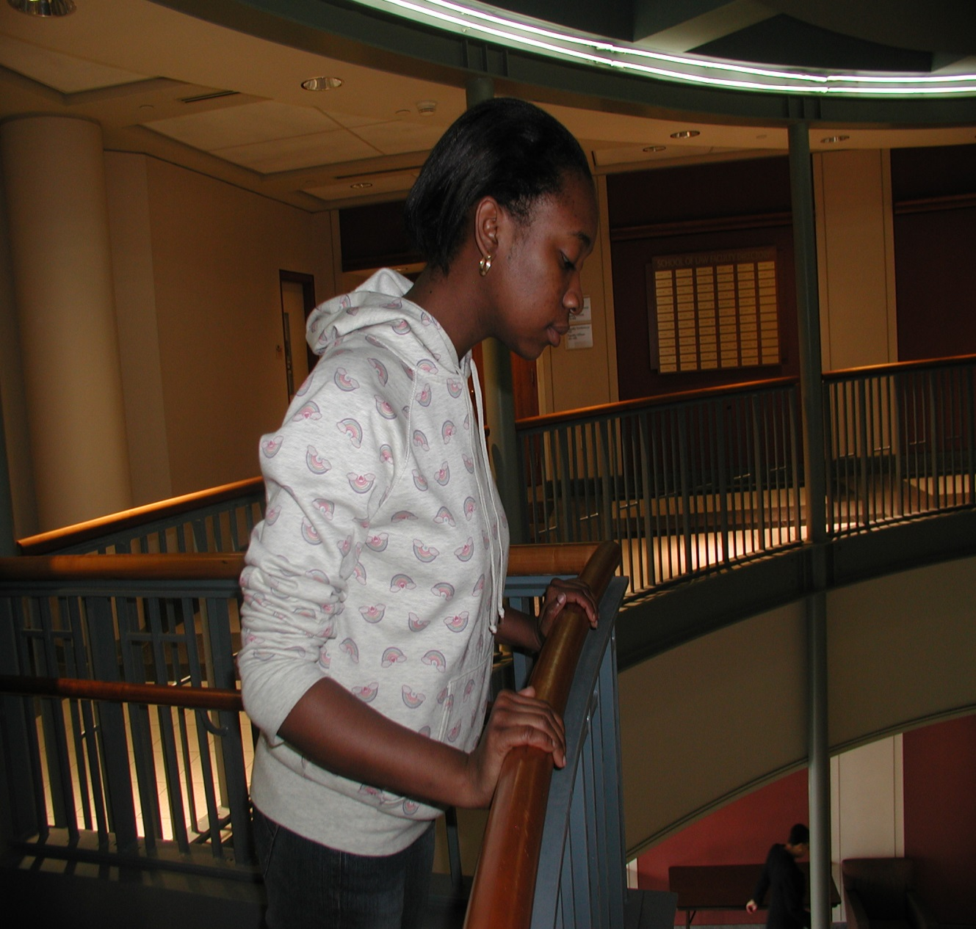
Do resources moderate height judgments?
Does trait self esteem operate as a resource?
Do internal resources supplement external resources?
Note that this subject has a physical resource she can draw upon: The handrail which gives her a feeling of security.
What if she didn’t have this physical resource?
HANDRAIL

Slide 42
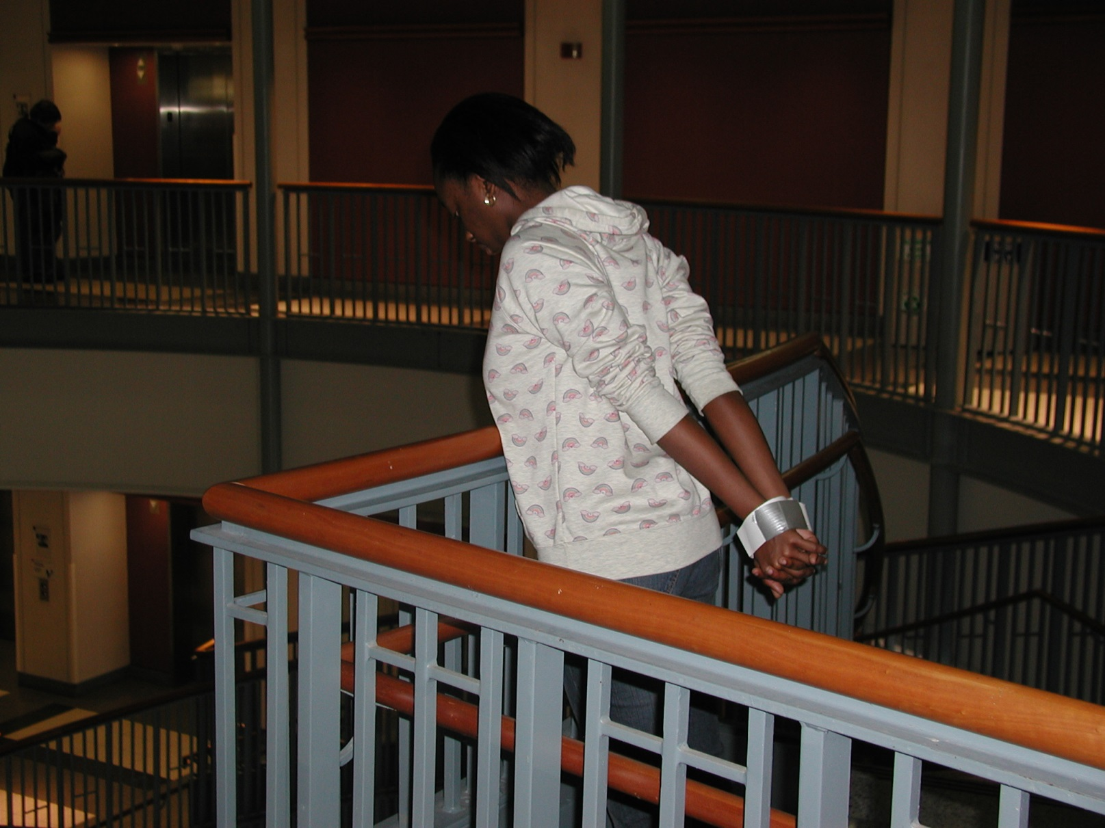
Here’s what it looked like for subjects in the “no physical resource” condition.
They had to look down without being able to hold the handrail.

Slide 43
Self Esteem, External Support, and Height Perception
Actual height
This graph shows that for subjects with the resource of high self-esteem, holding or not holding the handrail made little difference.
Both groups were equally, and quite, accurate in their height perceptions.

Slide 44
Self Esteem, External Support, and Height Perception
This graph shows that the handrail mattered much more for low esteem subjects.
Low esteem subjects who COULD hold the handrail did fine. Perception was very accurate.
BUT, low esteem subjects who COULD NOT hold the handrail were very inaccurate.

Slide 45
Conclusions
Resources affect the perception of :
Others’ distress (baby cries)
Distance to stressors (tarantulas)
Heights
Hill slants
Similar effects derive from different resources:
Social support (baby cries, hill slant)
Emotional disclosure (baby cries)
Self worth (distance to tarantula)
Self esteem (height)
Resources may enhance coping by moderating stressor perception

