Slide 1
Class 17: Social Judgment and Empathy
NOTES:
1. Diary # 3 Today
2. Subject pool open for extra credit. 30 min. = 1 credit; 1 hour = 2 credits.
3. You can earn up to, no more, than 6 Extra Credits Points.
4. Switching order of classes: Empathy today, Emotions & Percept. on Thursday.

Slide 2
REVIEW QUESTION 1
Schachter found that subjects expecting a severe shock wanted to be with others except when:
___ A. They were not allowed to talk other people
___ B. They were uncertain about their own emotions
___ C. They would be with people who were in positive moods
___ D. They were uncertain about the nature of the situation
___ E. None of the above
X

Slide 3
REVIEW QUESTION 2
Alice Isen’s studies on happiness and helping showed that:
___A. Helping is all about reciprocity
___B. Happiness promotes only requested helping
___C. The happier people feel, the more help they give
___D. Finding no money in pay phone makes people hostile
___E. None of the above
X

Slide 4
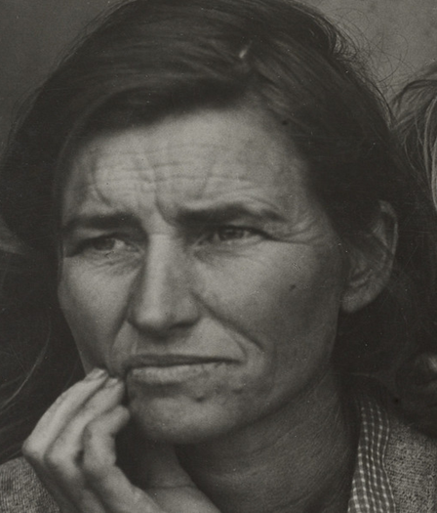
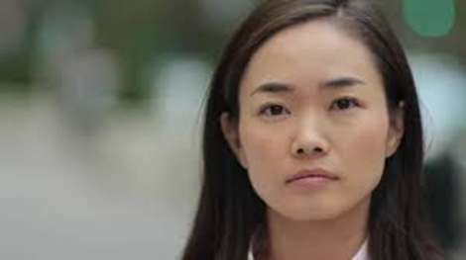
Current Emotions and Judgment of Others’ Feelings
Evidence from Psych of Emotions 2023
What are you
feeling today?
What emotions do you see in this picture?

Slide 5

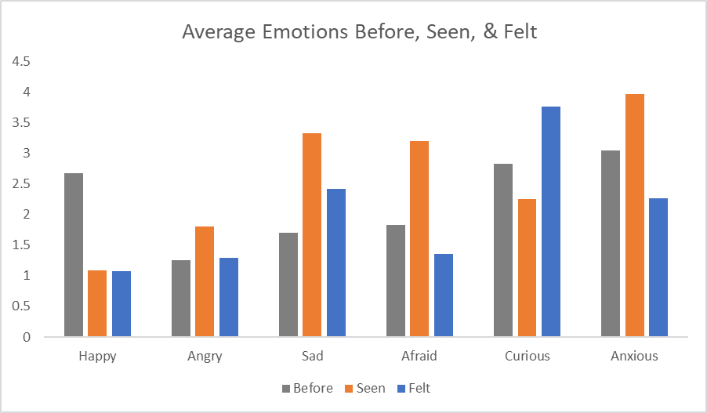
Emotions that the Class Felt and Saw

Slide 6
How Emotions Felt Before Seeing Photo Affected Judgments of Woman in Photo
Neg. Emotions Seen in photo
Negative Emotions Felt Before Seeing Picture
r (49) = .27, p = .06

Slide 7
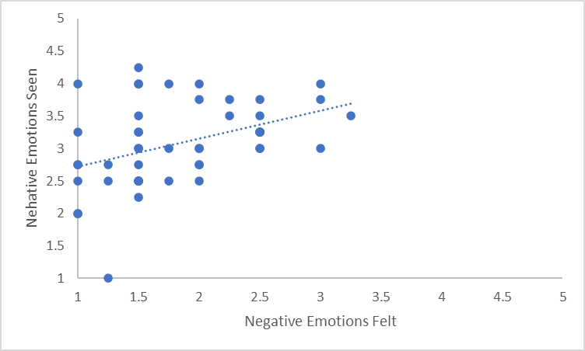
How Emotions Felt While Seeing Photo
Relate to Judgments of Woman in Photo
Neg. Emotions Seen in photo
Negative Emotions Felt While Seeing Picture
r (48) = .40, p = .005

Slide 8
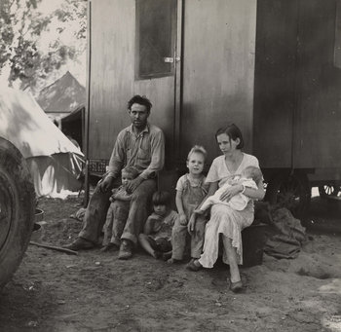
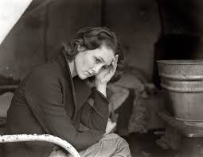
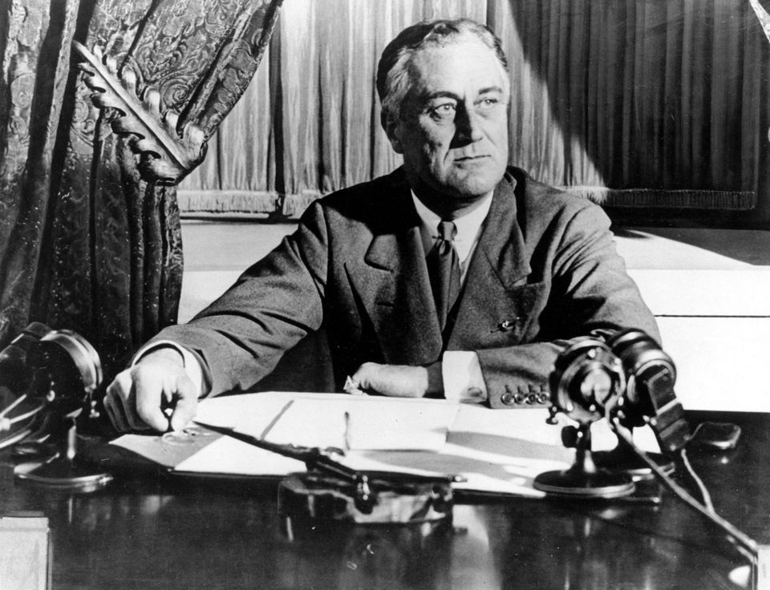
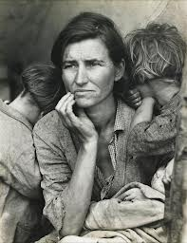
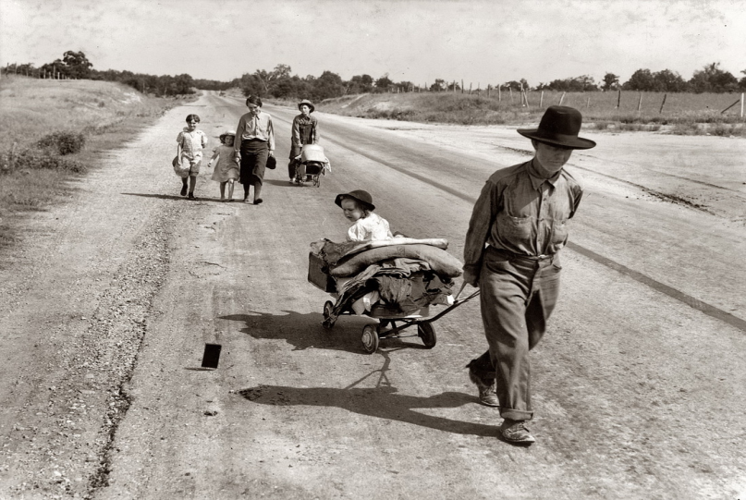
Dorothea Lange and New Deal Photos of the Great Depression (1932-1942)

Slide 9
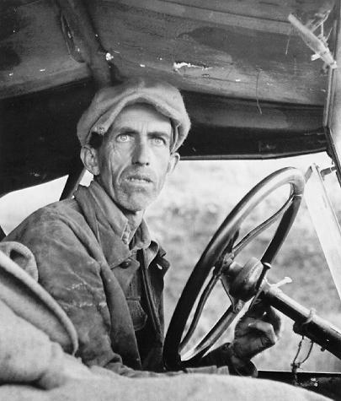


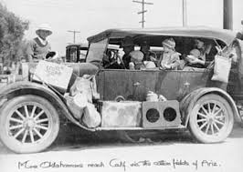
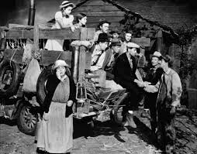
FSA to Hollywood:
New Deal Imagery

Slide 10
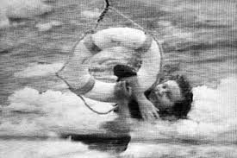
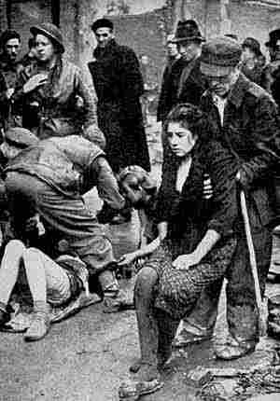
Acts of Selfless (?) Heroism
The “fifth man” in Air Florida crash
Polish Concentration Camp Guard
Question: What motivates this behavior?

Slide 11
Why Do People Help Others?
Altruistic explanation – Caring:
Someone else’s well-being comes first.
Egoistic explanations
Negative state relief: Stop personal discomfort
Avoid social/self punishments: Shame, guilt
Seek social/self rewards: Honor, pride

Slide 12
A “Selfishness Bias” in Psychology?
Freud: Behavior based on pleasure principle
Skinner: Behavior based on pleasure principle
Modern Social Psychology focused on the selfish self:
1. Totalitarian ego:
a. False uniqueness
b. False representativeness
2. Self affirmation and Self Esteem
3. Downward Social Comparison

Slide 13
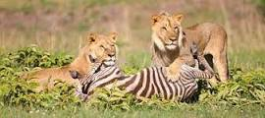
The “Selfish Gene” Theory
Fundamental goal of life-forms – pass on genes
Who will pass on genes? Those who survive
Therefore behaviors that promote survival are “adaptive” and are “selected in”
Behaviors that jeopardize survival are maladaptive and are “selected out”
Who is more likely to survive, the selfless helper or the selfish non-helper?

Slide 14
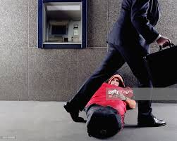

Daniel Batson: Empathy and Altruism
Batson conducts classic research on “bystander intervention”, showing how situations can prevent people from helping.
Jerusalem to Jericho study: Just being in a slight hurry stop people from helping hurt stranger.
Batson becomes interested why some people help, even if situation makes it hard to help.
He asks: Are we capable of caring?

Slide 15
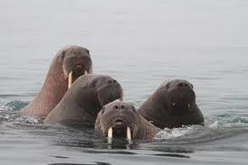
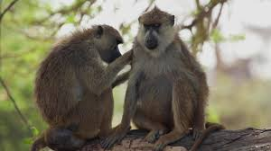
Challenges to “Selfish Gene”
Inclusive Fitness:
Share genes with others
Risk taking for others promotes their survival
People more apt to sacrifice for those closest to them in terms of shared genes
Reciprocal Altruism:
“You scratch my back, I’ll scratch your back” I help you today, you help me tomorrow, and typically with interest.

Slide 16
Emotions Consistent with
Egoistic (Selfish) Behavior
Emotions Consistent with
Altruistic Behavior
Envy Pride
Jealousy Spite
Greed
Lust
Gluttony
Covetousness
Schadenfreude
Empathy
"Enjoyment obtained from the troubles of others"

Slide 17
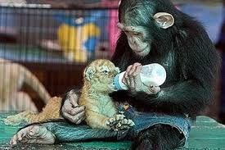
“Circumstantial” Evidence of Empathy → Altruism Link
1. Evolutionary Biology
2. Neurology/Physiology/Facial expressions
3. Empathy evident at a very early age.
a. Sympathetic crying b. Help kid who lost his marbles
4. Empathy evident in non-human species.
Walruses help harpooned fellows
5. Empathy exists in individualistic and collectivistic societies
6. Empathy → helping has immediate quality
a. Experiments on helping: physio reaction → helping
b. Accounts of helpers: “Didn’t think, just did it” “It felt right”
THE HERO CAT – GOTTA WATCH!: https://www.youtube.com/watch?v=E1k4wNXfDB8

Slide 18
Logic of Batson Empathy and Altruism Experiments
Prosocial Behavior
Social
Desirability
Negative
State Relief
Empathy
Reciprocity
Altruistic
Motive
Ego-centric Motives
If helping is due ONLY to ego-centric motives,
And if these motives can be satisfied without helping,
Then there will be no helping when ego-centric motives are satisfied.
BUT if helping occurs because of empathy
Then when empathy is aroused
Helping will occur EVEN IF ego-centric motives are satisfied

Slide 19
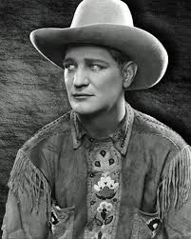
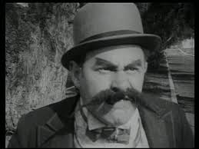
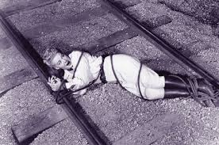
Batson’s Empathy and Altruism Experiment:
Testing Empathy Vs. Social Desirability
Empathy: Emotion that motivates altruism (i.e., selfless helping).
Social Desirability: Motive to look good, not bad, to others.
Logic of Experiment
High Empathy Subject
Low Empathy Subject→
See Elayne in distress
Experimenter invites subject to help Elayne, AND:
Provides, or does not provide, a way to escape helping without looking bad.
Prediction: Low empathy subject will help, but only if there is no way to escape.
High empathy subject will help, even if there is a way to escape.

Slide 20
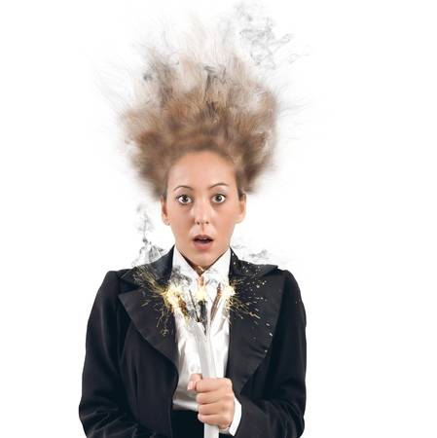
Is Helping Due to Empathy or Social Desirability The “Elayne” Study
1. Subject told: Study is about learning and shocks
2. Subject is “observer”, Elayne (an actor) is “learner”
3. Subject sees Elayne showing distress, upset when shocked
4. Exptr. calls a break, asks Elayne if OK, “yes, but water please.” Elayne is clearly distressed.
5. During break, Subject completes “mood check-list”.
True purpose: To ID people high/low on empathy for Elayne
6. Elayne tells Expt. she had a childhood trauma w’ shocks.
7. Expt. asks Subject “You willing to switch places w’ Elayne?”
8. Subject must qualify to help by performing well at a test
a. For ½ Subjects “Easy test, most can do well”
b. For ½ Subjects “Hard test, most can’t do well”

Slide 21
Central Predictors in Empathy and Social
I. Reaction to Elayne: High Empathy or Low Empathy
High Empathy Subjects: Scored high on empathy measure.
“Poor Elayne! I feel so bad for her. Can I help her?”
Low Empathy Subjects: Scored low on empathy measure.
“Those shocks look awful. No way I want to take those shocks”
II. Excuse to Escape Having to Help Elayne,
Without Feeling Ashamed
Escape Absent: Test is “very easy, anyone can pass”.
Escape Present: Test is “very hard, most don’t pass”
NOTE: All subjects get the same test, which in reality is easy to pass.
So subjects who do poorly on test are likely faking it.

Slide 22
“Social Desirability” vs. “Empathy and Altruism”
If helping is only due to Social Desirability
Escape from Helping
Low
Empathy
High
Empathy
Escape Absent
Helps
Helps
Escape Present
No Help
No Help
If Helping Can Be Due to Empathy
Escape from Helping
Low
Empathy
High
Empathy
Escape Absent
Helps
Helps
Escape Present
No Help
Helps

Slide 23
Effort Made to Qualify to Help “Elaine” Due to Empathy and Opportunity for Face-Saving Out
Batson, et al., 1988
Number of Correct Answers
Note: Easy Test = No Escape from helping
Hard Test = Escape available from helping.
Remember: All subjects actually got the same, easy-to-pass test.
Low empathy people do well on test only when it is “easy”.
High empathy people do well on test even when it is “hard.”
Thus, high empathy people don’t “escape” helping even when they can escape doing so.

Slide 24
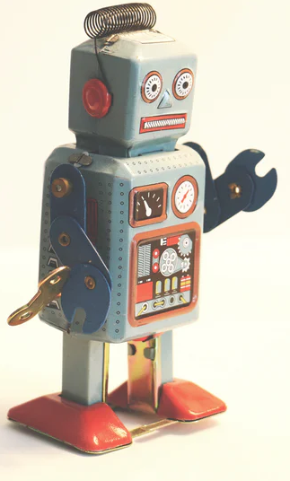
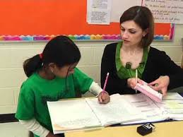
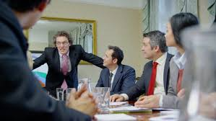
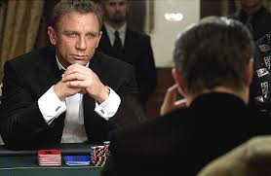

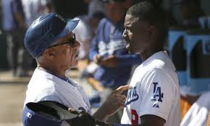

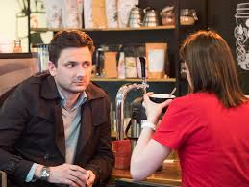
Empathy: How Do We Understand Others?
Human relations requires understanding others’ psychological lives:
Motives Feelings Perspectives
Cognitive machinery affords this ability
Theory of Mind (ToM)
Simulating
Mentalizing
Empathizing
Notes:
If behaviorism was correct, if people didn’t have minds or internal mental states, social interactions would be easy. Boring but easy. You apply a nickle’s worth of stimulus and you’d consistently get a corresponding gumball of response.
Fact is, people differ from each other, and they differ from themselves at different times, in different contexts. This makes human interaction vastly more complex. To know a person requires some sense of their motives, emotions, and thoughts. Luckily human mental machinery makes this possible. Skills variously labeled ToM, simulation mentalizing all refer to the human ability to know others’ inner states. The most encompassing of these constructs is empathy.

Slide 25
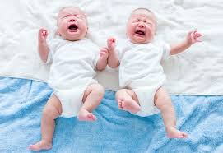
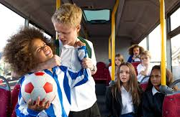
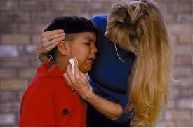
Empathy = Emotion Match + Perspective Taking
Not simply reacting to another’s emotions
Empathy ≠ Emotional Contagion
Not simply recognizing another’s distress
Empathy ≠ Personal Distress
Requires: 1. Emotions aroused by another
2. Matching between own/other’s feelings
3. Making sense of this match
Empathy = Emotional Response + Perspective Taking
Perspective Taking means not only feeling what the
other is feeling but also seeing the situation as he/she does.
Notes:
Empathy may be meta-cognition, once removed.

Slide 26
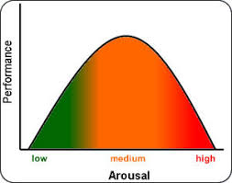
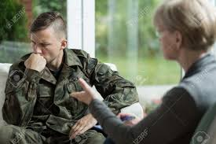
Emotional Challenge of Empathy
We use our own emotions to understand the other’s emotions.
“Affect as Information” (Schwarz & Clore, 1996).
But need proper distance from emotions to use them.
Too emotional → overwhelmed
Too analytical → detached
Empathy = Balancing emotional openness with mental calculation. Requires feeling and thinking, in balance.

Slide 27
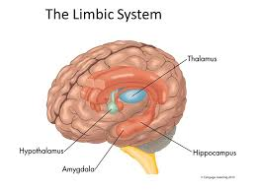
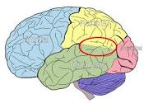
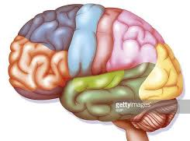
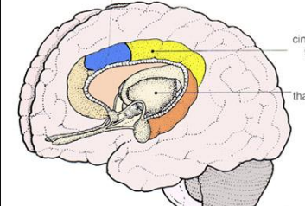
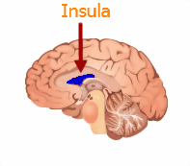
Empathy and Emotional Regulation
Decety, 2010
Emotional Understand Emotional
Arousal Own Emotion is Regulation / Response to Other Mental Control
+
+
+
Emotional
Response to Other
+
Theory
of Mind
Perspective Taking
Helpful Action
Limbic System
ACC
Insula
+
+
Prefrontal
Cortex
TPJ
LIMBIC SYSTEM
INSULA
TPJ
PREFRONTAL CORTEX
ACC
Notes:
Jean Decety, a prominent social neuroscientist who specializes in empathy, proposes that empathy involves three different mental states, and brain areas corresponding to these states. Arousal, mediated by limbic, ACC, and Insula; ToM/knowing experience arises from another—not oneself, moderated by TPJ (tempero-parietal junction). And perspective taking, which requires emotional control, mediated by prefrontal cortex. This is NOT a social neuro talk! But I draw on Decety’s work to emphasize that empathy requires feelings, thinking, and self-control.

Slide 28


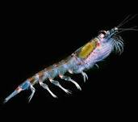

Can Empathy Be a Bad Thing?
Paul Bloom, 2017
versus
Single Sufferer Natalee Holloway
10000s Suffering in Darfur
versus
Cute Panda
Essential Plankton

Slide 29
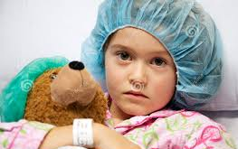

Problems with Thinking Empathically
Sheri Summers is 9 years old. She had a fatal and painful disease. There is a treatment, but it requires being on a waiting list.
Patient Perspective: Take a minute and think about being Sheri; Being scared, in pain, seeing the fear in your parents’ eyes. Wondering what will happen to you.
OR
MD Perspective: Take a minute and think about being the chief of medicine, wanting to do the right thing for all your patients.
Should Sheri go to the top of the list for treatment?
Patient Perspective: YES
MD Perspective: NO

Slide 30
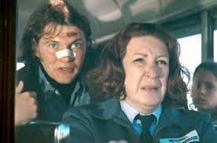
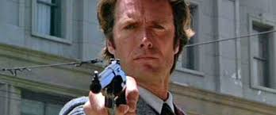

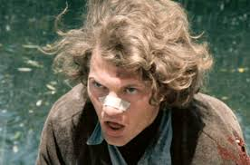
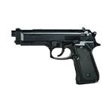
Empathy and Violence
How Empathy for Victims Leads to Sadism to Victimizers
Bad Guy torments innocent nice people.
We empathize with victims.
Our empathy makes us dislike the bad guy.
Good Guy shows up.
He seeks to punish bad guy
We want bad guy punished.
“Go for it, Good Guy! Make our day!”
We feel good when bad thing happens to Bad Guy
Bottom line: More empathy for victims → less empathy for victimizer.
Makes it OK to enjoy another person’s (Bad Guy’s) suffering.

