Slide 1
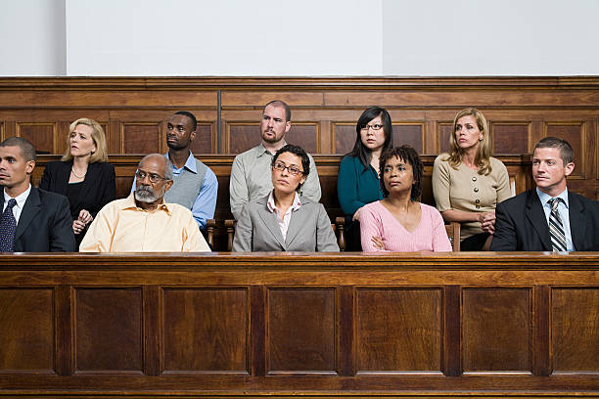
CLASS 16:
EMOTIONS AND SOCIAL JUDGMENT

Slide 2
UPDATES
a. Midterm graded
Subject Pool Open for Extra Credit starting Monday (3/27)
  Instruction available on my web page and on Canvas
Other Extra Credit Opportunities
1. Going Flat Face (2 points)
2 . Ten Meter Tower (2 points)
See Blackboard for instructions, also Class 13.
You can get 6 pts of extra credit via any combination of:
1. Flat Face
2. Ten Meter Tower
3. Subject pool studies

Slide 3
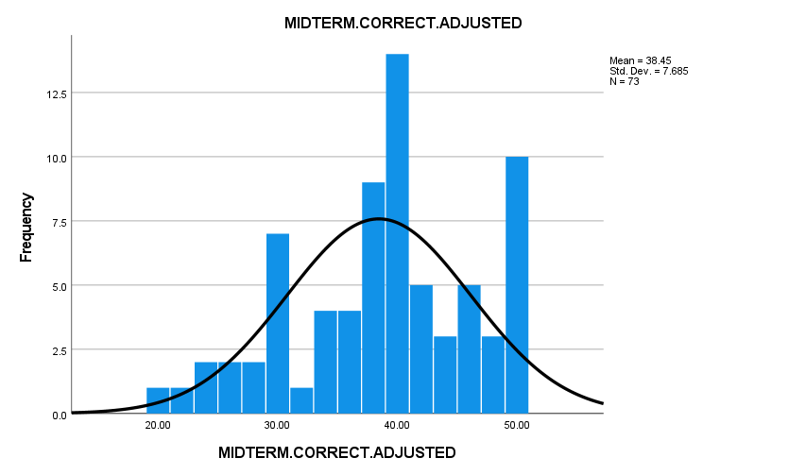
Midterm
Midterm Score = Correct + 3 points, due to Harber absence

Slide 4
Emotions Diary Exercise
Emotion Diary Project = 15 points toward your final grade. It is an easy way to make points, if you complete it as instructed.
Packet of 8 diaries, including today's.
No need to make copies, I’ve done that for you!
Complete diary at start of class, from Tues (March 21) to April 13; or do so twice a week for the next 4 weeks, in any case.
On April 13 I will provide materials for analyzing your diaries.
NOTE: I will not see your individual diaries—they are yours. What you write on them is for your eyes only! However, you are welcome to share Diary content in your write-up if you wish to do so. All Diary reports will be held in strict confidence.

Slide 5

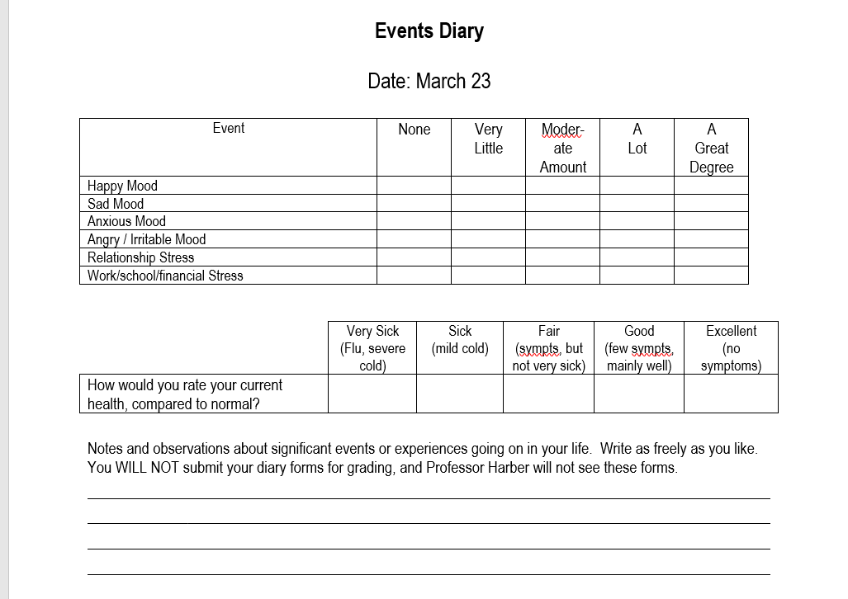
Date: March 21

Slide 6
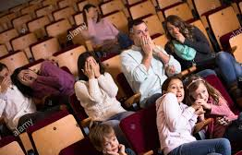
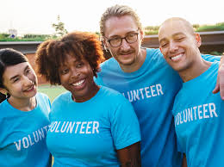
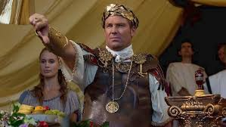
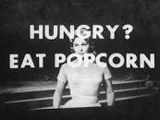
How Emotions Affect Judgment and Behavior
Anxiety and affiliation
Happiness and helping
Subliminal Priming of Emotions

Slide 7
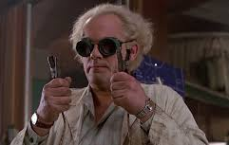
Stanley Schachter: Anxiety and Affiliation Studies
Enter "Gregor Zilstein"
"Punishment and Learning Study"
Severe Electric Shocks -- but be assured--"No permanent tissue damage" OR
Mild Electric Shocks -- sort of like a light tickling sensation
Please wait while we set up materials.
Would you like to wait alone or with others?

Slide 8
Schachter Measures of Anxiety and Affiliation
Anxiety measure
“How do you feel about the prospect of getting shocked?”
1 2 3 4 5 6 7
I enjoy it I dislike it
very much very much
Affiliation measure ____ I prefer being alone ____ I prefer being with others ____ I really don’t care

Slide 9
Effects of Anxiety Manipulation on Self-Reported Anxiety
What’s the purpose of this measure?
Manipulation check. Make sure manip. Worked.

Slide 10

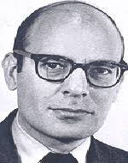
Stanley Schachter and Anxiety and Affiliation
What’s really going on here?
Zilstein is really an actor
No one ever gets shocks—Misled about shocks to arouse high anxiety (severe shock cond) or low anxiety (mild shock cond).
True purpose: How does anxiety affect desire to be with others?
Schachter has noted that isolation leads to intense anxiety (seem relevant with COVID-19?).
If isolation → anxiety, does anxiety → desire to affiliate?
Stanley Schachter

Slide 11
Anxiety Condition and Choosing to Be Alone or With Others

Slide 12
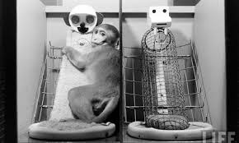
Why Might People Facing Threat Seek Out Others?
Information
Find out if their own reactions are normal
Social solidarity—belongingness (attunement?)

Slide 13
Anxiety and Affiliation Follow-on Studies
Do people ONLY seek out information?
a. Will prefer opportunity to be with others, even if not allowed to talk.
b. However, want to talk to:
1. Check out reality of situation 2. Gauge normalcy of own responses
Do threatened people want to be with ANY others, or only those in sim. situation?
Prefer those in sim. situation
Do threatened prefer being with non threatened, or being alone
Prefer being alone

Slide 14
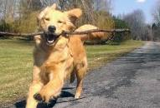
Feeling Good and Helping
(Alice Isen, 1987)
Does positive mood lead to helping others?
Prior research suggests it does:
Ss in good mood more willing to help Experimenter
Ss in good mood feel more empathy for others
Problems with prior research
Is it really pos. mood, or just arousal?
Help is requested, not spontaneous
Alice Isen conducts studies to better understand mood and helping

Slide 15
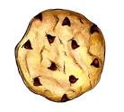
Cookie Distribution in Isen “Cookies and Kindness” Study
C | C | C | C | C
X | X | X | X | X
C | C | C | C | C
X | X | X | X | X
C = Received Cookie X = Didn’t Receive Cookie
Shaded = asked to help Un-shaded = asked to distract

Slide 16
Percent Willing to Help/Distract Another Student Due to Receiving or Not Receiving a Cookie

Slide 17
Number of Minutes Agreeing to Volunteer Due to Cookie Condition and Task Solicited

Slide 18
Problems with Cookies Study?
Invocation of reciprocity norm: You give me cookie, I owe you.
What did it feel like to NOT get a cookie? Maybe effect occurred b/c non-cookie Ss felt rejected.
What were Ss’ actual moods? We don’t know.
Help was solicited by experimenter, not spontaneous.

Slide 19
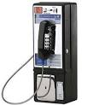
Dime in Payphone Study
Setting: Shopping Mall
Subjects: Shoppers
Procedure:
1. Confed #1 goes to payphone, leaves or doesn’t leave dime in slot
2. Subject is next person who uses phone
3. If subject completes call AND checks slot, OK
4. Confed #2 walks in front of S, drops papers
“tel-a-phone”
Outcome Measure?
Does subject help confed pick up papers.

Slide 20
Number of People Helping a Stranger After Finding/Not Finding a Free Dime in a Pay Phone
Number Help / Not Help

Slide 21
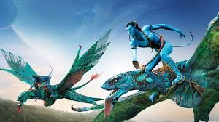

Subliminal Priming of Emotions and Judgment

Slide 22
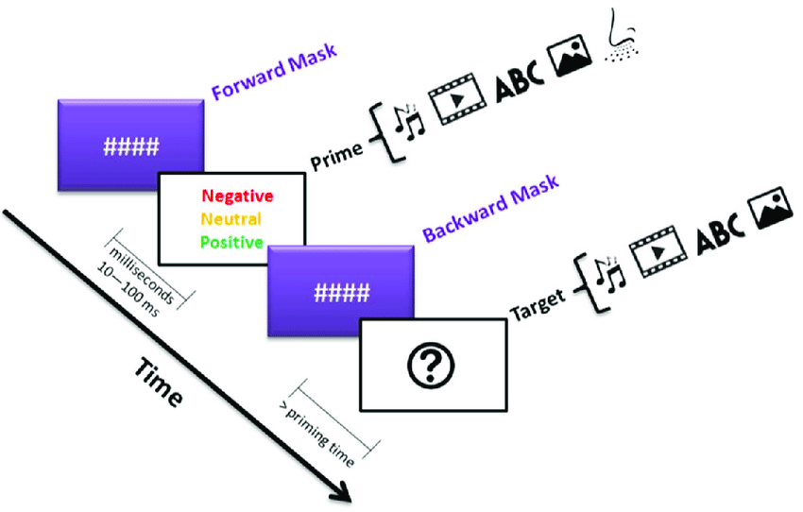
The Logic of Subliminal Priming

Slide 23
Do Subliminally Primed Emotions Affect Liking for Things You Consume?
Winkielman, Berridge, & Wilbarger, 2005

Slide 24
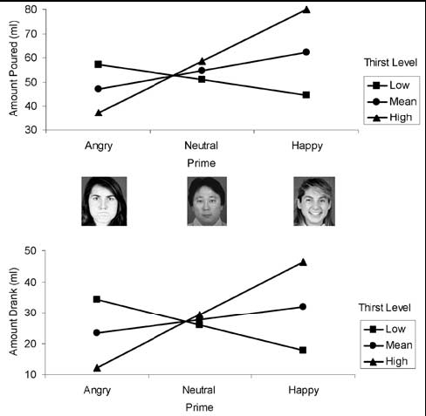
Note: Are results like “emotional signaling” in infants (Campos et al.)?

Slide 25
Subliminally Priming Moods and Stereotyping Bargh & Chartrand, 1996
Study 1: Does Subliminal Priming Affect Moods?
Ss told: Interested in how fast people can react to visual stimuli.
Procedure
1. Four stimulus words, all of which are:
a. Very pos: music, friends
b. Mildly pos: clown, parade
c. Mildly neg: worm, Monday
d. Very neg: war, cancer
2. Backward mask: XBMEMENGYRYRBHXM
3. Mood measure

Slide 26
Effect of Subliminal Prime on Mood
Friends
Worm
Clown
War

Slide 27
Subliminal Moods and Stereotyping
Bargh & Chartrand, Study 2
Who are more likely to apply stereotypes?
People in good moods?
Wait and see.
People in bad moods?
Procedure:
1. Subliminal Priming using Study 1 technique.
2. Ss complete stereotyping task:
John/Jane fed the baby because __________
Sally/Steve changed the motor oil because ______
Effort to "explain away" gender-inconsistent action = stereotyping.
John fed the baby because “the mom was visiting family.”
Sally changed the motor oil because “she lived in the country”

Slide 28
Effect of Mood on Stereotyping
Why do positive moods lead to stereotyping?
Stereotypes are mental short-cuts.
People take short cuts in positive moods.

