Slide 1
Emotional Intelligence
Class 14

Slide 2
Midterm March 11 OR March 14?
Several classes were done remotely.
We could spend March 9 on a mid-term review.
But, your spring break will involve studying for midterm
Let’s vote
Midterm will cover everything from Class 1 (Introduction) up to and including Class 15 (Emotions and Reasoning II).
Format: 50 multiple choice + 4 extra credit multiple choice.
Duration: 100 minutes

Slide 3
Review Question 1
Which of the following is an example of Mood Congruent Learning?
____If you learn 16 words in a happy mood you’ll remember
more when you’re also in a happy mood.
____If you’re in a sad mood you will remember more sad
events from the past week.
____If you learn nonsense words under water you’ll have a
harder time recalling them on dry land.
____All of the above.
____None of the above.
X

Slide 4
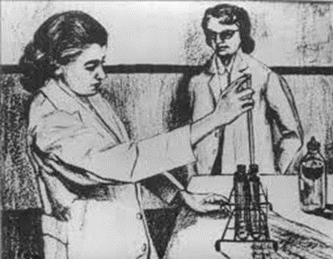
Review Question 2
Happy and sad subjects were shown ambiguous TAT pictures like this one, in order to show that moods have what effect on thinking?
____ Affects career choices
____ Affects memory of personal experiences
____ Affects how people interpret psychiatric patients
____ Affects how moods affect imagination
____ None of the above

Slide 5
What is Your Mood Right Now?
SAD ----------NEUTRAL----------- HAPPY

Slide 6
What Letter Do You See?
MM
MM
MM
MM
MM MM MM

Slide 7
Mood and Global Versus Local Processing
What letter do you see in this figure?
According to Gasper and Clore, your mood determines if you see “L” or “M”
Positive mood → Global (big picture) processing (i.e., the L).
Negative mood → local (small picture” processing (i.e., the M).
Design:
Ss write about a happy, neutral, or negative life event
Ss then see pictures, as on next slide.

Slide 8
Which option below, A or B, is more similar to the image at the top?
Gasper & Clore, 2002
A
B
B
A
Happy subjects pick ____. Sad, anxious subjects pick ___

Slide 9
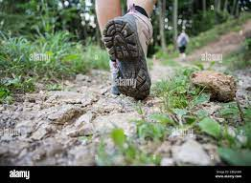
Mood and Visual Processing
Happy: More global, see “big picture”
Sad: More local, focus on the details.

Slide 10
Emotions and the Human Dilemma
We know enough to know we don’t know enough.
We need to act in order to survive
Acting requires making choices
Best choices based on complete information
We rarely have complete information
Yet we must chose anyway
Emotions: 1. Help us set priorities
2. Give us action cues when we lack other information

Slide 11
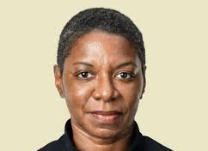
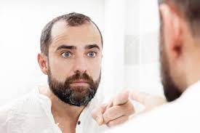
What Is Emotional Intelligence?
Ability to recognize others’ emotions
Ability to recognize one’s own emotions
Ability to appropriately express own emotions
Ability to manage one’s own emotions
Ability to manage other’s emotions
Salovey and Meyer Definition:
The ability to monitor one’s own and other’s feelings and emotions, to discriminate among them and to use this information to guide one’s thinking and actions.

Slide 12
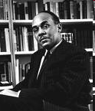
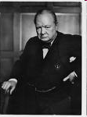
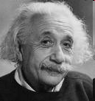
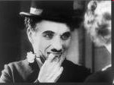
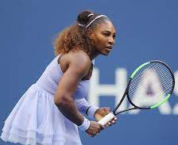
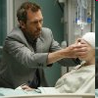
Which of These Professions Require Emotional Intelligence?

Slide 13
What Professions/Occupations Benefit from Emotional Intelligence?
Political leaders Clergy
Writers Military
Actors Scientists
Therapists Physicians
Salespersons Lawyers
Managers Animal trainers
Teachers Law Enforcement
Coaches Who doesn't????

Slide 14
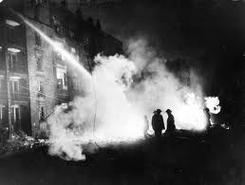
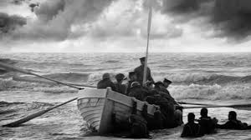
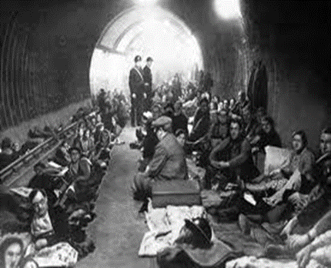
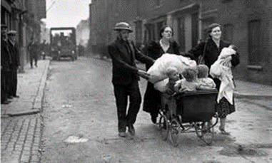
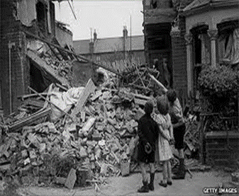
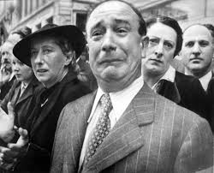
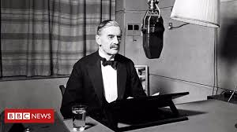
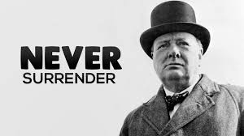
Emotional Intelligence and Leadership
https://www.youtube.com/watch?v=Wh2X1dTMFsY
https://https://www.youtube.com/watch?v=skrdyoabmgA

Slide 15
We shall go on to the end, we shall fight in France, we shall fight on the seas and oceans, we shall fight with growing confidence and growing strength in the air, we shall defend our Island, whatever the cost may be, we shall fight on the beaches, we shall fight on the landing grounds, we shall fight in the fields and in the streets, we shall fight in the hills; we shall never surrender,
Four score and seven years ago our fathers brought forth on this continent, a new nation, conceived in Liberty, and dedicated to the proposition that all men are created equal.
Now we are engaged in a great civil war, testing whether that nation, or any nation so conceived and so dedicated, can long endure. We are met on a great battle-field of that war. We have come to dedicate a portion of that field, as a final resting place for those who here gave their lives that that nation might live. It is altogether fitting and proper that we should do this.
But, in a larger sense, we can not dedicate -- we can not consecrate -- we can not hallow -- this ground. The brave men, living and dead, who struggled here, have consecrated it, far above our poor power to add or detract. The world will little note, nor long remember what we say here, but it can never forget what they did here. It is for us the living, rather, to be dedicated here to the unfinished work which they who fought here have thus far so nobly advanced. It is rather for us to be here dedicated to the great task remaining before us -- that from these honored dead we take increased devotion to that cause for which they gave the last full measure of devotion -- that we here highly resolve that these dead shall not have died in vain -- that this nation, under God, shall have a new birth of freedom -- and that government of the people, by the people, for the people, shall not perish from the earth.

Slide 16
Parent/Baby Games
Goodnight Moon
by Margaret Wise Brown
In the great green room-
Goodnight room
Goodnight moon
Goodnight cow jumping over the moon
Goodnight light
And the red balloon
Goodnight bears
Goodnight chairs
Goodnight kittens
And goodnight mitten
1. Central theme imbedded in variations gives sense of invariant; higher- order abstraction is constant, even if variations differ.
Hey, honey...Yeah, honey... Hi, honey...Whatcha doing, honey?...Yeah, whatcha doing?....What are ya doing?....ya doing nothing?

Slide 17
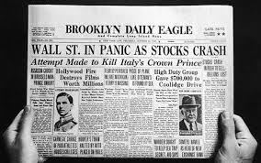
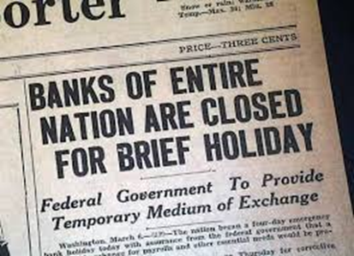
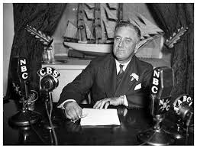
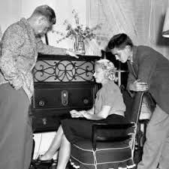
Emotional EQ and Leadership: FDR Fireside Chats
https://www.youtube.com/watch?v=iipnhLTdh-0
What Makes This Emotionally Intelligent?
I want to tell you what was done, why done, what will be done.
Explain in plain language to average citizen.
When you understand why, you will cooperate
What happened causing the bank closure? I’ll explain.
Clear language.
Admits to facts of danger
Explains reasons
Conveys confidence in self
Conveys confidence in public
Problem focused—no self focused

Slide 18
Historic Bias Against Emotions
Publilius Syrus: “Rule feelings lest they rule you”
Young: Emotions = “acute disturbances of the individual as a whole”
Psych Texts: Emotions as “a complete loss of cerebral control’ containing no “trace of conscious purpose”.
Woodworth: IQ should contain tests showing ability TO
NOT be afraid, angry, grieved, curious about things that
arouse emotions in kids.

Slide 19
Central Domains of Emotional Intelligence
1. Expressing and Understanding own emotions
2. Understanding others' emotions
3. Regulating own emotions

Slide 20
Mayer-Salovey-Caruso Emotional Intelligence Test: MSCEIT
Test of Emotional Intelligence
Is NOT strongly related to IQ
Is a reliable measure -- Time 1 scores resemble Time 2 scores
Predicts: Greater Helping
Less Deviancy
Better Academic performance

Slide 21
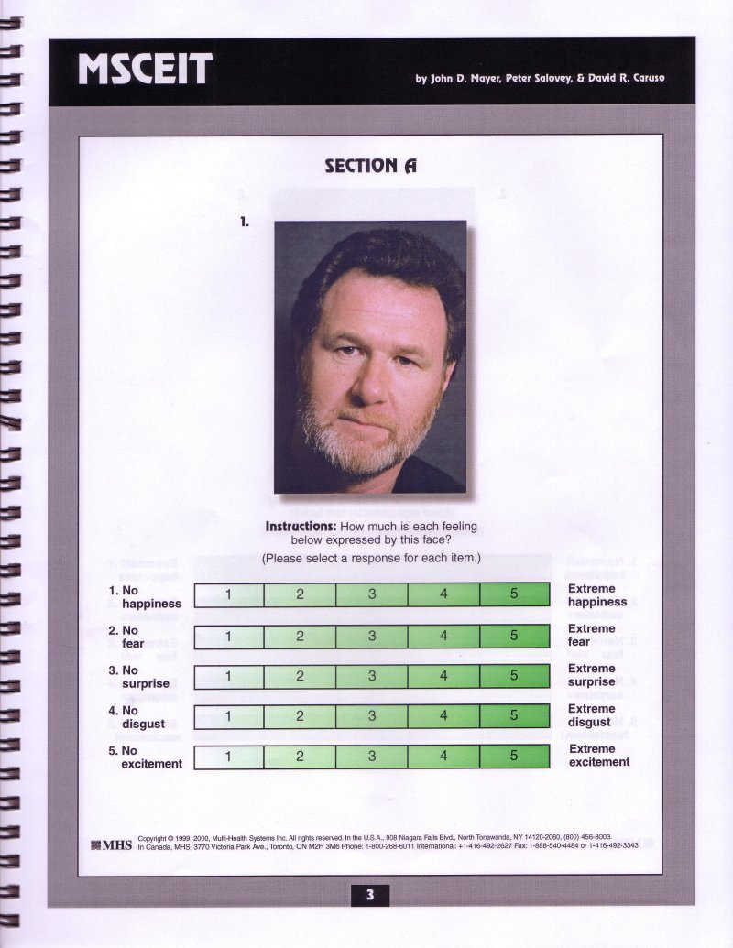

Slide 22
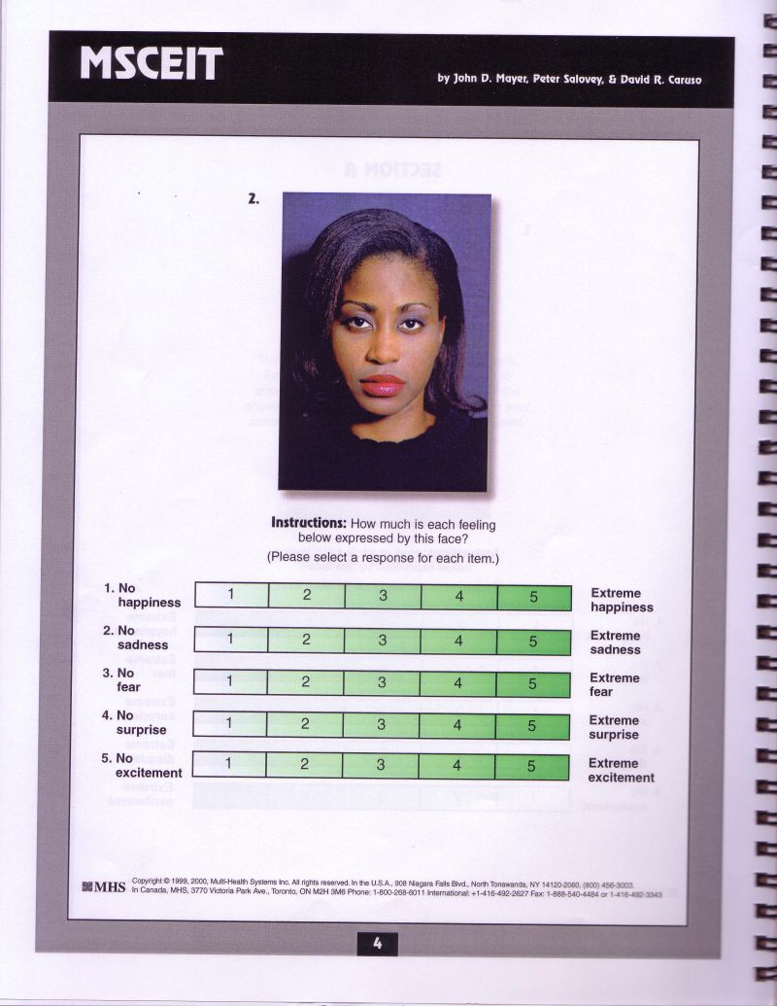

Slide 23
Verbal Items From MSCEIT
MATCHING MOODS WITH EVENTS/TASKS
What mood(s) might be helpful to feel when following a very complicated cooking recipe?
a. Tension b. Sorry c. Neutral mood
UNDERSTANDING OTHERS’ EMOTIONS
Marjorie felt more and more ashamed, and began to feel worthless. She then felt:
a. Overwhelmed b. Depressed c. ashamed d. Self-conscious
TRANSLATING FROM SENSORY TO EMOTIONAL DOMAINS
Imagine you are feeling cold, slow, and sharp. This is like?
a. Challenged b. Isolated c. Surprised

Slide 24
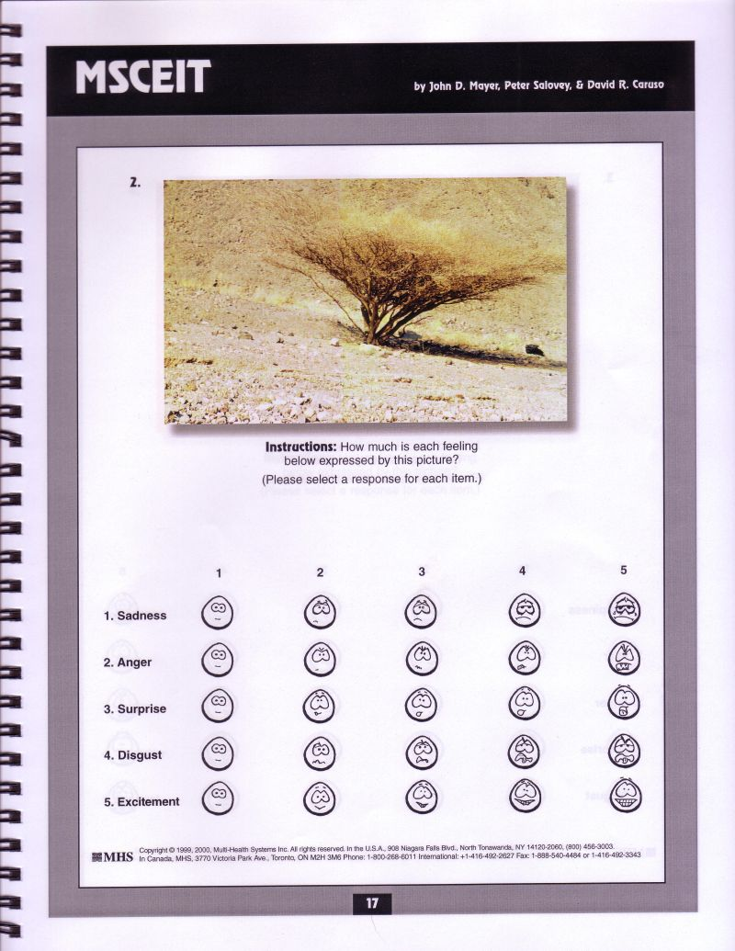

Slide 25
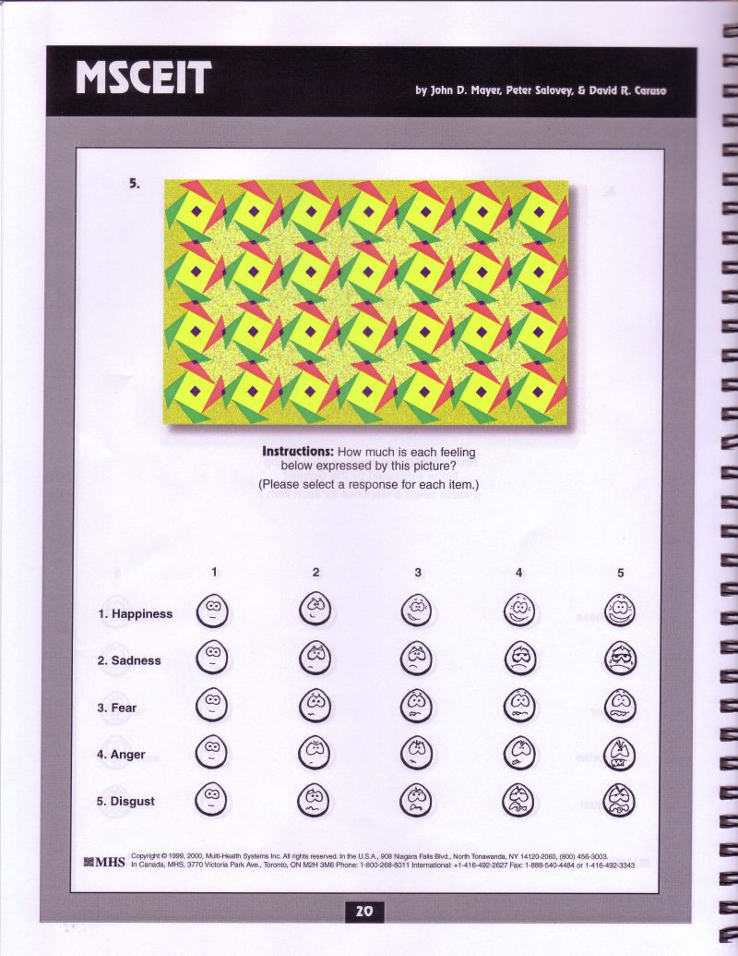

Slide 26
READING THE MIND IN THE EYES TEST
Playful
Comforting
Irritated
Bored
https://http://socialintelligence.labinthewild.org/mite/
Simon Baron-Cohen: The Essential Difference: Men, Women, and the Extreme Male Brain
Who is Simon Baron-Cohen's brother?

Slide 27
Emotionally-Intelligent Communication: Referential Activity (RA)
RA is language that helps convey emotions and emotional experiences
Transfers information from the emotional/sensory realm to the abstract/linguistic realm.
* Imagistic: Boats anchored in the open bay rocked and strained like troubled men tossing through a restless sleep.
* Concrete: Her face was set, eyes focused on the lead runner, deep lines above knit brows, cheek bones sharp under taut skin.
* Sensory: Her voice, soft and calm, was like a cool morning breeze that feathered the back of his neck.

Slide 28
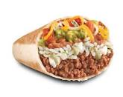
Examples of High RA vs. Low RA
Low RA: I went to the cafeteria. The salsa was a gustatory success. The burritos, however, were unpalatable, odious, distasteful.
High RA: I Went to the cafeteria—you could smell the salsa before you got there, tangy oniony smell that tickles the back of your nose and makes your eyes blink. But the burritos were like rotting beached whales; beans and rice oozing out the side like spilled guts and a smell like last week’s laundry.
* High RA leads to better therapy outcomes.
* High RA speech in therapy precedes breakthroughs

