Slide 1
Emotions and Health
Class 12

Slide 2
Midterm March 9
Midterm will cover everything from Class 1 (Introduction) up to and including Class 15 (Emotions and Reasoning II).
Format: 50 multiple choice + 4 extra credit multiple choice.
Duration: 100 minutes; entire class period.

Slide 3
Review Question 1
The chemical that Oliver Sacks used to “awaken” patients with sleeping sickness was:
___ Acetylcholine
___ Adrenaline
___ Dopamine
___ CCK
___ All of the above
X

Slide 4
Review Question 2
After receiving a nasal spray of oxytocin, subjects were more likely to focus on another person’s:
___ Hand gestures
___ Tone of voice
___ Body posture
___ Eyes and mouth
___ All the above
X

Slide 5
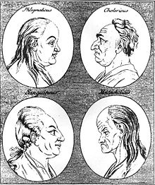
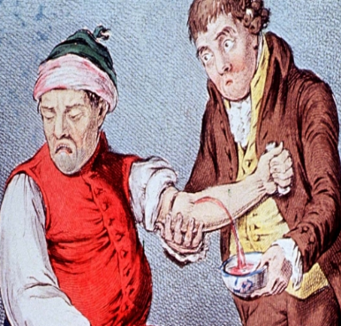
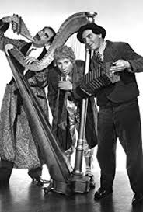
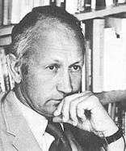
Folk Wisdom About Emotions and Health
King Solomon: “A merry heart doeth good like medicine” Proverbs, 17:22
Hippocrates: Humors, personality, mood states, health
Blood = Sanguine = hearty, happy Black Bile = Melancholic = Sad Yellow Bile = Choleric = Grumpy, Hostile Phlegm = Phlegmatic = Apathetic
Moods and Health arose from imbalance of Humours. Cure?
Norman Cousins: Heals self with “laughing cure” for supposedly incurable connective bone tissue disease.

Slide 6
Correlations Between Mood and Health
Depression co-occurs with illness
Medical inpatients report mood/anxiety disorders
Access to psychologists reduces MD visits
What do these correlations suggest?

Slide 7
Immunocompetence
Effectiveness of the immune system; ability to ward off illness, infection, etc.
Measured by immune substances, quickness of arousal.
T Cells, Natural Killer Cells, Immunoglobulin A (S-IgA)
Moods are associated with immunocompetence
Pos mood increases Immunoglobulin A (S-IgA)
Neg mood decreases S-IgA

Slide 8
Immunocompetence and Mood
Cohen, et al. (1995): Exposure to virus, mood state, and illness
* Ss report mood, then inhale cold virus or placebo
* Worse moods → higher illness rate after cold virus.
Labott, et al. (1990): Manipulated moods → immune levels
* Ss watch sad or funny movie
* Higher S-IgA for funny movie, lower for sad movie
Stone, et al. (1994): Frequency of desirable events and onset of respiratory illness.
Stone, et al. (1996): Frequency of pos. events and immune levels

Slide 9
Emotional Management
Responding to events with humor vs. crying.
Expressing or suppressing emotions
Using healthy or unhealthy behaviors to regulate moods
Behaviors that alter mood, but are harmful:
Drinks, smokes, drugs, eats, thrill-seeking, unsafe sex
Behaviors that alter mood, but are helpful:
Exercise, socialize, disclosure

Slide 10
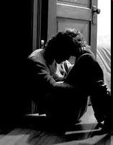
Depression: The High Cost of Being Low
1. 15% of all people suffer depression
2. Chronic depression --> brain damage
* Poorer Memory
* Failed concentration
3. ____ Men ____ Women 2 X more likely
to get depressed.
X

Slide 11
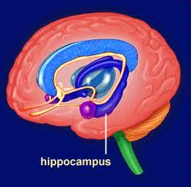
Hypercortisolemia and Hippocampus Damage
Hippocampus functions include:
a. Long term memory b. Spatial navigation
Hippocampus in depressed women smaller than in non-depressed women.
Rats given cortisol show atrophied hippocampus.
Depression --> increased cortisol (cortisolemia).
What does this add up to?
hippocampus atrophy
cortisolemia
memory loss
Depression --> ___________ --> _____________-->______________

Slide 12
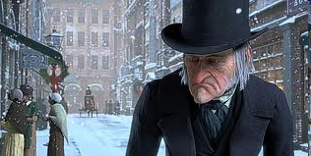
Hostility Defined
Hostility is considered to be an attitudinal set—perhaps a personality trait—which stems from an absence of trust in the basic goodness of others and centers around the belief that others are generally mean, selfish, and undependable.
Williams, Barefoot, & Shekelle, 1985

Slide 13
Hostility Scale – Sample Items
(Cook and Medley, 1954)
 |  | YES | NO
1 | No one cares much what happens to you
2 | I have often met people who were supposed to be experts who were no better than I.
3 | Some of my family have habits that bother and annoy me very much.
4 | I often have to take orders from someone who did not know as much as I did.
5 | It makes me feel like a failure when I hear of the success of someone I know well.
6 | People often disappoint me.
7 | It is safer to trust nobody.
8 | I have often felt that strangers were looking at me critically.
9 | I tend to be on my guard with people who are somewhat more friendly than I expected.
10 | My way of doing things is apt to be misunderstood by others.

Slide 14
Hostile Personality and Health
Hostile Personality IS NOT: Angry all the time
Aggressive all the time
Hostile Personality IS: Way of perceiving the world
* Distrustful * Cynical
* Suspicious * Vigilant
Highly stable trait: Correlation over 4 yrs, r = .84
Which gender is more prone to Hostile Personality?
Men

Slide 15

Case Study of Hostile Personality
https://www.youtube.com/watch?v=_n77eoOfRPE

Slide 16
Health Correlates of Hostility
Blockage of blood vessels
Coronary Heart Disease (CHD): 1.5 time greater odds
20-year increased risk of death due to:
* Coronary Heart Disease
* Malignant Neoplasms (cancer)
* All causes of death combined

Slide 17
Is Relation Between Hostility and Heart Disease Linear or Catastrophic?
Linear
Catastrophic

Slide 18
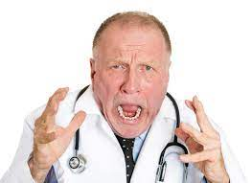
Hostility and Coronary Heart Disease Among MDs Barefoot, et al., 1983

Slide 19
MD Survival Rates Post Heart Attack Over 25 Years
Low Hostile vs. High Hostile

Slide 20
Pathway From Hostility to Heart Disease
Hostile Personality → Increased Vigilance for Threat →
Appraisal of threat higher →
Defensive mode (fight) → More cardiac output →
Increased cortisol → Atherosclerosis
NOTE: Cortisol is key player in stress → Illness

Slide 21
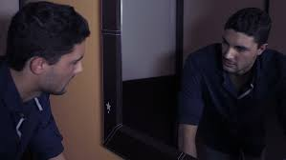
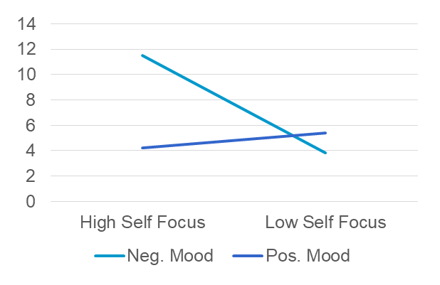
Informational Value of Emotions to Health
Mood affects recognition / interpretation of own symptoms
Pos mood → attn. outward → less focused on symptoms
Neg mood → attn. inward → more focus on symptoms
Symptoms Reported
Gendola et al., 2005

Slide 22
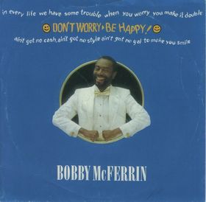
Happiness as a Health Risk
Happiness leads to:
Stronger immune system
Fewer illness
Less risk hypercortisolemia, memory
Less hostility, cardio health
Less hyperfocus on symptoms
Happiness as Health Risk
Happiness as Health Benefit
Illusion of Invulnerability
More health-promoting behaviors
Blind to danger signs
Willing to risk upsetting diagnoses
Less defensive about hearing health risk information

Slide 23
Psychoneuroimmunology and AIDS
Psychoneuroimmunology: New inter-disciplinary area that looks at how psychological states affect the body’s resistance to illness
AIDS: Acquired Immune Deficiency Syndrome
HIV: Human Immunodeficiency Virus. The virus that causes AIDS.

Slide 24
Psycho-social Aspects of AIDS
Why do some people who get HIV infections acquire AIDS sooner than do others? (Cole, 2000).
1. Sample: Gay men who acquired HIV at about the same time.
2. Looks at whether disclosed or hid gay identity, HIV status
Who is more likely to become symptomatic, "hiders" or "disclosers"?
Hiders
Why is this so?

Slide 25
Why Do “In Closet” Gays Develop AIDS Sooner?
A. (Hide Gay Identity)
B. (AIDS)
Is it that suppressing was itself a stressor, stress → illness, therefore suppressing leads to quicker AIDS onset?
NO

Slide 26
Why Do “In Closet” Gays Develop AIDS Sooner?
A. (Hide Gay Identity)
B. (AIDS)
C. Sensitizer
Is it that suppressing was itself a stressor, stress → illness, therefore suppressing leads to quicker AIDS onset?
NO
Suppressors tend to be “sensitizers”, easily disturbed by any kind of event, especially social events.
NOTE: THIS LINKS TO "TEMPERAMENT"

Slide 27
How Stress Hastens AIDS Onset
1. “T” cells important immuno-agent
2. T Cells sprout molecular “hand holds”, like Velcro, at times.
3. HIV uses these hand-holds to attack T cells.
4. Researchers artificially induce “hand-holds” by using harsh
laboratory chemicals.
5. Cole asks: What kinds of natural chemicals have same effect?
6. Clues: * AIDS faster among stressed vs. non-stressed
* Stress releases nor-epinephrine (nor-epi)
Finds: Exposing healthy T cells to nor-epi → more hand-holds.
Gay “sensitizers” more susceptible to stress
  → More nor-epi → T-Cells more susceptible to HIV → increased AIDS

Slide 28
Full Circle: From Hippocrates to Kagan to AIDS
Hippocrates: Body type (humours) affect moods affect health.
Kagan: Temperament – shy versus outgoing
Stress → cortisolemia → illness
Cole: Gay HIV + who are sensitizers (shy as kids?)
more susceptible to stress, more likely to
develop AIDS.

