Slide 1
Physiology of Emotions III
Class 11

Slide 2
ANNOUNCEMENTS
MIDTERM
Midterm will cover everything from Class 1 (Introduction) up to and including Class 15 (Emotions and Reasoning II).
Format: 50 multiple choice + 4 extra credit multiple choice.
.
Duration: Entire class: 100 minutes
Counts for 30% of course grade.
FLAT FACE EXTRA CREDIT
Due April 18

Slide 3
Review Question 1
Joseph LeDoux’s “emergency route” involves which neural pathway?
____ Sensory → Thalamus → Cortex → Amygdala
____ Sensory → Striatum → Amygdala → Thalamus
____ Sensory → Thalamus → Amygdala
____ Cortex → Parietal → Pituitary
____ Rte 17 → Garden State Parkway → NJ Turnpike
X

Slide 4
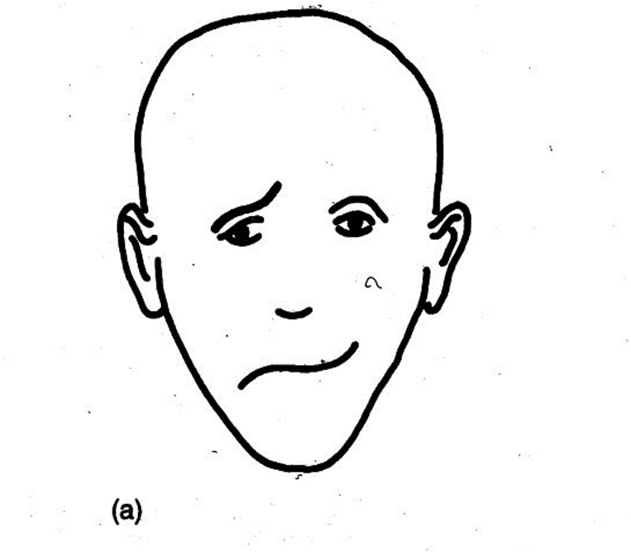
Review Question 2
Who is more likely to see this face as happy?
____ A left-handed person
____ A person who has reviewed TAT cards
____ A person with an intact corpus callosum
____ A person like Phineas Gage
____ None of the above
X

Slide 5
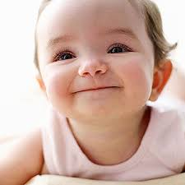
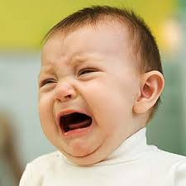
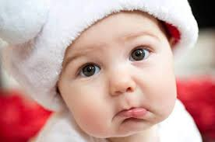
Which Hemisphere Develops First in Babies:
Left (language) or Right (emotions)?
Right hemisphere develops first. Why? Recall how important emotions are critical for bonding and for the psychological and even physical health bonding supplies.

Slide 6
Neurological Development and the Limbic System
R-Hemi has closer connections to limbic system than L-Hemi.
R-Hemi develops earlier in infancy than L-Hemi
Emotions appear in babies before language
Emotionally expressive babies start talking later
When babies start to talk, don’t show emotion
13 mos—talk, no emotion
19 mos—talk + emotion
What does this say about separate systems?

Slide 7
Are Affective Styles Genetic? Davidson, Kagan et al. 1993
Subs: 2.5 year olds (N = 386) tested with moms present.
Start (“T”): Hang out with mom
T + 10: Talking robot appears
T+ 13: Robot leaves to “take a nap”
T+ 20: Stranger with fun toys “Want to play?”
T + 23: Stranger leaves
Three types of children identified:
1. Inhibited: Hover near mom, quiet, avoid robot, stranger
2. Un-inhibited: Less time w’ mom, engage in activities
3. In-betweeners: Between inhibs and un-inhibs

Slide 8
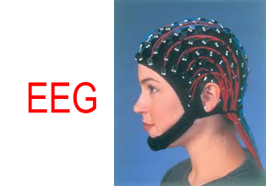
Hemisphere Activation and Temperament: Kagan, et al. Study of Inhibited/Uninhibited Kids
Hemisphere activation measured using?
→ Left Hemi
Right Hemi ←
Implications for shyness: Learned or inherited?

Slide 9
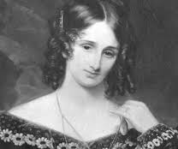
Neurochemicals and Emotions
Mary Shelly
1797-1851

Slide 10
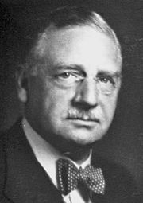
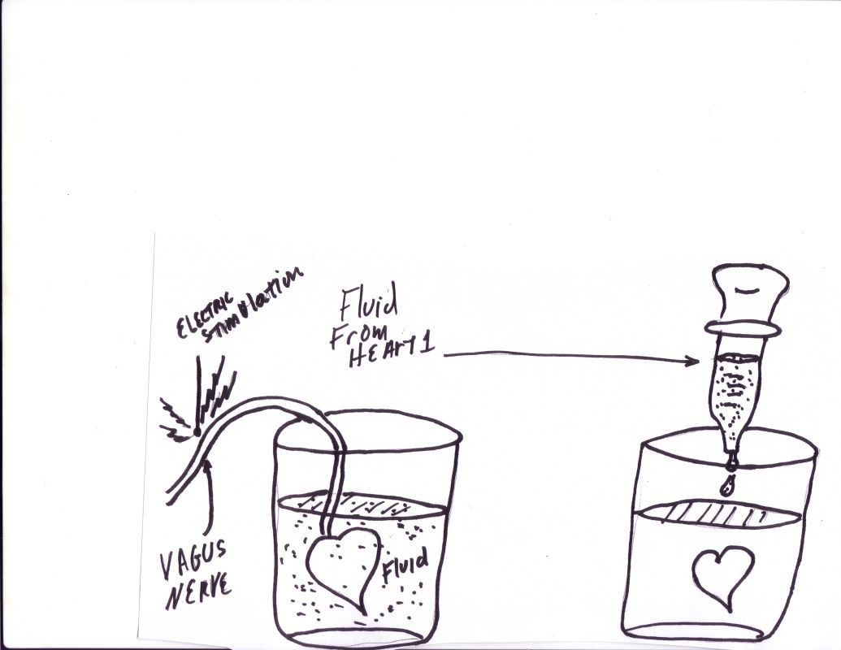
OTTO LOEWI AND THE DISCOVERY OF NEURO-CHEMICALS
1873-1961
Heart #1
Heart #2
Stim. vagus nerve, slows Heart
2. Extract fluid from Heart1 bath
3. Apply Heart 1 fluid to Heart 2.
What happens to Heart 2?
It slows.
Why?
Acetylcholine

Slide 11
Neurochemicals and Emotions
1. Neurotransmitters (e.g., acetylcholine) From nerve to nerve
2. Hormones (e.g., adrenaline, from adrenals) Blood borne
3. Neuromoderators (e.g., endorphins, other opiates). CNS → Pituitary Gland
Relevance to emotions
* Different emotional systems employ different neuro-chemical messengers
* Different chemicals lead to different emotional states
* What clinical value might these "emotional" chemicals have?
Discovery of psychotropic drugs to treat: depression, anxiety, hyper-arousal.

Slide 12
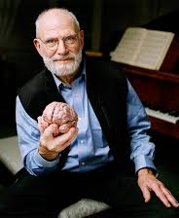
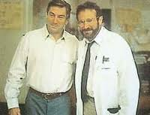
L-Dopa
Awakenings, (1990)
1. Pre-cursor to dopamine, a neurotransmitter
2. Acts on striatum—motor activity
3. “Re-awakens” sleeping sickness patients
Revived planning, spontaneous action
Revived emotions--probably b/c revived striatum communicates with ???
Amygdala
https://www.youtube.com/watch?v=GKsHG_mW-GA

Slide 13
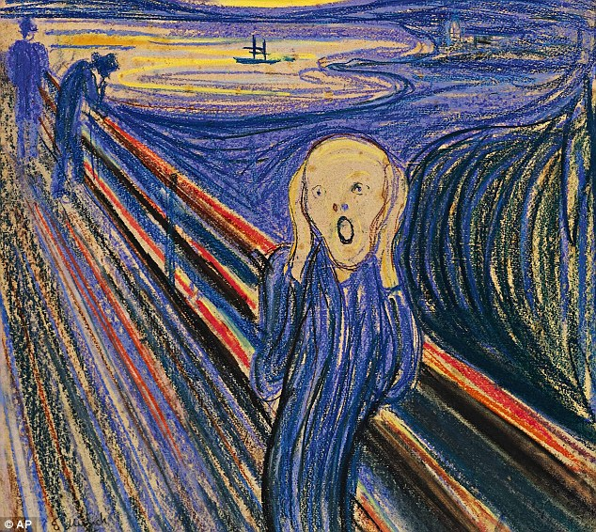
Panic Attacks
Sudden rush of fear, lasts 15-30 min
Come "out of the blue"
Feels like heart attack, will lose control
Can lead to agoraphobia--fear of being in the open

Slide 14
CCK (cholecytokinin)
1. CCK is a peptide, large molecule neurotransmitter
CCK → increased blood to limbic system
Tied to panic attacks
4. Give CCK to humans, monkeys, rats --> panic attack

Slide 15
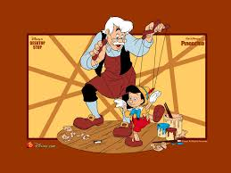
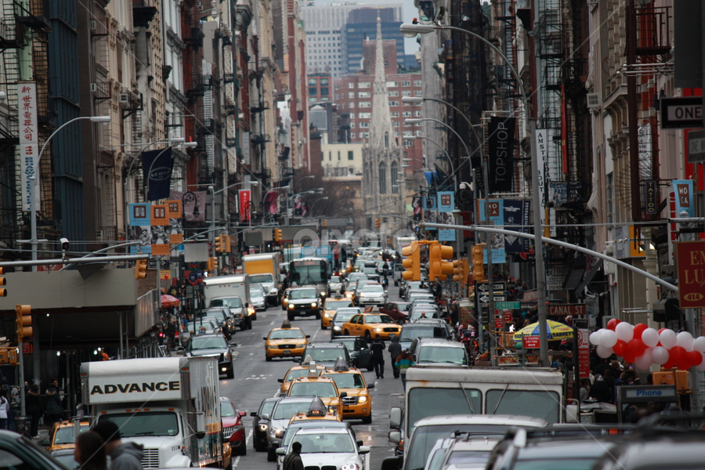
Emotional Systems
If you were to create a human, what 7 capacities would you include?
HINTS: To survive, secure next generation, deal with other humans, etc.?

Slide 16
Emotional Systems
Brain anatomy and brain neurochemistry work together in "Emotional Systems"
Each system has own anatomical locale and own neurochemicals
Advantage of emotional systems: Vital human behaviors are "hard wired", don't need to be learned from scratch.
There are 7 emotional systems: these are:
1. Fear 5. Anticipation
2. Attachment 6. Play
3. Maternal nurturance 7. Sex
4. Anger

Slide 17
Rats’ Maternal Behavior: Example of an Emotional System
Female becomes pregnant
Pregnancy hormones: More prolactin and estradiol; less progesterone
Birth hormone: oxytocin; Brain centers: hypothalamus, amygdala
Hormones affect arousal in mothers
--Most aroused when around own pups vs. with other rats, around food, or alone.
--Affects virgin females: become more nurturing to pups.
Maternal cue sensitivity increases: to separation squeaks, pup odor
Maternal behaviors: Nursing, cleaning, protection.

Slide 18
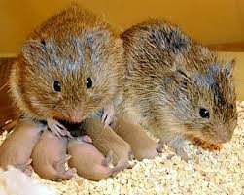
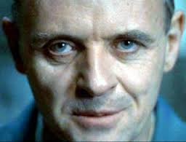
Oxytocin in Humans
The “Love Hormone”
1. Oxytocin increases dramatically during sex (for all mammals).
Oxytocin may explain feelings of closeness, affection during and after sex.
Lack of oxytocin may explain psychopathology --inability to feel affection for another.
Prairie Vole:
Highly monogamous
Produce lots of oxytocin.

Slide 19
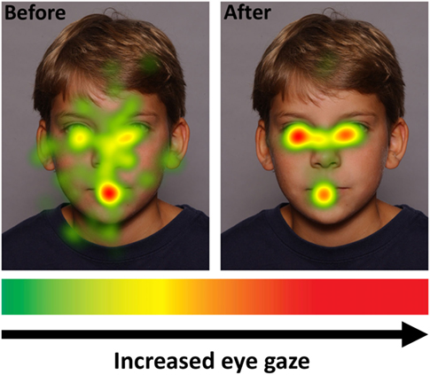
Oxytocin and Emotional Sensitivity
EYES
If you want to understand
another person’s emotion, what parts of face would matter most?
Oxytocin affects eye gaze accordingly!
MOUTH
Subjects get nasal spray: oxytocin or neutral
Subjects then look at photos of human faces.
Eye tracker tracks where the subjects focus.
Before / after nasal spray shows increased focus on eyes and mouth—BUT ONLY FOR OXYTOCIN!
Before oxy
After oxy

Slide 20
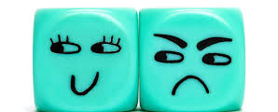
Downside to Oxytocin
Oxytocin has been called love hormone.
Perhaps we should hand it out to everyone and everyone will love everyone, yes? NO!!!
1. Increases jealousy and envy.
2. Increased affection for in-group BUT also hostility to out-group.
3. Increases “SCHADENFREUDE” – Pleasure in another’s misfortune.
Why these negatives?
Maybe oxy. makes you value others so much that you don’t want to lose them—even to other persons.

Slide 21
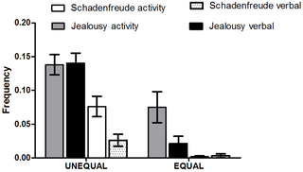
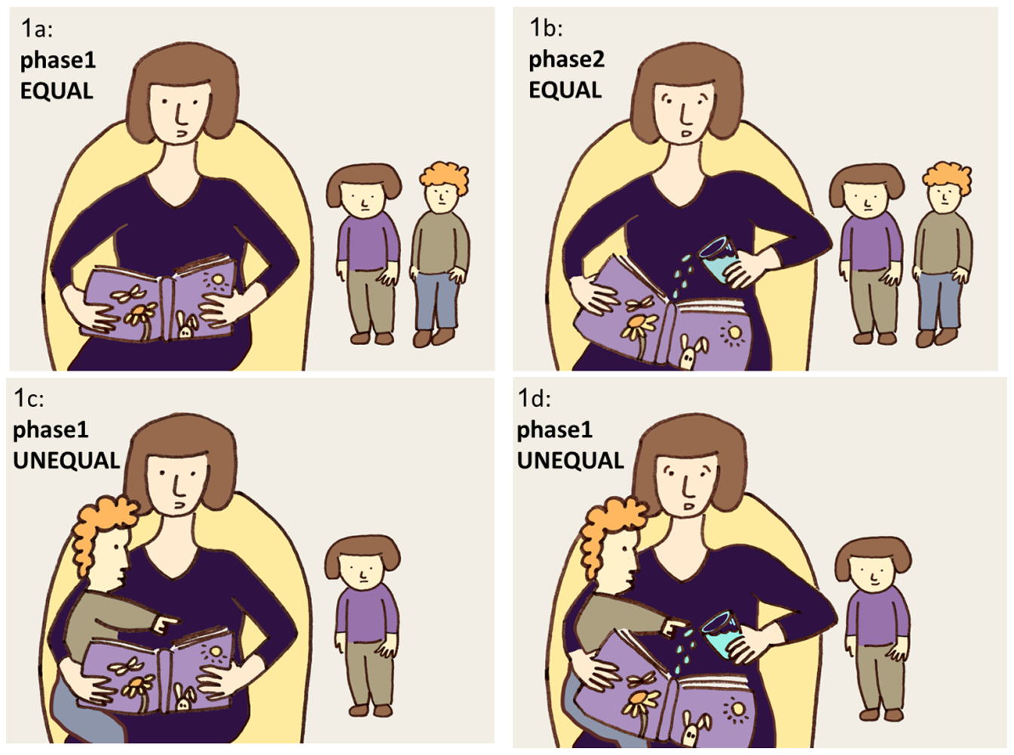
Schadenfreude and Inequality
Shamay-Tsoory, Ahronberg-Kirschenbaum, & Bauminger-Xviely, 2014
Subjects: 2 year olds. See equal or unequal treatment, followed by a mishap to the agent of inequality.
Key point: Schadenfreude may relate to fairness.

Slide 22
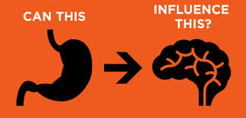
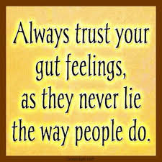
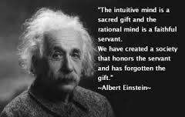
Are Gut Feelings Real?

Slide 23
Winning on Gut Feelings
Frith, C. (2007)
[win]
[draw]
[lose]
Subjects in a gambling experiment see flickering shapes.
Images indicate "win", "lose", or "draw", but are too fast to consciously see.
After each image, the subject is asked to bet or not bet about $2.50
Subjects told to go with "gut feeling" about betting.
Over time, subjects do better than chance when told to "go with gut"
How come???

Slide 24
Neurogastroenterology: “Gut Brain”
Features of "gut brain"
* 100 million neural fibers, more than spinal cord
* The fibers are non-mylinated, as are neurons in "big brain"
* Neural fibers surrounded by neurochemicals as in "big brain"
* Suffers damage during diseases that attack CNS:
-- Alzheimers
-- Parkinsons
* Responsive to psychotropic drugs
-- Prozac over-activates gut
-- Anti-psychotic meds heal gut ailments

Slide 25
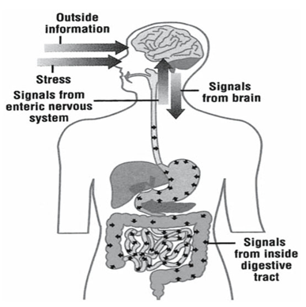
Neurogasterentology and Intuition
Big brain and gut brain communicate, via mid-brain
* Mid-brain remembers big brain experiences
* Next occasion of event, midbrain sends signal first to gut brain.
* “Gut feeling” occurs when gut brain reacts to past experience (e.g., tightening of stomach)

