Slide 1
Emotional Attunement
Class 7

Slide 2
Quiz 1 on Thursday (Feb. 9)
15 Multiple Choice questions plus 2 Extra Credit questions
Covers Class # 1 up to/including Tuesday’s class
Time to complete Quiz: 25 minutes.
NOT open book, NO notes. That was during COVID
Quiz 1 Counts for 10% of total course grade
Study tips:
PowerPoint Slides
Readings, with slides as guide
Quiz questions will be like our “Review Questions”

Slide 3
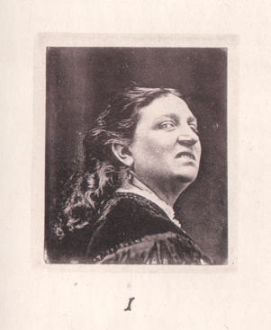
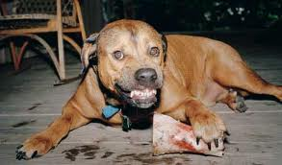
Darwin’s Approach to Emotions
Not interested in Emotions, per se. Uses Emotions to show humans evolved from more primitive critters.
Human emotions are VESTIGIAL
Human emotions reflect animal signals
Sneering – revealing teeth – bite threat
Eye raise – forehead pulled back
– flat ears on dogs
Uselessness of emotions … phone call hand gestures
Darwin a Victorian.
Darwin ties emotions to bodily states.

Slide 4
QUIZ 1 SAMPLE QUESTION
Darwin considered emotions to be VESTIGIAL. Evidence in support of this is:
A. ___ People show a range of basic emotions.
B. ___ Same emotions exist across cultures.
C. ___ Emotions are affected by display rules.
D. ___ Use of emotive hand gestures when on the phone.
E. ___ None of the above
X

Slide 5
Cultural Differences and Constraints: North vs. South

Slide 6
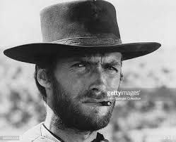
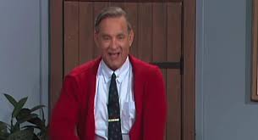
Results of Insult Experiments
Southerners
Northerners
Insult Study 1: Emotions expressed after insult
* South: Anger
* North: Amusement
Insult Study 2: Stress and aggression hormone activation
* Cortisol: Higher among insulted Southerners
* Testosterone: Higher among insulted Southerners
3. Insult Study 3: Behavioral measures
a. Handshake: Firmer among insulted Southerner
b. Poster: More dominant among insulted Southerner

Slide 7
QUIZ 1 SAMPLE QUESTION
Cohen and Nisbett’s studies where Southerners were insulted show that emotions are:
A. ___ Shaped by culture
B. ___ Evident in biochemistry
C. ___ Evident in facial expressions
D. ___ Evident in behavior
E. ___ All of the above
X

Slide 8
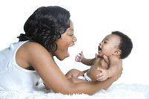
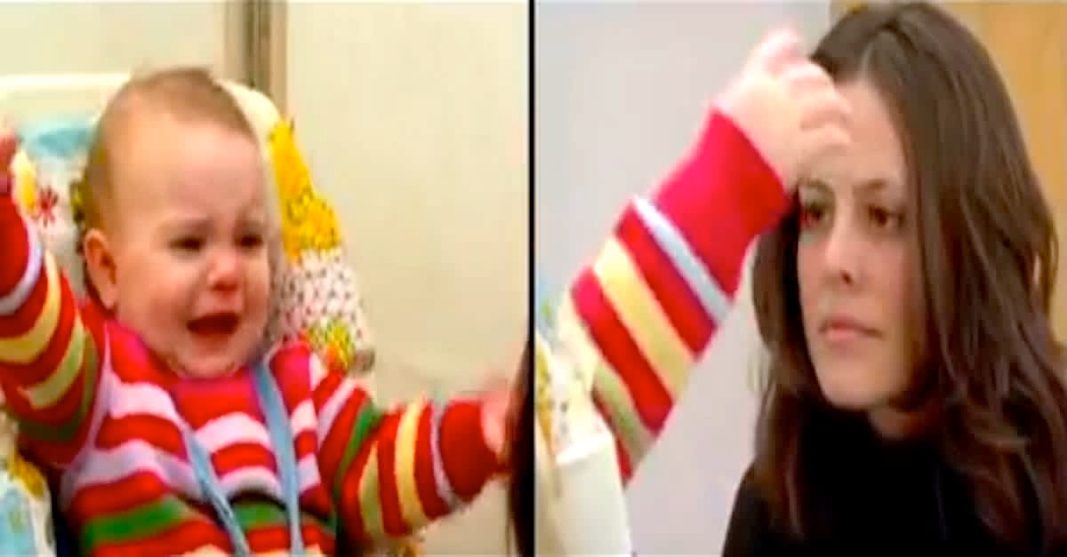
Emotional Development Video
Ed Tronick: Mom and baby have “emotional dance”
Emotional dialogue: Emotions are “on tap”, no prior learning
Mom goes flat face—dialogue stops
Baby shows extreme distress
Physiologically regresses (drools)
Similar behavior among babies with depressed moms

Slide 9
Going Flat Face Extra Credit
Have conversation with friend/family but show no emotion. No emotion in face. No emotion in voice.
Do this for at least 2 minutes, but not so long as to create a problem.
Re-do flat face on the phone—in this case, flat voice. 2 minutes.
Tell your partner afterwards what you were up to. Ask them how it felt to them, what they thought.
Complete 1-2 page summary.
Background: Who was person, what was situation, but no personal info about you or your partner.
Your inner experience
Your interpersonal experience: How long until friend noticed? What did they say?
Compare phone vs. in-person
Relation to class material: Provide at least 2 connections.
General comments and impressions
Background questions on back of Instructions Sheet
Due April 18, start of class: Counts 2 points toward final grade.

Slide 10
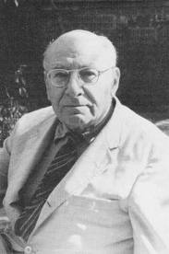
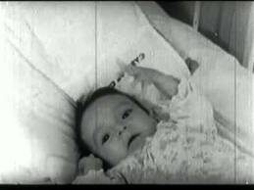
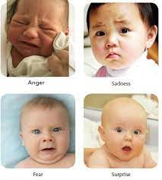
Emotional Development Video
Spitz foundling home study
What were kids’ emotions? Why?
How does it feel to watch this sequence?
Emotions as first language
Caroll Izard:
Infant motions seem built-in,
universal. Calls out parental
response.
Rene Spitz
1887-1974

Slide 11
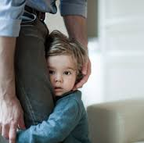
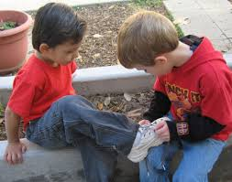
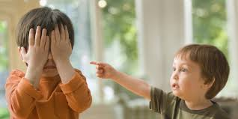
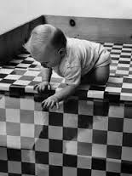
Emotional Development Video
Temperament and mom/child interaction
Greenspan, Kagan: Temperament is genetic. Shyness
That if mom doesn’t adjust/accept baby’s temperament?
Early empathy and socialization
Self-contingent emotions:
Embarrassment (how was it assessed?)
Emotional signaling—Joe Campos:
Visual cliff + parental cues
Note: Does baby need to first learn what parents’ emotions mean?

Slide 12
Infant-Directed Speech / Prosody (aka "Motherese")
a. Mom's use similar tonalities across cultures
b. Babies seem to understand these tonalities at birth.
c. Tonalities convey specific meanings
* Short, brief =
* Long, loopy =
d. Tonalities are emotional
Danger
Affection
Anne Fernald

Slide 13
The Existentialists' Valentine’s Card
Are we ever able to truly understand another person?
Are others able to truly understand us?
Can we ever really know ourselves?
Are humans basically alone?

Slide 14
What Emotion Do These Things Evoke?
1. Person totally understands how you feel in a wide variety of situations.
2. Person knows what to say and how to act when you're sad, angry, happy,
3. The person knows who you are, deep down.
4. The person knows how to be with you, without saying much.
5. You can count on the person to be these ways, day in/day out.
Emotion?
Love

Slide 15
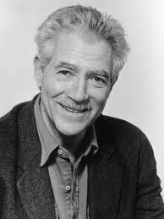
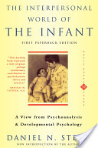
Affect Attunement
Process that occurs between parent and infant which allows an infant to perceive how it is perceived.
1. Requires that parent be able to read the infant’s emotional state / inner experience from overt behavior.
2. Infant must be able to interpret parents’ response as deriving from its own behavior.
What if this didn’t happen? Imagine following:
Baby smiles, mom goes “Ooooh! Big smile!”
But baby has no idea why mom responds this way.
OR Mom is a robot: “oo-oo-oo. big.smile.oo-oo-oo”
What would baby make of this flat communication?
Daniel Stern
(1934-2012)

Slide 16
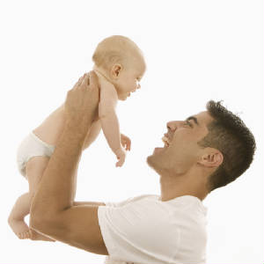
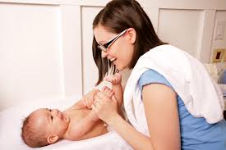
Examples of Attunement
Baby excited by toy, grabs it, lets out an “aaaahhh!!!”
Mom does intense go-go dancer shimmy, lasts as long as baby’s “aaaahhh”.
Baby boy hits things with plastic hammer, in steady rhythm. At each stroke, dad goes “kaaa-boom! kaaa-boom! Kaaa-boom!” in cadence with hammer strikes.
Baby reaches for toy just beyond reach. As it pushes towards toy, aunt goes “uuh, ….uuuuh!, ---uuuuhhh!!!” with baby’s efforts.

Slide 17
What Are Attunements?
Attunement is not simply imitation. Not mirroring, not echoing.
Cross modal: Channel used by mom different from that
used by baby
Reference for match is internal state, not simply external
behavior.
Nature of match is itself an expression of inner state that
corresponds to inner state expressed by baby
Process is rapid and largely unconscious

Slide 18
Attunement Study Design
* 10 moms, 5 w’ baby girls, 5 w’ baby boys
* Moms told to bring baby and two of baby’s favorite toys
* Moms told to play with baby as normally do
* Interactions videotaped, moms help score “events”
* Event is:
1. Any time baby showed marked change in emotion
2. Mom behaved in way that looked like mirroring,
matching, attuning to baby behavior
3. Baby could either see or hear behavior.

Slide 19
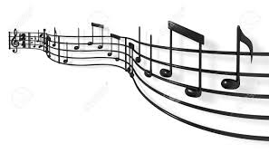
What Got Scored in Attunement Study
1. Modality Match: Voice, face, etc.
2. Dimensions of Match:
Intensity: Absolute level, directional shift
Timing Matches: Beat, Rhythm, duration
Shape Matches: contour (rise, fall, rise of voice, e.g.)
3. Mom’s awareness of her own behavior
4. Type of Attunement: Over-match, equal match, under-match

Slide 20
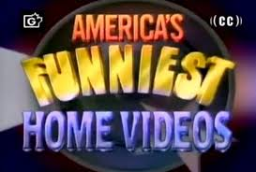
Functions of Attunement?
1. Commune: To be with (positive)
To be with (negative) FHV--Mom laughs at child's fear of own shadow.
3. Responses: Pos or neg reinforcement
4. Tuning: Increase or decrease arousal level
5. Restructure interaction: Change course of behavior
6. Play routine: Match part of an established play routine

Slide 21
Results of Attunement Study
Frequency of attunements:
Mode of attunements:
c. Types of attunements
d. Mom’s awareness
1 every 65 seconds.
Vocalizations
Gestures
Facial displays
Same mode:
Cross mode:
Mixed mode:
13%
39%
48%
Fully aware:
Partly aware:
Unaware:
31%
30%
38%

Slide 22
Functions of attunements
1. Commune = 45%
2. Respond = 33%
3. Tune = 19%
4. Restructure = 2%
5. Play routine = 1%
NOTE: “Commune” = “To be with”

Slide 23
Babies' Responses to Attunements
Most common response from baby is: ___ smiling
___ cooing
___ playing more
___ no response
X
Mom's told to "mis-attune" to baby.
Baby looks at mom as if saying "What gives?"
Indicates baby feels like mom/baby are a single unit, need to respond only if the "unit" fails.
What does this say about how emotions arise?

Slide 24
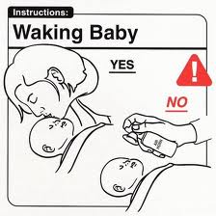
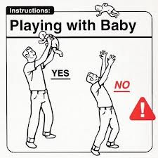
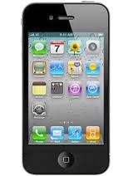
Attunements and Mis-Attunements
Siri Support: Affect without attunement
Siri, is this a good day?
Siri, am I a good boy?

Slide 25
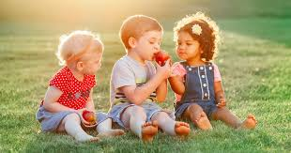
Attunement and the Sharable Self
Theory of Mind: At 9 mos., baby learns it has mind, and that others do also.
Separate minds (me, others around me) means I’m separate.
Can this separation be bridged?
Attunement is the communication bridge.
* Provides sense of own/others mental lives
* Self and other can connect via emotional expression
* Provides sense of what can be shared.

Slide 26
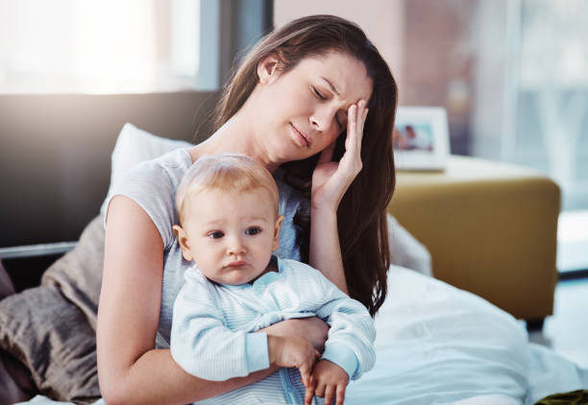
Cost of Failed Attunement
Stern: People can only put into words inner experience that they believe is sharable.
When attunement fails, babies become people who are:
Less able to articulate and KNOW own inner lives, Less able to understand others’ inner lives Therefore, less able to connect deeply with others as adults. Less able to develop sense of self.
What psychological state causes moms to attune badly?
Depression

Slide 27
Main Take-Home Points of Attunement Study
a. Importance of cross-modality of attunements
b. Attunement is relatively automatic
c. Attunement is very constant, almost continual
Communing is #1 function.
Why?
What does communing do? What purpose does it serve?

Slide 28
Attunement and the Sharable Self
Theory of Mind: At 9 mos., baby learns it has mind, and that others do also.
Separate minds (me, others around me) means I’m separate.
Can this separation be bridged?
Attunement is the communication bridge.
* Provides sense of own/others mental lives
* Self and other can connect via emotional expression
* Provides sense of what can be shared.

Slide 29
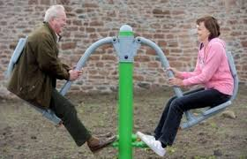
Adult Attunement?
What term do lovers often call each other?
“Baby”
How do dating couples talk to each other?
Hey my little snookums!
Come here and give someone a big old hug!!!
Is adult attunement only part of romantic relationships? What about friendships?

Slide 30
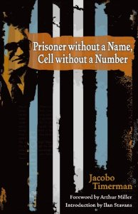
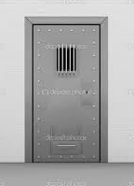
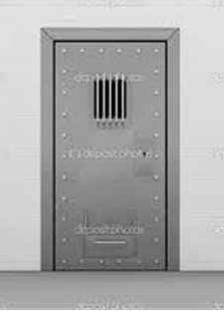
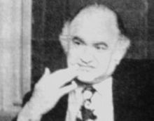
Attunement Behind Bars
Jacobo Timmerman
1923-1999

Slide 31
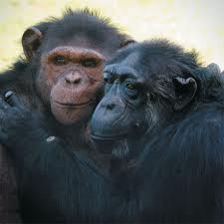
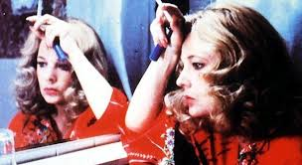
Why Does “Intersubjectivity” Matter?
Play, flirting, connecting:
Empathy, compassion
3. How do men, women "attune"?
4. Emotional support, understanding
John Cassevettes, Gena Rolands: A Woman Under the Influence (1974)
Rolands: Dad, aren’t you going to stand up for me?
Dad: Stands up.

Slide 32
THE FOLLOWING SLIDES WILL NOT BE ON QUIZ 1

Slide 33
Main Take-Home Points of Attunement Study
a. Importance of cross-modality of attunements
b. Attunement is relatively automatic
c. Attunement is very constant, almost continual
Communing is #1 function.
Why?
What does communing do? What purpose does it serve?
Communing provides foundation for sense of self.

Slide 34
The Sense of a Core Self in Infancy
Daniel Stern, The Interpersonal World of the Infant, 1985
Infant's first job is to form sense of core self and core others.
When does self begin to emerge?
2-3 mos, says Stern, 1 yr., others
What are 4 critical elements of having a self, being a self?
SENSE OF
1. Agency: Author of own actions
2. Coherence: Not fragmented, whole
3. Affectivity: Feelings that belong to own experiences
4. Personal history: Enduring continuity

Slide 35
Early Parent/Child Interactions, and the Discovery of Invariants
Motive to order one's universe (i.e., make meaning) is an imperative of mental life.
Identifying "invariants", constants across situations, is critical to achieving this ordering.
Parent/child play provides lessons in invariants
a. Walking fingers game
b. Mom leaning in to/pulling back from baby (in video, e.g.)
These games involve both repetition but also variation around theme.
a. Strict repetition too boring, b. Constant variation too weird

Slide 36
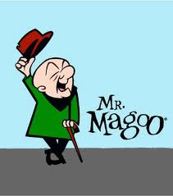
Lessons in Parent/Baby Games
What does baby learn in these games?
1. Central theme imbedded in variations gives sense of invariant; higher- order abstraction is constant, even if variations differ.
Hey, honey...Yeah, honey...Hi, honey...Whatcha doing, honey?...Yeah, whatcha doing?....What are ya doing?....ya doing nothing?
Exquisite repetition and variation: Bach: https://www.youtube.com/watch?v=FwWL8Y-qsJg Ella: https://www.youtube.com/watch?v=PrVu9WKs498
2. Self Regulation: Baby can pull back, reset. Capacity to use own intention to change inner state.
3. Agency: Motor plans develop
a. handwriting demo—with mouth!
Uncle Lew’s Magoosical career.

Slide 37
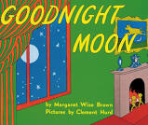
Goodnight Moon by Margaret Wise Brown
In the great green room
-
Goodnight room
Goodnight moon
Goodnight cow jumping over the moon
Goodnight light
And the red balloon
Goodnight bears
Goodnight chairs
Goodnight kittens
And goodnight mitten

Slide 38
Invariants and the Stable Self
Baby learns that its own emotions have consistency over time.
Certain things always bring pleasure, others anger, sadness.
Certain moods arise with same underlying causes, even if external situation differs.
People respond to self in predictable ways, and can be caused to behave in predicable ways, in accord with own personality.
These cross-situational consistencies, underscored by emotions, point to a consistent, inner self.

Slide 39
Cost of Failed Attunement
Stern: People can only put into words inner experience that they believe is sharable.
When attunement fails, babies become people who are:
Less able to articulate and KNOW own inner lives,
Less able to understand others’ inner lives
Therefore, less able to connect deeply with others
as adults. Less able to develop sense of self.

