Slide 1
Development and Emotions
Class 6

Slide 2
Quiz 1 Next Thursday (Feb 9)
Covers: Class 1 Introduction up to and including Class 9, Attunement and Attachment.
15 Questions, Multiple Choice, 40 minutes.

Slide 3
Review Question 1
You go to WAKOs all night diner and ask for a cup of coffee. Your friend starts getting all agitated as he talks about how much he hates his cable company. According to Schachter and Singer, you are most likely to share your friend’s anger if:
____ You ordered regular coffee and you got regular coffee
____ You ordered regular coffee but you got decaff
____ You ordered decaff and you got decaff
____ You ordered decaff and you got regular coffee
____ None of the above

Slide 4
Review Question 2
According to Zajonc’s facial feedback theory of emotion, which of the following behaviors will cause your mood to go up?
____ Saying “LOOM, VACUUM, SALOON”
____ Making the corners of your mouth go down
____ Biting down on pencil, like a horse with a bit
____ Counting the letter “e” in this review question
____ None of the above

Slide 5
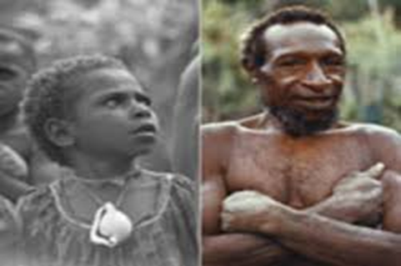
Examples of Appraisal vs. Separate Systems
How to Reconcile Appraisal vs. Separate Systems?
Appraisal: Cognition → Emotion
I find lottery ticket, scratch it, win $10,000 feel ???
South Fore finds lottery ticket, scratches if, finds $10,000, feels ???
Sep. Systems: Emotion → Cognition
You leave school, have jittery, disturbed “something’s wrong” feeling, can’t find reason, get home, realize you missed important meeting.
Emotion is like radar—signaling something important happened.

Slide 6
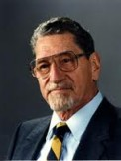
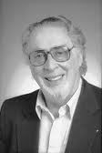
Reconciling "Appraisal" (Cognition First) and "Separate Systems" (Emotion First) Approaches
Discrepancy Theory
Soft drink, competes with Pepsi______.
Coke
Mighty tree, sheds acorns______.
Richard Lazarus
George Mandler
oak
Schemas are mental-preparations
Built with experience
Shape our perception, search-strategies
VIOLATION OF SCHEMAS → EMOTION
Short funny story, ends with punch line_____.
joke
Where there is fire, there is ______.
smoke
albumin
White part of egg _____.

Slide 7
Virtues of Discrepancy Theory of Emotion
Discrepancy Theory
Emotion directs attention to discrepancy.
Emotion scaled to size of discrepancy. Minor discrepancy (“Albumin”) → minor reaction. Major discrepancy (trauma) → major reaction.
After discrepancy resolved, emotion goes away. Joke is not funny 2nd time. Why? No discrepancy.
Shows that emotions “teach” psyche. Schemas change after emotion is pursued.
Discrepancy theory explains connection between cognition (schemas) and feelings.
Soft drink, competes with Pepsi______.
Coke
Mighty tree, sheds acorns______.
oak
Short funny story, ends with punch line_____.
joke
Where there is fire, there is ______.
smoke
albumin
White part of egg _____.

Slide 8
A Little Test of Unconscious Processes
My bet:
I will show you a list of 5 words, one at a time. I bet I can get you to misread 5TH word, even when you try not to.
1. INSULT
2. DISRESPECT
3. OFFEND
4. SLANDER
5. PUT DOWN
Notes:
ASK ST

Slide 9
A Little Test of Unconscious Processes
PUT
What was 5th word?
Notes:
ASK ST

Slide 10
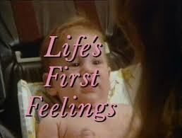
Life’s First Feelings
Documentary
Documentary at: www.youtube.com/watch?v=79ApIwtWY0A
Documentary starts at 40 seconds, with very sappy lead in music. Skip the initial, ancient Tylenol news story.
Entire documentary last 1 hour.
Use the Movie Study Guide, next slides.

Slide 11
Life’s First Feelings Study Guide
Write 1-3 main points for each section
Ed Tronick: Mom and baby interaction
________________________________________________________________________________________________________________________________________________________________________________________________________________________________________________
Rene Spitz and Robert Emde: Children deprived of caregiver
________________________________________________________________________________________________________________________________________________________________________________________________________________________________________________
Stanley Greenspan: Matching moms and babies’ sensitivities.
________________________________________________________________________________________________________________________________________________________________________________________________________________________________________________

Slide 12
Life’s First Feelings Study Guide
Write 1-3 main points for each section
Caroll Izard: Facial expressions and basic emotions
________________________________________________________________________________________________________________________________________________________________________________________________________________________________________________
Jerome Kagan: Inborn temperament
________________________________________________________________________________________________________________________________________________________________________________________________________________________________________________
Joe Campos: Emotional signaling from parents to children
________________________________________________________________________________________________________________________________________________________________________________________________________________________________________________

Slide 13
Life’s First Feelings Study Guide
Write 1-3 main points for each section
Michael Lewis: Social emotions and sense of self
________________________________________________________________________________________________________________________________________________________________________________________________________________________________________________
Marion Yarrow and Caroline Wexler: Development of empathy.
________________________________________________________________________________________________________________________________________________________________________________________________________________________________________________
Stanley Greenspan: Stages of emotional development
_______________________________________________________________________________________________________________________________________________________________________________________________________________________________________________

