Slide 1
Emotions Defined II
Class 5

Slide 2
Announcement
Quiz 1 on Thursday, February 9
Covers Class 1 up to and including Class 7 (Development of Emotions I)
15 Multiple Choice + 2 Extra Credit
25 minutes to complete

Slide 3
Review Question 1
According to Keltner, Oatley, and Jenkins, which of the following are aspects of emotions?
____ Evaluation of events as relevant to goals
____ Readiness to act
____ Distinctive mental states
____ Sometimes accompanied by body changes, expressions,
and/or actions
____ All the above
X

Slide 4
Review Question 2
The “appraisal theory” of emotion, in which emotions arise from thinking, is closely related to what kind of psychotherapy?
____ Cognitive-Behavioral (CBT)
____ Psychoanalysis
____ Group therapy
____ Relational therapy
____ Hypnotherapy
X

Slide 5
Appraisal vs. Separate Systems Theories of Emotion
Controversy: Do emotions always follow thought, or can emotion precede thinking? What comes first, thinking or feeling?
Appraisal Theory: Thinking comes first. See a thing, evaluate (appraise) it, then emotion follows.
Separate Systems: Emotions can come first. See a thing, feeling emerges, thoughts follow.

Slide 6
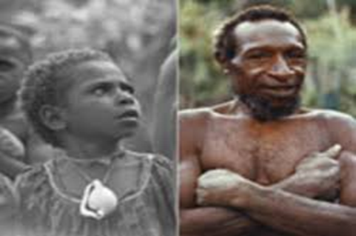
Examples of Appraisal vs. Separate Systems
Appraisal: Cognition → Emotion
I find lottery ticket, scratch it, win $10,000 feel ???
South Fore finds lottery ticket, scratches if, finds $10,000, feels ???
Sep. Systems: Emotion → Cognition
You leave school, have jittery, disturbed “something’s wrong” feeling, can’t find reason, get home, realize you missed important meeting.
Emotion is like radar—signaling something important happened.

Slide 7
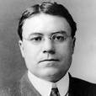
Thinking First
Cannon-Bard Central Nervous Model
Walter Cannon
1. Emotions produced by brain, not body.
2. Same body change (high vs. low arousal) for all emotions.
3. Brain "labels" arousal as different emotions.
4. Thus emotion = arousal + cognition

Slide 8
Schachter & Singer (1962) Two Factor Theory of Emotion
Stanley Schachter
Related to Cannon-Bard
Emotion = arousal + cognition
Fits with Cannon-Bard Central Systems Theory
Emotion only occurs if:
a. Body is aroused, AND
b. A reason for arousal is located
How arousal is labeled determines specific emotion
Arousal w/o cognition leads to no emotion

Slide 9
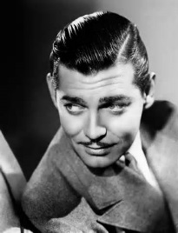
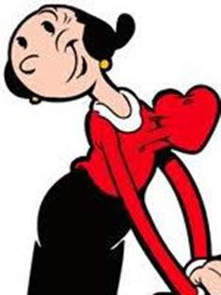
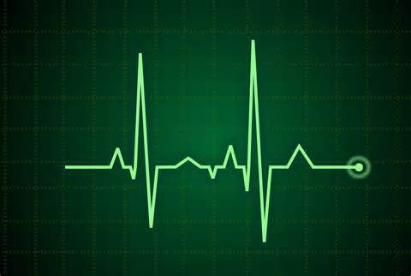
Schachter and Singer Model of Emotions
Love,
Clark
Love,
Jason
Social / Environ-mental information
Because you’re special!
Emotion-producing event
+
Emotion
Affection
Flowers Delivered
Terror
Neutral
Physiological Response

Slide 10
Schachter & Singer Experiment (1962)
Subject told study concerns effect of new vitamin
Given an injection:
Epinephrine (epi) or Placebo (saline)
Told that shot is arousing (informed) or not told (uninformed)
Told to wait in room, fill out survey
Also in room is confederate (poses as another subject)
a. Confed is very happy, OR
b. Confed is very angry
5. Question: What emotion will the subject feel?

Slide 11
Results of Schachter & Singer
Confederate’s Behavior
Happy Angry Neutral
Subject’s Emotion
Experimental Condition
Epi, uninformed
Epi, informed
Placebo, uninformed
Placebo, informed
Happy
Angry
Afraid
Neutral
Neutral
Neutral
Neutral
Neutral
Neutral
Neutral
Neutral
Neutral
“Epi” = Epinephrine, stimulant.

Slide 12
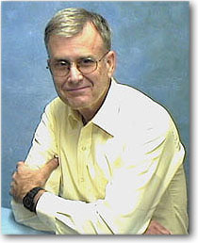
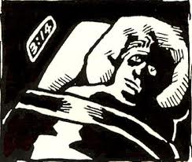
Insomnia and the Attribution Process
Storms and Nisbett, 1970
Richard Nisbett
Idea: Would shifting explanation for night-time nervousness from anxious thoughts to a pill reduce insomnia?
Why would this happen? How is this related to Schachter & Singer?

Slide 13
Storms & Nisbett Study Design
Subjects: 42 insomniacs at Yale, all given placebo, but told:
"Arousing Drug Cond" "This drug....will increase your heart rate and...body temp., You may feel like your mind is racing. ..."
"Relaxing Drug Cond" "This drug...will lower your heart rate...body tem. And it will calm your mind ... "
Which condition will sleep better?
"Arousing" Drug
"Relaxing" Drug

Slide 14
Storms & Nisbett Study Design
Subjects: 42 insomniacs at Yale, all given placebo, but told:
"Arousing Drug Cond" "This drug....will increase your heart rate and...body temp., You may feel like your mind is racing. ..."
"Relaxing Drug Cond" "This drug...will lower your heart rate...body tem. And it will calm your mind ... "
Which condition will sleep better?
X
"Arousing" Drug
"Relaxing" Drug
Why?
Misattribution
Attribution = Judgment of cause. When given “arousing” drug, subjects believe arousal due to drug, not to worries.
They “mis-attribute” wakefulness to drug, not to anxiety.

Slide 15
Study Results
Minutes to Fall Asleep
Minutes to Falling Asleep
Note: Arousal pre-drug due to 2 outliers
*

Slide 16
Storms and Nisbett (S & N) Questions
Does misattribution lead to:
a. More anxiety about thoughts:
I was feeling somewhat worried about test,
but if sedative doesn’t work, I am very worried!
OR
b. More anxiety about emotions:
Oh no, here comes my anxiety!! I'll never sleep now
because of my anxiety. I am worried about my
inability to stop worrying!

Slide 17
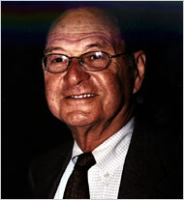
Separate Systems Approach to Emotions
Affective reactions are primary and basic (not reducible to thoughts, etc.)
b. Affect is inescapable (can’t intentionally be turned off)
c. Affective reactions tend to be irrevocable, in contrast to cognitive judgments
d. Affect implicates the self: cognitive judgments center on features of objects.
e. Emotions are not always verbalizable
f. Affective reactions don't always depend on thinking
g. Affective reactions can be separated from content knowledge
Robert Zajonc
1923-2008

Slide 18
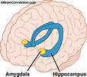
"Circumstantial" Evidence for
Separate Systems Theory of Emotions
Physiological:
a. Hemisphere Specificity: Emotional expressions flashed to R hemi. recalled better than to L hemi.
b. Amygdala -- direct link to sensorium, bypasses cortex
2. Developmental: Infants "know" emotions from birth.
3. Cross cultural: All cultures "know" same emotions (Ekman).
4. Evolutionary: Emotion system existed long before neo-cortex
Amygdala

Slide 19
Zajonc “Mere Exposure” Experiment
X
X
Subjects see many cards showing a Chinese character.
Some cards shown repeatedly, others shown only once.
After viewing many cards, subjects asked:
a. Which cards did were shown repeatedly?
b. Which cards they like the most.
MEMORY ACCURACY
At chance level
Better than chance

Slide 20
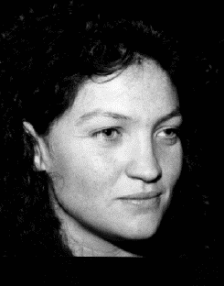
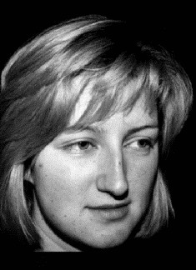
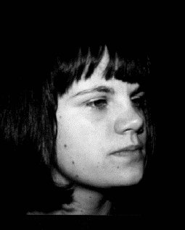
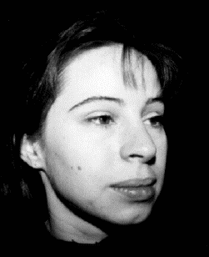
Mere Exposure and Social Judgment
Moreland & Beach, 1992
* Student in psych class (n = 130).
* Woman poses as student,
attends 0, 5, 10, 15 times.
*Students see pics of woman,
rate her at end of term, on:
Seen 0 times
Seen 5 times
Seen 10 times
Seen 15 times
Attractiveness
Could become friends?
Would enjoy time?
Would work well together?
1 2 3 4
1 2 3 4
1 2 3 4
Similarity
Same background?
Understand her?
Similar plans?
1 2 3 4
1 2 3 4
1 2 3 4
Implications for segregation / integration? Romance? Team building?

Slide 21
Mere Exposure Study Main Point
Liking becomes an emotional memory for repeated exposure. Even when conscious memory fails us.
“Preferences” (liking/not liking) “need no inferences” (conscious judgments and evaluations).

Slide 22
Studies Showing Affect-Based vs. Feature-Based Memory
Hyde & Jenkins (1969)
Rogers, Kuiper, & Kirker (1977)
WORD LIST
Leg
Cup
Money
Skunk
Dishrag
Pretzel
WORD LIST A
a. Funny
b. Lazy
c. Athletic
Word List B
a. Organized
b. Hazy
c. Sporty
Subs. do one of four tasks:
A. Compare fonts
B. Does word rhyme?
C. Do words mean same thing?
D. Do words refer to me?
Which group shows better recall?
Subs. do one of three tasks:
A. Count letters
B. Does word contain "e"?
C. Rate pleasantness
Which group shows better recall?

Slide 23
Role of Body in Emotion, and Thinking 1st vs. Feeling 1st Debate
If emotions can, sometimes, come first, then emotions should show up in bodily arousal.
Also, if emotions come first, each emotion should be physiologically distinct, rather than “general arousal” shaped by thinking.
Therefore, locating separate emotions in the body would support Separate Systems approach.

Slide 24
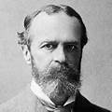
James’s Peripheral Theory of Emotion Emotion = Feeling
William James
1842-1910
1. Emotions are, literally, feelings.
2. Every emotion accompanied by corresponding change in bodily sensation.
Emotions are the sensation of what is going on in the body, arise from the body.
Therefore, each emotion is physiologically distinct.
Contrasts to Cannon-Bard, who say emotions arise in brain, not body. All emotions are basically arousal + cognition.

Slide 25
Testing James’ Peripheral Theory
If emotions require sensation from the body, what group of people might show reduced emotions?
Spinal cord injured. Less feeling in body, therefore (per James) less emotion.
Hohmann (1966): Spinal cord injured (SCI) report less sexual arousal, less fear, less anger.
Bermond (1991): No general loss of emotion.
Research problems?
Maybe injury → emotional numbing

Slide 26
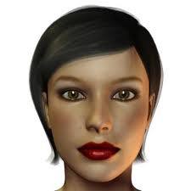
Zajonc Facial Feedback Theory
a. Changing bodily state → change in emotion
b. Face is primary source of emotional change
* Word study : Seal, leaf, teenie vs. loom, vacuum, saloon
* Pencil-in-mouth study
* Face-pose study and picture judgments (Larson et al., 1992)
Sad | | | | | Happy

Slide 27
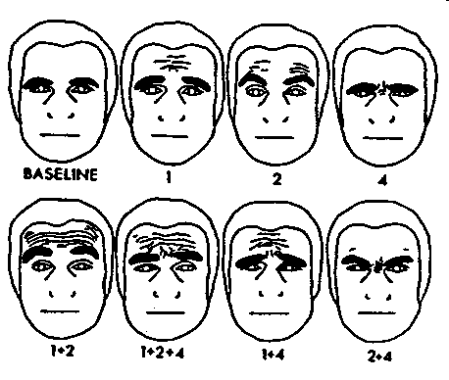
Ekman's Facial Action Coding System (FACS)
and Emotion Generation

Slide 28
Ekman, et al.: Facial Poses and Emotional Arousal
Facial Pose Heart Rate Galvanic Skin
Response
Happy Low XXXX
Disgust Low XXXX
Surprise Low XXXX
Sadness High Low
Anger High High
Fear High High

Slide 29
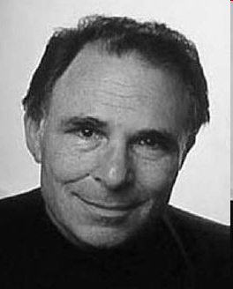
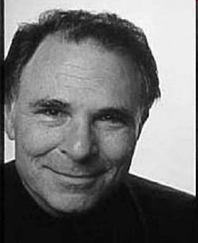
Facial Expression of Emotion: Duchene Smile
Duchene Smile: Genuine, real, non-fake smile.
Which is the Duchene (genuine) smile, A or B?
A
B
Fake smile
Duchene smile
Fake: Zygomatic (mouth) muscles only -- voluntary muscle action
Duchene: Zygomatic (mouth) + orbicularis oculi (eyes) -- involuntary muscle action
QUESTION: If facial poses activate emotion, does fake smile have same arousal as Duchene (true) smile? Ekman doesn’t address this.

Slide 30
So, Do Emotions Have Distinctive Physiological “Signatures”?
Cacioppo et al. (1993) conducted a major review of many studies on emotion and bodily change.
Jury is still out, results too conflicted.
Example: 10 comparisons of happiness and anger, 5 do show differences, 5 do not.

Slide 31
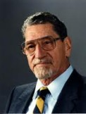
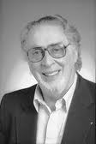
Reconciling "Appraisal" (Cognition First) and "Separate Systems" (Emotion First) Approaches
Discrepancy Theory
Soft drink, competes with Pepsi______.
Coke
Mighty tree, sheds acorns______.
Richard Lazarus
George Mandler
oak
Schemas are mental-preparations
Built with experience
Shape our perception, search-strategies
VIOLATION OF SCHEMAS → EMOTION
Short funny story, ends with punch line_____.
joke
Where there is fire, there is ______.
smoke
albumin
White part of egg _____.

Slide 32
A Little Test of Unconscious Processes
My bet:
I will show you a list of 5 words, one at a time. I bet I can get you to misread 5TH word, even when you try not to.
1. INSULT
2. DISRESPECT
3. OFFEND
4. SLANDER
5. PUT DOWN
Notes:
ASK ST

Slide 33
A Little Test of Unconscious Processes
PUT
What was 5th word?
Notes:
ASK ST

