Slide 1
Emotions Defined
Class 4

Slide 2
Review Question 1
Which of the following best describes the attitude towards emotions during the Enlightenment?
____ Nature is basically good, benign
____ The notion of the “Noble Savage”
____ Emotions need to be tamed, controlled
____ The heart has its reasons that the reason cannot know
____ All of the above
X

Slide 3
Review Question 2
In the Cohen and Nisbett studies on Culture of Honor, Southerners were more likely to show elevated cortisol and testosterone after:
____ Shaking hands with an experimenter
____ Being insulted by a stranger at a filing cabinet
____ Receiving a letter from an ex-con seeking a job
____ Visiting friends north of the Mason-Dixon Line
____ None of the above

Slide 4
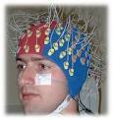
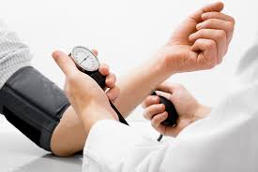
Ways of Defining Emotion
Descriptive
1. What are the different types of emotions?
2. How do different emotions look, sound, feel?
3. How can emotions be measured/observed?
Causal
1. What circumstances give rise to emotions?
2. How are emotions evoked?
Functional
1. What do emotions do? What’s their purpose?

Slide 5
Affect-Related Terms
Affect: Covers emotions, feelings, moods, and preferences.
Preferences: Mild subjective reactions of positive/negative directed toward specific objects. ”Like / Don’t Like”
Moods: General positive or negative states without a specific target.
Emotions: Specific states directed toward specific targets.
Feelings: Basically, synonymous with emotions but more direct reference to corresponding bodily sensation.

Slide 6
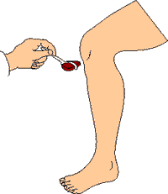
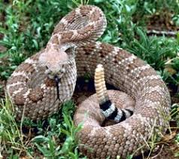
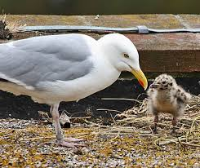
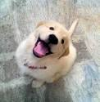
From Reflexes to Emotion
a. Reflexes
b. Patterns of action
c. Innate releaser/sign stimulus/cue
d. Emotions

Slide 7
Emotions and Action Patterns

Slide 8
Emotions Promote Action Readiness “E-Motion”
Action
Emotion
Ready to strike, hit, attack:
Wanting to flee, escape:
Wanting to join, touch, be with:
Anger
Fear
Love, Affection

Slide 9
Emotions and Problem Solving
Emotions draw attention to problems
Emotions keep attention on problems, until problems are solved.
Different emotions are keyed to different kinds of problems
EMOTION PROBLEM SOLUTION .
Guilt
Betrayal of another
Make amends Restore bonds
Fear
Threat to self
Self Protection
What happens to emotion after solution enacted?
You make amends, what happens to guilt?
What does that say about emotions?

Slide 10
Non-Verbal Signals of Emotion: Emotions Cause Us to Sing and Dance!
Non-Verbal Signal Enactment
Emblems Thrust fist, extended middle
finger, thumbs up
Illustrators Accent/emphasis in voice, hand
waving, clenched fist
Affect Displays Smiling, frowning
Regulators Nods, eyebrow movement
Adaptors Self-touching, self grooming

Slide 11
“Pregnant” example of vocal expression of emotion.
Twee maander zwanger
“Three months pregnant”

Slide 12
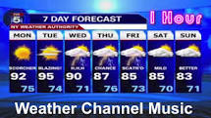
Music of Emotional Expression
https://www.youtube.com/watch?v=SnKulfkNG1Q
https://www.youtube.com/watch?v=Ckxz2ipmNAE

Slide 13
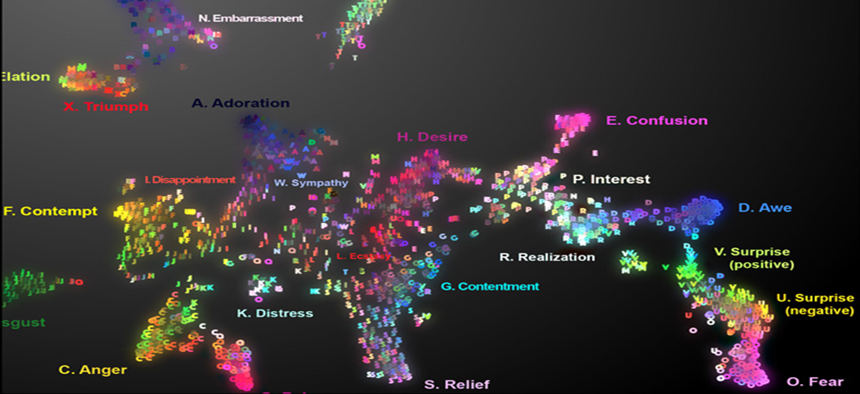
Map of 24 Emotional Signals
Cowen, Elfenbein, Laukka, & Keltner, 2019
https://s3-us-west-1.amazonaws.com/vocs/map.html#
Created 2080 voice bursts (2032 in lab + 48 real world) by 1105 people.
Emotional samples reduce to 24 distinct kinds of emotion.
Supports distinct emotions (Ekman) more than Circumplex model (Russell)
However, emotions seem to follow continuum versus discrete categories

Slide 14
How Keltner, Oatley, and Jenkins define emotion: Appraisal Theory
a. Emotion is caused by a person evaluating an event as relevant to an important goal; emotion is positive if event advances goal, negative if event impedes goal.
b. Core of emotion is readiness to act. Emotions give priority to action.
c. Emotions are experienced as distinctive mental states, sometimes accompanied by bodily changes, expressions, actions.
Note: This is an appraisal approach to emotions
Event → Evaluation of Event → Emotion

Slide 15
Goals, and Appraisal Theory of Emotion
You are alone at party. Nice looking person looks in your direction, and smiles.
Appraisal: Recognition of an event as significant?
Significant events:
Goal Relevance: Does event relate to goals?
Goal Congruence/Incongruence: Does event advance or impede goals?
Ego Involvement: How does event affect one’s sense of self (e.g., affirm, dis-affirm)?
YES
YES
ADVANCE
AFFIRM
EMOTION?
HAPPY

Slide 16
Goals, and Appraisal Theory of Emotion
But is smiling at person sitting next to you.
Appraisal: Recognition of an event as significant.
Significant events:
Goal Relevance: Does event relate to goals?
Goal Congruence/Incongruence: Does event advance or impede goals?
Ego Involvement: How does event affect one’s sense of self (e.g., affirm, dis-affirm)?
YES
YES
IMPEDE
DIS-AFFIRM
EMOTION?
UNHAPPY

Slide 17
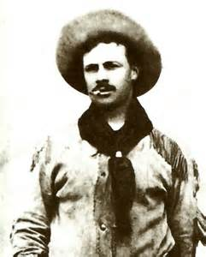
Emotions Per Keltner, Oatley & Jenkins
Goal Relevance: I’m looking for parking space and:
Space suddenly opens, I feel:
Euphorically, insanely happy
Someone steals space, I feel:
Bloodthirsty rage
Readiness to act: I’m from the South, and the parking space stealer sneers and says “Sorry, Slick”. My body reacts by:
Fight mode, testosterone, cortisol, HR, etc.
Distinct mental states: Not only is my body aroused, I am aware of my emotions and can label my emotions.

Slide 18
Appraisal Habits and Emotion: Cognitive/Behavioral Therapy (CBT)
Event: Saw someone from school at market, but she didn’t acknowledge me.
Thought: Probably doesn’t like me.
Emotion: Hurt, sadness → depression
Alternative appraisal: The person might not have even seen me. Or maybe she is shy, or maybe she is a stuck-up jerk.
New emotion: → Relief, Compassion, Distain

Slide 19
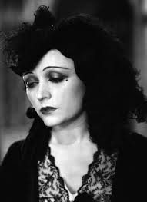
Changing Emotions By Changing Cognitions in The Dain Curse Dashiel Hammet, 1929
“I—” She sat down on the side of the bed close to me, elbows on knees, tortured white face between hands. “I’ve not ever been able to think clearly, as other people do, even the simplest thoughts. Everything is always so confused in my mind. No matter what I try to think about, there’s a fog that gets between me and it, and other thoughts get between us, so I can barely catch a glimpse of the thought I want before I lose it again, and have to hunt through the fog, and at last find it, only to have the same thing happen again and again and again. Can you understand how horrible that can become: going through life like that—year after year—knowing you’ll always be like that—or worse?”

Slide 20
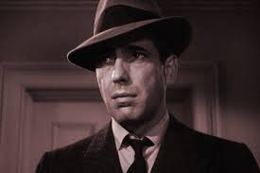
Changing Emotions By Changing Cognitions in The Dain Curse
“It sounds normal as hell to me. Nobody thinks clearly, no matter what they pretend. Thinking is a dizzy business, a matter of catching as many of those foggy glimpses as you can and fitting them together as best you can. That’s why people hang on so tight to their beliefs and opinions; because compared to the haphazard way they’re arrived at, even the goofiest opinion seems wonderfully clear, sane, and self-evident. …”
She took her face out of her hands and smiled shyly at me saying: “it’s funny, I didn’t like you before.”

Slide 21
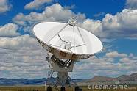
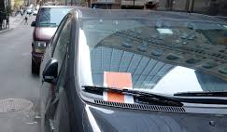
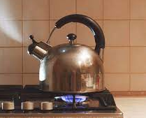
Thinking → Emotion, or Emotion → Thinking?
Emotions shift direction of thought: Like a “Mental radar”
Emotions focus attention to personally relevant things.
Emotions focus attention onto un-solved problems
Feeling anxious, not sure why, Wait, did I turn off stove??

Slide 22
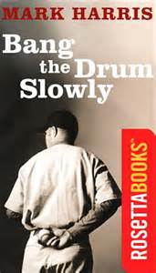
Do Emotions Shape Thought? From Bang the Drum Slowly Mark Harris, 1956
…We filled up with antifreeze, the kid in the station saying, “this will last you a lifetime”. You would be surprised if you listen to the number of times a day people will tell you something will last a lifetime or tell you something killed them,or tell you they are dead. “I was simply dead” they say, “He killed me, “ I am dying,” which I never noticed before but now begun to notice more and more.
For narrator, mortality is: hypercognized or hypocognized

