Slide 1
Culture and Emotions
Class 3

Slide 2
Review Question 1
Which philosopher believed that emotions were tied to narrative (i.e., stories) and promoted “Katharsis”?
____ Aristotle
____ Descartes
____ Spinoza
____ Jefferson
____ None of the above
X

Slide 3
Review Question 2
Why did Paul Ekman conduct research with the South Fore people of New Guinea?
____ To study people who do not have basic emotions
____ To conduct research south of the Equator
____ To study a pre-literate culture
____ To confirm Russel’s circumplex model of emotions
____ None of the above
X

Slide 4
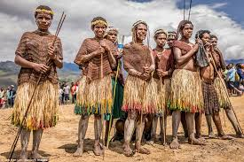
Universality of Emotions
Emotional expression evident among blind, deaf
Emotion expression common across pre-literate cultures
Ekman studies
Heiders: Dani’ of Indonesia

Slide 5
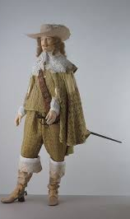
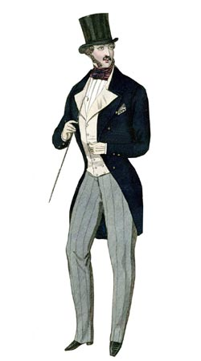
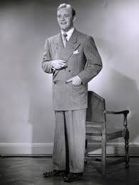
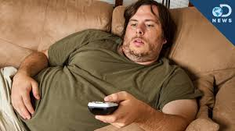
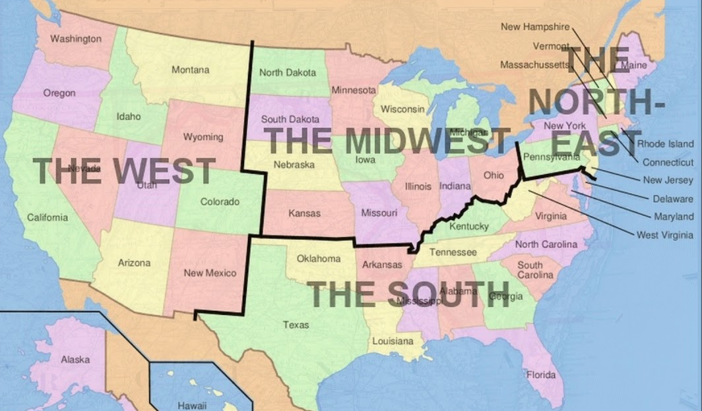
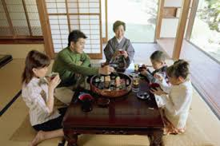
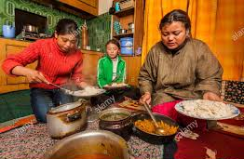
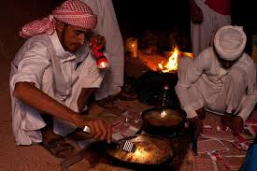
Researching Culture and Emotion
1. Across time within a society
2. Between regions within larger society
3. Between separate societies

Slide 6
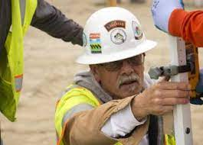


Emotional Differences Between Cultures Represent Adaptations
Cultures differ in constraints (i.e., challenges, and opportunities) that they face.
Constraints favor some emotions, some emotional expressions, and disfavor others.
Emotions are adapted to the problems people face in different places and different times.
Constraints – adaptive in certain situations, not in others

Slide 7
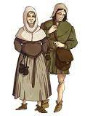
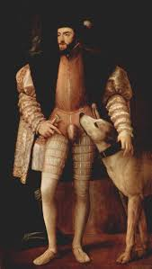
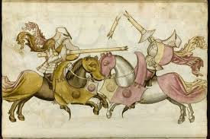
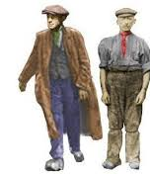
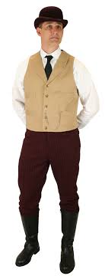
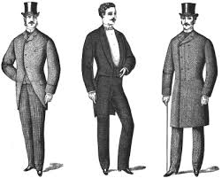
Clothing, Manners, Social Eras, Life Expectancy

Slide 8
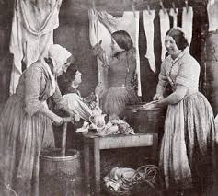
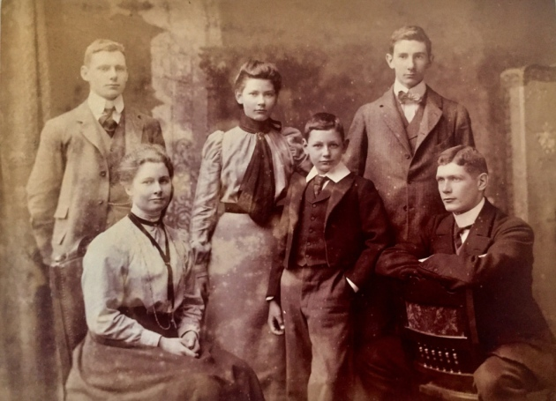
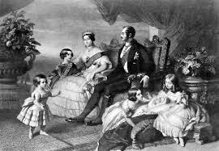
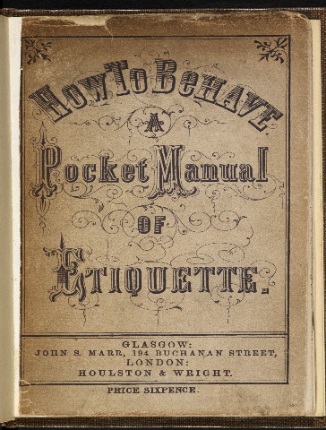
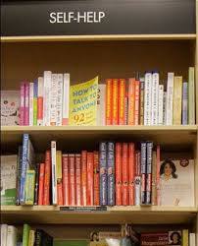
Emotional Restrictiveness and Social Class
Working Class
Middle Class
Upper Class
Which class was the most sexually
and socially inhibited?
Why?
Social ladder is new, important to show refinement. Reputation is critically important.

Slide 9
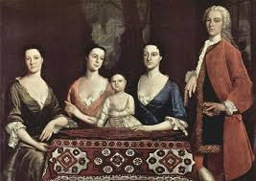
Emotions During the Enlightenment
1. Reason and rationality great equalizers
2. Darwin: emotions associated with more primitive animals.
3. Spinoza: Spiritual freedom gained by controlling the “passive” emotions
4. Emotions associated with the irrational, the untamed, the feminine, the weak, the insane.
Embracing of science → industrial revolution, command over nature

Slide 10
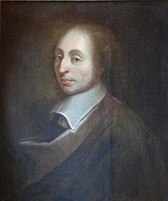
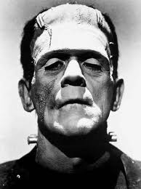
Romanticism and Emotions
1. Reaction to the hyper-rationality of the Enlightenment
2. Philosophical spokesman: Blaise Pascal (1623-1662)
“The heart has its reasons the reason cannot know”
3. Themes of Romanticism
a. Nature is basically benign
b. Good life lived in harmony with nature—inner and outer
c. Notion of “noble savage”
d. Dangers of ignoring nature: warped wonks
Frankenstein: Science run amok

Slide 11
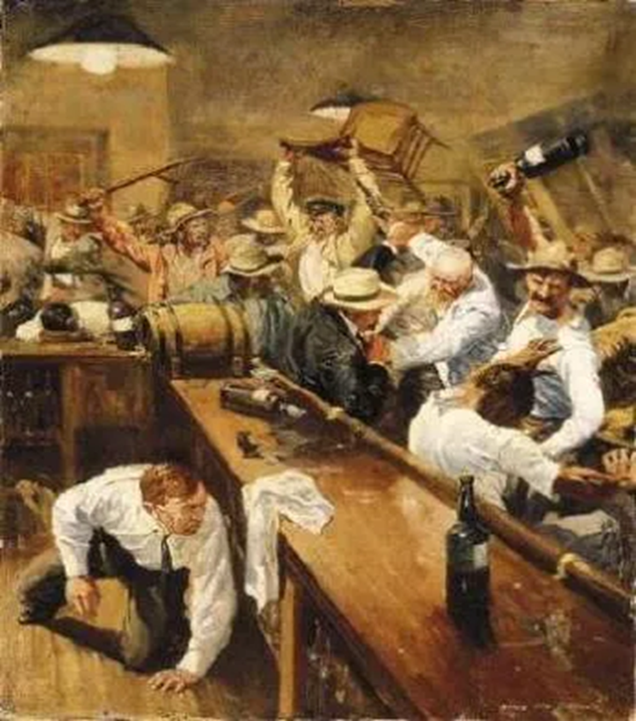
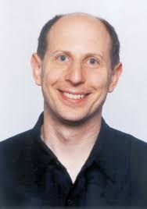
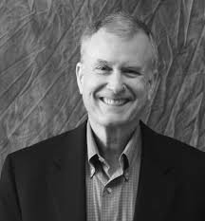
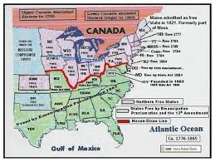
Emotions in Different Parts of the Same Culture, in the Same Era
North vs. South United States and the “Culture of Honor”
Dov Cohen and Richard Nisbett

Slide 12
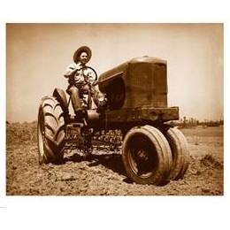
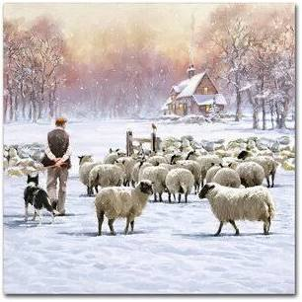
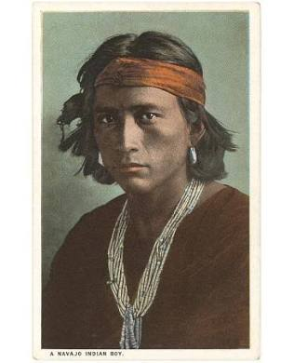
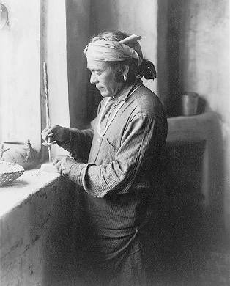
Economics, Culture, and Violent Emotions
Which occupation more associated with violence? Why?
Herders – Their livelihood is more easily stolen. Must project toughness.
Navajo:
Herders, Fierce Warriors
Zuni: Farmers, Peaceable

Slide 13
Cultural Differences and Constraints: North vs. South

Slide 14

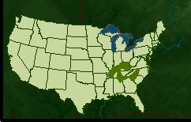
Differences in Violence,
North vs. South
Homicide in Cumberland Mtns: 10 times national rate, twice as high as inner cities during 1980s
Violent past-times:
Purring, no holds bar fights, toss-rock-at-head game
Laws lenient re. honor-related violence
Killing unfaithful wife and lover justified in Texas
Jury acquits man who shoots name-callers

Slide 15
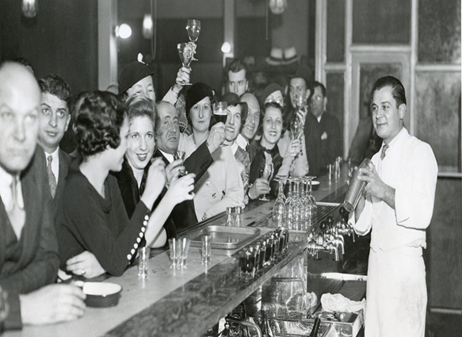
Percent Who Approve of Punching a Drunk Who Bumps into One's Wife, Non-South vs. South

Slide 16
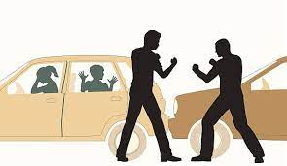
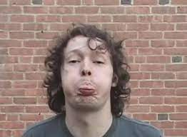
Percent Who Would Be Angry with Friend for a Month Following a Fist-Fight or an Insult,
Mid-West vs. South

Slide 17
Homicide Rates Related to Insults
in Cities of Less than 200,000
North vs. South

Slide 18

Cohen and Nisbett Motorcycle Shop Study
Employment request letters sent to cycle shops in North and in South
“Applicant” is highly qualified motorcycle mechanic
BUT, applicant has a criminal past
a. Applicant stole money, went to prison
b. Applicant caught another man with his wife, thrashed the man, went to prison.
4. Who hires applicant?

Slide 19
Offer Job to Convict, Convicted of Stealing or Honor-Motivated Manslaughter, North Vs. South
NORTH SOUTH
THIEF Rarely Rarely
REVENGING Rarely Moderately
HUSBAND

Slide 20
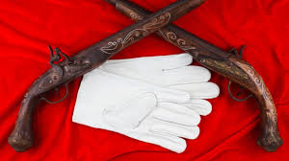
Culture of Honor Experiments
Aim: To show that culture causes different emotional responses to insult.

Slide 21
Sequence in Cohen and Nisbett Insult Studies
Subjects: White males, non-Hispanic and non-Jewish
Subjects are from the North or the South
3. Subject told to walk down narrow corridor, drop off form and return
4. Subject encounters/doesn’t encounter guy working a file cabinet.
5. Filer first grumpily makes way for Subject
When Subject returns filer bumps him and calls him “asshole”
Observer-Experimenter views entire encounter, but doesn’t know if the subject is from the North or the South.

Slide 22
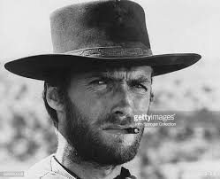
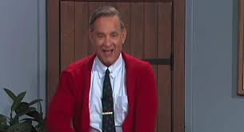
Results of Insult Experiments
Southerners
Northerners
Insult Study 1: Emotions expressed after insult
* South: Anger
* North: Amusement
Insult Study 2: Stress and aggression hormone activation
* Cortisol: Higher among insulted Southerners
  * Testosterone: Higher among insulted Southerners
3. Insult Study 3: Behavioral measures
a. Handshake: Firmer among insulted Southerner
b. Posture: More dominant among insulted Southerner

Slide 23
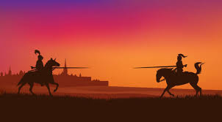
Distance (in feet) Before Avoiding Fred the Bouncer in “Chicken Game”, After No Insult or After Insult
North vs. South

Slide 24
Conclusions from Culture of Honor Studies
Culture shapes meaning of events, and therefore emotional reactions.
Culture shapes how people act on emotions
Implications for policy: change social conditions that support need to project toughness.

Slide 25
Cross-Cultural Analysis of Emotion
Different societies face different environments, histories, and current challenges
The factors influence emotional emphases
Hypercognized: Emphasized, have special names, objects of discussion:
Anger –related words
Calm-related words
Hypocognized: Underemphasized, not conceptualized.
Example: Anger vs contentment, US vs. Asia

Slide 26
Cultures Factors US vs. Japan
U.S .A. Japan
Environ. Wide open continent Small Island
History Settled by rebels, 1000 yrs, little immigration
people willing to break ties
Values Distrust authority Respect authority
Independence Collectiveness
“I” self “We” self
Innovation Tradition

Slide 27
Emotions, US vs. Japan
Amae: Japanese positive emotion
Comfort in another’s complete acceptance
No US equivalent
Anger: Japan – OK between groups, not within group
US – OK to show anger to close others
Infant toy study: Baby approaches toy when mom shows
joy, fear, or anger, Japan vs. US.
Which emotion most inhibiting:
Which babies most affected?
Anger
Japanese

Slide 28
Saying “No” in US and Japan
USA Japan
I don’t think this will work
No, we cannot do that
Are you out of your %$##%
mind???
That is interesting
We would like to think about that
We may have a problem

Slide 29

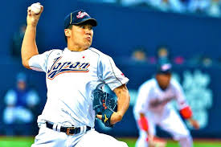
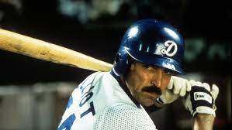
Saved in Translation: How Conflicts are Avoided by Understanding Cultural Display Rules
American players in Japan have translators who know when to modify language according to cultural norms.

Slide 30
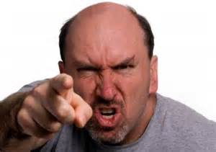
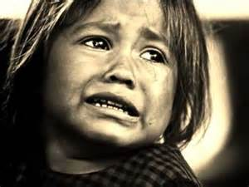
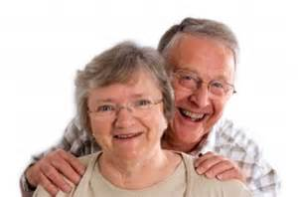
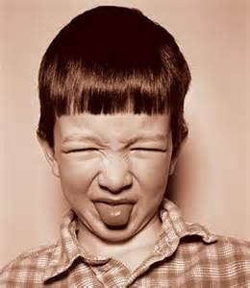
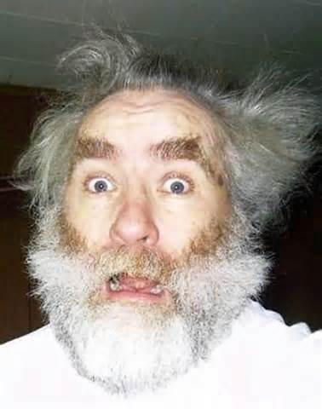
Display Rules
Culturally determined rules about when, and to what degree, spontaneous emotion can be publicly expressed.

Slide 31

Design and Results of Ekman Study on Display Rules

Slide 32
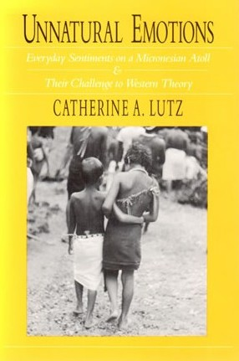
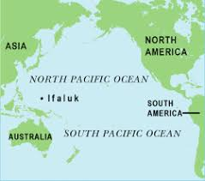
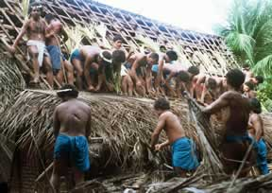
Circumstances of USA and Ifaluk

Slide 33

Emotions of the Ifaluk
1. Ker = self-centered happiness, draw attn. to self, rowdiness
2. Maluwelu: gentle, quiet, calm pleasantness
3. Song: Dissatisfaction with another’s break of social decorum
4. Fago: Compassionate love/sadness. Most valued emotion
Child rearing: Never use corporal punishment
Discipline through lecturing AND
“Ghost woman” who threatens to eat bad kids.
Sense of self: Collective rather than individualistic
Norms: Collaboration emphasized

