Slide 1
Approaches to Emotions: Philosophical and Evolutionary
Class 2

Slide 2
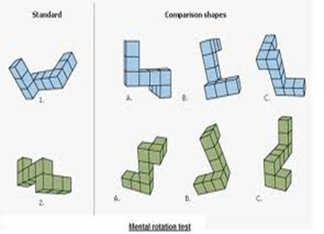
Review Question 1
Which of the following finally opened the door to the scientific study of mental states (and overcame Behaviorism)?
___ Mesmerism
___ Behaviorism
___ Roger Sheppard “mental rotation” studies
___ Freud’s psychosexual theory
___ None of the above
X

Slide 3
Review Question 2
Robert Zajonc used Chinese ideograms, such as this one,
in his “mere exposure” studies to show that
___ Humans do not have minds
___ We can emotionally remember familiar things
___ Faces on Japanese crabs demonstrate natural selection
___ Facial expressions of emotions are vestigial
___ All of the above

Slide 4
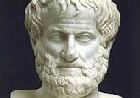
Philosophers of Emotion: Aristotle, Descartes, Spinoza, and Jefferson
Aristotle (384-322 BCE)
* Emotions connected to action
* Emotions follow beliefs but also can shape beliefs
* Emotions tied to narrative, to stories and drama
* Function of tragic theater is Katharsis—clarity
gained by emotional identification with others.

Slide 5
How Stories Evoke Emotions
Facts About Bill
Said “Hey, get outta here!”
Ordered pepperoni pizza
Wedding next day
Left house
Got shot
Jokes with Tommy
Robber barges in
Goes to Tommy’s Pizza
Kindly social worker
Bill’s Bad Day
Bill, a kindly social worker, left his house and went for lunch at Tommy’s Pizza. He joked with Tommy and ordered a pepperoni pizza. Suddenly a robber barged in. Bill shouted “Hey, get outta here!” He got shot. His wedding was the next day.

Slide 6
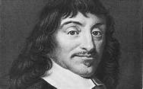
Descartes (1596-1650)
* Mind and body not tied, but separate. Body a machine.
* Emotions occur not in body but in “soul”
* Emotions tell us how events affect our thinking selves.
* Emotions shaped by the way we appraise events.

Slide 7
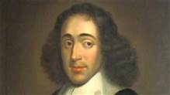
Spinoza (1632-1677)
* Active emotions —come from loving the world as it is.
Passive emotions —bitterness, envy—come from rejecting perfection of universe.
* People aware of desires, but ignorant of causes (Freud?)
* Emotions stem from how we appraise the world
* Emotions cloud understanding; need to understand emotions to be free of them.

Slide 8
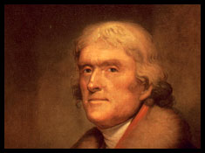
Thomas Jefferson: My Head and My Heart
Vita
1743- July 4, 1826
Drafted Declaration of Independence
Secty. of State (1789-1794)
Vice President (1797-1801)
President (1801-1809)
Hobbies: Inventor, architect, farmer
John F. Kennedy Welcoming Nobel Prize Winners at the White House:
This is the most extraordinary collection of talent, of human knowledge, that has ever been gathered together at the White House, with the possible exception of when Thomas Jefferson dined alone.
We hold these truths to be self-evident, that all men are created equal, that they are endowed by their Creator with certain unalienable Rights, that among these are Life, Liberty and the pursuit of Happiness.

Slide 9
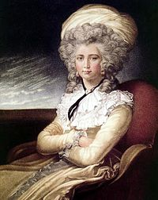
Jefferson "My Head and My Heart"
Background: Jefferson had affair with Maria Cosway. Artist, composer, musician, founded girls' school.
Letter is "love letter" upon their separation. Maintained correspondence for remainder of Jefferson's life.
Letter written as internal dialogue between Jefferson's head "reason" and heart "emotions" about the pain of separation.
Jefferson had recently broken wrist, wrote letter with left hand, thus references to "hurt wrist."
Jefferson never married.

Slide 10
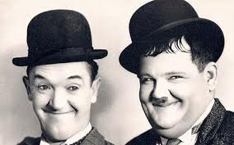
Heart
Head
Agree?
What the Head tells the Heart
While suffering the costs of your follies you, you may perhaps learn from them.
I told you, you were impudently engaging your affections", "I warned you about separation pain, that there was NO FUTURE, and what chance is there she'll come to America? Nearly none. “Be Realistic. Focus on objective facts.
"You must learn to look forward before you take a step which may interest our peace.“
"Everything in this world is a matter of calculation. "Do not bite the bait of pleasure..."
"The art of life is the art of avoiding pain."
Y or N
Y or N
Y or N
Y or N

Slide 11
WHAT THE HEART SAYS TO THE HEAD
Bloodless philosophers confuse supreme wisdom with supreme folly: they mistake for happiness the mere absence of pain.
Respect for myself now obliges me to set you straight.
To you [nature] allotted the field of science, to me that of morals.
Morals were too essential to the happiness of man to be risked
on the uncertain combinations of the head.
EXAMPLES: Wounded soldier asking for ride, poor woman
asking for charity. America's bid for independence from Britain:
I do not know that I ever did a good thing on your (head's)
suggestion, or a dirty one without it.
Heart
Head
Agree?
Y or N
Y or N
Y or N

Slide 12
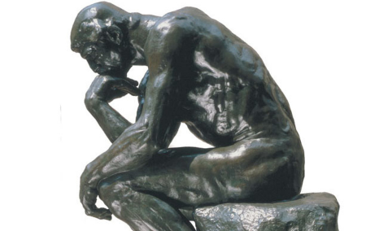
Early Thinkers’ Scorecard on Emotions
Philosopher / Theorist | Emotions Helpful or Harmful | Thinking → Emotions | Emotions → Thinking
Aristotle | Helpful | YES | YES
Descartes | Helpful | YES | NO
Spinoza | Harmful | YES | NO
Jefferson | Helpful | Unclear | YES

Slide 13
Basic Emotions: Whattya Think?
Do you think there are basic emotions, from which all other emotions arise?
Sort of like the three primary colors.
Take a moment and write down what you would list as the basic, fundamental emotions.

Slide 14
The Basic Emotions
Happiness
Anger
Sadness
Fear
Disgust
Surprise (maybe)

Slide 15
Russell’s Circumplex Model of Emotion
AROUSED
UNPLEASANT PLEASANT
UNAROUSED
Angry
Happy
Calm
Depressed

Slide 16
Are Emotions Universal?
Do all cultures experience the same emotions?
Do all cultures express basic emotions the same way?
Do cultures differ in how intensely they show emotion, for the same kinds of events?
If emotions are genetically determined, does culture play any role in shaping them?

Slide 17
Ekman’s Neurocultural Theory of Emotion
Paul Ekman
I. Facial expression for each emotion is set by evolution.
II. Culture affects emotion in three ways:
1. Determines what kinds of events cause us to experience emotions.
2. Sets norms for expressing emotion—Display rules
3. Says how to act on emotions.

Slide 18
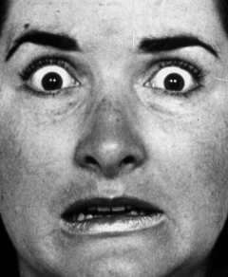
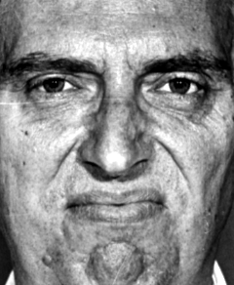
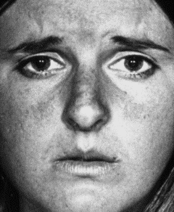
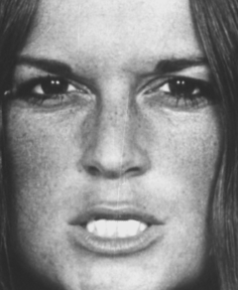
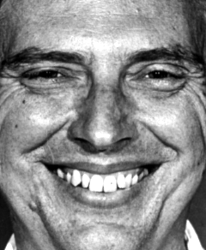
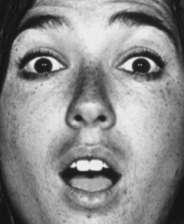
Ekman’s Basic Emotions
Fear
Disgust
Sad
Anger
Happiness
Surprise

Slide 19
Judgment of Emotion by Observers in Five Literate Cultures
(Ekman & Friesen, 1971)
Percent Agreement

Slide 20
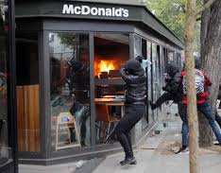
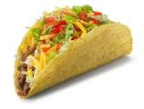
Critique of Ekman's "Literate Cultures" Study
1. All cultures share common literature, TV, radio
2. Cultures could influence each others. 50 years ago:
French would never eat Big Macs
Americans would never eat raw fish
Michiganders would not eat "Tah-kohz“
3. How is cultural influence a problem in terms of emotion recognition as evidence that emotions are universal?
Literate, modern cultures could inform each other about emotional expression. True difference would be hidden.

Slide 21
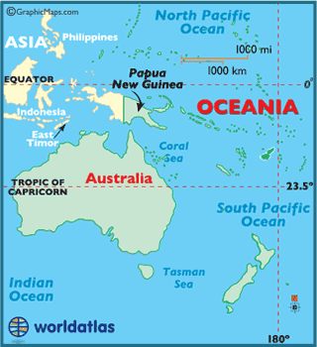
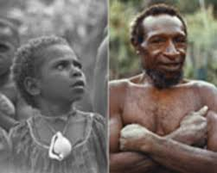
Ekman’s Pre-Literate Culture Studies
Literate cultures share books, movies, therefore get common understanding of emotions.
Solution?
Study a pre-literate culture.
South Fore People of New Guinea

Slide 22
Ekman Study 1 (1967): Ask S. Fore to Identify Emotions
Results a mess. No evidence that S. Fore label these faces according to basic emotions.
Are there no basic emotions?
Or was the study done wrong?

Slide 23
Ekman Study 2 (1968): Hear A Story and Pick Correct Emotion
A wild boar is standing outside her hut. What emotion does she feel?
A B C
S. Fore perform as well as Americans

Slide 24
Ekman Study 3: Hear A Story and Make Appropriate Facial Expression
South Fore man asked to make expression for story: “Mom cooked roadkill for dinner”
S. Fore respond comparably to Americans

Slide 25
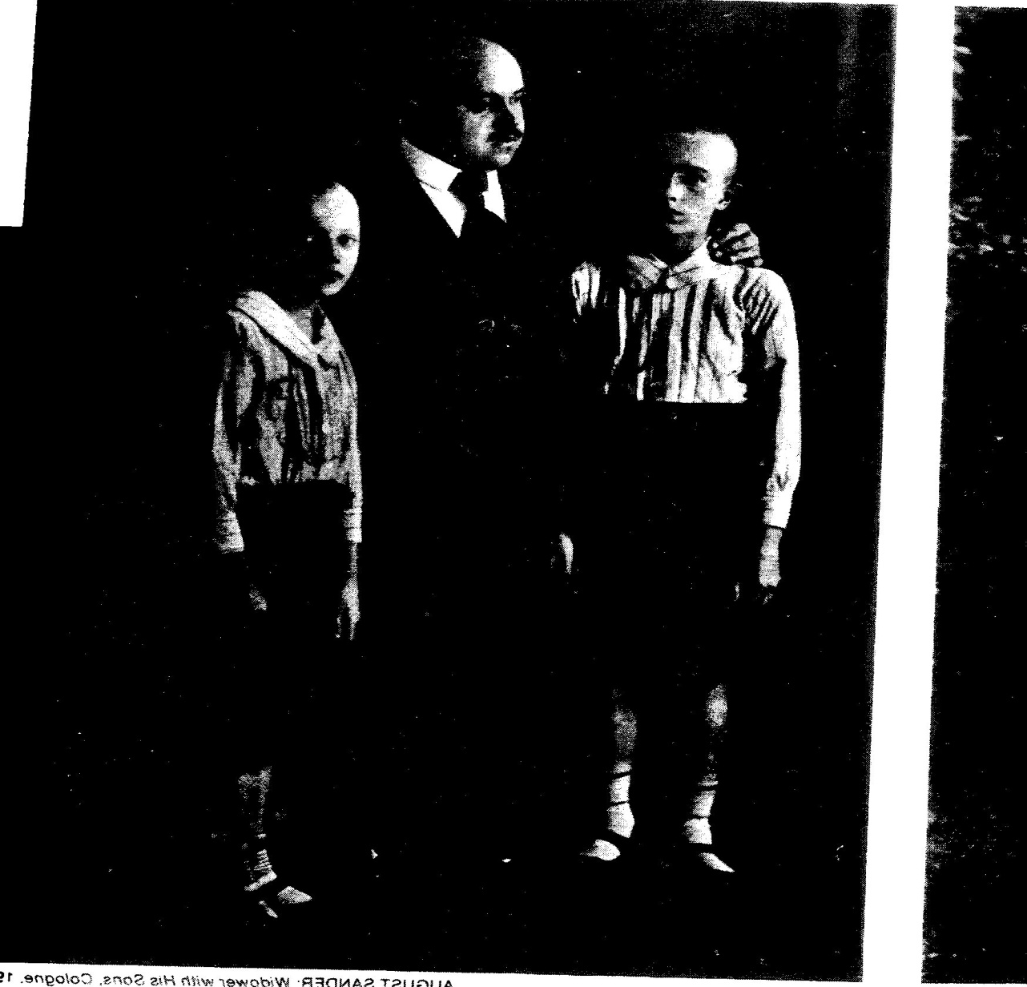
What Emotion?

Slide 26
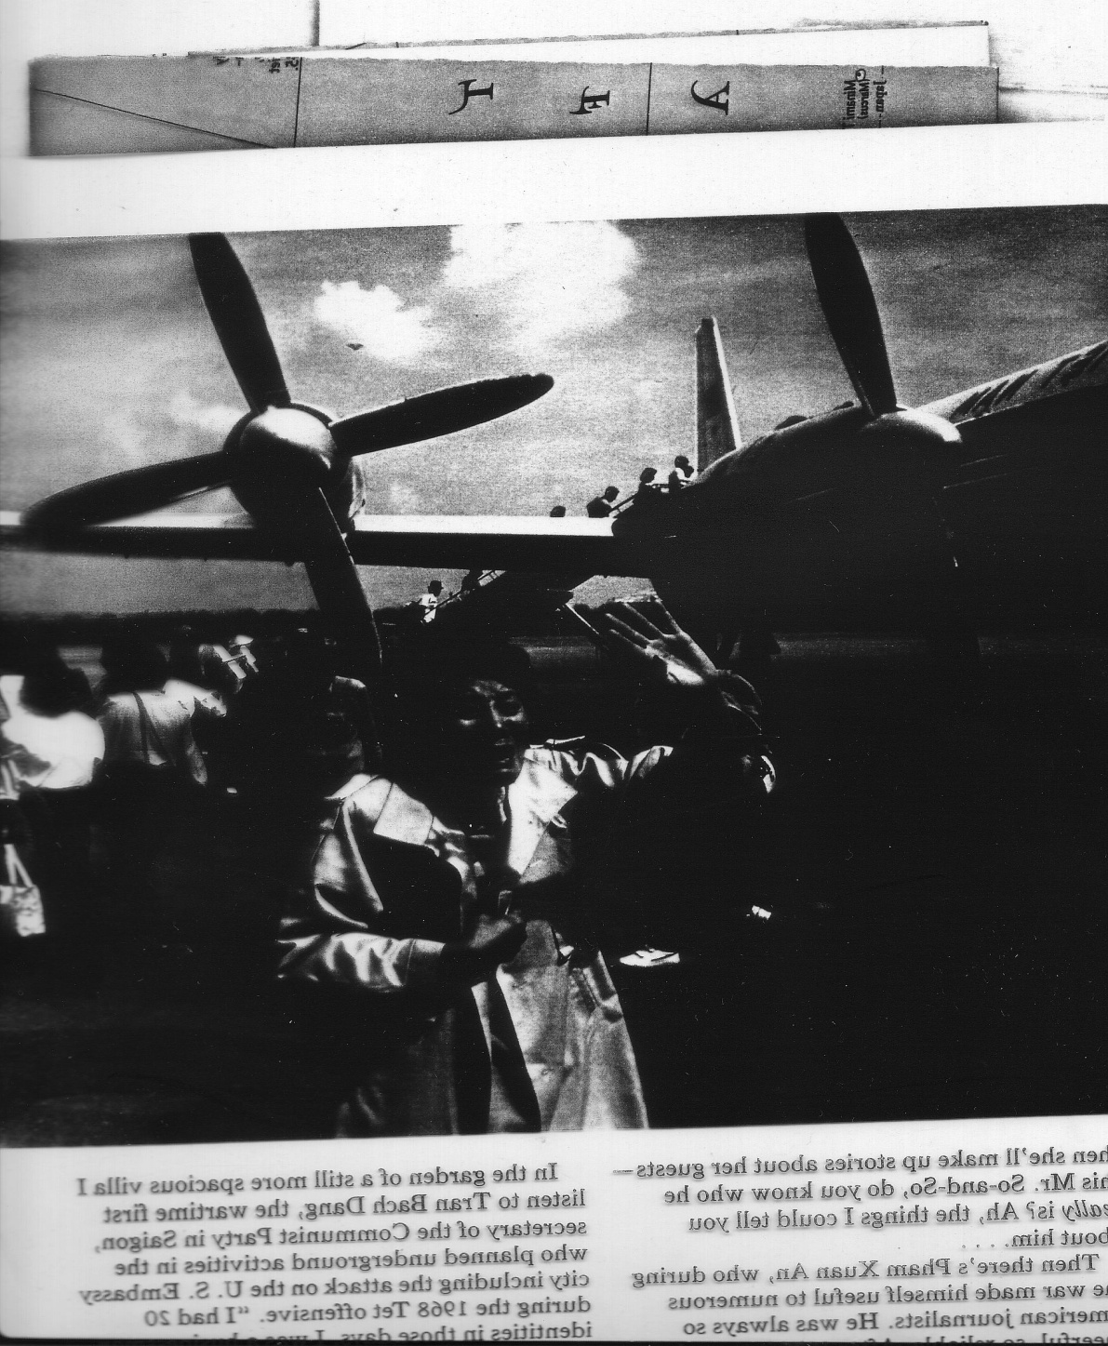

Slide 27
Other Clues to Universal Nature of Emotions
What are other sources of "data" that people show same emotions across cultures?
That emotions are "born", not "taught", and are the same everywhere?
1. Infant studies (more on this in later classes)
2. Blind/deaf: a. Same facial expressions b. Same postures
3. Primate studies

Slide 28
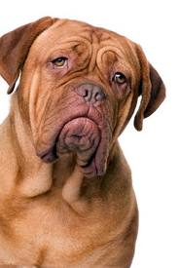
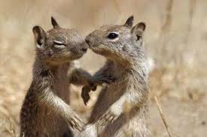
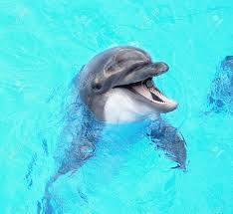
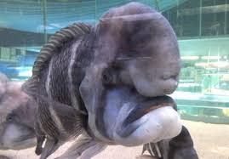
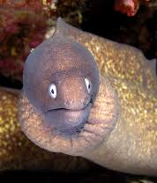
WHY DO WE THINK THESE ANIMALS HAVE EMOTIONS?
http://www.youtube.com/watch?v=nGeKSiCQkPw

Slide 29
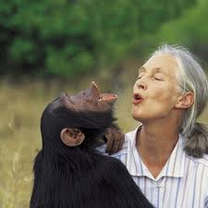
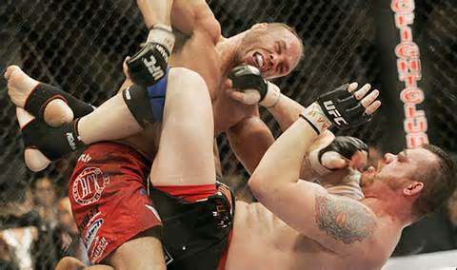
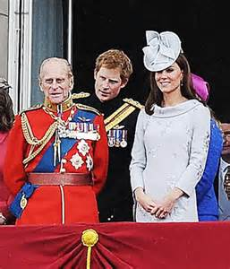
Primate Studies and Emotions as Inherited
Jane Goodall’s Chimp Observations
Chimp society based on aggression and sex and status.
What other animal does that sound like?

Slide 30
Primate Studies and Emotions as Inherited
Jane Goodall’s Chimp Observations
Aggression relates to social hierarchies
Males fight every 3 days; females every 5 days
Aggression in chimps linked to serotonin levels. Same for humans Serotonin promotes aggression, assertiveness, social confidence. Serotonin is key component of Prozac
Beta chimp given serotonin → becomes new alpha
Alpha chimp given serotonin inhibitor → becomes beta
Chimps appear to be emotional—and share same basic emotions as humans.
Jane Goodall: “Emotional states of chimps are so obviously
similar to ours that even an inexperienced observer can
interpret the behavior”.

