Slide 1
Hello Psych of Emotions Class, Spring 2023
Instructor: Professor Kent Harber
Meeting Times: Tuesdays and Thursdays; 11:30-12:40
Office Hour: Tuesday, 2:00-3:30, Smith 352
Email: kharber@psychology.Rutgers.edu
Location: Ackerman 106

Slide 2
Valeria Vila, Psych of Emotions Grader
valeria.vila@rutgers.edu

Slide 3
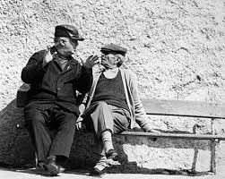
Harber's Research Program
Emotions, Resources, and Perception
The Function of Emotional Disclosure
Interracial Feedback

Slide 4
What Are You Feeling Now?

Slide 5
What Emotions Do You See?
What Emotions Do You Feel?

Slide 6
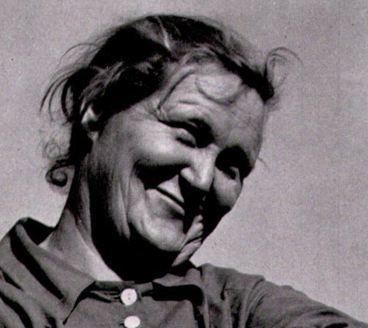
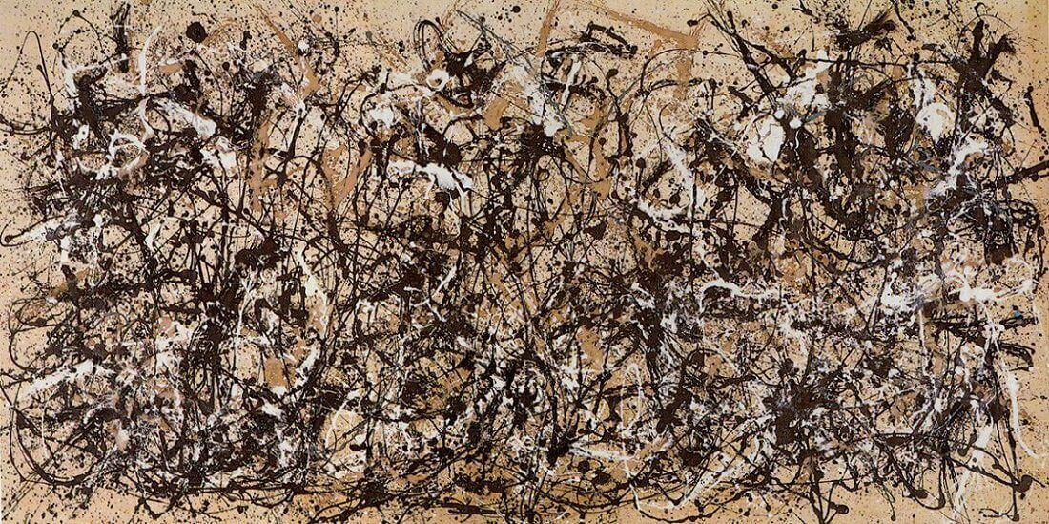
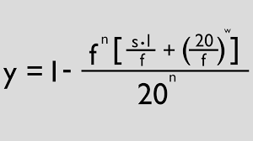
What Emotions Do You See and Feel?

Slide 7
Some “Big Questions” About Emotions
What is an emotion? How differ from mood? From temperament?
Why do we have emotions?
Do people everywhere have the same emotions?
Do animals have the same emotions as humans?
Are emotions helpful or hurtful?
Are there good emotions and bad emotions?
What comes first, thinking or feeling?
Can we have feelings about our feelings?
Can machines understand emotions? Can machines have emotions?

Slide 8
Scope of Class
Might want to follow along on course syllabus.
Section I: General Background Classes 1-10
Section II: Functions and Processes Classes 11-16
Section III: Specific Emotions and Classes 17-24
Emotion Management

Slide 9
Section I: General Background and Basic Principles
1. Approaches to understanding emotions
2. Evolution of emotions
3. Culture and emotions
4. Defining emotion
5. Development and emotion
6. Physiology of emotion

Slide 10
Section II: Functions and Processes of Emotions
1. Emotions and health
2. Emotions and learning and memory
3. Emotions and reasoning
4. Emotions and social judgment
5. Empathy
6. Emotions and Perception

Slide 11
Section III Specific Emotions and Emotion Management
1. Positive emotions 6. Emotional Disclosure
2. Anger and hostility 7. Traumatic Events
3. Fear, Anxiety 8. Emotional Broadcaster Theory
4. Disgust, morals 9. Machines and Emotions
5. Emotion Regulation

Slide 12
Class Structure
Challenging class!
* Covers a lot of ground
* Principles a pre-requisite
* Intensive reading load, about 60 pp. per week
* Some readings from scientific journals
* Some material ONLY in lecture
* Grading—not easy, not crazy. Reflects only material covered in class.

Slide 13
Readings and Lectures
Readings
* Understanding Emotions, Keltner, Oately & Jenkins, 3rd Ed. 2012 At: Barnes & Noble, Bradley Hall—about $75—but also at Amazon—about $10, used.
* Class Reader: All readings posted on Harber Webpage:
http://nwkpsych.rutgers.edu/~kharber/emotions/
Lectures
* Mostly follow class reading
* Sometimes go beyond class reading
PowerPoints
* Available on Harber Webpage http://nwkpsych.rutgers.edu/~kharber/emotions/
* Use these for test prep, but back up with readings.

Slide 14
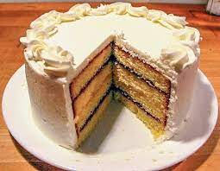
Grading
Grade calculation
Class Project 15%, 2 Quizzes 10% each (20% total)
Midterm= 30%, Final = 35%
Tests are multiple choice
Tests are challenging. Not impossible, but not cake.
PSYCH. EMOTIONS TESTS
≠

Slide 15
Grading: Previous Class Taught
Number of Students

Slide 16
Tips on Reading, Studying, and Class Notes
1. Take notes during class.
2. Read with your pen. Make margin notes, don't just highlight.
3. Empirical (research) articles
Read Intro and Discussion carefully, skim methods and results. I will cover methods and results in class.
PowerPoint Slides: Download and study these!!!

Slide 17
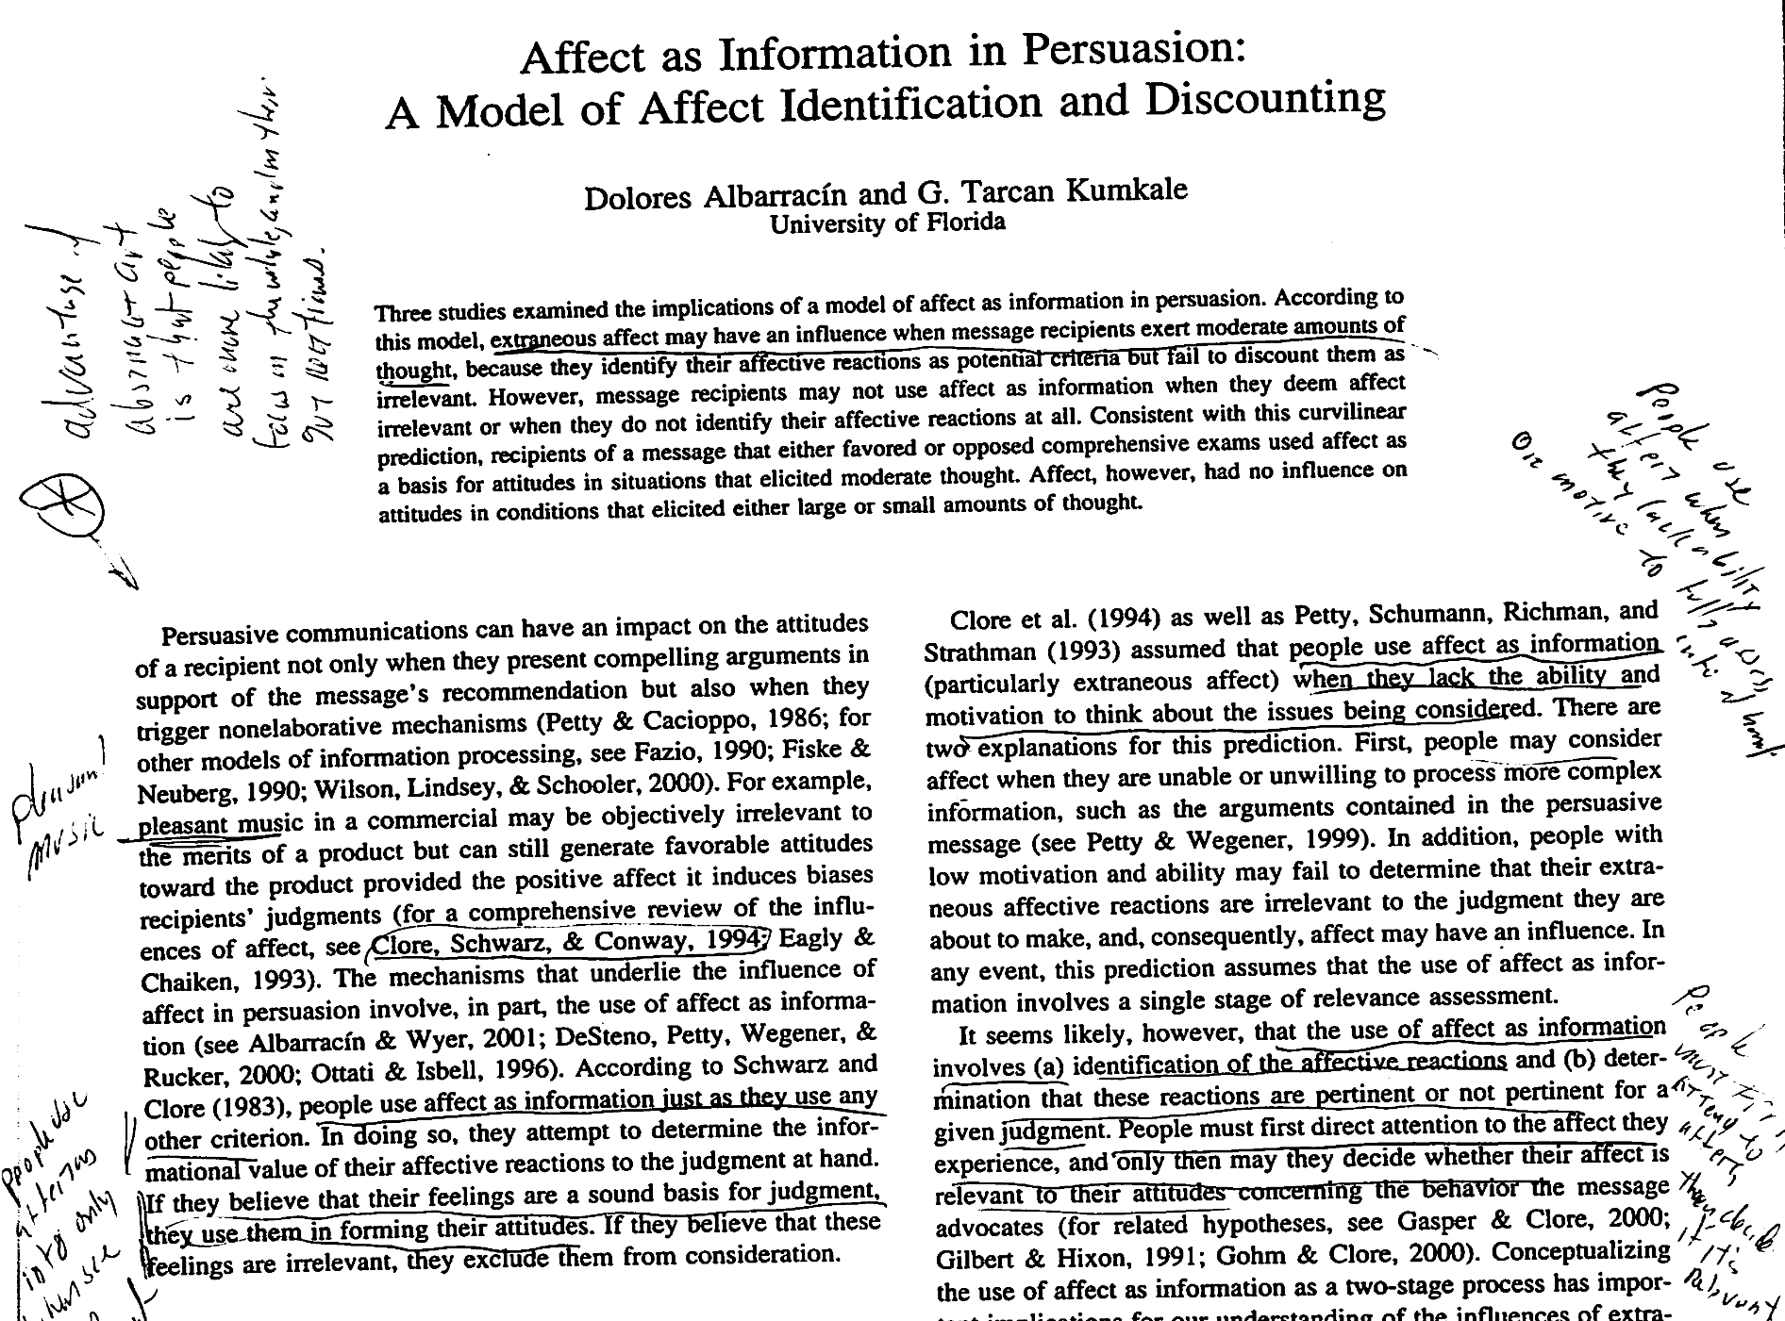
Reading With Your Pen

Slide 18
Extra Credit
You can earn up to 6 points applied to final grade.
Thus, 84 Points = B; Plus 6 Pts Extra credit = 90 pts = A
How to earn Extra Credit:
Psychology Dept. Experiments. 1 point for every 30 min. of experiment participation.
But no more than 4 points from Subject Pool.
Ten Meter Tower: Watch short YouTube and write brief 2-page essay = 2 points.
Going Flat Face. Go flat face with family/friends,
and brief 2-page = 2 points.
You can earn NO MORE than 6 points extra credit.

Slide 19
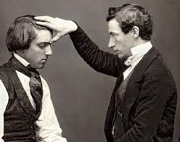
Neglect of Emotions in Psychology
40 yrs. ago, experimental psychology silent on emotions
Emotions addressed in early days, but then disappears
Psych wants to be a science, emotions too flakey
Mesmerism
Freud – cigars, sex, bad mothers
Emotions make people nervous: Taboo impulses: sex, anger, desire Reminds people of animal natures
How do you even study emotion?

Slide 20
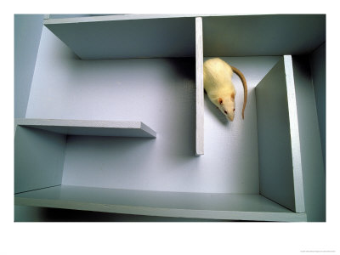
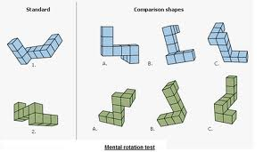
Rediscovery of Emotions
Dominance of Behaviorism (1950-1975-ish):
BF Skinner: Humans do no have minds
Cognitive revolution (1970-1990) –
R. Sheppard: Humans have minds!
Minds affect behavior.
Emotional revolution (1990 – and ongoing)
R. Zajonc: Humans have emotions! Emotions affect thinking and behavior. “Mere Exposure” studies

Slide 21
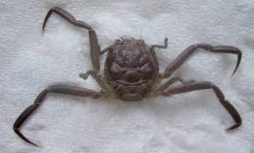
Charles Darwin and Emotions
Theory of Natural Selection, AKA, Evolution

Slide 22
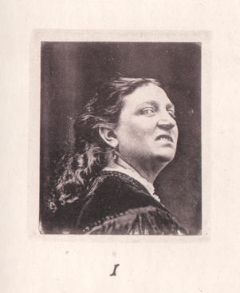
Darwin’s Approach to Emotions
Not interested in Emotions, per se. Uses Emotions to show humans evolved from more primitive critters.
Human emotions are VESTIGIAL
Human emotions reflect animal signals
Sneering – revealing teeth – bite threat
Eye raise – forehead pulled back
– flat ears on dogs
Uselessness of emotions … phone call hand gestures
Darwin a Victorian.
Darwin ties emotions to bodily states.

Slide 23
Darwin’s Taxonomy of Emotions

Slide 24
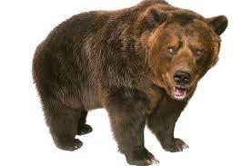
In What Order Do These Things Occur?
See a Bear
Fear
Run

Slide 25
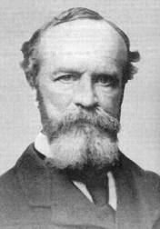
James / Lange Theory of Emotion
Place these events in correct order:
I see a bear, I run, I feel fear
Exciting event → bodily response → emotion
“I see a bear, I run, I feel fear.”
Ties emotions to bodily states
Our bodies “know” meaning of events, automatically
Greater intensity of bodily arousal →more intense emotion.
Emotions give color, warmth to experience
But, emotions are still passive. Reactions, not causes.

Slide 26
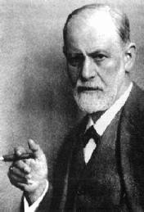
Freud and the Case of Katherina
Kath. 18 year old daughter of inn keeper, suffers panic attacks
Freud: Looks to see when/where fear started
Freud asks: Seen anything embarrassing?
Kath: Sees father having sex with cousin. Vomiting fits for 3 days
After telling story, Kath. Improves
She was like someone transformed. The sulky unhappy face
had grown lively, here eyes were bright and exalted.

Slide 27
Sigmund Freud and Emotions
1. Emotions are tied to bodily states
2. Emotions reveal underlying, unconscious thoughts and perceptions.
3. Emotions tied to the self
4. Emotions can precede conscious awareness of important facts
5. Humans defend themselves against emotionally-disturbing facts.
6. Emotional conflicts lead to psychological and physical ailments
7. Putting emotions into language advances coping.

