Slide 1
Research Ethics
Class 2

Slide 2
Philosophy of Science Debate
When: Class 4 (9/12)
Purpose: Integrate Popper and Kuhn readings
Team Project – 5% of course grade
Prep Team meets at outside class (two times is best)
Preps questions and preps answers
Debate Teams take turns as question asker/question answerer
Each member of team must ask/answer at least 1 question
Performance determined by quality of questions/answers.
See handout for details.

Slide 3
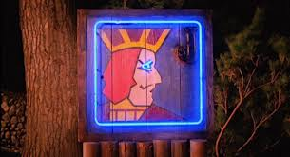
Research Ethics Debate:
One Eyed Ghaks

Slide 4
GHAK OF ALL TRADE-OFFS
OR: Is Justice Blind-ing?
One-Eyed Ghaks
You are a new MD, sworn to uphold the standards of modern medicine, but also to respect people from other cultures.
You are starting a 5-year foreign service program to bring modern health care to Ghakistan. You are stationed in a remote village and you are the only trained MD in the region.
One-Eyed Ghaks
You are a new MD, sworn to uphold the standards of modern medicine, but also to respect people from other cultures.
You are starting a 5-year residency in upstate New York, which has many excellent medical institutions and private practices.

Slide 5
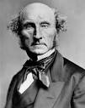
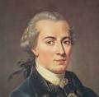
Ethical Systems
Utilitarianism (John Stuart Mills)
* Goal—the most good for the most people
* Ends justify the means
* OK to make people the means to other’s needs
Individual Rights (Immanuel Kant, Martin Buber)
* Goal—protection, sanctity of the individual
* Benign ends never justify harmful means
Fairness (John Rawls)
* Goal—balance individual rights with group needs
* Produce rules that you would accept if applied to yourself
* The perfect is the enemy of the good.

Slide 6
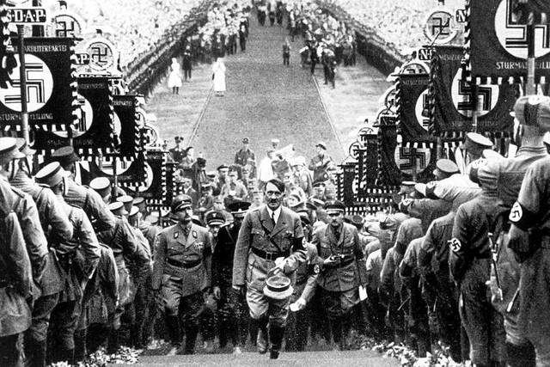
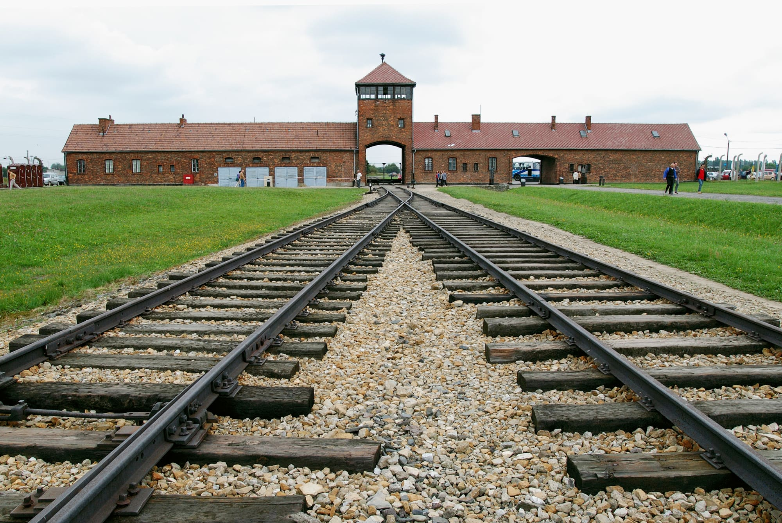
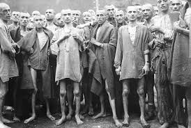
Understanding the Horror of Fascism: Who Follows Orders?

Slide 7
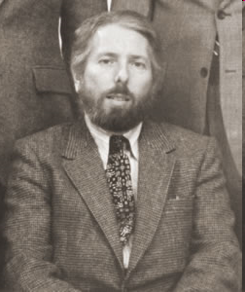
STANLEY MILGRAM STUDIES IN OBEDIENCE
 | "I don't see how they can fail to recognize a soldier's obligation to obey orders. That's the code I've live by all my life." (11/1/45) Alfred Jodl, Chief of Operations, Nazi High Command, Nuremberg, 1945

Slide 8
Panel of Shock Generator
15 | 45 | 90 |  | 120 | 150 | 180 |  | 210 | 240 |  | 270 | 300 |  | 330 | 360 |  | 390 | 420 | 450
╩ | ╩ | ╩ |  | ╩ | ╩ | ╩ |  | ╩ | ╩ |  | ╩ | ╩ |  | ╩ | ╩ |  | ╩ | ╩ | ╩
Slight Shock |  |  | Moder. Shock |  | Strong Shock |  | Very Strong |  |  | Intense Shock |  |  | Extreme Intensity Shock |  |  | Danger: Severe Shock |  | XXX

Slide 9
Distribution of Obedience Study Quit Points
Designation | Volts | No. of Subjects Who Stopped at this Point
Slight | 15-60 | 0
Moderate | 75-120 | 0
Strong | 135-180 | 0
Very Strong | 195-240 | 0
Intense < 300 | 255-285 | 0
Intense = 300 | 300 | 5
Extreme Intensity | 315-360 | 8
Danger: Severe | 375-420 | 1
XXX | 435 | 0
XXX: Maximum Level | 450 | 26

Slide 10
Emotional Strain in Milgram Study
“I observed a mature and initially poised businessman enter the laboratory smiling and confident. Within 20 minutes he was reduced to a twitching, stuttering wreck who was rapidly approaching a point of nervous collapse. He constantly pulled on his earlobe, and twisted his hands. At one point he pushed his fist into his forehead and muttered: ‘Oh God, let’s stop it.’ And yet he continued to respond to every word of the experimenter, and obeyed to the end”.
Stanley Milgram, 1963

Slide 11
The Milgram Ethical Paradox
1. Does experiment create suffering?
2. Are there long-term scars?
3. Who is complying with edict “The
experiment must go on”?
Does Expt’r think subject is suffering?
Does subject request relief ?
Does Expt’r prolong subject’s suffering?
Why doesn’t Expt’r stop the subject’s
suffering?
Yes
None reported
Yes
Yes
Yes
The experiment must go on

Slide 12
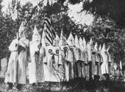
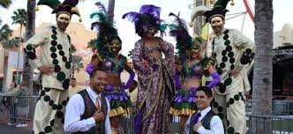
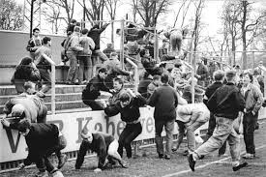
Deindividuation and Evil
Individuation: Actions that assert one’s individual identity.
De-individuation: Circumstances that hide individual identity.
De-individuation → less inhibition:
* Masks at Mardi Gras
* Crowd behavior at sporting events
* Hoods and sheets for KKK
Question: Do formal social roles, especially high vs. low authority, lead to deindividuation?

Slide 13
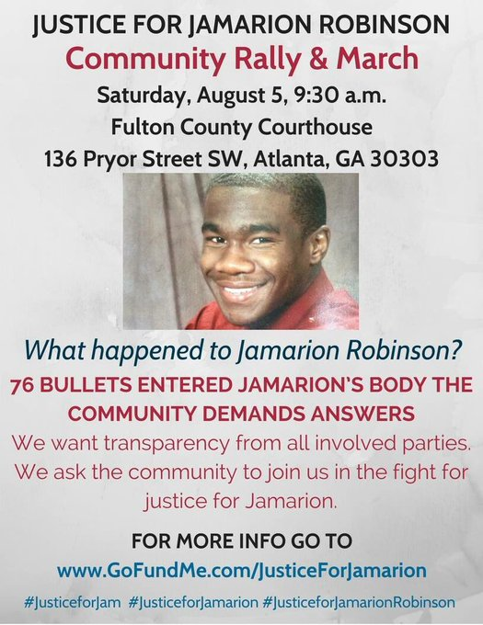
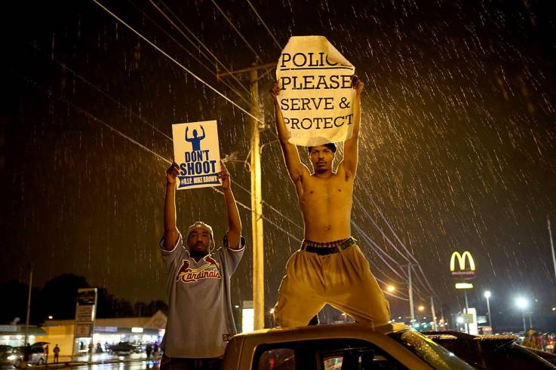
Police Violence

Slide 14
Procedure of Stanford Prison Study
Setting: Stanford basement is prison
Zimbardo is head warden
Ex-con provides advice
Subjects: Young men living in/near Palo Alto
Sign up for 2 weeks,
$15 per day (= $70 today)
Role Assignment: Totally random

Slide 15
Becoming a prisoner:
Arrested at home, taken to police HQ
Deindividuation at Stanford Prison
-- search and stripped
-- deloused
-- issued emasculating uniform
-- wear chain
-- issued prison number
Becoming a guard:
No specific training
Issued uniform that confers authority
Reflective sunglasses → deindividuation

Slide 16
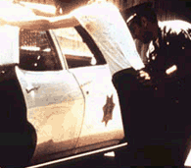
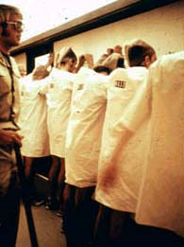
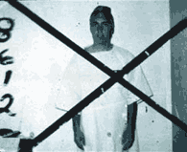
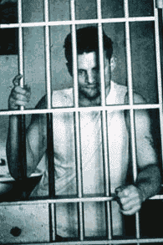
Key Episodes in Zimbardo Prison Study
http://www.prisonexp.org/psychology/2
http://www.prisonexp.org/psychology/14
http://www.prisonexp.org/psychology/22
http://www.prisonexp.org/psychology/31
http://www.prisonexp.org/psychology/40

Slide 17
Termination of Prison Study
Prison Study terminated in 6 days, rather than 2 weeks.
* Guards becoming increasing sadistic, especially
late at night when presumed to be unobserved.
* Prisoners becoming increasingly pathological; depressed, demoralized.
* Experimenters lose distinction between roles of “warden” and researcher.
TAKE HOME POINTS???
1. Situations can rob people sense of self, reduce them to dependent compliance
2. Positions of authority can lead to abuse of power, and to expression of “dark impulses”. Thanatos (Freud), impulse
to destroy.

Slide 18
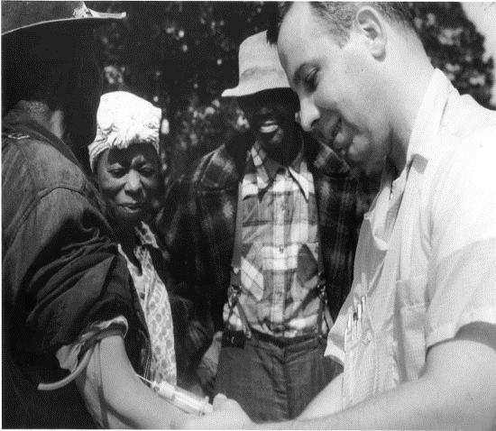
Ethical Concerns in Psychology Research
Infamous Research: Tuskegee Syphilis Study
Background: 1932-1972 US Public Health Service (USPHS) observed 399 Black men with syphilis, 201 without syphilis to chart effects of untreated disease.
Deception: Subjects not told they could get treatment elsewhere, local MDs told not to treat subjects. Subjects told study provided treatment; not true.
Racism: Why only Black men?
Harm: Untreated men, their partners, their county all suffer unnecessarily.
Justifications: To show that treatment was effective, to limit disease spread.
Which ethical system does this justification represent?
Utilitarianism

Slide 19
Did Tuskegee Atrocity Erode Trust in Medicine Among African Americans?
Is there distrust in medical authority? Yes.
Early in COVID 14% of Blacks regarded vaccine as safe.
18% would definitely get vaccine.
Is distrust due to Tuskegee, other race-based medical abuses?
NO.
What is cause? Everyday racism, in encounters generally, in encounters with medical system.

Slide 20
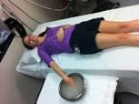
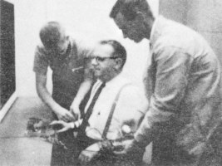
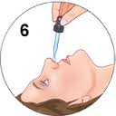
Ethical Concerns in Psychology Research
Deception
Emotional pain
Threats to dignity
Physical Pain
Stress and Cold Pressor
Milgram:
Dangers of Obedience
Cohen &
Nisbett:
Culture and Violence
Zimbardo:
Authority and Cruelty
Social Support & Cold Virus

Slide 21
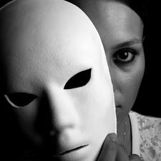
The Special Problem of Deception
1. Invasion of privacy:
* Reveal personal information
* Face unpleasant facts about self (Milgram, Stan. Prison)
* Learn false facts about self (IAT, maybe)
2. Erodes informed consent safeguards
3. Erodes faith in social institutions (Bok)
4. Actual costs are generally trivial (90% volunteer at UM)
5. Forbidden deception: deceiving during debriefing

Slide 22
Critique of Bok Critique of Deception
Valid Points Invasion of privacy Ss might learn things they don’t want to know Some researchers uncaring, calloused Value of alternatives to deception Can’t assume shallow debriefing resolves distress
Unverified Deception erodes faith in social institutions Points Deception makes expt’rs immoral, psychopathic
Silly Points Claims review committees not always used Don’t use deception for replication studies No need to train in deception methods Use observation rather than deception
Bok Ethical Paradox:
How can her assertions be reliably verified?
Deception Studies

Slide 23
Alternatives to Deception
Alternative
Problem w’ Alternative
Observational studies
No control
Role playing and
mutual disclosure
People can’t predict own motives, cognitive processes
People can’t predict interactive effects
Biased responses: social desirability, e.g.

Slide 24
Remedies and Safeguards to Deception Research
1. Provide Ss as much info as possible
2. Option to not participate is clear and easy
3. Option to quit at any time is clear and easy
4. Carefully monitor Ss in high-stress designs
5. Apply no more stress than can be easily alleviated
6. Experimenters expertly trained
7. Treat Ss with courtesy and respect. Restore dignity
8. Debriefing: careful, thorough.
9. Process debrief for false feedback
10. Provide way to volunteer for deception at outset

Slide 25
Social Contributions of Deception Research
(A Very Small Sample)
Social Issue
Do people stand up for beliefs, even if others disagree?
Will people resist immoral authority?
Do people see their own prejudices?
Group conflict require history of tension?
Can group conflict be resolved?
Deception Research
People compliant to consensus (Asch)
People comply with authority, even at peril to others (Milgram)
Often not (Gaertner & Dovidio)
Group conflict can be created quickly, based on minimal diffs. (Sharif).
Yes, focus on common goals (Sharif)

Slide 26
Self-Affirmation Reverses Racial Achievement Gap: A Deception Study
Cohen, G. L., Garcia, J., Apfel, N., & Master, A. (2006). Reducing the racial achievement gap: A social-psychological intervention. Science, 313, 1307-1310.

Slide 27
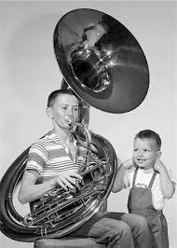
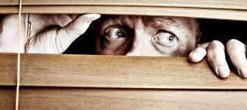
Empirical Costs of Not Deceiving
Uncontrollable Noise
Glass & Singer (1972): Uncontrollable noise depresses task performance.
Gardner (1978): Cannot fully replicate Glass & Singer. WHY?
IRBs introduced after 1972, require fully informing subjects.
Gardner (1978) informs/does not inform subjects.
Not informed: Replicate Glass & Singer
Informed: Do not replicate.
Reason: Informed now have subjective control!
Social cost: Dangers of noise pollution, uncontrollable
events, not known or are regarded as a non-issue.
Schwartz (1973) Informed consent can lead to “subject paranoia”. Second guess experiment, give contrary responses.

Slide 28
Societal Costs of Not Deceiving
Decades of valuable research would be lost, or;
2. Important phenomena would be misunderstood
Uncontrollable noise (and other stimuli) has no effect on performance (and other outcomes).
Perceived control fundamental to well being.
3. Science pathways disrupted
Value of subjective autonomy
Nature of attention, attentional resources.
4. Social changes not made.
Value of noise reduction at school, work, home.
Value of personal control in pain medication
Solution: Partial informed consent at start, full disclosure at debriefing.

Slide 29
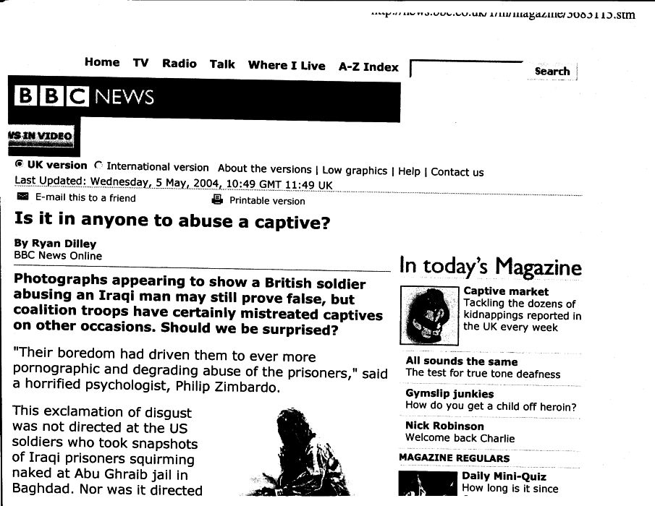

Slide 30
Remedies and Safeguards to Deception Research
1. Provide Ss as much info as possible
2. Option to not participate is clear and easy
3. Option to quit at any time is clear and easy
4. Carefully monitor Ss in high-stress designs
5. Apply no more stress than can be easily alleviated
6. Experimenters expertly trained
7. Treat Ss with courtesy and respect. Restore dignity
8. Debriefing: careful, thorough.
9. Process debrief for false feedback
10. Provide way to volunteer for deception at outset

Slide 31
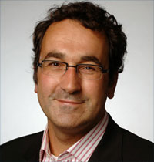
Dutch University Sacks Social Psychologist
Over Faked Data
by Martin Enserink, Science Insider, 7 September 2011, 5:50 PM
Coping with Chaos: How Disordered Contexts Promote Stereotyping and Discrimination
Diederik A. Stapel¹,* and
Siegwart Lindenber Science 8 April 2011: Vol. 332 no. 6026 pp. 251-253
Diederik Stapel
Tilburg U., Holland
Editor: Psych Sci., PSPB
As to the whistleblowers, [Dean] Eijlander told the television interviewer that "I have a lot of respect for them, because they found it very difficult."

Slide 32
Ethics Unrelated to Methods or Procedures
Intellectual property: Who owns an idea?
Fraud: p = .056; Overselling
Authorship: Order, power-assertion, conformity
Reviewing manuscripts, grants: How many, well, fairly?
Departmental citizenship: Teaching, committees, etc.
Subject pools: Forced labor? Distribution of R pts.
Socially disruptive findings

Slide 33
https://cos.io/prereg/
When you preregister your research, you're simply committing to your plan in advance, before you gather data. Preregistration separates hypothesis-generating (exploratory) from hypothesis-testing (confirmatory) research. Both are important, but the same data cannot be used to generate and test a hypothesis, which can happen unintentionally and reduce the clarity and quality of your results. Removing these potential conflicts through planning improves the quality and transparency of your research, helping others who may wish to build on it.

Slide 34
Neurocognitive correlates of liberalism and conservatism
David M Amodio¹, John T Jost¹, Sarah L Master² & Cindy M Yee²
Abstract
Political scientists and psychologists have noted that, on average, conservatives show more structured and persistent cognitive styles, whereas liberals are more responsive to informational complexity, ambiguity and novelty. We tested the hypothesis that these profiles relate to differences in general neurocognitive functioning using event-related potentials, and found that greater liberalism was associated with stronger conflict-related anterior cingulate activity, suggesting greater neurocognitive sensitivity to cues for altering a habitual response pattern.
Study finds left-wing brain, right-wing brain

Slide 35
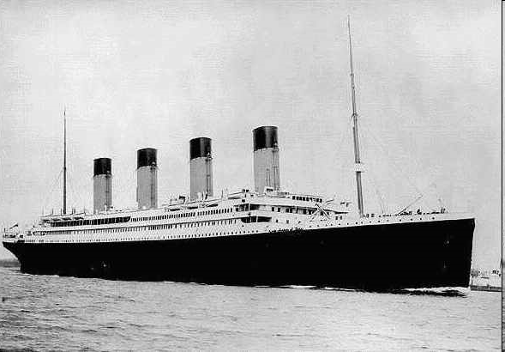
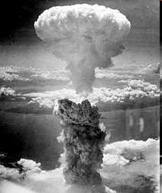
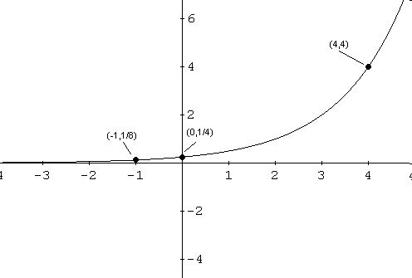
Science Charging Blindly
Exponential change is catastrophic.
“Singularity 1” – Artificial intelligence, "Moore's Law"
“Singularity 2”– Health care and (im)mortality
Should there be limits on science? What kind? Set by whom?

Slide 36
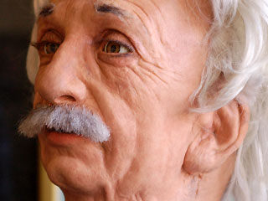
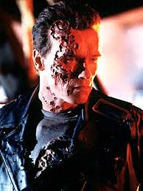
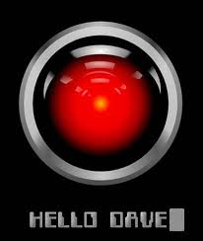
Meet Albert, Your New Friend
https://www.youtube.com/watch?v=pkpWCu1k0ZI

Slide 37
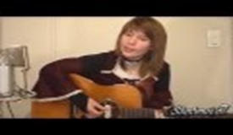
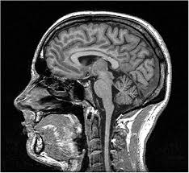
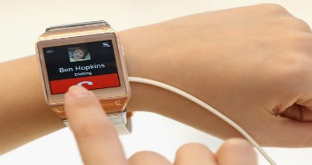
Mind Mapping—and Trapping?
Die Gedanken Sind Frie
Thoughts are free, who can guess them? They fly by like nocturnal shadows. No man can know them, no hunter can shoot them with powder and lead: Thoughts are free! I think what I want, and what delights me, still always reticent, and as it is suitable. My wish and desire, no one can deny me and so it will always be: Thoughts are free! And if I am thrown into the darkest dungeon, all these are futile works, because my thoughts tear all gates and walls apart: Thoughts are free!
www.youtube.com/watch?v=cHuSktaQRuE

Slide 38
Are Reliability and Validity Sufficient?
Publish?
Study locates gene that predicts altruism.
Yes
No
Study reports altruism gene slightly
higher amongst Bulgarian females.
Yes
No
Study locates gene that predicts sociopathy.
Yes
No
Study reports sociopathy gene slightly
higher amongst Bulgarian females.
Yes
No

Slide 39
Ramifications of Publication Decisions
Don’t
Publish
Publish
What are rules for not publishing?
Who are rule makers? Rule enforcers?
Stereotypes reinforced.
Trust in Science Erodes
Genetic Profiling
Legal implications
Employment implications
Interpersonal implications
Will science become politicized?
Will valuable science be deterred?

Slide 41
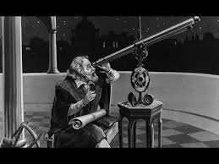
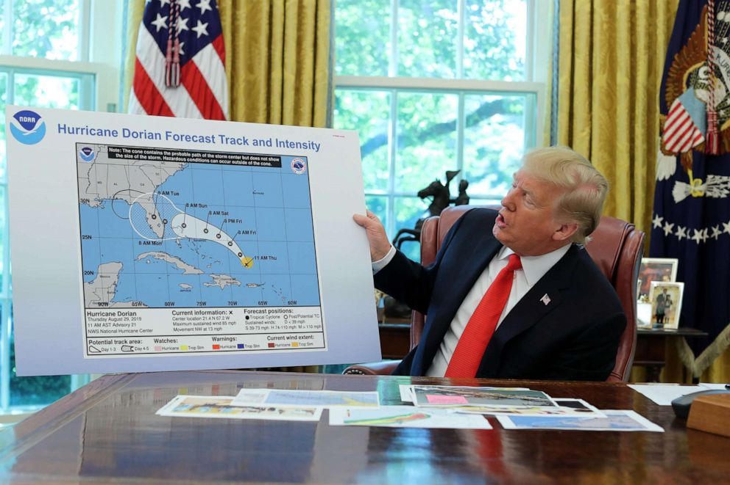
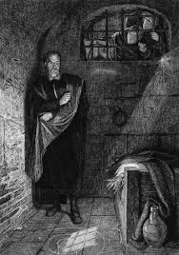
“Disruptive” Science vs.
“Comforting” Non-Science
Commerce Chief Threatened Firings at NOAA After Trump’s Dorian Tweets, Sources Say

